Slide 1
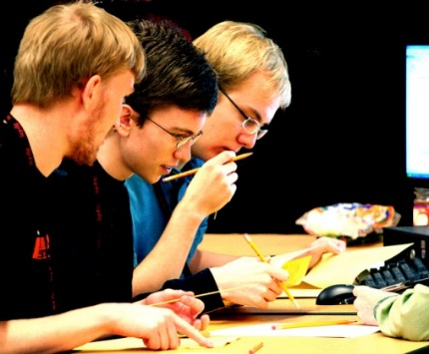
MAT 0022C/0028C Final Exam Review
BY:
West Campus Math Center

Slide 2
Topics
Factoring
#1, 2, 3, 4, 5, 6, 7, 8, 9, 10, 11, 12, 13, 14, 15, 16, 17, 18
Problem Solving (Word Problems)
#19, 20, 21, 22, 23, 24, 25, 26, 27, 66, 67, 68, 69, 70
Graphing
#28, 29, 30, 31, 32, 33, 34, 35
Exponents and Polynomials
#36, 37, 38, 39, 40, 41, 42, 43, 44, 45
Square Roots/Radicals
#46, 47, 48, 49, 50, 51, 68
Equations and Inequalities
#52, 53, 54, 55, 56, 57, 58, 59, 60, 61, 62, 63, 64, 65,
Test Taking Tips
MyMathLab Tips, How to study, General Test Taking Tips

Slide 3
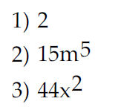
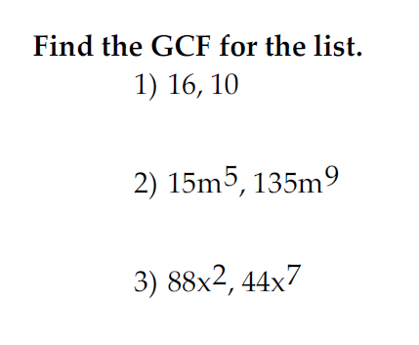
Problem #1, 2, 3 (GCF)
1) GCF = 2
2) GCF = 15m⁵
3) GCF = 44x²
Remember GCF for like variables = smallest exponent
EXAMPLE: GCF for x⁵, x³ = x³ (pick smallest exponent)

Slide 4
Factoring Trinomials (Leading Coefficient = 1)
Form: x² + bx + c
Signs could be + or – in the trinomial.
Form: x² + bx + c
Factored Form: (x )(x )
+c
-c
Sign of
Bigger Factor
Matches
Middle
Term
bx
}
+
–
+
+
Match Sign of
Middle Term
bx
–
–

Slide 5
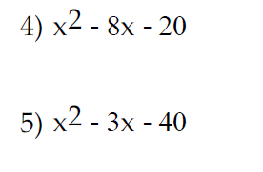
Problem #4 (Factoring Trinomials)
-20
Factored Form: (x )(x )
1
20
Find factors of 20 that
subtract to make 8.
+
2
–
10
4
5
Sign of bigger factor matches middle term
bx
Solution: (x + 2)(x – 10)

Slide 6
Problem #5 (Factoring Trinomials)
-40
Factored Form: (x )(x )
1
40
Find factors of 40 that
subtract to make 3.
2
20
4
10
Sign of bigger factor matches middle term
bx
+
5
–
8
Solution: (x + 5)(x – 8)

Slide 7
Problem #6 (Factoring)
xy + 6x – 3y – 18
GCF = x
x(y + 6)
GCF = -3
-3(y + 6)
(y + 6)
(x – 3)
(y + 6)(x – 3)

Slide 8
Problem #7 (Factoring)
xy – 2yz + 7x – 14z
GCF = y
y(x – 2z)
GCF = +7
+7(x – 2z)
(x – 2z)
(y + 7)
(x – 2z)(y + 7)

Slide 9
Problem #8 (Factoring)
10x² – 8x – 15x + 12
GCF = 2x
2x(5x – 4)
GCF = –3
–3(5x – 4)
(5x – 4)
(2x – 3)
Live
example!
(5x – 4)(2x – 3)

Slide 10
Factoring Trinomials (Leading Coefficient a $≠$ 1)
Form: ax² + bx + c
Signs could be + or – in the trinomial.
2 methods:
1) A$∙$C method 2) Guess-and-check
We will illustrate both methods.
+a$∙$c
-a$∙$c
Sign of
Bigger Factor
Matches
Middle
Term
bx
}
+
–
+
+
Match Sign of
Middle Term
bx
–
–

Slide 11
SIGN RULES (For all Factoring Methods)
+
–
Sign of
Bigger Factor
Matches
Middle
Term
bx
}
+
+
Match Sign of
Middle Term
bx
+
–
–
–

Slide 12
Problem #9 (Factoring – AC method)
-168
Find factors of 168 that
subtract to make 17.
1
168
8
21
2
81
12
14
Sign of bigger factor matches middle term
bx
3
56
4
42
4 terms: 8x² + 24x – 7x – 21
6
28
We now factor by grouping!
–
7
+
24

Slide 13
Problem #9 CONT…
-168
4 terms: 8x² + 24x – 7x – 21
–7
+24
8x² + 24x – 7x – 21
GCF = 8x
8x(x + 3)
GCF = – 7
– 7(x + 3)
(x + 3)
(8x – 7)
(x + 3)(8x – 7)

Slide 14
Problem #10 (Factoring – Guess/check method)
–
(4y 3)(4y 3)
–
(4y – 3)²
1y
16y
1
9
2y
8y
–
3
–
3
SAME SIGNS,
Match Middle Term!
4y
4y

Slide 15
Problem #11 (Factoring – AC method)
-144
Find factors of 144 that
subtract to make 7.
1
144
+
9
–
16
2
72
12
12
Sign of bigger factor matches middle term
bx
3
48
4
38
4 terms: 12x² + 9x – 16x – 12
6
24
We now factor by grouping!
Live
example!
8
18

Slide 16
Problem #11 CONT…
-144
4 terms: 12x² + 9x – 16x – 12
+9
–16
12x² + 9x – 16x – 12
GCF = 3x
3x(4x + 3)
GCF = – 4
– 4(4x + 3)
Live
example!
(4x + 3)
(3x – 4)
(4x + 3)(3x – 4)

Slide 17
Problem #12 (Factoring)
+36
Factored Form: (x )(x )
1
36
Find factors of 36 that
add to make 12.
2
18
3
12
SAME SIGNS, Match Middle Term!
4
9
Solution: (x + 6)(x + 6) = (x + 6)²
+
6
+
6

Slide 18
Problem #13 (Factoring)
–
(6x 5)(6x 5)
–
(6x – 5)²
1x
36x
1
25
2x
18x
–
5
–
5
3x
12x
SAME SIGNS,
Match Middle Term!
4x
9x
6x
6x

Slide 19
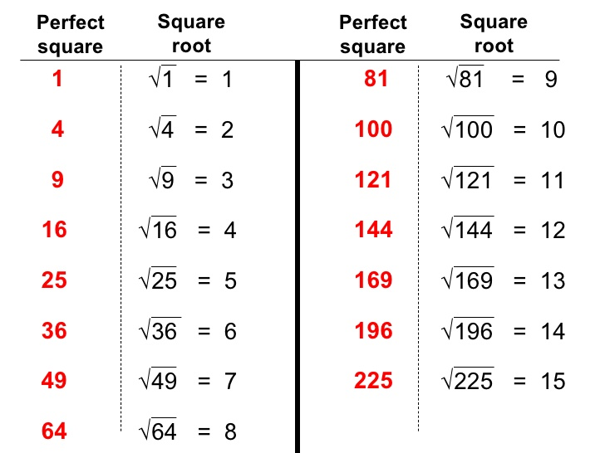
Factoring Difference of Squares
Form: a² – b²
Factored Form: (a + b)(a – b)
where a and b are square roots.
For variable,
divide exponent by 2
EXAMPLES:
$$\sqrt{x^{2}}= x^{1}=x$$
$$\sqrt{x^{4}}= x^{2}$$
$$\sqrt{x^{10}}= x^{5}$$
$$\sqrt{x^{88}}= x^{44}$$
$$\sqrt{x^{100}}= x^{50}$$

Slide 20
Problem #14 (Difference of Squares)
Factored Form: ( + )( – )
Solution: (2x + 5)(2x – 5)
$$\sqrt{x^{2}}= x^{1}=x$$
4x²
25
2x
2x
5
5

Slide 21
Problem #15 (Difference of Squares)
Factored Form: ( + )( – )
$$\sqrt{x^{2}}= x^{1}=x$$
$$\sqrt{y^{2}}= y^{1}=y$$
Solution: (5x + 8y)(5x – 8y)
25x²
64y²
5x
5x
8y
8y

Slide 22
Problem #16 (Difference of Squares)
$$\sqrt{625}=25$$
$$\sqrt{x^{4}}= x^{2}$$
Factored Form: ( + )( – )
x⁴
625
Solution: (x² + 25)(x² – 25)
x²
x²
25
25
x
x
5
5
Solution: (x² + 25)(x – 5)(x + 5)
Live
example!

Slide 23
Factoring ONLY vs. Solving
Factor:
x² + 6x + 8
Solve:
x² + 6x + 8 = 0
(x )(x )
(x + 2)(x + 4) = 0
Find factors of 8 that
add to make 6.
+8
Same Signs,
Match Middle
(x + 2) = 0
(x + 4) = 0
1
8
+
2
+
4
x = –2
x = –4
(x + 2)(x + 4)

Slide 24
Problem #17 (Factoring)
-60
1
60
Factored Form: (x )(x ) = 0
2
30
Find factors of 60 that
subtract to make 7.
3
20
4
15
Sign of bigger factor matches middle term
bx
–
5
+
12
Factored: (x – 5)(x + 12) = 0
6
10

Slide 25
Problem #17 CONT…
Factored: (x – 5)(x + 12) = 0
(x – 5) = 0
(x + 12) = 0
x = 5
x = –12

Slide 26
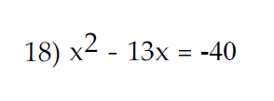
Problem #18 (Factoring)
First Step, make
equation equal to 0
ADD 40 to both sides!
Solve: x² – 13x + 40 = 0
+40
Factored Form: (x )(x ) = 0
1
40
Find factors of 40 that
add to make 13.
2
20
4
10
Same Signs, Match Middle
–
5
–
8
Factored: (x – 5)(x – 8) = 0

Slide 27
Problem #18 CONT…
Solve: x² – 13x + 40 = 0
Factored: (x – 5)(x – 8) = 0
(x – 5) = 0
(x – 8) = 0
Live
example!
x = 5
x = 8

Slide 28
Problem Solving (Types)
Percent and Applications
Proportions
Perimeter (Rectangle)
Pythagorean Theorem (a² + b² = c²)

Slide 29
Percent Applications (2 methods)
Proportion:
$$\frac{PART}{TOTAL}= \frac{\%}{100}$$
Equation:
Key Words:
IS: =
OF: Multiply
Key Words:
$$\frac{IS}{OF}= \frac{\%}{100}$$
What number/percent
→ Variable
What number/percent
→ Variable

Slide 30
Problem #19 (Problem Solving)
Proportion:
$$\frac{IS}{OF}= \frac{\%}{100}$$
75% of 84 is what number?
Solve:
$$\frac{x}{84}= \frac{75}{100}$$
Equation to solve:
100x = 75 $∙$ 84
100x = 6300
x = 63

Slide 31
Problem #19 (Method #2)
75% of 84 is what number?
Equation to solve:
0.75 $∙$ 84 = x
Change 75% → 0.75
x = 63

Slide 32
Problem #20 (Problem Solving)
Proportion:
$$\frac{IS}{OF}= \frac{\%}{100}$$
90 is what percent of 60?
Solve:
$$\frac{90}{60}= \frac{x}{100}$$
Equation to solve:
60x = 90 $∙$ 100
60x = 9000
x = 150%

Slide 33
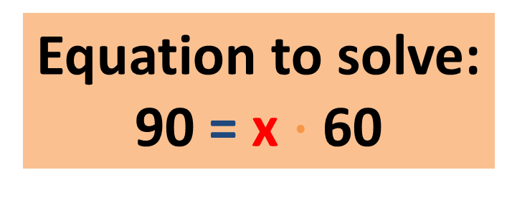
Problem #20 (Method #2)
90 is what percent of 60?
Equation to solve:
90 = x $∙$ 60
x = $\frac{90}{60}=\frac{3}{2}$ = 1.5
Change 1.5 → 150%

Slide 34
Problem #21 (Problem Solving)
Proportion:
$$\frac{IS}{OF}= \frac{\%}{100}$$
125% of what number is 75?
Solve:
$$\frac{75}{x}= \frac{125}{100}$$
Equation to solve:
125x = 75 $∙$ 100
125x = 7500
x = 60

Slide 35
Problem #21 (Method #2)
125% of what number is 75?
Change 125% → 1.25
Equation to solve:
1.25 $∙$ x = 75
x = $\frac{75}{1.25}=\frac{7500}{125}$ = 60
Live
example!

Slide 36
Problem #22 (Problem Solving)
Proportion:
$$\frac{PART}{TOTAL}= \frac{\%}{100}$$
Total = $230; Percent = 5%
Part is missing (Discount Amount)
Equation to solve:
100x = 230 $∙$ 5
Solve:
$$\frac{x}{230}=\frac{5}{100}$$
100x = 1150
x = $11.50 (Discount)
Sales Price = $230 - $11.50 = $218.50

Slide 37
Problem #22 (Alternative Method)
Total = $230
Percent = 5%
Discount = 5% of 120,000
of: key word for multiply!
Solve: (0.05)(230)
= $11.50 (Discount)
Sales Price = $230 - $11.50 = $218.50

Slide 38
Problem #23 (Problem Solving)
Proportion:
$$\frac{PART}{TOTAL}= \frac{\%}{100}$$
Total = $2000; Part = $408
Percent is missing
Equation to solve:
2000x = 408 $∙$ 100
Solve:
$$\frac{408}{2000}=\frac{x}{100}$$
2000x = 40800
x = 20.4%

Slide 39
Problem #23 (Alternative Method)
$$\frac{PART}{TOTAL}$$
= $\frac{408}{2000}$
= $\frac{204}{1000}$
$÷$2
= 0.204
$÷$2
= 20.4%
Live
example!

Slide 40
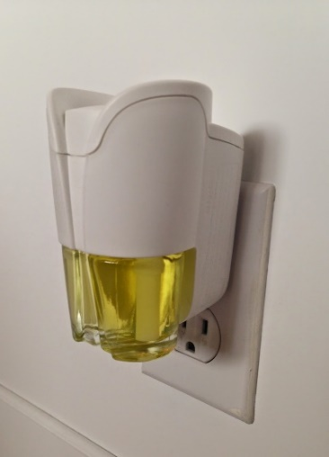
Problem #24 (Problem Solving)
Just Plug-in:
P = 24, W = 6
P = 2L + 2W; P = 24, W = 6
Live
example!
Solve:
2L + 12 = 24
24 = 2L + 2(6)
24 = 2L + 12
L = 6

Slide 41
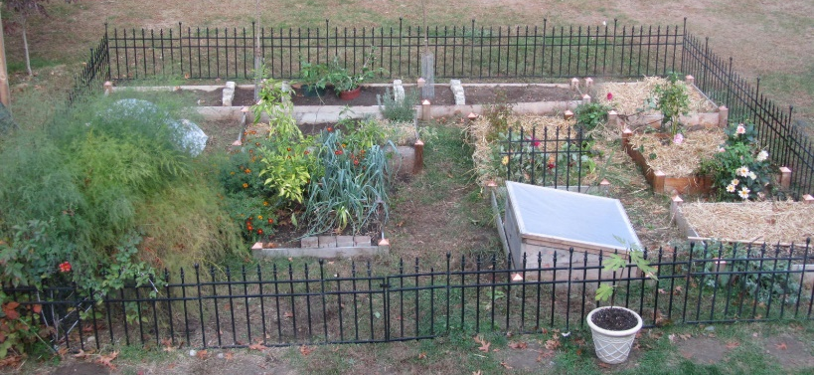
Problem #25 (Problem Solving)
2 m
Fencing goes around (Perimeter)
= 48 m
w
w
2 m
Solve: 2w + 4 = 48
w = 22 m

Slide 42
Problem #26, 27 (Problem Solving)
Proportion:
$$\frac{IS}{OF}= \frac{\%}{100}$$
26) 7% of what number is 43.3?
27) 38.8 is 65% of what number?
26)
$$\frac{43.3}{b}= \frac{7}{100}$$
27)
$$\frac{38.8}{b}= \frac{65}{100}$$

Slide 43
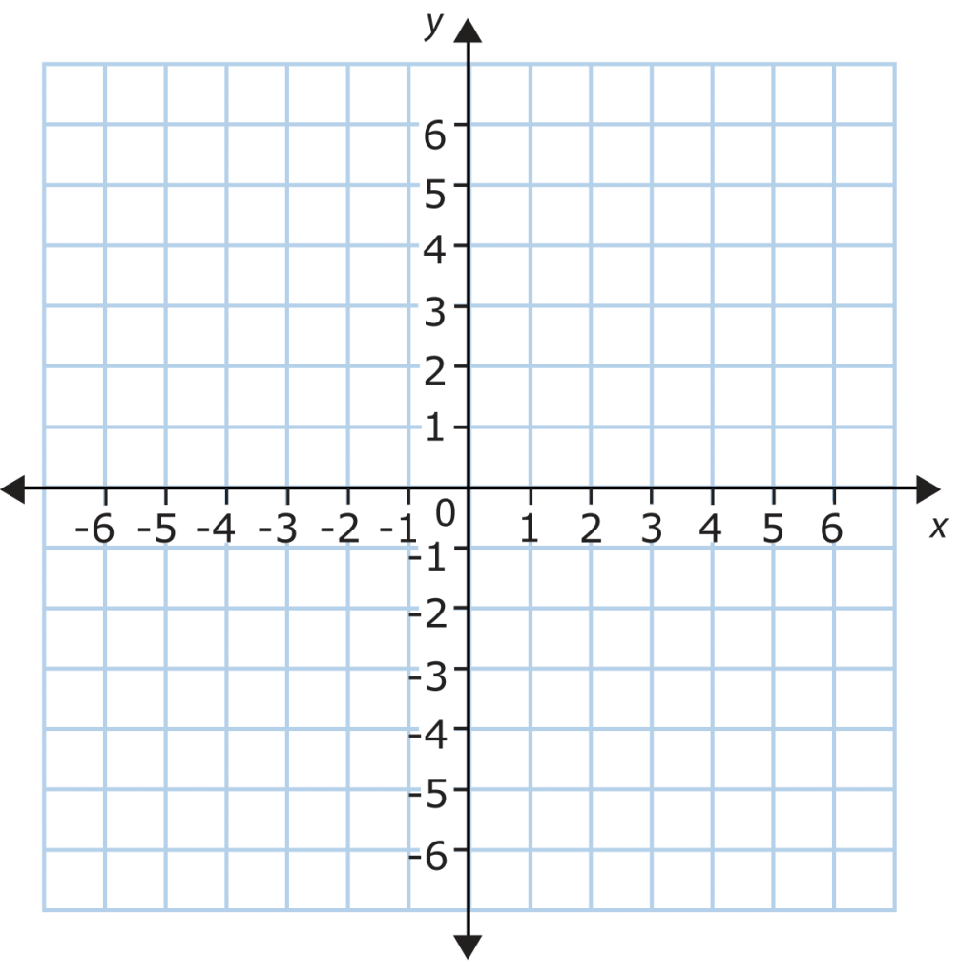
Problem #28 (Graphing)
x | y
(0, | __)
(__, | 0)
-2
(-2, 0)
-2
(0, -2)

Slide 44
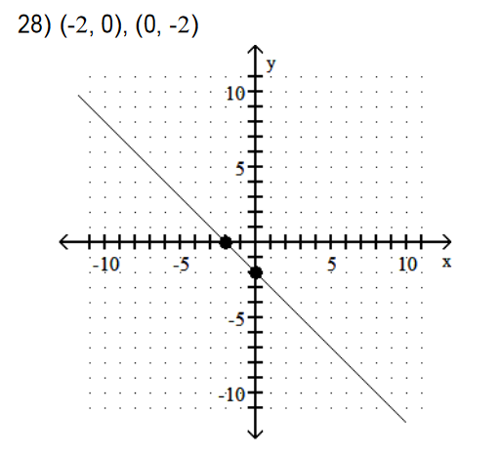
Solution for #28

Slide 45
Problem #29 (Graphing)
x-intercept (Plug y = 0):
16(0) – 4x = –8
y-intercept (Plug x = 0):
16y – 4(0) = –8
Solve:
– 4x = –8;
x = 2
Solve
16y = –8;
y = $−\frac{8}{16}=−\frac{1}{2}$
x | y
(__, | 0)
(0, | __)
2
x-int:
(2, 0)
y-int:
(0, $−\frac{1}{2}$)
$$−\frac{1}{2}$$

Slide 46
Problem #29 (Graphing)
x | y
(__, | 0)
(0, | __)
2
$$−\frac{1}{2}$$
(2, 0)
(0, - ½)

Slide 47
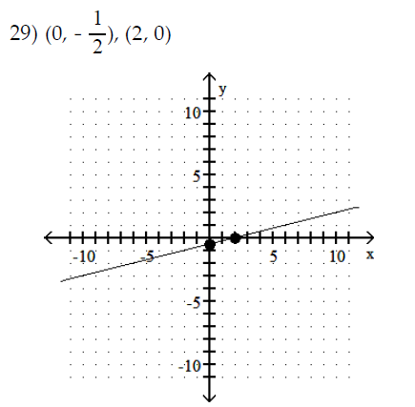
Solution for #29
Live
example!

Slide 48
Problem #30 (Graphing)
Slope-intercept form:
y = mx + b
y = $\frac{2}{5}x$ – 1
First point: (0, -1)
(5, 1)
Slope = $\frac{2}{5}= \frac{UP 2}{RIGHT 5}$
(0, - 1)

Slide 49
Problem #30 (Alternative Method)
For x = 0:
y = $\frac{2}{5}$(0) – 1
x | y
( , | )
( , | )
y = –1
0
-1
For x = 5:
y = $\frac{2}{5}$(5) – 1
5
1
y = 1

Slide 50
Problem #30 CONT…
x | y
( , | )
( , | )
0
-1
5
1
(5, 1)
(0, - 1)

Slide 51
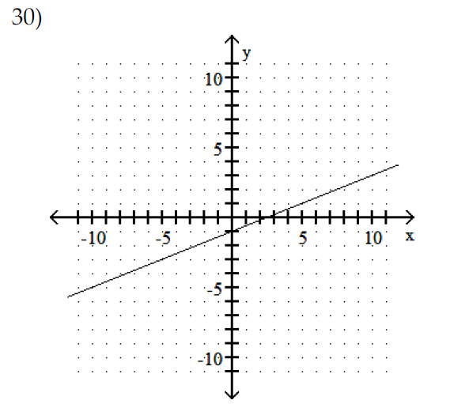
Solution for #30
Live
example!

Slide 52
Problem # 31 (Slope)
1) Remember slope-intercept form; y = mx + b
2) The slope is the coefficient of x; m.
Number in front of x is the slope.
The slope for y = -8x – 10 is -8.
m = - 8 (SLOPE)

Slide 53
Problem #32 (Slope)
y₁
x₂
y₂
Slope between 2 points
x₁
m = $\frac{y_{2} − y_{1}}{x_{2} − x_{1}}$
7
–5
= $\frac{7 + 5 }{ 8 + 9 }$
= $\frac{12 }{ 17 }$
m = $\frac{ − }{ − }$
8
–9

Slide 54
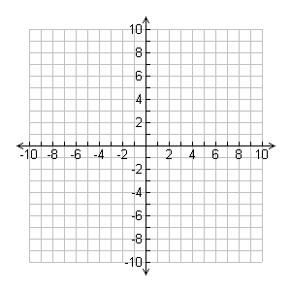
Problem #32 (Checking)
Right 17
(8, 7)
Up 12
= positive
slope
(-9, - 5)

Slide 55
Problem #33 (Graphing)
Any method is acceptable
since no method is specified.
After Solving, we have:
y = $\frac{1}{2}x − \frac{7}{2}$ →
y = $\frac{1}{2}x −3\frac{1}{2}$
Slope-intercept form:
y = mx + b
Solve for y.
Slope-intercept form:
y = mx + b
y = $\frac{1}{2}x$ – 3$\frac{1}{2}$
First point: (0, – 3$\frac{1}{2}$)
Slope = $\frac{1}{2}= \frac{UP 1}{RIGHT 2}$

Slide 56
Problem #33 CONT…
Slope-intercept form:
y = mx + b
y = $\frac{1}{2}x$ – 3$\frac{1}{2}$
First point: (0, – 3$\frac{1}{2}$)
Slope = $\frac{1}{2}= \frac{UP 1}{RIGHT 2}$
(2, -2½)
(0, - 3½)

Slide 57
Problem #33 (Alternative Method)
We must still solve for y:
y = $\frac{1}{2}x −3\frac{1}{2}$
For x = 0:
y = $\frac{1}{2}$(0) – 3 $\frac{1}{2}$
x | y
( , | )
( , | )
y = –3$\frac{1}{2}$
0
-3½
For x = 2:
y = $\frac{1}{2}$(2) – 3 $\frac{1}{2}$
2
-2½
y = -2½

Slide 58
Problem #33 CONT…
x | y
( , | )
( , | )
0
-3½
2
-2½
(2, -2½)
(0, - 3½)

Slide 59
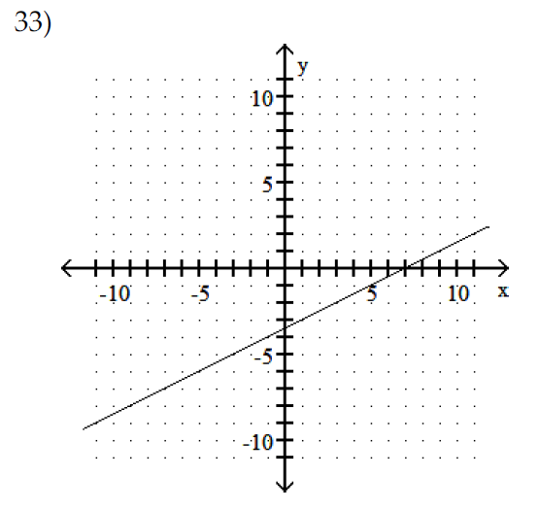
Solution for #33

Slide 60
Problem #34 (Graphing)
x | y
(0, | __)
(__, | 0)
-5
(-5, 0)
-5
(0, -5)

Slide 61
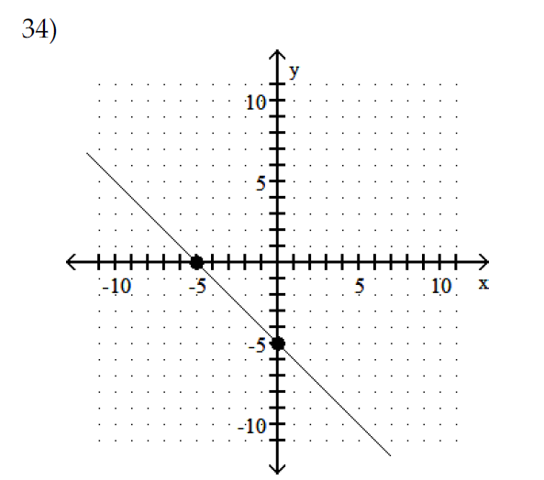
Solution for #34

Slide 62
Problem #35 (Intercepts)
x-intercept (Plug y = 0):
4x + 5(0) = 20
y-intercept (Plug x = 0):
4(0) + 5y = 20
Solve:
4x = 20;
x = 5
Solve:
5y = 20;
y = 4
x | y
(__, | 0)
(0, | __)
5
x-int:
(5, 0)
y-int:
(0, 4)
4

Slide 63
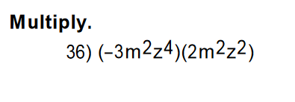
Problem #36 (Exponents)
1) Remember property: x^{m}x^{n} = x^{m + n}
EXAMPLE: x⁵x² = x⁷
(For multiplication → ADD exponents for like variables)
2) For coefficients, multiply!
(-3m²z⁴)(2m²z²) = -6m⁴z⁶

Slide 64
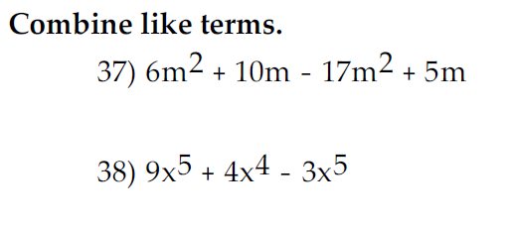
Problem #37, 38 (Simplifying)
6m² + 10m – 17m² + 5m
= -11m² + 15m
9x⁵ + 4x⁴ – 3x⁵
= 6x⁵ + 4x⁴
6

Slide 65
Problem #39 (Polynomials)
Descending Order: Highest → Lowest Exponent
Number/Constant is always last!
Concept: Combining Like Terms
9x + 6 – 11x + 4
= –2x + 10

Slide 66
Problem #40 (Polynomials)
Just copy
Multiply by -1 (change signs)
4x⁷ – 8x⁶ – 5
– 2x⁷ – 11x⁶ – 19
2x⁷
–19x⁶
–24

Slide 67
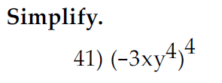
Problem #41 (Exponents)
1) Remember property: (x^{m})^{n} = x^{mn}
EXAMPLE: (x⁵)² = x¹⁰
(For exponents to exponents → MULITPLY exponents for like variables)
2) For coefficients, raise to exponent like usual!
(-3x¹y⁴)⁴
=(-3)⁴ x⁴y¹⁶
= 81x⁴y¹⁶
Check: (-3xy⁴)(-3xy⁴)(-3xy⁴)(-3xy⁴) = 81x⁴y¹⁶

Slide 68
Problem #42 (Polynomials)
(4x + 4)(x – 3)
4x² – 12x
+4x – 12
4x² – 8x – 12

Slide 69
Problem #43 (Polynomials)
Write the binomial twice!
(3a – 4)(3a – 4)
9a² – 12a
–12a + 16
9a² – 24a + 16

Slide 70
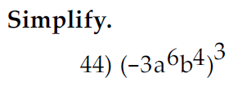
Problem #44 (Exponents)
1) Remember property: (x^{m})^{n} = x^{mn}
EXAMPLE: (x⁵)² = x¹⁰
(For exponents to exponents → MULITPLY exponents for like variables)
2) For coefficients, raise to exponent like usual!
(-3a⁶b⁴)³
=(-3)³ a¹⁸b¹²
= –27a¹⁸b¹²
Check: (-3a⁶b⁴)(-3a⁶b⁴)(-3a⁶b⁴) = –27a¹⁸b¹²

Slide 71
Problem #45 (Polynomials)
Write the binomial twice!
(3m + 1)(3m + 1)
9m² + 3m
+ 3m + 1
9m² + 6m + 1

Slide 72
Simplifying Square Roots
Know your perfect squares!
We will factor our biggest perfect square!
For variable,
divide exponent by 2
EXAMPLES:
$$\sqrt{x^{2}}= x^{1}=x$$
$$\sqrt{x^{4}}= x^{2}$$
$$\sqrt{x^{10}}= x^{5}$$
$$\sqrt{x^{88}}= x^{44}$$
$$\sqrt{x^{100}}= x^{50}$$

Slide 73
Problem #46 (Square Roots/Radicals)
$$\sqrt{x^{2}}=x$$
$$\sqrt{16x^{2}} ∙\sqrt{3y}$$
4x
$$\sqrt{3y}$$
4x $\sqrt{3y}$

Slide 74
Problem #47 (Square Roots/Radicals)
$$\sqrt{x^{2}}=x$$
$$\sqrt{36x^{2}} ∙\sqrt{3}$$
6x
$$\sqrt{3}$$
6x $\sqrt{3}$

Slide 75
Problem #48 (Square Roots/Radicals)
$$\sqrt{x^{12}}= x^{6}$$
$$\sqrt{49x^{12}} ∙\sqrt{x}$$
7x⁶
$$\sqrt{x}$$
7x⁶ $\sqrt{x}$
Live
example!

Slide 76
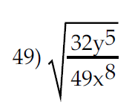
Problem #49 (Square Roots/Radicals)
4y² $\sqrt{2y}$
= $\frac{\sqrt{32y^{5}}}{\sqrt{49x^{8}}}$
=7x⁴
$$\sqrt{32y^{5}}$$
$$\sqrt{y^{4}}= y^{2}$$
$$\sqrt{16y^{4}} ∙\sqrt{2y}$$
$$\frac{4y^{2}\sqrt{2y}}{7x^{4}}$$
4y²
$$\sqrt{2y}$$

Slide 77
Problem #50 (Square Roots/Radicals)
$$\sqrt{20}$$
4$\sqrt{5}$ – 7(2 $\sqrt{5}$)
$$\sqrt{4} ∙\sqrt{5}$$
2
$$\sqrt{5}$$
4$\sqrt{5}$ – 14$\sqrt{5}$
2 $\sqrt{5}$
–10$\sqrt{5}$

Slide 78
Problem #51 (Square Roots/Radicals)
$$\sqrt{48}$$
$$\sqrt{243}$$
4 $\sqrt{3}$
–10($9\sqrt{3}$)
–9($2\sqrt{3}$)
$$\sqrt{16} ∙\sqrt{3}$$
$$\sqrt{81} ∙\sqrt{3}$$
4$\sqrt{3}\text{–}\text{9}\text{0}\sqrt{3}$ $\text{–}\text{18}\sqrt{3}$
4
$$\sqrt{3}$$
9
$$\sqrt{3}$$
$$\sqrt{12}$$
$$\text{–}\text{104}\sqrt{3}$$
$$\sqrt{4} ∙\sqrt{3}$$
Live
example!
2
$$\sqrt{3}$$

Slide 79
Problem #52 (Equations)
A = P + PRT
–P
–P
A – P = PRT
T = $\frac{A −P}{PR}$
PR
PR

Slide 80
Problem #53 (Equations)
Clear fractions!
V = $\frac{1}{3}$Ah
$$∙3$$
$$∙3$$
h = $\frac{3V}{A}$
3V = Ah
A
A

Slide 81
Problem #54 (Equations)
-1x = 11
-1
-1
3x = 4(x + 4) – 5
3x = 4x + 16 – 5
x = -11
3x = 4x + 11
–4x
–4x

Slide 82
Problem #55 (Equations)
-4x = 24
-4
-4
-4(x + 3) – 36 = –14 – 10
x = -6
-4x – 12 – 36 = – 24
-4x – 48 = – 24
+48
+48

Slide 83
Problem #56 (Equations)
Clear fractions!
LCD = 10
$$2$$
$$5$$
$$2$$
$$\frac{6}{5}x=−\frac{1}{2} − \frac{3}{5}$$
$$∙10$$
$$∙10$$
$$∙10$$
x = $−\frac{11}{12}$
2 $∙$ 6x = 5 $∙$ –1 – 2$∙$ 3
12x = – 5 – 6
12x = – 11
12
12

Slide 84
Problem #57 (Equations)
Clear fractions!
LCD = 3
$$\frac{a}{3} −\frac{1}{3}=−5$$
$$∙3$$
$$∙3$$
$$∙3$$
a – 1 = –15
+1
+1
Live
example!
a = $−$14

Slide 85
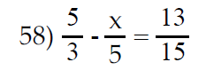
Problem #58 (Equations)
Clear fractions!
LCD = 15
$$5$$
$$3$$
$$\frac{5}{3} − \frac{x}{5}= \frac{13}{15}$$
-3x = -12
$$∙15$$
$$∙15$$
$$∙15$$
-3
-3
5 $∙$ 5 – 3x = 13
25 – 3x = 13
x = 4
-25
-25
– 3x = –12

Slide 86
Problem #59 (Equations)
Get variable to 1 side!
7x – 7 = 5x - 8
2x = -1
–5x
–5x
2
2
2x – 7 = –8
x = $−\frac{1}{2}$
+7
+7
2x = –1

Slide 87
Problem #60 (Equations)
Clear Decimals!
Move decimal point 2 places over.
1.4 x – 3.1 = 0.7 x – 1.98
0
0
0
140x – 310 = 70x – 198
–70x
–70x
70x – 310 = – 198
+310
+310
70x = 112

Slide 88
Problem #60 CONT…
70x = 112
70
70
$$\frac{112}{70}$$
$$=\frac{56}{35}$$
$÷$2
$$÷7$$
$$=\frac{8}{5}$$
DIVIDE!
$÷$2
$$÷7$$
x = 1.6

Slide 89
Problem #61 (Equations)
Clear Decimals!
Move decimal point 2 places over.
0
-0.7 x + 1.15 = -0.4 x + 2.05
0
-70x + 115 = -40x + 205
-30x = 90
+40x
+40x
-30
-30
-30x + 115 = 205
x = -3
–115
–115
Live
example!
-30x = 90

Slide 90
Graphing Inequalities
For < or >:
( )
For < or >:
[ ]

Slide 91
Interval Notation
For < or >:
Use ( )
For < or >:
Use [ ]
For $−∞$ or $∞$:
Use ( )
ONLY!

Slide 92
Problem #62 (Inequalities)
Inequality Flips/Reverses
When both sides are multiplied/divided by a negative!
$−\frac{1}{5}x$ < 6
$$∙−5$$
$$∙−5$$
Interval Notation:
(-30, $∞$)
$x$ > -30
(
-$∞$
$$∞$$
-30

Slide 93
Problem #63 (Inequalities)
4x < 16
24x + 28 < 4(5x + 11)
4
4
24x + 28 < 20x + 44
–20x
–20x
4x + 28 < 44
Since both sides are being divided by a positive 4,
WE DO NOT FLIP INEQUALITY SYMBOL!
–28
–28
x < 4
4x < 16

Slide 94
Problem #63 CONT…
x < 4
Live
example!
Interval Notation:
($−∞$, 4]
]
-$∞$
$$∞$$
4

Slide 95
Problem #64 (Inequalities)
5y < 45
-5(6y + 3) < -35y + 30
5
5
-30y – 15 < -35y + 30
+35y
+35y
5y – 15 < 30
Since both sides are being divided by a positive 5,
WE DO NOT FLIP INEQUALITY SYMBOL!
+15
+15
y < 9
5y < 45

Slide 96
Problem #64 CONT…
y < 9
Live
example!
Set-builder Notation:
{y| y < 9}
-$∞$
$$∞$$
9

Slide 97
Problem #65 (Inequalities)
Since both sides are being multiplied by a positive 5,
WE DO NOT FLIP INEQUALITY SYMBOL!
$$∙5$$
$\frac{1}{5}$y > 6
$$∙5$$
Set-builder Notation:
{y| y > 30}
y > 30
-$∞$
$$∞$$
30

Slide 98
Problem #66 (Problem Solving)
A fence is to be installed around a rectangular field.
The field’s perimeter is 210 feet. The length of the field is 5 feet
more than the width, find the length.
w + 5
w + 5
w
w
w
w = 50 feet
Width
w + 5
Solve:
4w + 10 = 210
50 + 5 = 55 ft
Length

Slide 99
Problem #66 (Alternative Method)
A fence is to be installed around a rectangular field.
The field’s perimeter is 210 feet. The length of the field is 5 feet
more than the width, find the length.
w + 5
P = 2L + 2W
w
SOLVE:
210 = 2(W + 5) + 2W
Solve:
4w + 10 = 210
w = 50 feet
Width
SOLVE:
210 = 2W + 10 + 2W
50 + 5 = 55 ft
Length

Slide 100
Problem #67 (Problem Solving)
A county assesses annual property taxes at a rate of 4% of the
appraised value of the property. A property is appraised for $120,000.
What are the property taxes?
Total = $120,000
Percent = 4%
Part is missing (Taxes)
Proportion:
$$\frac{PART}{TOTAL}= \frac{\%}{100}$$
Equation to solve:
100x = 120000 $∙$ 4
Solve:
$$\frac{x}{120,000}=\frac{4}{100}$$
100x = 480000
x = $4,800
Live
example!

Slide 101
Problem #67 (Alternative Method)
A county assesses annual property taxes at a rate of 4% of the
appraised value of the property. A property is appraised for $120,000.
What are the property taxes?
Total = $120,000
Percent = 4%
Taxes = 4% of 120,000
of: key word for multiply!
Solve: (0.04)(120,000)
= $4,800
Live
example!

Slide 102
Problem #68 (Problem Solving/Square Roots)
Television Sets: What does it mean to refer to a 20-in TV set or a
25-in TV set? Such units refer the diagonal of the screen.
a) A 15-in TV set also has a width of 12 inches. What is its height?
b) A 20-in TV set also has a width of 16 inches. What is its height?
Right Triangle
a² + b² = c²
(Pythagorean Theorem)
Diagonal
Height
Hypotenuse
c
Diagonal of TV =
Hypotenuse of Right Triangle
Width

Slide 103
Problem #68 (Problem Solving/Square Roots) PART A
Television Sets: What does it mean to refer to a 20-in TV set or a
25-in TV set? Such units refer the diagonal of the screen.
a) A 15-in TV set also has a width of 12 inches. What is its height?
Solve: b² + 12² = 15²
b² + 144 = 225
–144
–144
b² = 81
15 in
x
b = $\sqrt{81}$ = 9 in
12 in
Live
example!

Slide 104
Problem #68 (Problem Solving/Square Roots) PART B
Television Sets: What does it mean to refer to a 20-in TV set or a
25-in TV set? Such units refer the diagonal of the screen.
b) A 20-in TV set also has a width of 16 inches. What is its height?
Solve: x² + 16² = 20²
x² + 256 = 400
–256
–256
x² = 144
20 in
x
x = $\sqrt{144}$ = 12 in
16 in

Slide 105
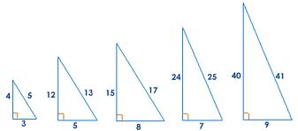
Pythagorean Triples
Common Pythagorean Values:
1) 3, 4, 5
2) 5, 12, 13
3) 8, 15, 17
4) 7, 24, 25
5) 9, 40, 41
Times 3:
1) 9, 12, 15
Times 4:
1) 12, 16, 20
& Their Multiples
Times 10:
2) 50, 120, 130

Slide 106
Problem #69 (Problem Solving)
People drive, on average, 11,400 miles per year. About how many
miles each week is that? Round to the nearest tenth.
NOTE: 1 year = 52 weeks
$$\frac{11,400}{52}$$
= 219.23 $≈$ 219.2 miles
per week
Long divide!

Slide 107
Problem #70 (Problem Solving)
A woman earns $2600 per month and budgets $338 per month for
food. What percent of her monthly income is spent on food?
$$\frac{PART}{TOTAL}$$
= $\frac{338}{2600}$
= $\frac{169}{1300}$
= $\frac{13}{100}$
$÷$2
$$÷13$$
$÷$2
$$÷13$$
= 13%

Slide 108
MyMathLab Tips
Pay careful attention to all instructions!
$$\frac{3}{4}$$
$$0.75$$
$$110$$
$$109.75$$
$$110$$
$$109.8$$
$$3$$
$$(0, 3)$$

Slide 109
MyMathLab Tips CONT…
Pay careful attention to all instructions!
WRONG!!
RIGHT!!
(-6, 1)
(-5, 0)
(-2, -3)
(0, -5)

Slide 110
How to Study…
1) This workshop is a good step towards studying for the final (Review this presentation and video)
2) Work on the practice final exam in MyMathLab with no help, notes, calculators, or any assistance and time yourself.
3) Review the workshop packet and try to do each problem by yourself with no help, notes, calculators, or any assistance.
4) Review your in-class exams, on-line quizzes, and on-line homework.
5) Visit the Math Connections for additional support and resources!
Study a little each day, DO NOT CRAM!!

Slide 111
General Test Taking Tips
1) Preview the exam and do the problems that are easy and you are familiar with.
2) Pace yourself… do not spend too much time on any 1 problem.
3) DO NOT RUSH!
4) Go back and check your answers (if time allows).
5) Follow instructions carefully!
6) Double check your work!
When you submit your exam, review your exam!

Slide 112
Now go study and do well on your final exam!

