Slide 1

Select Slides…
2015Training
Strengthening Teaching and Learning through the Results of Your Student Feedback on Instruction (SFI)
For Faculty
Valencia Institutional Assessment (VIA) office
Laura Blasi, Ph.D., Director, Institutional Assessment 4/2015

Slide 2
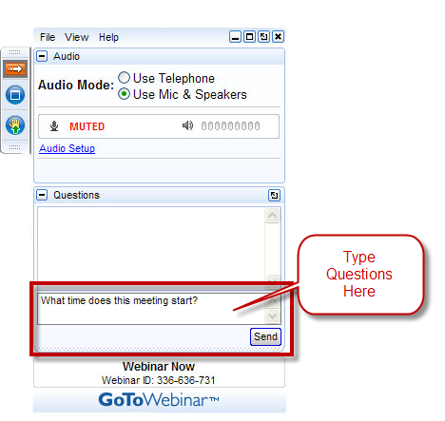

Webinar: State of the State
Virtual Participants may be muted
Use Questions Box to Participate
This session will be recorded
Technical Help?
888-259-8414
Our Session is online
Notes:
Announcement Script:
Welcome to this webinar session.
If you are attending this webinar remotely (from your office or another location) please take advantage of the Questions Section to post your any questions that you may have during the session, and our presenter will address them at specific intervals during the training.
As an added benefit, we are recording this webinar session and will be forwarding you a link to the recorded webinar session.
You may also notice that you can hear but not speak. Please note that your presenter may have muted all virtual participants in an effort to improve the quality of the audio that is being recorded.
Last but not least, for those of you attending the session virtually, you will be asked to complete a survey as soon as the webinar is complete. Please take a few moments to provide us with that feedback.
Ok! Let’s get started!

Slide 3
This course will introduce faculty members to the basics of the student feedback on instruction (SFI) at Valencia College through our online course evaluation system, including ways of increasing student participation. Advanced topics will also be covered such as the development of formative midterm assessment measures and strategies for acting on your results in terms of teaching practices and professional portfolio development.
Overview

Slide 4
Terms to know…
Student Feedback on Instruction (SFI) – questions & process
CoursEval – online program, the tool

Slide 5
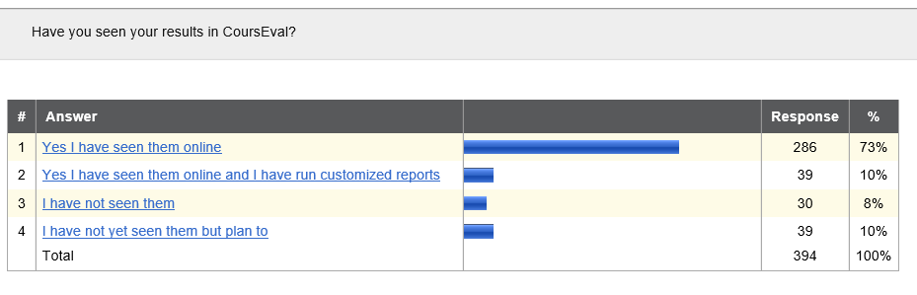

Slide 6
Outcomes – One
Participants should be able to explain and use the tools available in Valencia College’s online evaluation system for developing course evaluation questions and for accessing, interpreting, and using related feedback reports.

Slide 7
Outcomes - Two
Participants should be able to articulate and implement a strategy for integrating the student feedback on instruction into a larger plan for the continuous improvement of teaching.

Slide 8
Outcomes - Three
Participants should be able to discuss and address prevalent myths and relevant research regarding the student assessment of instruction as described in Student Course Evaluations: Research, Models and Trends (Gravestock and Gregor-Greenleaf, 2008.)

Slide 9
History of the Changes: Student Feedback on Instruction (SFI) through CoursEval
In Spring 2012, under the leadership of Bob Gessner, Faculty Council (FC) began work to improve the Student Assessment of Instruction (SAI) through a committee including representation from faculty, deans, and Institutional Assessment.
In early fall term 2012, then Association President Rob McCaffrey sent out the first report from this committee to the entire College faculty, which dealt with recommendations to improve student participation. In September 2012, FC sent a college-wide survey to faculty asking for their opinions about the areas of feedback (topics) most important to them.
The Committee, established by the FC and led by Carl Creasman, continued to work through that fall and early 2013, and presented final changes to FC during the spring term 2013. FC endorsed several changes (see February minutes of FC), and the pilot has now been completed.

Slide 10
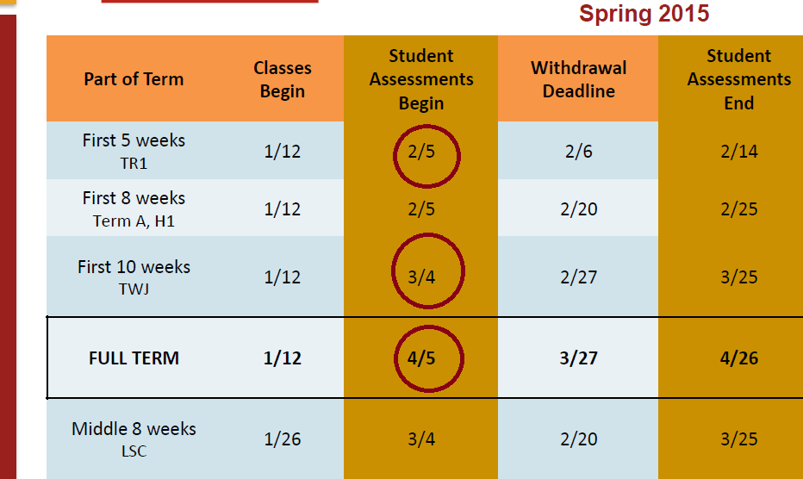
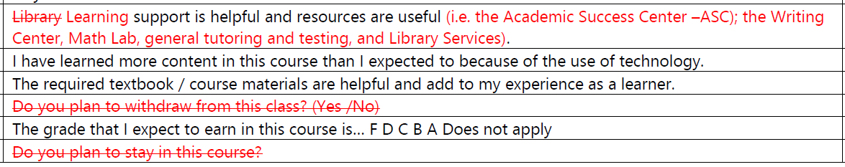
Changes
The name of the survey was changed from SAI to the Student Feedback on Instruction (SFI).
More recently a few questions were dropped or modified and the calendar changed.

Slide 11
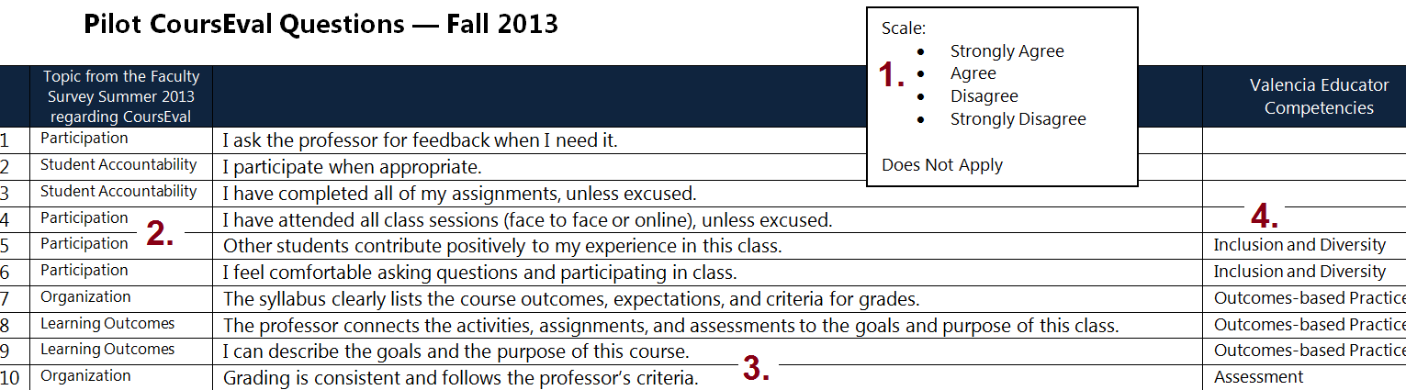
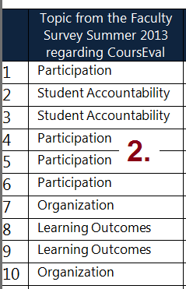
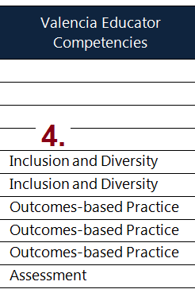
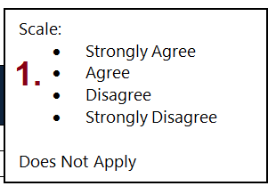
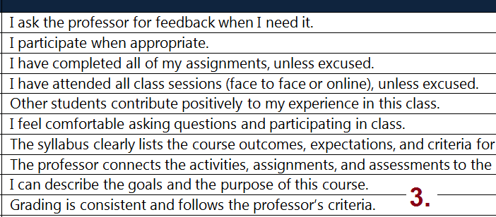

Slide 12
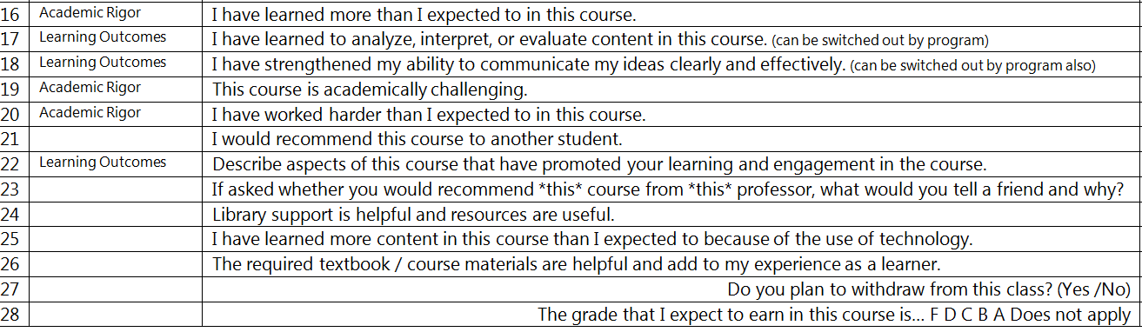
Getting the Most Out of Your Results:
Begin thinking about the kinds of questions you want to ask over time – find a focus

Slide 13
Key Points:
Reflection Feedback Loop
Gather Info
Reflect
Act
Discuss
Read
Communicate
Strengthen Teaching
& Learning Using Multiple Sources
Consider Midterm Evaluations
Build on the SFI Process with Reports
Make a Plan

Slide 14
Midterm Evaluations as Part of a Process
Formative vs. Summative Feedback
Midterm vs. End of Term
Tools to Use
Examples

Slide 15
Improving Teaching and Learning
Using Multiple Sources of Feedback
Midterm + End of Term [SFI]
+ other sources of data – presented in…
  Portfolio
  Conversations with Deans
  Sharing with Colleagues (mentoring also…)
  Discussions of decisions (related to redesign…)
What might other sources of data may help?

Slide 16
Where Can I Start this Term?
Example of Design… Midterm
Centre College Example
http://ctl.centre.edu/assets/midtermeval.sample1.pdf

Slide 17
Using the Feedback
Read the students' comments carefully.
Think about changes.
Reflect with a faculty developer or colleague.
Make a brief list of comments to respond to in class.

Slide 18
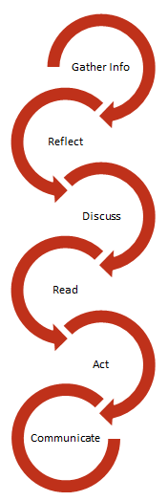
Use the Feedback as Part of Your Reflection Loop
Discussing your response to a few of the students' responses shows you take their comments seriously.
Respond to student suggestions with an explanation of why you have decided NOT to make any adjustments.
At the end of the semester, revisit the midterm evaluations, along with the end-of-semester course evaluations, to remind yourself of the feedback students provided at each stage. Then, write a few notes to yourself about specific aspects of the feedback that you will want to remember the next time that you teach.
Document your changes and impact when possible…
Adapted from: http://teachingcenter.wustl.edu/midterm-evaluations

Slide 19
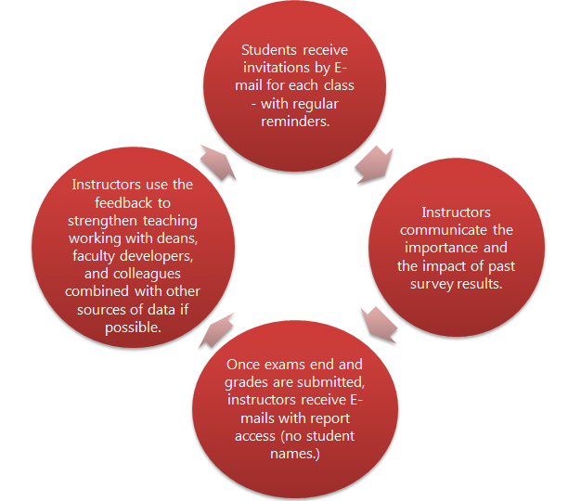
SFI – end of term

Slide 20
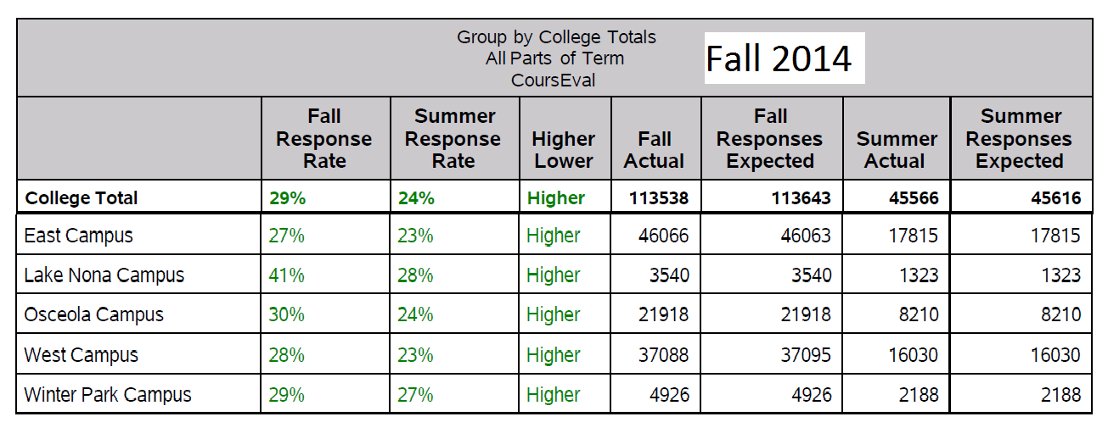

Slide 21
Views, Log-ins, and Accessing and Running Your Reports
Note: If you are online – this means opening a separate window – if you are disconnected from the Webinar be prepared to log back in using your original login information. You may also want to….
print this PPT out (if you downloaded it beforehand)
watch as I browse and access your own account later and/or
keep both windows open if you explore on your own…

Slide 22

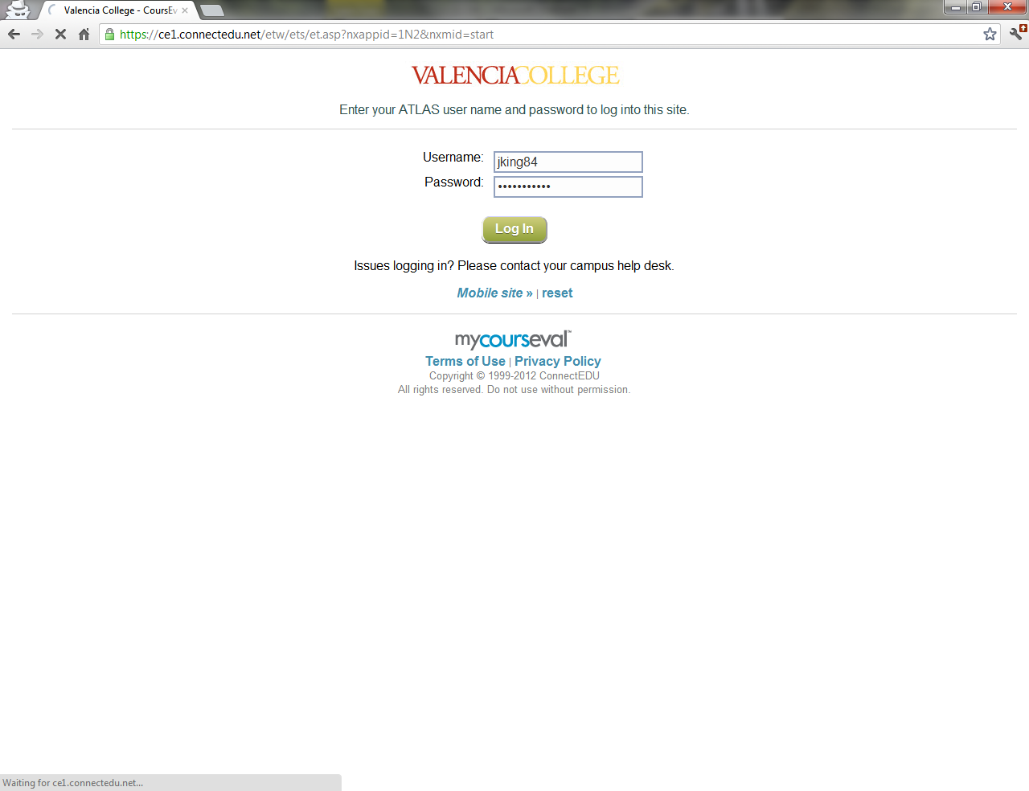
Log In
http://tiny.cc/CoursEval_Faculty
(https://p1.courseval.net/etw/ets/et.asp?nxappid=1N2&nxmid=start)
Use your Valencia (Atlas) Credentials

Slide 23
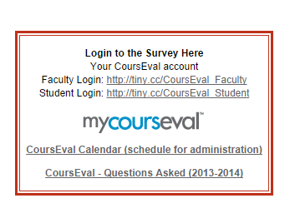
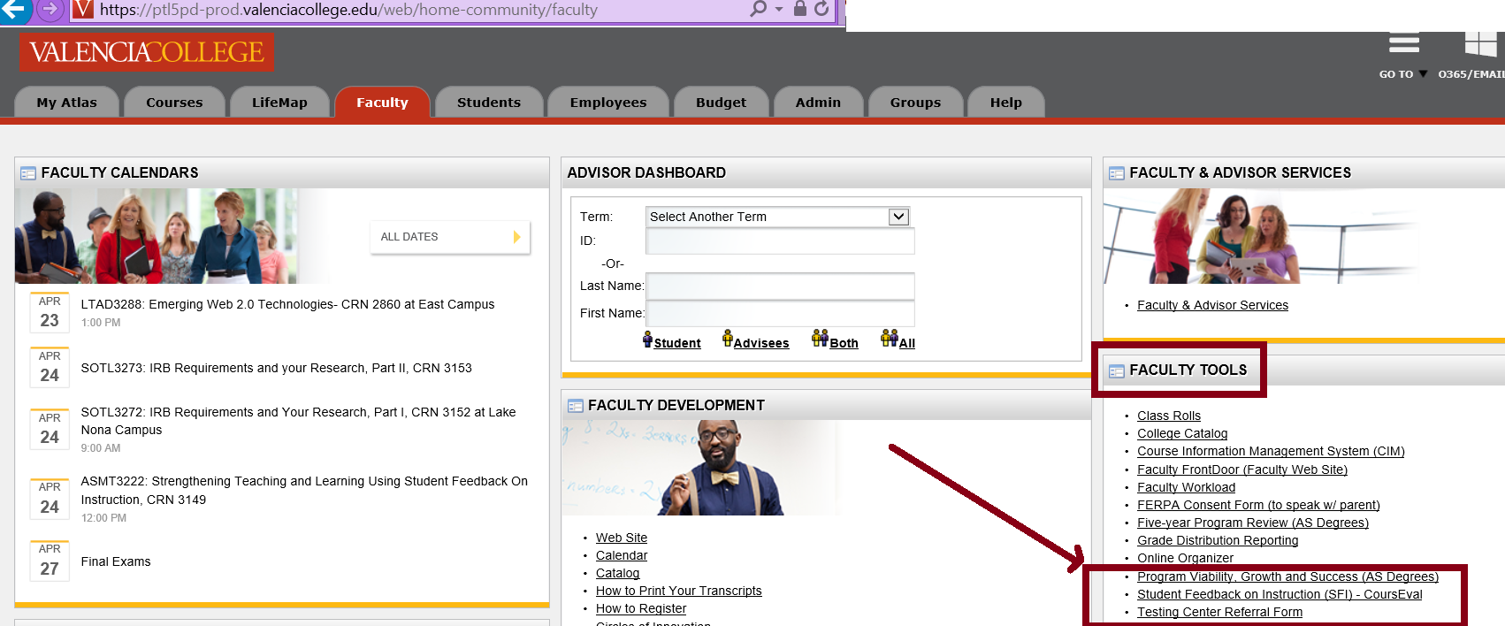
Atlas Faculty Tab – right side or VIA Website….

Slide 24
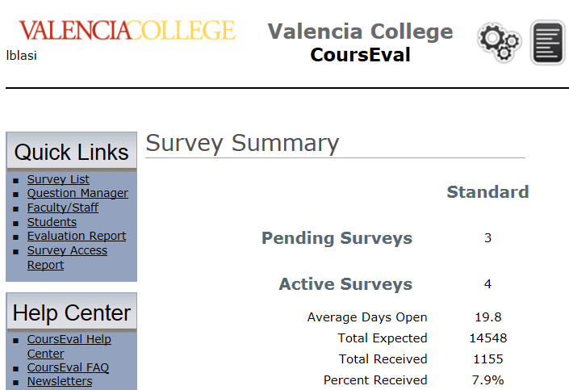
A First Look… VIA Office

Slide 25
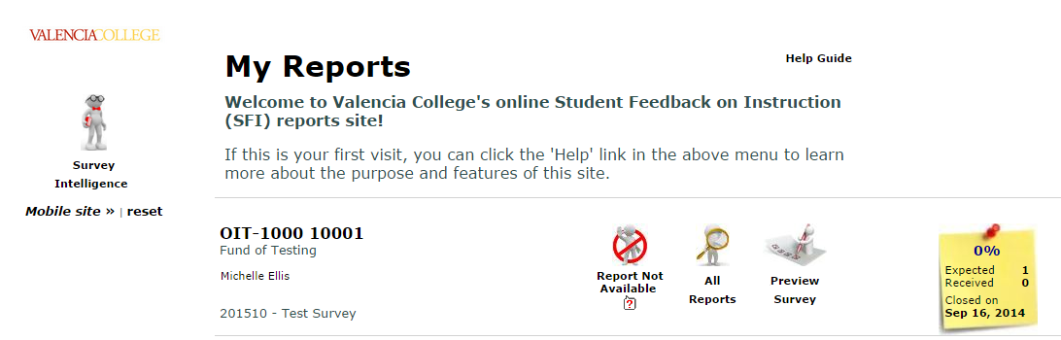
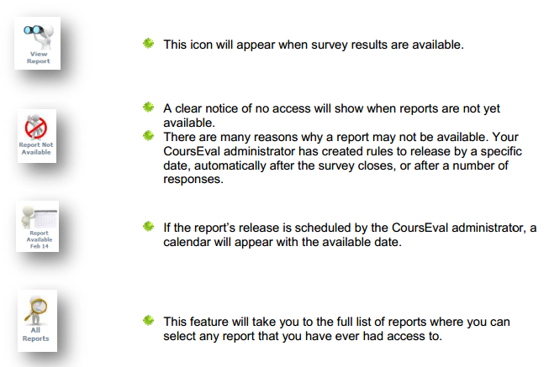
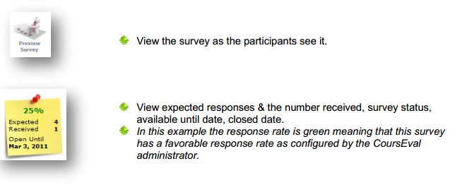
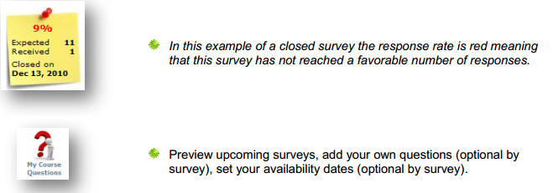
Faculty View

Slide 26
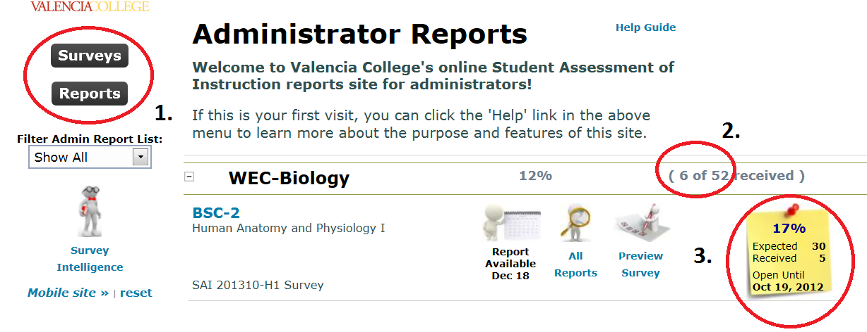
Dean View

Slide 27
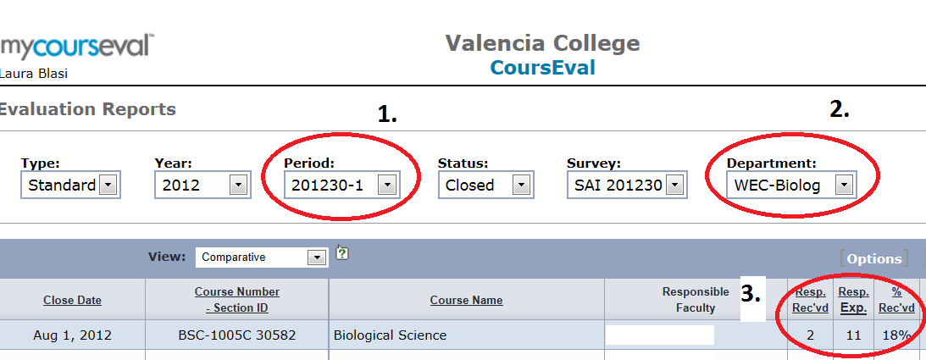
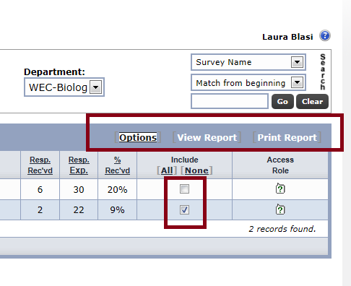
Watch Out for Filters….

Slide 28
Next steps regarding the CoursEval tool
Get ready to explore
First we’ll look at a basic report and printing
Then we’ll look at another report possibility
Finally we will explore and set “options”

Slide 29
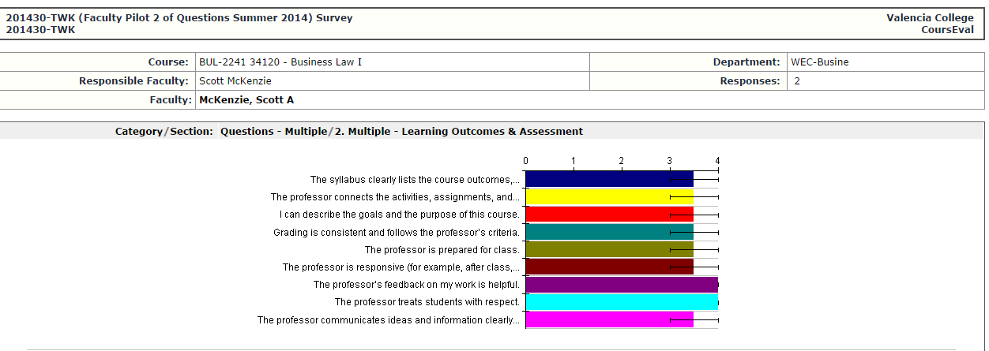

Reading an Individual Report

Slide 30
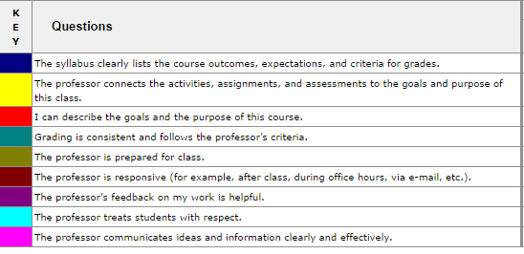

Slide 31
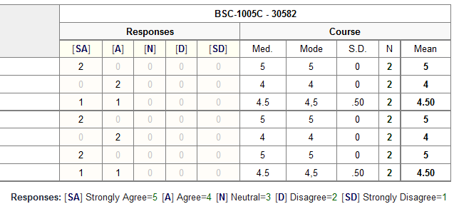

Slide 32
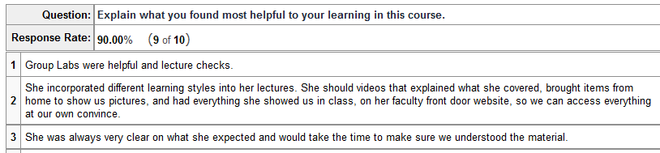

Ideas for use…
Strategies, Point Out Important Comments

Slide 33
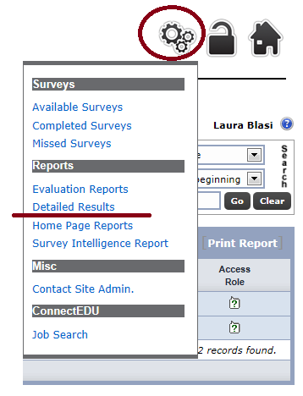

Slide 34
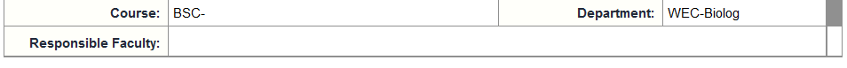
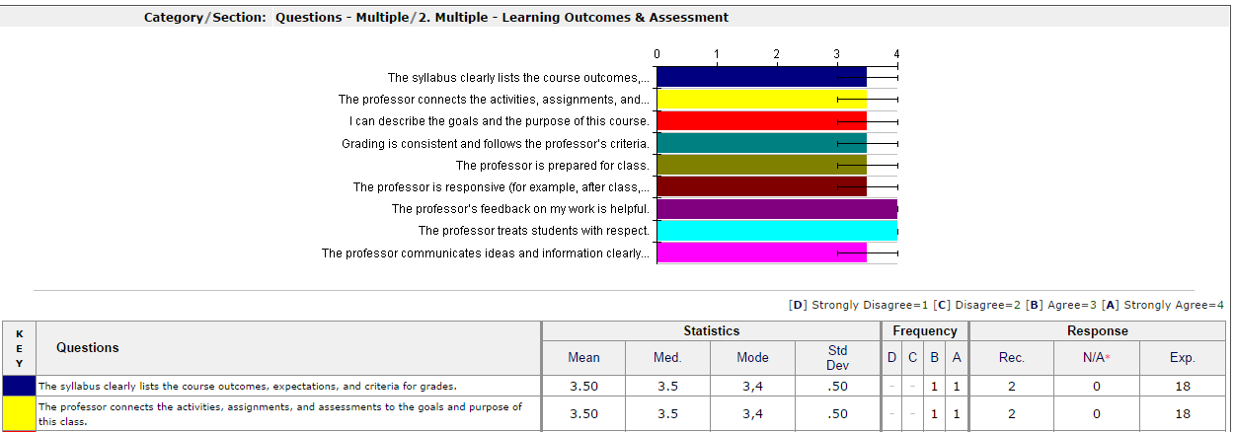

Slide 35
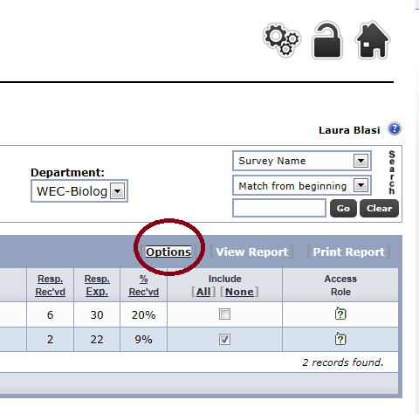
Options….

Slide 36
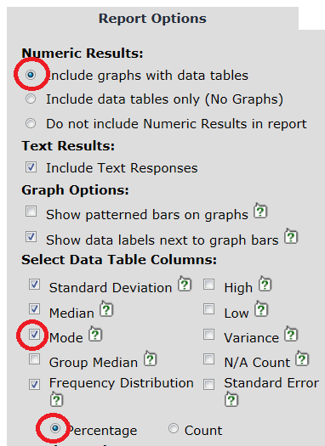
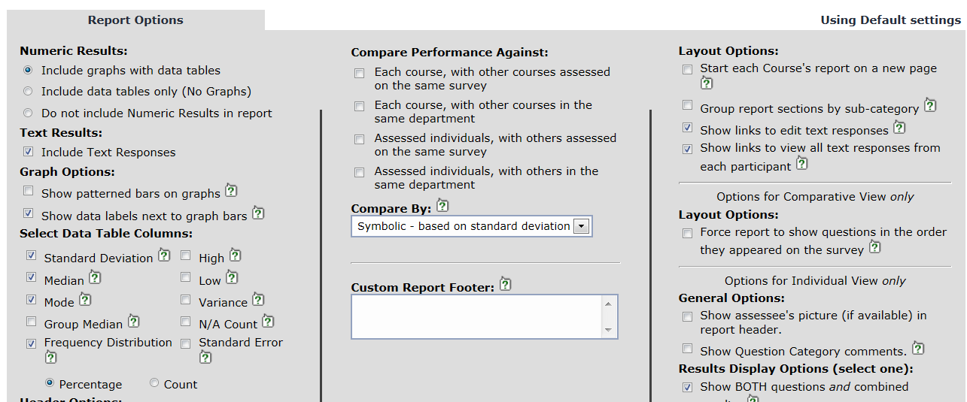
Try out your options I…

Slide 37
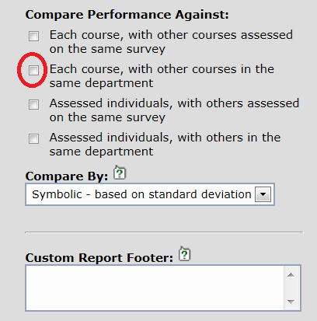
Try out your options II…

Slide 38
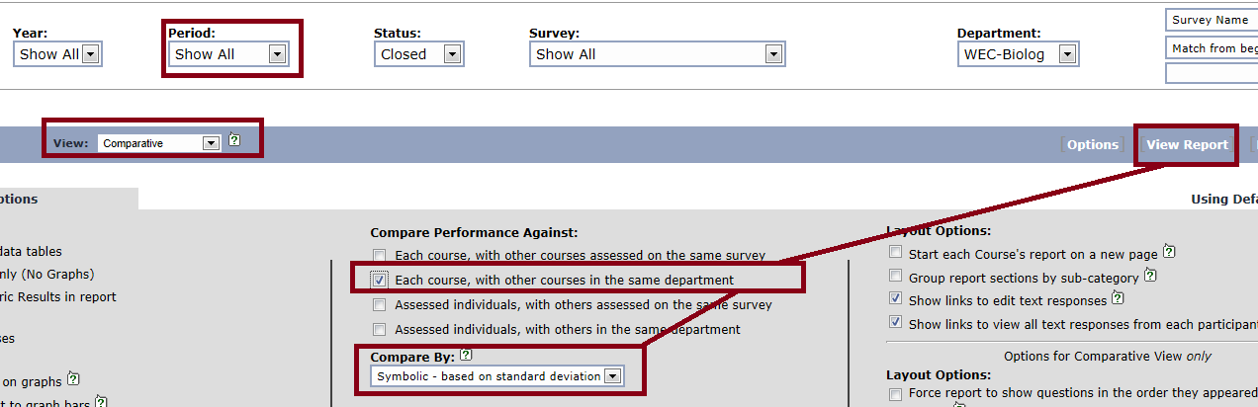
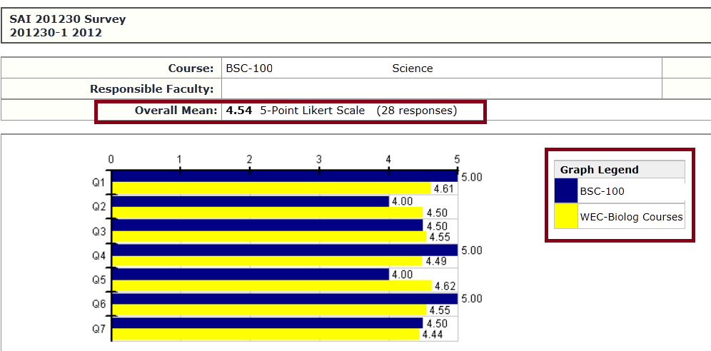
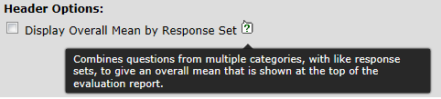

Slide 39
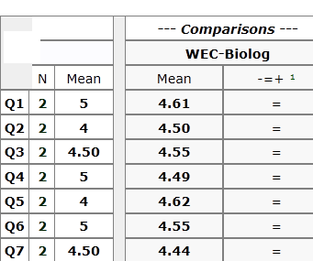

What
“symbolic” tells me….

Slide 40
Administration of CoursEval
Use a schedule aligned with terms
Run the courses, contact assistants
Announce to faculty and deans
Promote with students
Reminders every 5 days or more…
Announce report availability….

Slide 41
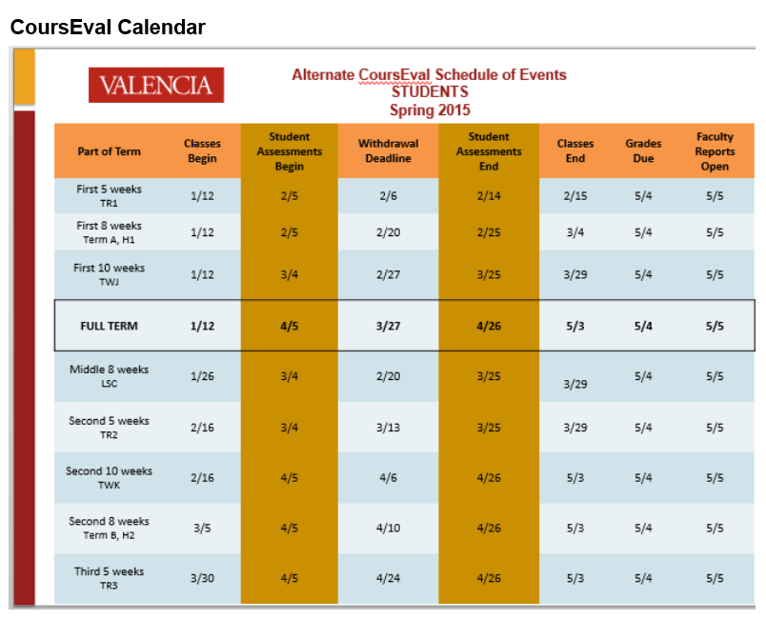

Slide 42
Education

Slide 43
We are….. Educating Students
… to have standards
…to self-assess and reflect
…to collaborate with faculty
…to know they are having an impact

Slide 44
Faculty – Concerns They Have
Who decides on questions?
How can we use these more effectively?
How are the reports used by deans and others?

Slide 45
What Do Students Say?
What we learned….

Slide 46
When asked about the survey, one student explained that the purpose is:
“…to assess the courses taken and provide constructive feedback for Valencia. After all, ‘Best in the Nation’ doesn't happen by itself!”
Launched on June 18, 2012 within a week our survey had 1,323 responses (or 5%.)

Slide 47
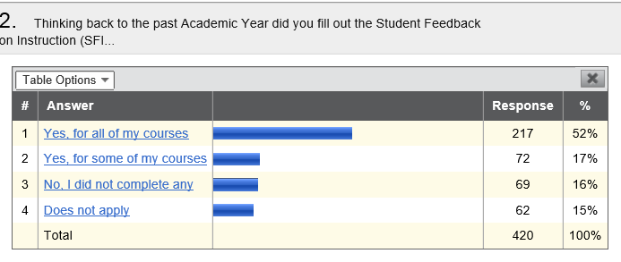
Most recent SFI opinion surveys….
Fall 2014: students (N=433)

Slide 48
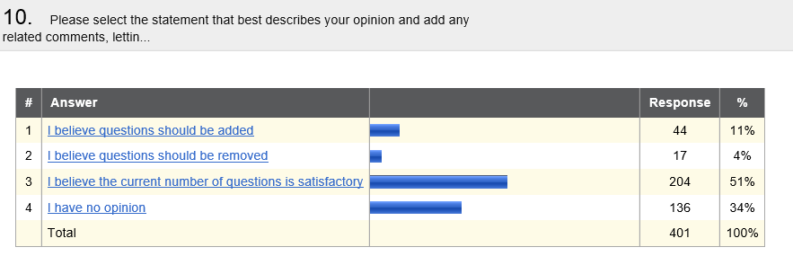
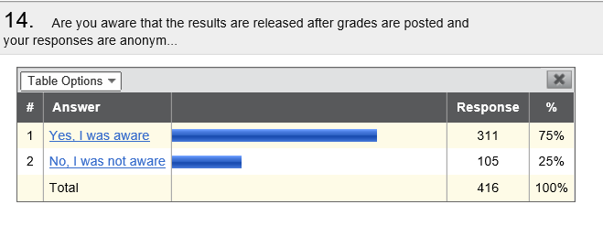

Slide 49
“It is helpful not only for the professors but for future student. Professors should get feedback on their classes and see what they can improve for his students in the future…”

Slide 50
It's too early to give my feedback about the course and professor. I know it’s coming, my first semester I had no idea what it was, but was told to fill it out.
I am very honest with my answers whether I like the class or not. I am just worried about the professor reading what I have to say and taking it wrong and re-paying with a bad grade. I completed it just fine
The instructors may become bias when find out who said what by our writing they can identify me and I still have to take class with them because of my program. I am fine completing the survey.
I have to take classes with 2 of my current professors next semester so I don't want them to figure out it was me who commented on the survey, but I do want to be able to write about my experiences with the teachers and I do want them to know what they are doing good and bad. It is helpful not only for the professors but for future student. Professors should get feedback on their classes and see what they can improve for his students in the future
I dont believe that taking the survey will have any effect. All the good professors are still good and all the garbage ones will act the same and not change a thing. The survey was just right.
I never know the outcome off these surveys I love filling these out and appreciate their existence.
The survey is due before the course ends. In the event a student is unhappy with the way the course went, the possibility of the professor seeing the results and who it came from.

Slide 51
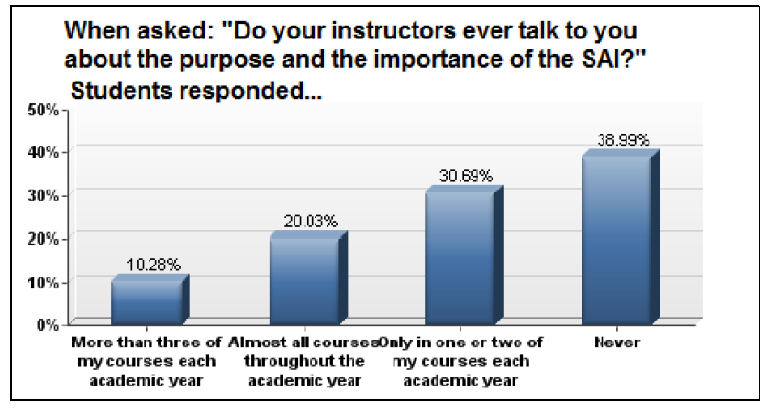
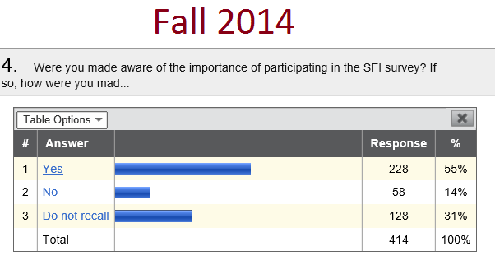

Slide 52
Student Comments from 2012
Still Relevant….
We received 900+ comments and this overview report can be paired with the initial report which provided an overview of all responses (dated 6/25/2012.)
This report summarizes the student responses to two of the SAI Survey open-ended questions: (1) “What is the purpose of the Student Assessment of Instruction?” and (2) “Are there any incentives that would encourage more students to complete the Student Assessment of Instruction?”

Slide 53
About Use: “I would hope that it would be implemented in an evaluation/discussion with the instructor to either fortify good techniques or enlighten them as to areas of opportunity ... perhaps in a perfect world but good instructors should be recognized and rewarded. The instructors that are just taking up space should be replaced ... again in a perfect world.”
About Purpose: “The purpose of the SAI is to determine how effective a class, and instructor was, or, is. And I would also like to believe that it also helps to improve the quality of the given courses. I just wish you guys would take action a lot faster than you tend to do when we the students give our input and recommendations via our responses through the surveys, because if you don’t then we will stop taking the time to reply. Thank you.”
About Motivation: “More communication about the surveys from the professors might encourage participation. If a professor told the class how the information is used and that they encourage both positive and negative feedback. I don't recall any professor last semester even mentioning the surveys. It might make others feel like the information is important and the extra few minutes can help make all the classes better each semester.”

Slide 54
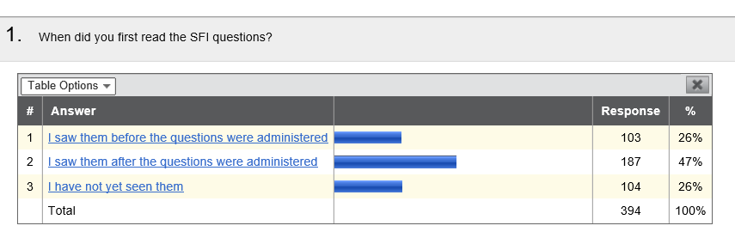
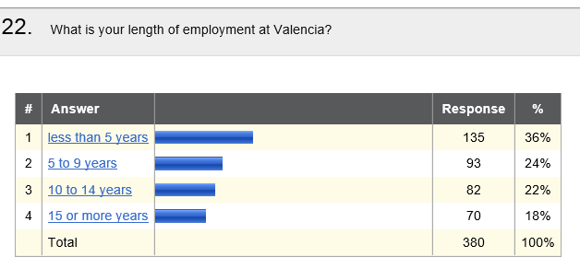
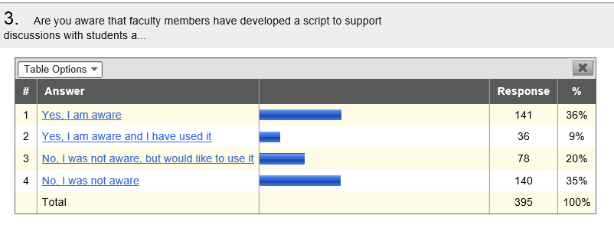
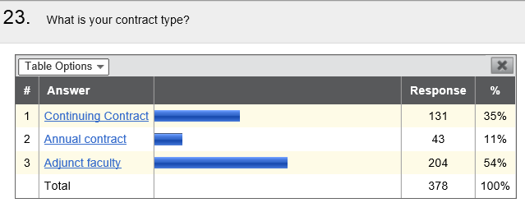
Faculty Responses….Fall 2014 (N=403)

Slide 55
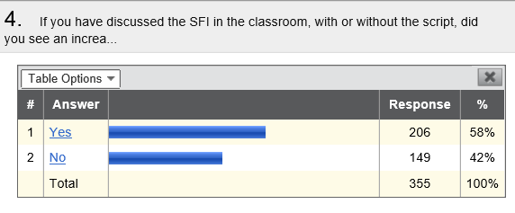


Slide 56



Slide 57



Slide 58


Slide 59
Faculty Comments - 2014
I changed examples in class to provide a semester long single example that I build on every week, so by the end of the semester, the students can see how the topics build on each other. This also gives them a bigger example to use to model their final project on. This was a request made in the "free form comments" how to improve the class.
I have disliked this since it was started. The old pen and paper evals had 100% completion because they were administered in the class and students had to do them and they gave really thoughtful feedback. Today - students do NOT do these surveys - they get so many emails and surveys from VC that they just become background noise and are meaningless. As a result, no matter how many times I say in class "please fill out the survey", they do not and I lose out on valuable feedback. Because I know the response rate is so low, I do not bother to check the results, because they have no meaning for me.

Slide 60
Added Changes to Instruction….
More in-class activities. 2. More focused lessons (not trying to go over everything in the book) 3. More group /pair activities.
I have increased the number of tests that I give, so each test can cover a smaller amount of material. I now require students to submit a class contract at the beginning of the class that outlines my expectations from them, and tells them what they should expect from me. I got tired of seeing students complain that they did not know what to expect when it was all laid out in the syllabus, which they clearly did not read. I have been teaching online for more than a decade (not all at Valencia). My experience has shown that the negative comments students provide in the SFI almost always relate to the fact that they chose not to read the syllabus, or the posted class announcements, or the online discussions.
I have been more careful to measure the pace to the students per semester and their own abilities rather than sticking to a strict curriculum. I have also made content changes to keep current within the industry after getting approval from my program chair.
I have added a Warm-up to my lessons as suggested by some of my students. I have added many challenging problems to address the need of the more advanced students. I am in the process of refining my lessons thanks to the comments made by the students. I have included power points to make the lessons a bit more interesting and decreasing the use of dry makers which tends to dry out too quickly.

Slide 61
Student Course Evaluations: Research, Models and Trends (Gravestock and Gregor-Greenleaf, 2008.)

Slide 62
Reviewing the Literature
Gravestock, P. & Gregor-Greenleaf, E. (2008). Student Course Evaluations: Research, Models and Trends. Toronto: Higher Education Quality Council of Ontario.
Dating back to the 1970s
Research published in the last 20 years
Also a survey of publicly available information about course evaluation policies and practices

Slide 63


Student Assessment of Instruction… means…
“Student evaluations,” “course evaluations,” “student ratings of instruction,” and “student evaluations of teaching (SETs).” Each of these phrases has slightly different connotations, depending on whether they emphasize students, courses, ratings, or evaluation.
Wright (2008) has suggested that the most appropriate term for end-of-course summative evaluations used primarily for personnel decisions (and not for teaching development) is “student ratings of instruction” because this most accurately reflects how the instrument is used.

Slide 64
Students as Evaluators – Are they accurate?
Agreement regarding the competency of students as evaluators can be traced back to the literature from the 1970s (Goldschmid, 1978).
Several studies demonstrate that students are reliable and effective at evaluating teaching behaviours (for example, presentation, clarity, organization and active learning techniques), the amount they have learned, the ease or difficulty of their learning experience in the course, the workload in the course and the validity and value of the assessment used in the course (Nasser & Fresko, 2002; Theall & Franklin, 2001; Ory & Ryan, 2001, Wachtel, 1998; Wagenaar, 1995).
Scriven (1995) has argued that students are “in a unique position to rate their own increased knowledge and comprehension as well as changed motivation toward the subject taught. As students, they are also in a good position to judge such matters as whether tests covered all the material of the course” (p. 2). P. 27

Slide 65
Q: Which Topics Are More
Difficult for Them to Assess?
Many studies agree that other elements commonly found on evaluations are more difficult for students to assess. These include the level, amount and accuracy of course content and an instructor’s knowledge of, or competency in, his or her discipline (Coren, 2001; Theall & Franklin, 2001; Green, Calderon & Reider, 1998; Cashin, 1998; Ali & Sell, 1998; d’Appolonia & Abrami, 1997; Calderon et al., 1996).
Such factors cannot be accurately assessed by students due to their limited experience and knowledge of a particular discipline. Ory and Ryan (2001) state that “the one instructional dimension we do not believe students, especially undergraduates, should be asked to evaluate is course content” (p. 38).

Slide 66
Myths Dispelled
Timing of evaluations: In general, the timing of evaluations has demonstrated no significant impact on evaluation ratings (Wachtel, 1998). There is some evidence to show that when evaluations are completed during final exams, results are lower (Ory, 2001); therefore, most scholars recommend that evaluations be administered before final exams and the submission of final grades (d’Apollonia & Abrami, 1997).
Workload/course difficulty: Although many faculty believe that harder courses or higher workload results in lower evaluations, this has not been supported by the research which has produced inconsistent results (Marsh, 1987). “Easy” courses are not guaranteed higher evaluations. Additionally, some studies have shown that difficult courses and/or those with a higher workload receive more positive evaluations (Cashin, 1988).

Slide 67
“If I have high expectations for my students I will get lower ratings” (myth)
Abrami (2001) and others have refuted this claim, arguing that the impact is not substantial. Abrami argues that neither lenient nor harsh grading practices impact course ratings in any statistically meaningful way.
Similarly, Marsh (1987) and Marsh and Roche (1997) have argued that while grade expectations may reveal a level of bias, the impact on ratings is weak and relatively unsubstantial. … Marsh and Roche (2000) found that higher evaluations were given to those courses and instructors with higher workloads.
Heckert et al. (2006) review some of the studies on the grades-evaluation relationship, noting the conflicting opinions in the literature. Their particular study tested the grading leniency hypothesis in a study of 463 students by examining the impact of two variables: class difficulty and student effort.
Heckert and colleagues found that higher evaluations were given to courses in which the difficulty level met students’ expectations. In addition, evaluations were also positive when students indicated they had expended more effort than anticipated. Overall, this study concluded that more demanding instructors received higher evaluations and therefore refuted the grading leniency hypothesis and the notion that faculty could “buy” better evaluations with higher grades.
“… higher evaluations were given to courses in which the difficulty level met students’ expectations. …”
“In addition, evaluations were also positive when students indicated they had expended more effort than anticipated…”

Slide 68
The Challenge: Integration
Since the widespread use of evaluation began, researchers have argued that course evaluation data can effectively be used for the purpose of improving teaching and thereby student learning (Goldschmid, 1978).
However, Marsh (2007) and Goldschmid (1978) have found that course evaluation data alone rarely bring about changes to teaching behaviours since many faculty are not trained in data analysis and are therefore less likely to have the necessary skills to interpret their ratings. What training is needed?
Moreover, many faculty are not given the opportunity (voluntary or mandatory) to discuss their results with departmental chairs or deans and only some take advantage of the services and resources offered by campus teaching and learning support offices. Do you get this opportunity?
As a result, the majority of faculty simply conduct a cursory review of the collected data and rarely attempt to make specific changes based on student feedback. (p. 16) What do you do?

Slide 69

Towards a more valid instrument…
Ory (2001) and Theall and Franklin (2001) note that, for evaluations to be valid measures of teaching effectiveness, the questions on the evaluation instrument must reflect both 1) the ways in which the evaluations are used for formative or summative evaluation of teaching and 2) the current pedagogical and instructional goals of the institution.

Slide 70
Another Student Perspective
What would you tell a friend? “I would tell them that it helps you the most, your learning environment and how you are being taught is important, it helps to inform/encourage the professors to give you the best experience possible.. it's all for you.”

Slide 71

Looking for patterns across classes and across disciplines….
(Campus Presidents’ Dashboard Image)

Slide 72
Questions for Reflection with Your Own Report of Results
(Helpful in Conversations with Deans…)
How can the student feedback translate into teaching strategies or some sort of action?
Have you been using a midterm evaluation to gather and respond to student ideas earlier in the term?
What is being done in your discipline’s Program Learning Outcomes Assessment Plan to strengthen the student experience (or specific to an item on their report)?
How can we improve the response rate in our division? What approaches are you using?

Slide 73
Suggest other resources
www.valenciacollege.edu/via
SF tab = faculty resources
LOA tab = their program LOA plans

Slide 74

Valencia Website www.valenciacollege.edu/via

Slide 75


Slide 76
Key Points:
Reflection Feedback Loop
Gather Info
Reflect
Act
Discuss
Read
Communicate
Strengthen Teaching
& Learning Using Multiple Sources
Consider Midterm Evaluations
Build on the SFI Process with Reports
Make a Plan

Slide 77
Next Steps -
Making a Plan….
Goal One
Start
Strategy
Goal Two
Start
Goal Three
Start
Source
Strategy
Source
Strategy
Source

Slide 78
Thank you….
Questions?

