Slide 1
NSE Assessment Overview: Your Role in Outcomes-Based Assessment
What Will We Learn About Our Students?
Notes:
Welcome. Facilitator introduction (Learning Assessment, Assistant Director Nichole Jackson).
This session is intended to move us all forward in knowing more about the assessment of student learning,
so with that in mind we should begin with students (6 in the videos made from recent assessment interviews).

Slide 2
Goals
Explain the purpose of NSE assessment activities
Familiarize faculty with their role in NSE assessment
Notes:
Purpose: The NSE faculty and the Assistant Vice President of Teaching and Learning invite the Assistant Director of Learning Assessment to give an overview of the goals and expectations of assessment to new NSE faculty. This high-level overview with hands on experience and models from other areas of the College prepares faculty to participate in assessment work and support data collection procedures that involve learning artifacts from their students.
This segment of the faculty development course is supported by the Director of the New Student Experience and the Office of Institutional Assessment. The participants will offer feedback through a survey upon completion of the course that includes this segment.

Slide 3
We will be able to…
Explain the purpose of NSE assessment activities
Classify the types of assessments that are embedded in the NSE Course
Familiarize faculty with their role in NSE assessment
Identify the skills needed to support assessment of student learning
Notes:
There are concrete outcomes that should result from this one-hour session.
Upon completion, you should feel confident with both of these.
If you still have questions or are unsure how to meet the outcomes, contact the lead NSE faculty member on your campus or Nichole Jackson, Assistant Director, Learning Assessment njackson18@valenciacollege.edu.

Slide 4
The QEP Assessment Plan includes
direct measures—student learning evidence and artifacts
Primarily supported by NSE faculty, NSO staff, and collegewide staff offering the learning activities
indirect measures—student, faculty, and staff perspectives
Primarily supported by Valencia Institutional Assessment Office administering the surveys
institutional measures—student success, program, persistence, and progression data
Primarily supported by Valencia Institutional Research Office storing and programming data
Notes:
Direct measures that are assignments drawn from SLS1122 includes the Academic Assignment for My Education Plan and the Final Story Planning Document and Project.
The Academic Assignment for My Education Plan, the Final Story Planning Document, and the Final Story project should be collected digitally through Blackboard as some of your students may be included in a stratified sample and their work will be needed as a student learning artifact.
All of the student submissions of the Academic Assignment for My Education Plan, the Final Story Planning Document, and the Final Story project should be graded in Blackboard so that their scores are included in the rubric report for your entire class.
All rubrics from all sections of SLS1122 are downloaded and included in the totals for measuring student competency with General Education Outcomes.
The CoCurricular direct measures are also drawn from students in SLS1122.
Student reflection papers should be submitted digitally (it is up to the discretion of the faculty member to ask students for the handouts and we do not use them even if they are part of the digital upload).
The new reflection paper rubric for the GoBes should also be used to record all students’ learning in Blackboard.
Indirect measures from students that you will be asked to support include the Student Feedback on Instruction (SFI) administered to all students in all classes at the college each term by email link to Course Eval.
You should know when the SFI survey opens and closes and strongly encourage your students to complete the survey. The SLS1122 version has many extra questions to support program level assessment, especially measures that can be compared to collegewide and nationwide Community College Survey of Student Engagement (CCSSE) results.
You will also be asked to encourage your students to take the GoBe survey, just when a new GoBe is implemented—this fall Strengths and Swipe Left.
It is emailed to all students, but you can also build the link into your Blackboard course and specifically send reminders to students who turn in a reflection on the new GoBe.
In the spring we will follow up on some of the themes in the data from the SFI by holding Student Facilitated Conversations (Focus Groups) with new students on each campus.
You will be asked to encourage students from fall and spring to participate. Some students from those conversations and others we didn’t hear from yet will be asked to participate in video interviews next summer, to gather insights like what you saw at the beginning of this session.
Indirect measures will also include your expertise as faculty.
You will be asked to take an End-of-Term survey in fall and spring, and if we follow up that survey with a focus group to give context to some of the themes you will be invited to participate as well, and we hope you will.
Finally, feedback on any faculty development that you participate in is also included as program level assessment to improve offerings and determine areas where more support is needed.
For assistance with direct measures or understanding how you can support the indirect measures please contact Nichole Jackson, Assistant Director, Learning Assessment njackson18@valenciacollege.edu.

Slide 5
One of Valencia’s Big Ideas The Purpose of Assessment is to Improve Learning
How is Course Level Assessment Different from Program Level Assessment?
Course-Level Assessment
Assess student learning outcomes at the end of the course
Often we assign grades to individual students
Grading typically involves only one faculty member who is teaching the course
Program-Level Assessment
Assess student learning outcomes at the end of the program
Evaluate aggregate student artifacts for purposes of program improvement, gatherings student videos, analyzing exam results, etc.
Evaluation involves faculty teams across the program/ discipline
Notes:
Think about the student first in both types of assessment processes. Consider how the student will receive the information about what they are being asked to do. Be sure you support them submitting items correctly so that the real measures of learning are accurate (ie. Students who only turn in a Final Story Planning Document printed and receive it back from you with comments, do not have that piece of evidence as part of the learning artifact sample—so the evidence of their learning that can be measured may show less mastery of outcomes than you and they know they mastered).

Slide 6
Notes:
“Everything we have to do in SLS are like mini samples of what we will have to do in other classes. In essence, it is a good warm up class to other college classes” (SFI data, Spring 2015).

Slide 7
One of Valencia’s Big Ideas The Purpose of Assessment is to Improve Learning
How is Gen Ed Assessment Different from NSE Program Assessment?
Gen Ed
Assessment
Assess student mastery of 6 learning outcomes and support the AA program
College-wide discussions about teaching and learning
Renewal of curriculum
Faculty development
NSE Programmatic Assessment
Assess student mastery of 6 learning outcomes and 7 program outcomes
College-wide discussions about teaching and learning
Renewal of components
Program improvement processes
Notes:
When thinking about assessment, it is important to remember it is to prove or improve existing practices.
In order for a program to evaluate itself, it is not necessary to single out individuals who receive or provide the services.

Slide 8
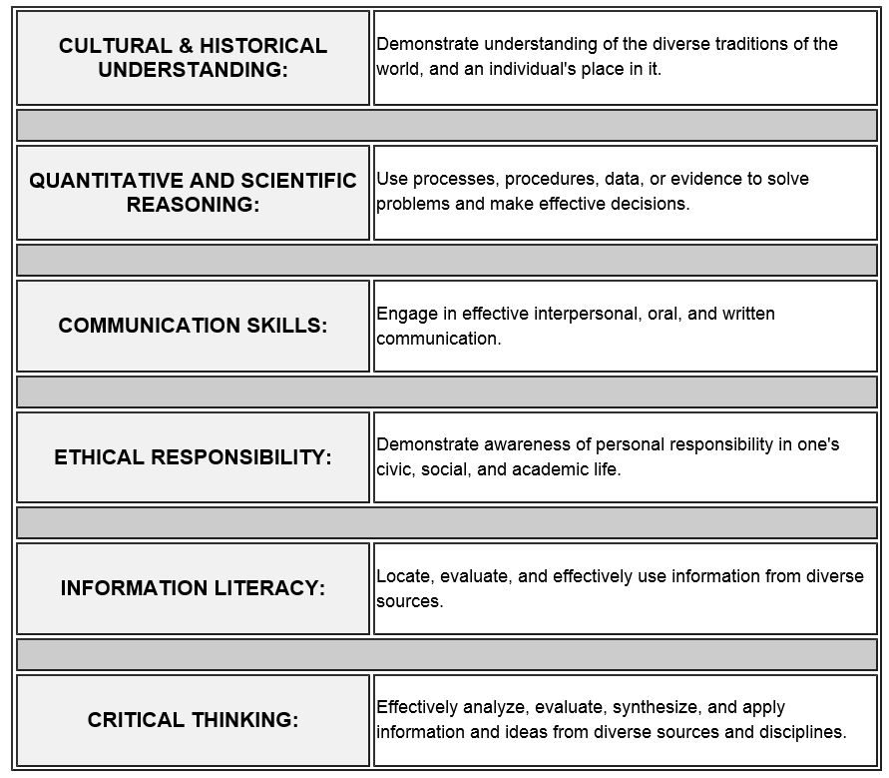
Valencia’s General Education Outcomes
Notes:
SLS1122 is a course that supports the Communication skills outcomes, interpersonal and oral.
All Gen Ed courses support the outcome of Critical Thinking.

Slide 9
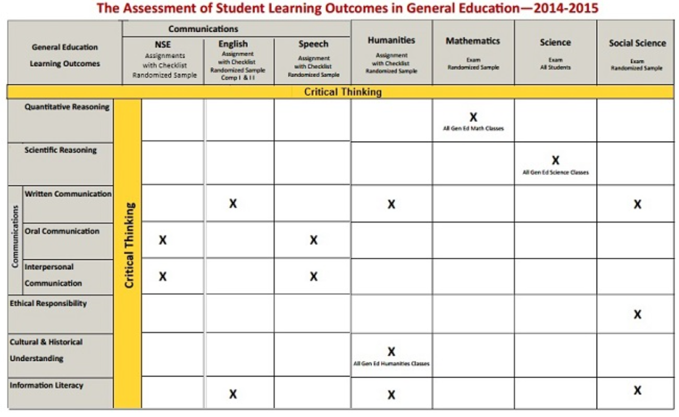
Notes:
On Friday, Oct. 10th, 2014, Valencia College introduced a new visual of the General Education Outcomes Map.
Any division that is documented as supporting an outcome is expected to assess for that outcome so that they have evidence of student learning which guides improvement processes for learning. Since all General Education courses have to assess for Critical Thinking, the learning is shown in the highlighted sections across all disciplines.
The new map shows the New Student Experience assessing for the same two Communication Outcomes as Speech. Since students exercise and improve their skills over time, it is expected that students will be at different levels of mastery when they begin learning the skills and when they later improve them.

Slide 10
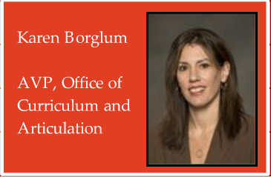
General Education Assessment
Each outcome will be assessed at two touch-points.
Keep in mind as you assess for the outcomes that for many students in the New Student Experience Course, this is the their first touch point.
Notes:
We want students to get to touches at each of the outcomes.
Every student will have critical thinking skills being assessed across the five areas of General Education.
It also means that with the Gordon-Rule and the writing component, students will have 4 different opportunities—
2 in English, 1 in Humanities, 1 in a Social Science where they will be assessed for Gordon-Rule writing and they will be assessed for Information Literacy.
They will have 2 opportunities to be touched by Cultural and Historical Understanding through Humanities,
2 opportunities for exposure to and be assessed for Quantitative Reasoning through Mathematics,
and 2 assessments in qualitative reasoning through the Science courses.
So they will have met all of the General Education Outcomes.
What we’re able to do on Assessment Day is then go through to determine how well our students are doing in all of these General Education Areas, and how we can improve to ensure our students are successful in these areas and how we can demonstrate that they are.

Slide 11
Faculty Role in Assessment
When we engage in assessment activities we can…
more readily notice areas in need of improvement.
commit to emphasizing instruction related to specific outcomes.
play a critical role in helping establish a community of practice.
participate in the continuous cycle of improvement which makes us more aware of the successes and necessary improvements.
Notes:
Assessment work may lead to recognizing areas that need improvement.
Outcomes-Based Assessment requires a commitment to learning goals.
Assessment Cycles become about creating and using the rubrics and assessment tools that anyone in any field can use to assess for mastery of stated outcomes.

Slide 12
Faculty Role in Assessment: A Gen Ed Example (Mathematics)
Students…
enrolled in College Algebra in Spring 2015 completed a multi-part common question embedded in their final exam.
A random sample of 250 students will be selected (stratified by time of day, campus, mode of delivery and FT/PT status of instructor teaching the course).
Artifacts will be collected for these 250 students which will be scored using a set of rubrics.
Notes:
Assessments can be embedded activities that are administered to all, even though an in-depth assessment can only be carried out on a sample.

Slide 13
Faculty Role in Assessment: A Gen Ed Example (Mathematics)
Faculty…
gathered at assessment day in May 2015 and decided to
administer an exit survey when the student leaves the question blank.
compare UCF common questions with the assessment question.
provide more application and word problem resources to faculty (in the existing Blackboard shell dedicated to assessment)
Notes:
It is recommended that faculty take an inventory of their own teaching experiences. Teaching as defined broadly to include any trainings they have ever administered and even recreational activities in which they support the development of others. It is from these experiences as facilitator of learning where they may best see the connection to curriculum. Faculty are encouraged to recognize the observations they make about their learners and the interventions or improvements that follow as what makes them a great teacher.

Slide 14
NSE Student Learning Outcomes Assessment
(NSE course
and co-curricular)
Notes:
SLS 1122, the New Student Experience Course and the New Student Experience Co-Curricular activities combined are intended to lead students to mastery of the stated outcomes, the six Ps.
In addition, there are academic skills within the New Student Experience Course that build student mastery of outcomes beyond those six Ps.

Slide 15
NSE Student Learning Outcomes Assessment
(NSE course
and co-curricular)
NSE
Course
SLO Assessment
(six outcomes - Ps)
Notes:
The NSE Co-Curricular activities were specially designed to support three of the Ps that are most related to skills beyond the cognitive learning in a classroom—Purpose, Personal Connection, and Place.
The NSE Course design resulted in learning opportunities for students that fall within three of the General Education Learning Outcomes—Critical Thinking (assessed for in all General Education courses) and Communication, both oral and interpersonal.

Slide 16
NSE Program Evaluation (QEP)
Implementation + Impact
General Education
NSE Student Learning Outcomes Assessment
(NSE course
and co-curricular)
NSE
Course
SLO Assessment
(six outcomes - Ps)
successfully complete the first 15 college-level credits at Valencia.
complete college-prep classes
and be prepared for college-level work.
develop academic behaviors associated with success in college.
develop an educational plan and course schedule to ensure timely success.
discover a plan for college as part of a purpose in life.
successfully complete a college-credit bearing course designed to facilitate a comprehensive introduction to Valencia and the skills associated with success in college.
engage Valencia as a place for learning and community.
Critical Thinking
Oral Communication
Interpersonal Communication
Notes:
Starting in the Fall of 2015, the NSE Course will be part of the General Education curriculum as a required course for all seeking their AA degree at Valencia. Other divisions of the college that support General Education also assess for the learning outcomes designated on this tiny map that you get to read later in the workshop.
The whole NSE Program Evaluation includes assessing for the six Ps (through the course and the co-curricular) as well as assessing for the three General Education Outcomes (through the course).
In addition, there are seven student outcomes that should result from the complete New Student Experience.

Slide 17
Your role is important…
Illustration activity
Notes:
Use what you know now about the NSE assessments that are embedded in the NSE Course to draw a simple illustration of the types of assessments.
AT THIS POINT IN THE SESSION YOU SHOULD BE ABLE TO—
Classify the types of assessments that are embedded in the NSE Course

Slide 18
Faculty Role in Assessment
The Valencia community will begin to understand what the students are experiencing and learning as a result of a program.
Faculty, staff, and administrators will be able to have conversations about best practices in implementation.
The evaluation activities will support continuous improvement of the experience for both faculty and students.
Notes:
We hope that all part-time and full-time faculty teaching the NSE Course across the college will find meaningful ways to stay involved with the assessment activities and informed about the full evaluation of the NSE.

Slide 19
Faculty Role in Assessment: An AA Pre-Major Program (Dance)
Students…
seeking an AA Pre-Major in Dance Performance dance choreography for an audience.
The performance is filmed and reconstructionists/guest artists/choreographers assess the performers from the video using a rubric.
Notes:
Authentic assessments place students in as close to real-world experiences as possible, and allow reviewers to rate them as the exhibit their skills. Authentic assessments can be better supported by industry experts and professionals in the field, and when they are included in the assessment process they are better informed to promote programs and advise programs as they improve.

Slide 20
Faculty Role in Assessment: An AA Pre-Major Program (Dance)
Faculty…
gathered at assessment day in May 2015 and decided to
continue using the Dance Performance Instrument.
compare rehearsal tapes to final filmed production as an additional evaluation of the formative learning.
state that no curricular changes are required at this time
the 2011-12 final report led to an additional class in the program curriculum
The 2012-13 results led to changes to sequence of courses offered in the program.
Notes:
It is recommended that faculty seek out Gen Ed disciplines and Programs that are of interest to them—what they earned their Bachelor’s Degree or Master’s Degree in. Faculty are encouraged to find ways to understand the measures and actions through the lens of their specialty.

Slide 21
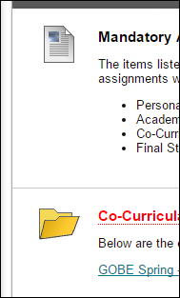
Faculty Role in Assessment: Student Scores
Mandatory assignments in the course are submitted to BlackBoard
Notes:
Faculty need to use Blackboard for submissions.

Slide 22
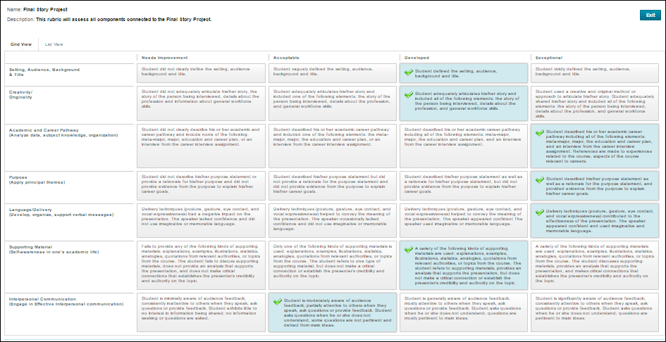
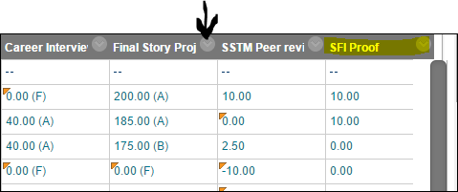
Faculty Role in Assessment: Student Scores
Mandatory assignments in the course are graded in BlackBoard using rubrics
Notes:
Faculty need to use Blackboard for grading.

Slide 23
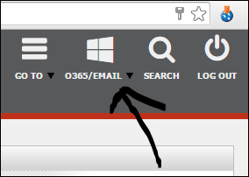
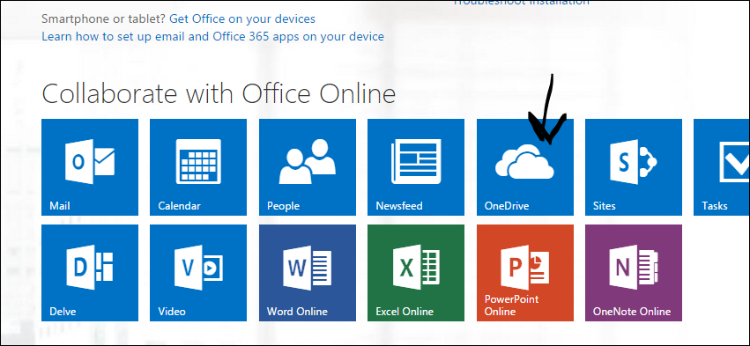
Faculty Role in Assessment: Student Learning Artifacts
Sample student learning artifacts are submitted to OneDrive
Notes:
Faculty whose students are in the sample will learn to use OneDrive.

Slide 24
Faculty Role in Assessment: Student Learning Artifacts
Videos of Final Story Projects are submitted to YouTube
Notes:
Faculty whose students are in the sample will learn to access video services and upload to YouTube.

Slide 25
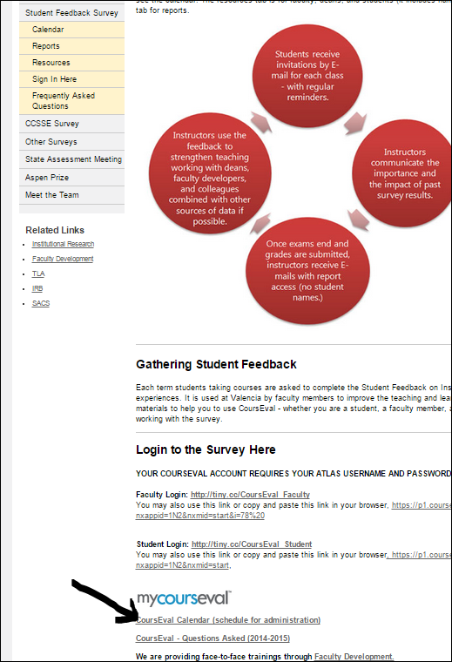
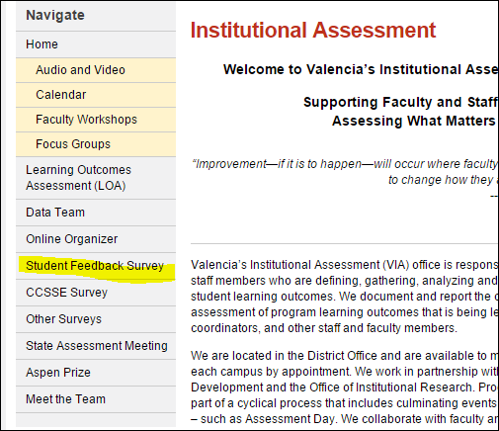
Faculty Role in Assessment: Student Feedback on Instruction
www.valenciacollege.edu/VIA
Notes:
Faculty need to know how to make use of student feedback from their students.

Slide 26
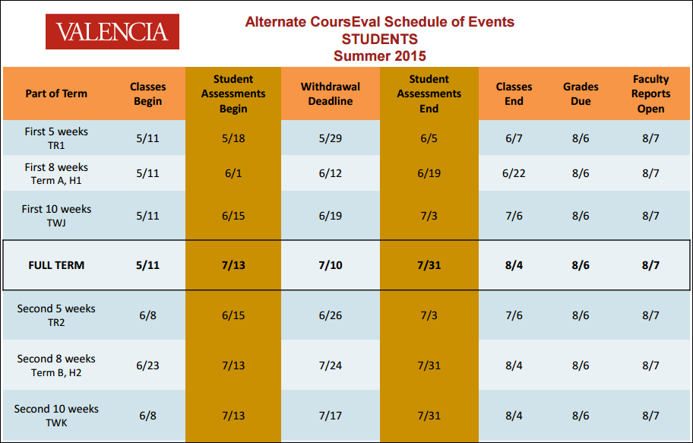
Faculty Role in Assessment: Student Feedback on Instruction
Notes:
Faculty need to encourage participation in the Student Feedback on Instruction survey.

Slide 27
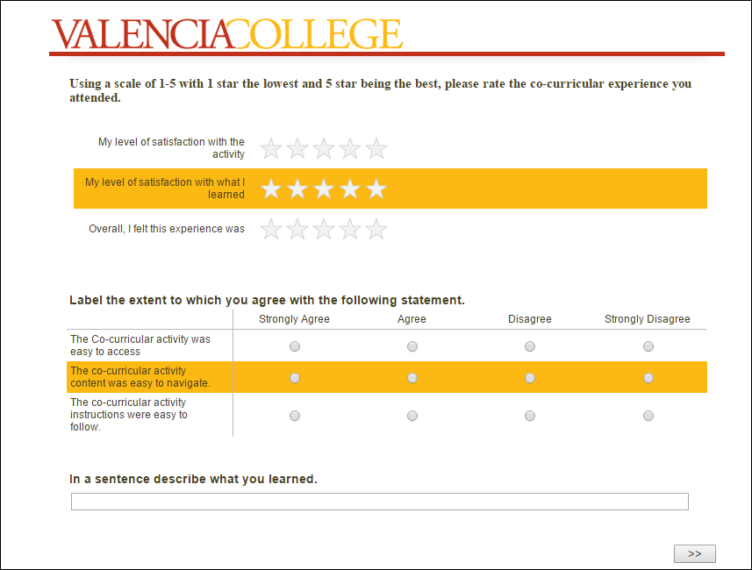
Faculty Role in Assessment: Student Feedback
Notes:
Faculty can identify students who need to take the GoBe survey.

Slide 28
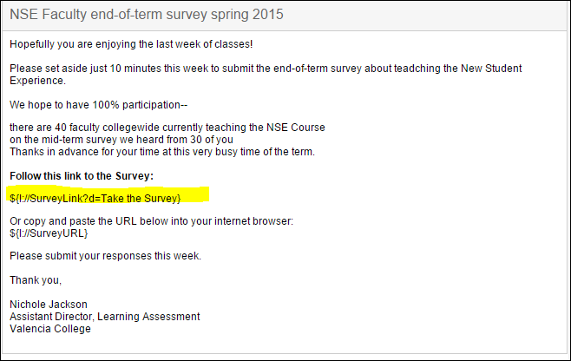
Faculty Role in Assessment: Faculty Feedback
Notes:
Faculty should make their expertise and experience drive the improvements by taking the survey.

Slide 29
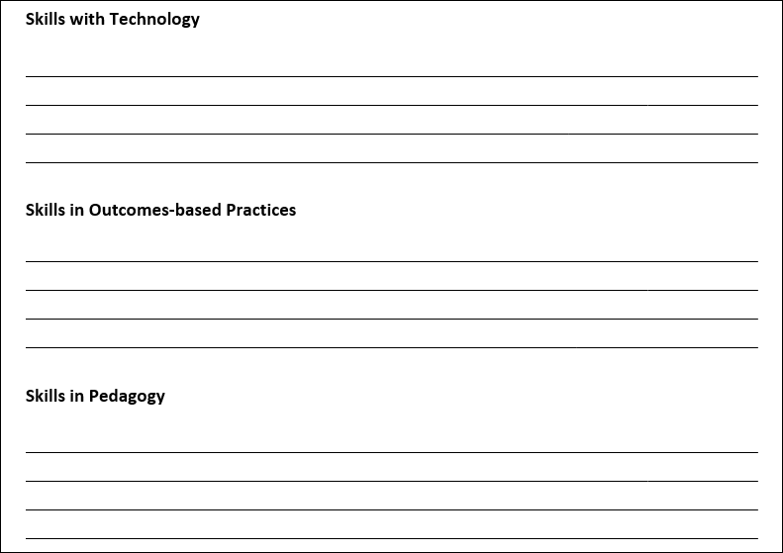
Your role is important…
Inventory activity
Notes:
Use what you know now about the NSE assessments that to create an inventory of the skills you have and that you need to develop to participate fully in outcomes-based practice.
AT THIS POINT IN THE SESSION YOU SHOULD BE ABLE TO—
Identify the skills needed to support assessment of student learning

Slide 30
What’s next…
Learning Outcomes-Based Assessment Opportunities (2015-16): Faculty Development Course
intended for Program Assessment
Using Rubrics to Create Dialogue LOBP 3334
10/22/15 on West Campus 5:30pm-8:30pm (CRN 3308, 3PD)
2/26/16 on Osceola Campus 9:00am-12:00pm (CRN 3309, 3PD)
4/7/16 on East Campus 1:00pm-4:00pm (CRN 3310, 3PD)
Notes:
Bring a team, and work of developing a rubric (or use an already developed rubric to learn about the process).
Facilitated by Nichole Jackson.

Slide 31
What’s next…
Learning Outcomes-Based Assessment Opportunities (2015-16): Faculty Development Courses
intended for Gen Ed Assessment
Thinking Things Through LOBP 3230
9/28/15 on West Campus 3:00pm-5:00pm (CRN 2614, 10PD)
& 11/9/15
9/29/15 on Osceola Campus 3:00pm-5:00pm (CRN 3286, 10PD)
& 11/10/15
Critical Thinking: Intellectual Standards LOBP 3231
4/7/16 on West Campus 2:00pm-4:00pm (CRN 2961, 2PD)
4/8/16 on Osceola Campus 2:00pm-4:00pm (CRN 2950, 2PD)
Notes:
Upcoming faculty development offerings supported by Valencia Institutional Assessment Office. If a team is interested in attending together, some of the material can be tailored to the specific needs of the NSE Course.
Facilitated by Michelle Lima and Shawn Pollgreen

Slide 32
Questions about your role…
Notes:
If you are reviewing this later and have questions related to learning assessment,
please feel free to call or email Nichole Jackson, Assistant Director, Learning Assessment 407-582-3829
njackson18@valenciacollege.edu

