Slide 1
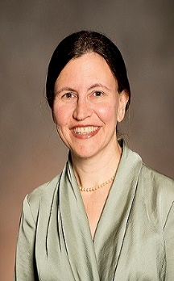
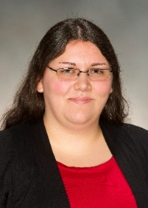
Reporting Tools in CoursEval: Making the Most of Your Student Feedback on Instruction (SFI) Results
Valencia Institutional Assessment (VIA) office
Laura Blasi, Ph.D., Director, Institutional Assessment and
Tana Damian, Program Support Specialist
April 2016

Slide 2
Terms to Know
Outcomes
You should be able to:
Run a detailed report of your results
Explore students’ written comments
Know where to ask for help and find resources to support your use
Student Feedback on Instruction (SFI) – questions & process
CoursEval – online program/the tool

Slide 3
SFI – history and changes
The faculty subcommittee made a few changes to the questions in Spring 2015 after surveying faculty and students in Fall 2014.
Complete list of questions available online: www.valenciacollege.edu/via -> Student Feedback tab.
Fall 2015 – SFI Overview in Spanish
Notes:
Faculty developed - moved from paper to online – changes piloted and implemented

Slide 4
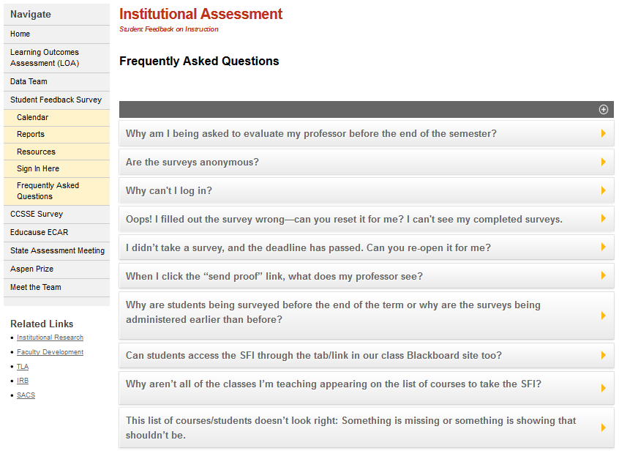
Website www.valenciacollege.edu/via

Slide 5
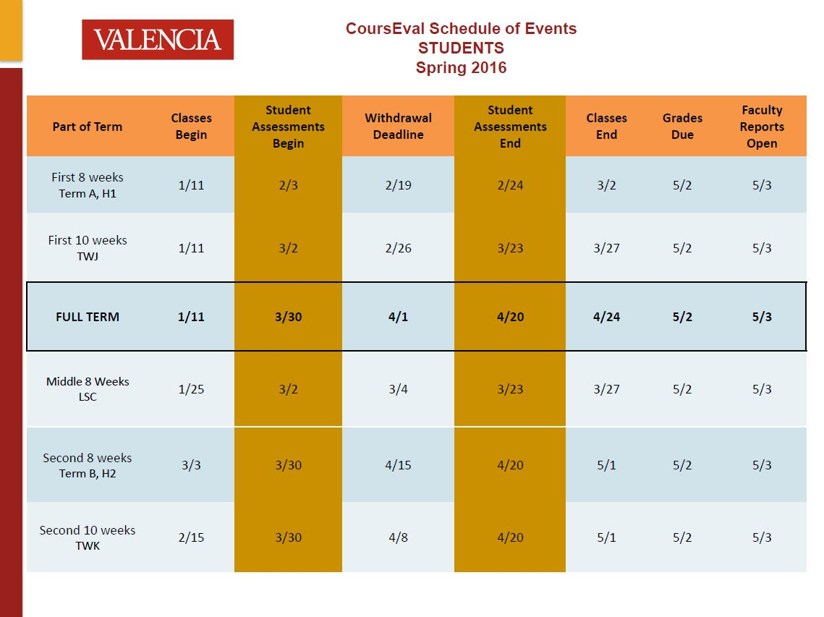
Notes:
Summer 2016, Fall 2016, Spring 2017, and Summer 2017 are currently available

Slide 6
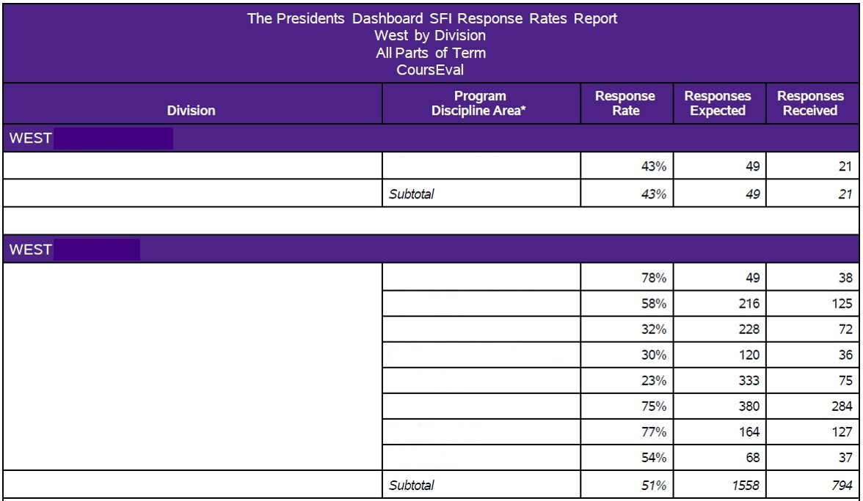
Presidents Dashboard Report
Notes:
Available on valenciacollege.edu/via – Student Feedback Survey - Reports

Slide 7
Best practices and tips for the effective use of the SFI reporting tools
First three:
Find a focus as you interpret results over time
Use multiple data sources - midterm survey
Create a plan for reading and using your results
Notes:
1. Focus – one item/question. 2. Qualtrics, in-class survey, etc. 3. TLA tenure review, end of year meetings with Dean

Slide 8
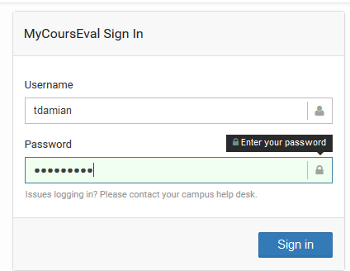
SFI Login
http://tiny.cc/CoursEval_Faculty
(https://p1.courseval.net/etw/ets/et.asp?nxappid=1N2&nxmid=start)
Use your Valencia (Atlas) Credentials

Slide 9
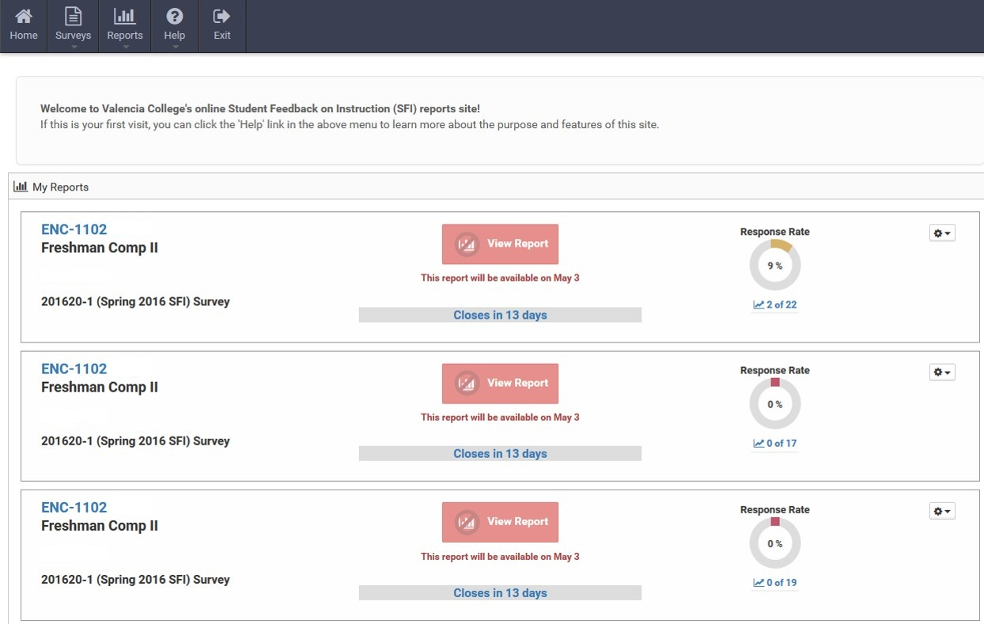
Faculty View

Slide 10
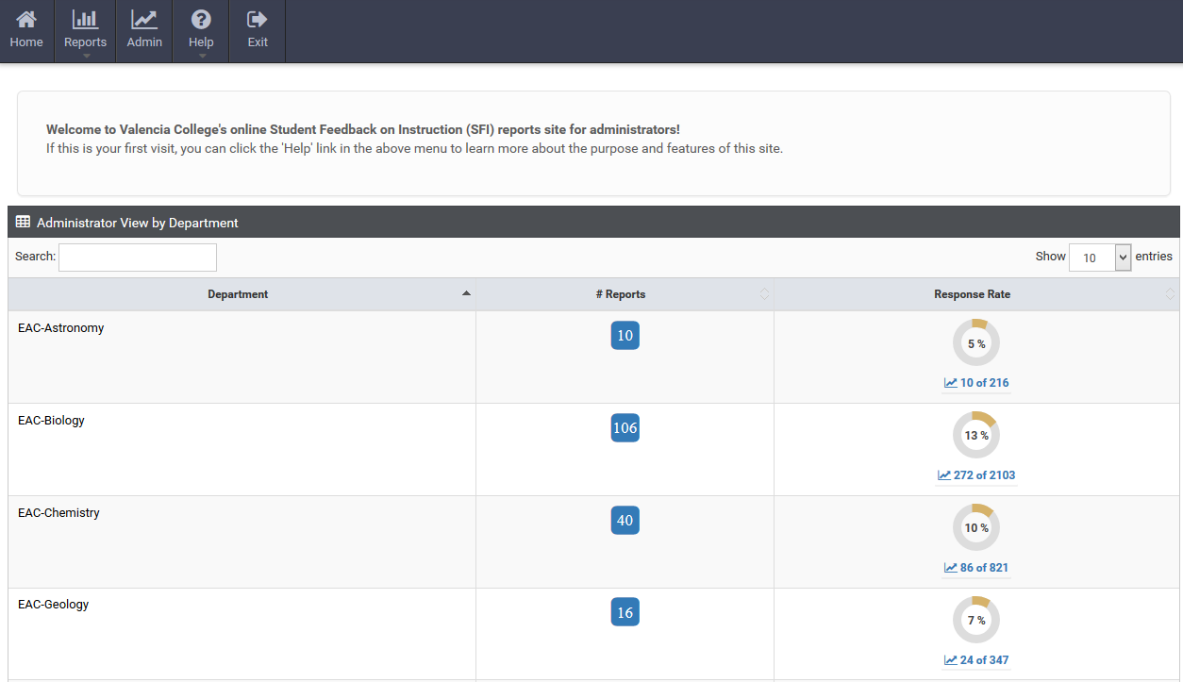
Dean View

Slide 11
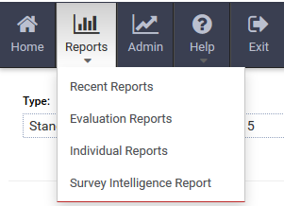
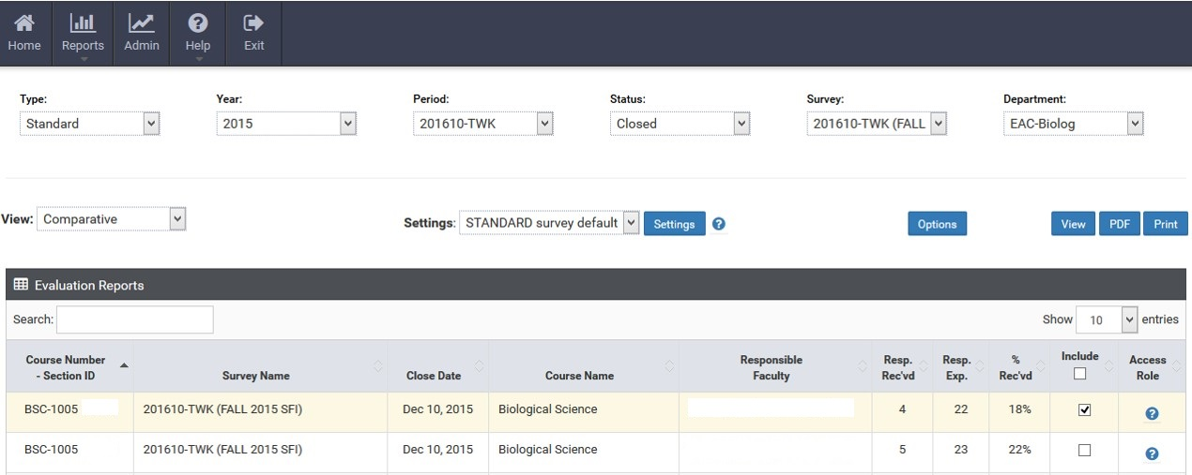
Best Practice Tip #4
Watch out for filters when running reports
Notes:
View: ‘Comparative’ or ‘Individual (Faculty)’. Setting to ‘Individual (Faculty)’ will change ‘Survey’ filter to ‘Faculty Assessed or Responsible’

Slide 12
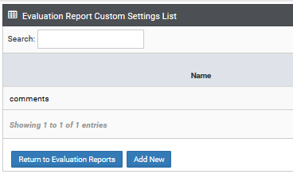
Best Practice Tip #5
Check out Options to customize reports
Save and reuse your report layout by adding a new Custom Setting.
Notes:
Standard survey default options cannot be changed. If you do not save selected options in a new custom setting, they will be lost – the system defaults to Standard settings.

Slide 13
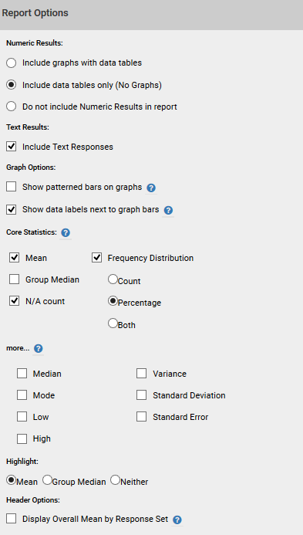
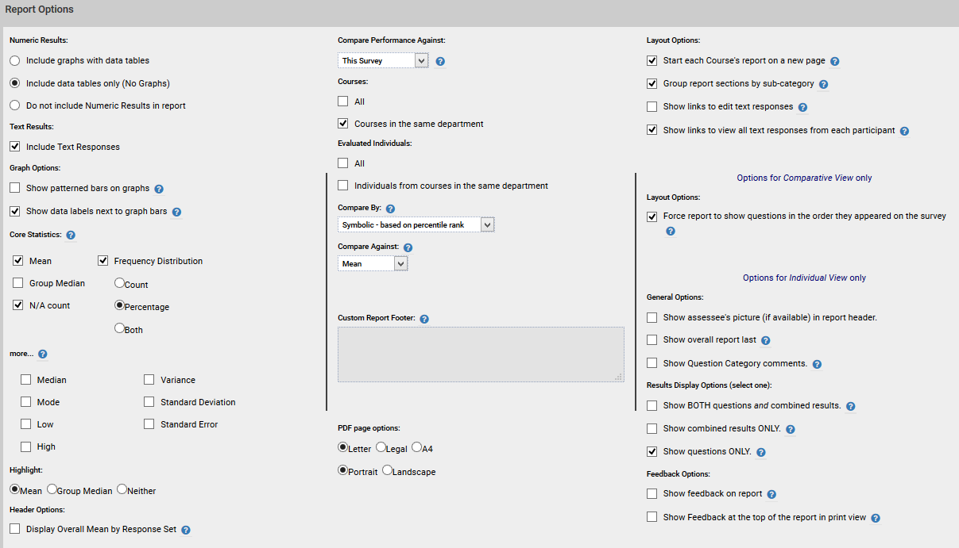
Options I

Slide 14
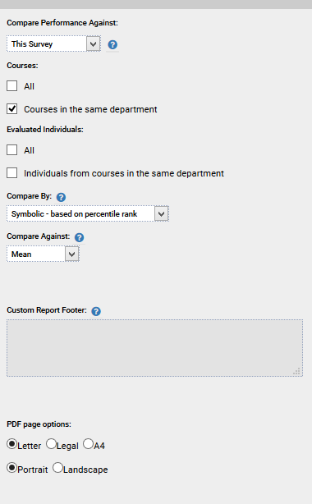
Options II

Slide 15
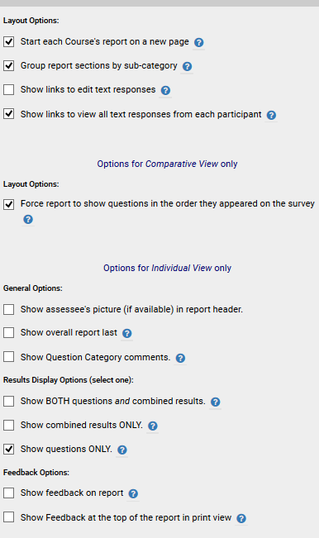
Options III
Notes:
Feedback is not enabled on our surveys.

Slide 16
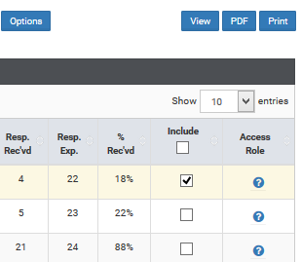
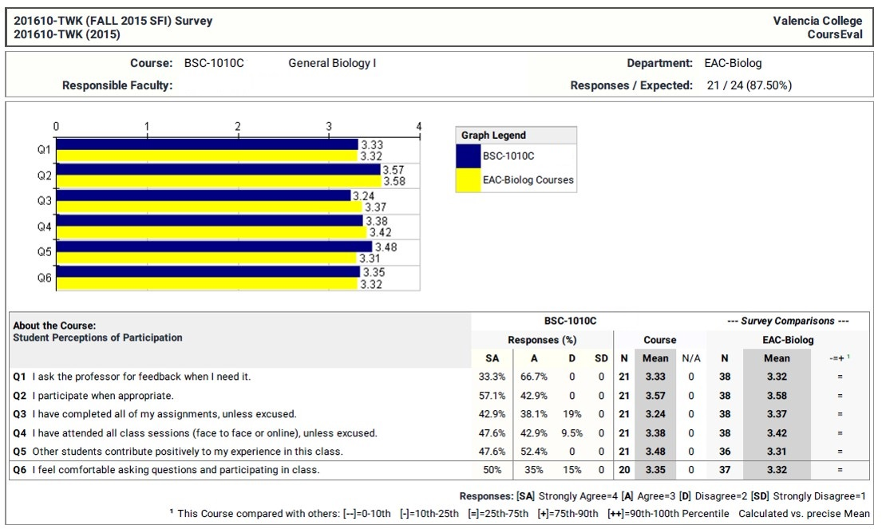
Reading your Report

Slide 17
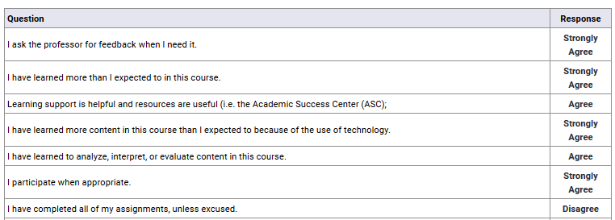
Make the most of written comments

Slide 18
Individual Report Option
Another way to view survey reports
Filters are slightly different
Cannot select multiple reports at once
Notes:
Splits the report by Overall Course Questions and People-based (faculty specific) questions.

Slide 19
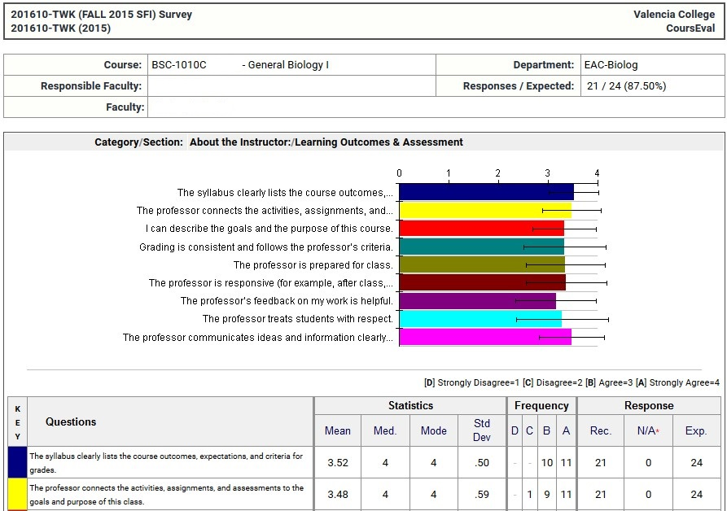

Slide 20
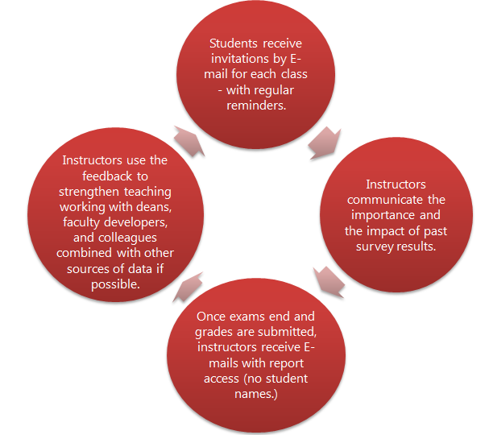
SFI Questions
www.valenciacollege.edu/via Student Feedback tab
Reply to CoursEval messages
Email: participate@valenciacollege.edu
Notes:
Note cycle can be shared with students

Slide 21
Outcomes
You should be able to:
Run a detailed report of your results
Explore students’ written comments
Ask for help and find resources to support your use

Slide 22
5 best practices and tips for the effective use of the SFI reporting tools
Find a focus as you interpret results over time
Use multiple data sources (midterm survey?)
Create a plan for reading and using your results
4. Remember to check your filters when running reports
5. Use Options to customize reports

Slide 23
Students Learn
…to have standards
…to self-assess and reflect
…to collaborate with faculty
…that they are having an impact
“As I teach future teachers, they learn about the need to give feedback as a student so they see how important it is to give and receive feedback as a teacher.”
- Lauri Lott, Teacher Education Program
“After my first semester, I understood how the SFI actually helped students. Seeing how those results could change how we did assignments and how we taught certain things was really helpful.”
- Jenny Lee, New Student Experience

Slide 24
20/20 Session Feedback
We’d love your feedback about this session!
Please access our survey using the info below or email us for a link.
http://tiny.cc/SFI_2020

