Slide 1
State Assessment Meeting 2013
Psychology’s General Education
Outcome: Improving Through
Assessment

Slide 2
Identifying the Gen Ed Learning Outcome (GELO)
Historically:
Attain a global social and multicultural perspective (2005)
Assigned to Social Science Gen Ed courses:
Demonstrate tolerance for a wide range of global, social and cultural points of view (2007)

Slide 3
A Measurable Outcome
Describe wide range of global, social and cultural points of view and apply various perspectives to analyze human behavior (2008)
Apply the scientific method to analyze human behavior from multiple perspectives and cultural viewpoints

Slide 4
Learning Outcome Report, Fall,2008
Psychology:
Introduction to Psychology – 312 students
Students earned an average grade of 2.89 (85.9% earned a C or better) on a 5 point scaled Assessment on the Assessment of the learning outcome of “describe a wide range of global, social and cultural points of view and apply various perspectives to analyze human behavior.”

Slide 6
But What does it Mean?

Slide 7
Closing the Loop – actionable data!
Align Assessment with the Learning Outcome
Identify strengths/weakness
Come up with a plan of action
Assess the effectiveness of the actions taken

Slide 8
Align Assessment with the Learning Outcome
From
20 m/c questions assessing course concepts
To
20 scenario based m/c questions applying knowledge of perspectives and analyzing behavior

Slide 9
DRAFT
PSY2012 Learning Outcomes
Fall 2007
Learning Outcomes: Students will:
1. apply the principles of the scientific method to the evaluation of research in the psychological sciences and to material presented in the media about the behavioral sciences. (Q1-4)
2. analyze human behavior in various contexts using the neuroscience, evolution, behavioral genetics, psychodynamic, behavioral, cognitive and socio-cultural perspectives (Q5-8)
3. evaluate human behavior using the various subfields of psychology including neuroscience, sensation, perception, states of consciousness, learning, memory, thinking and intelligence, motivation, personality, psychological disorders (Q9-17)
4. demonstrate a tolerance for a wide range of global, social and cultural points of view. (Q18-20)

Slide 10
Identify strengths/weakness
From external blame:
“Students can’t read”
“Advisors let students think psychology is easy”
“Students aren’t engaged or accountable”

Slide 11
Come up with a plan of action
To what action can we take?
Adopt a textbook with accessible reading level
Recommend sample syllabi available prior to registration
Incorporate activities to engage students in learning process with accountable deadlines

Slide 12
Assess Effectiveness of Actions taken
Compare year to year GELO (Gen Ed Learning Outcome) assessment data
Compare year to year exam scores
Compare year to year success rates
Examine relationships between newly added activities and exam scores

Slide 13
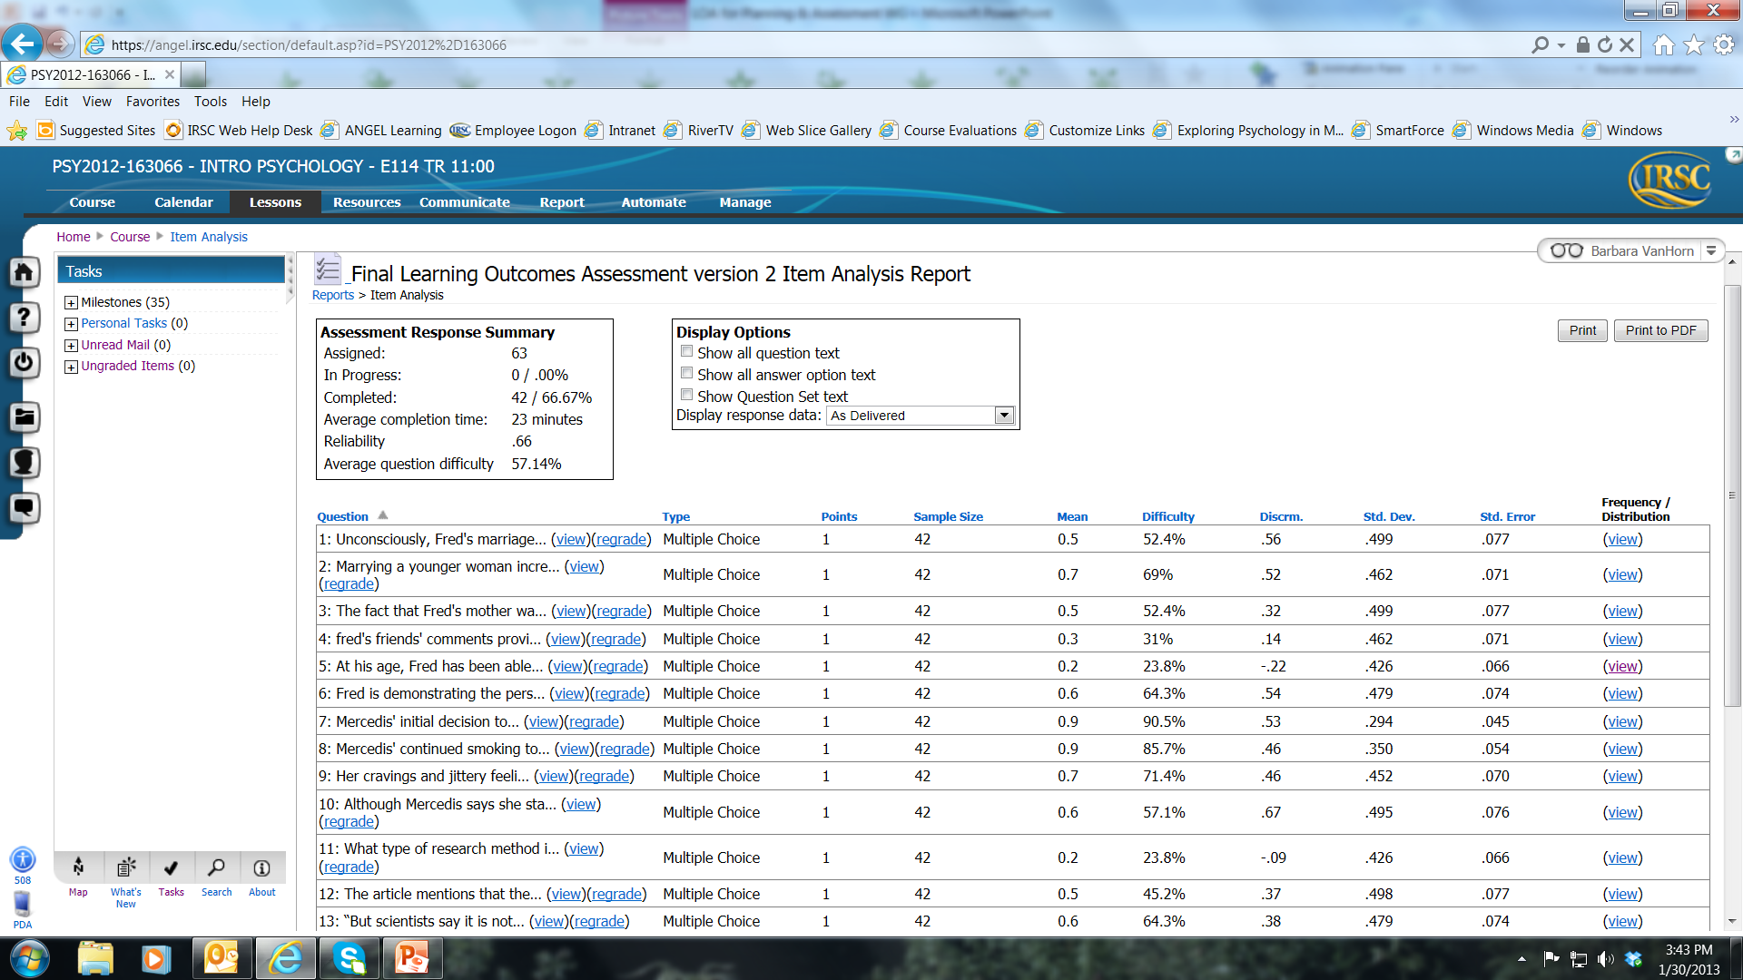
Gen Ed Learning Outcomes 2011

Slide 14
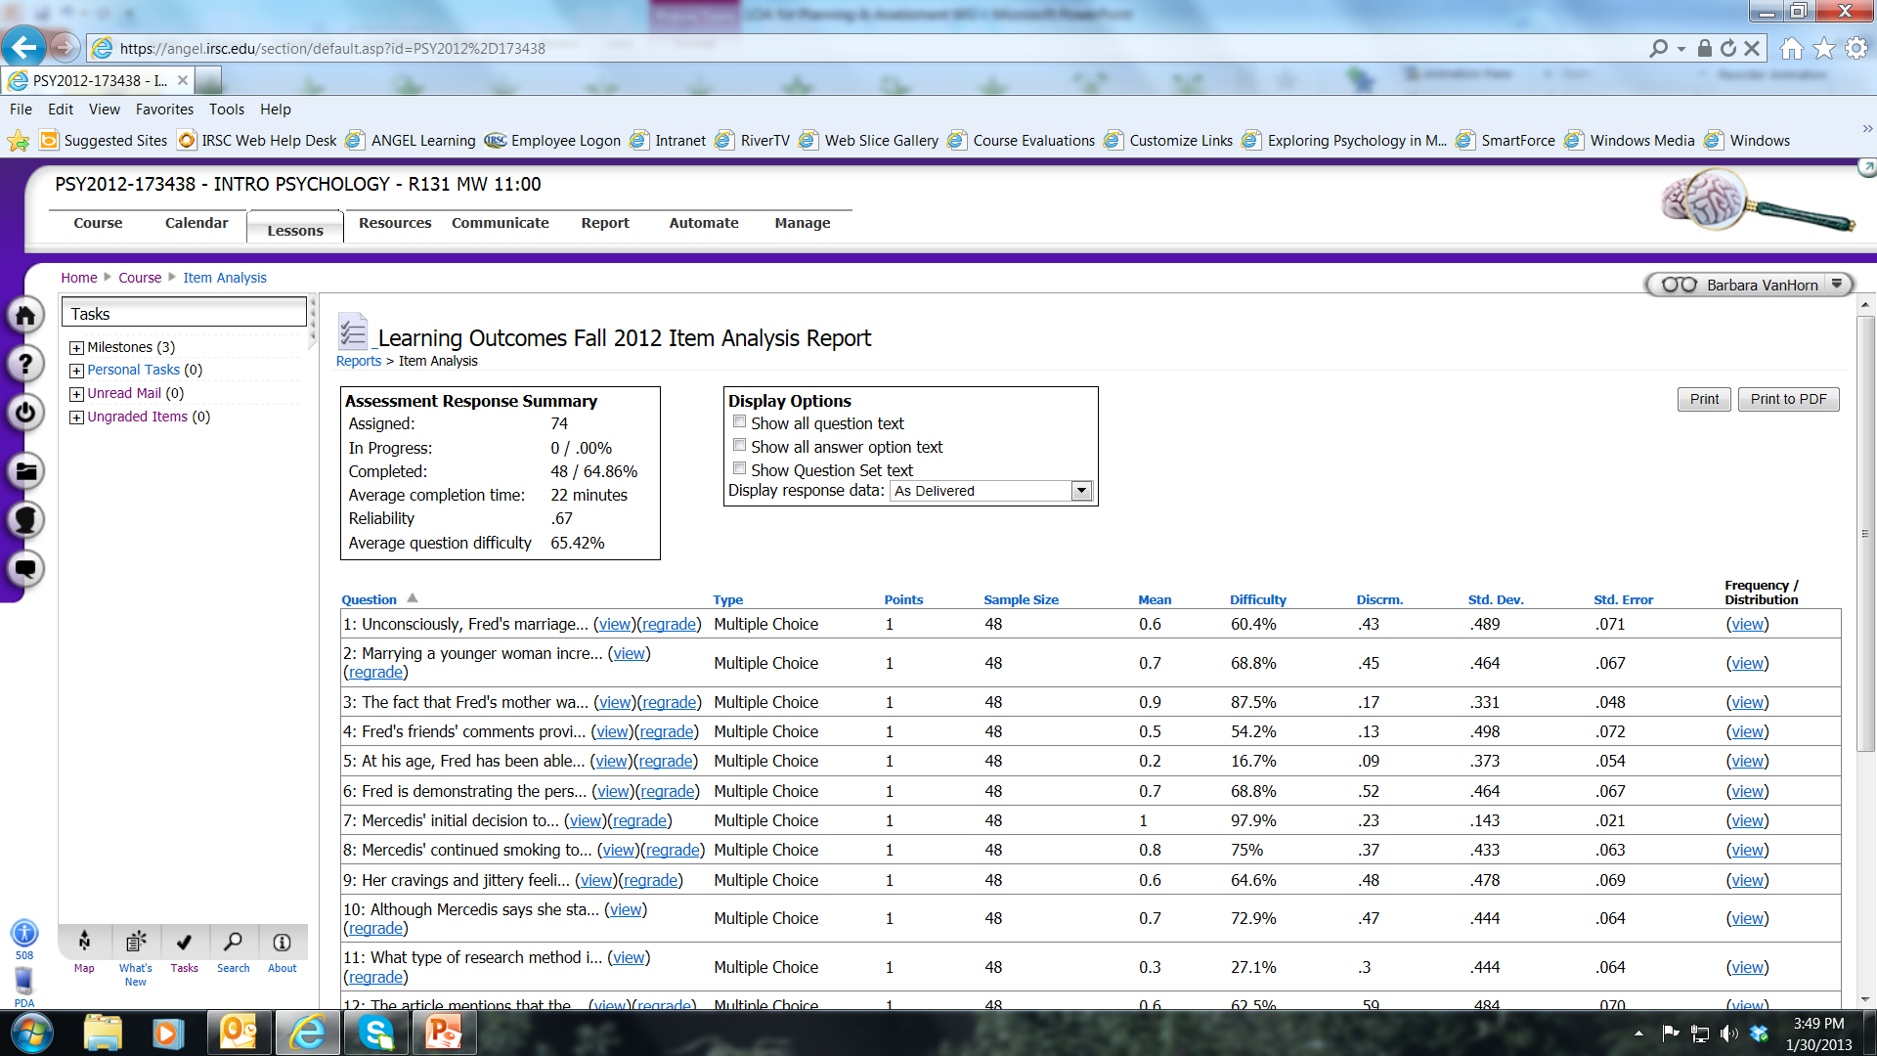

Slide 15
2011 to 2012 Exam scores
Dr. Russell’s PSY2012 exam scores year/year
Year N Mean S.D.
285 305.58 (76.3%) 49.05
2012 308 306.07 (76.5%) 46.49

Slide 16
Compare Year to Year Success Rate
2011 Overall Success Rate: 175/258 = 68%
2012 Overall Success Rate: 179/243 = 70%
2011 Face to Face Success Rate : 132/173 = 76%
2012 Face to Face Success Rate 116/157 = 74%
2011 Internet Success Rate: 43/85 = 51%
2012 Internet Success Rate: 54/86 = 63%

Slide 17
Examine Relationships
Correlations between all 4 exam scores and
Interactive quizzing r = .34
Mastery quizzing r = .57
Students who engaged in activities were more likely to earn higher exam grades

Slide 18
Possible hypotheses to explain the data:
One semester’s data may be insufficient to identify real change
Adopting a more accessible text doesn’t matter if students don’t read (future action: make greater effort to link class material to the textbook).
There is a learning curve for faculty adopting new materials and strategies (future action: continue to work at linking online materials to classroom activities and assessment)
Students must access and engage in activities in order to see an effect on learning (future action: work to remove barriers to early student access; reinforce student access efforts and contact students who are not using materials to increase access).

Slide 19
The cycle continues:
Review of spring data shows continued improvement in internet courses
Providing provisional access codes improved student performance on activities, but not overall grades
Faculty have voluntarily decided to use common exams, across instructors and formats during, Fall, 2013 term
We’re still seeking answers….. And strategies for improvement!

