Slide 1

Student Engagement through Self-Assessment: Research-based Strategies – A Panel Discussion
*The Life Map Tool for Students
*Carnegie’s Statway™ Pathway &
*Action Research: Collaborative Writing
June 2013
Laura Blasi, Director, Institutional Assessment
Donna Colwell, Professor, English
Kathleen Marquis, Academic Advisor
Russell Takashima, Dean, Mathematics

Slide 2
Summary
For over thirty years research has shown that student involvement in assessment can be used to increase their engagement in learning and can be an important part of learning outcomes assessment. Related research studies include terms such as “self-efficacy,” “mastery learning,” and “productive persistence” and it has be shown that instructors also benefit from these student activities. Reviewing the research, the panelists will discuss the impact of their student self-assessment techniques and the related the implications for their own teaching practice.

Slide 3
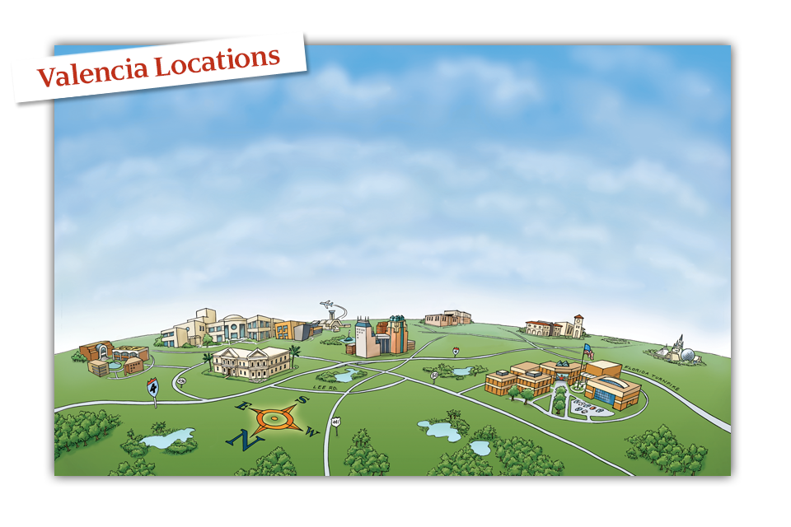
Valencia College now has three regional campuses, three area campuses, and two academic and administrative centers.
Criminal Justice Institute
East Campus
Osceola Campus
Lake Nona
Winter Park Campus
West Campus

Slide 4
What We Will Do [Laura]
Our Introductions (the panelists….)
Your Introductions
Questions for our Practice from Research Literature
The Projects
Panel Discussion with Questions
Group Discussion – What We Can Do
Next Steps and Questions

Slide 5
Outcomes
At the end of the session you will be able to:
    Articulate a reason for developing student self-assessment skills;
    Discuss several of the approaches and outcomes evident from the work of the panelists;
    Provide one example of a strategy for doing this connected to your of discipline / interest (student affairs…);
    Identify next steps or possible ways to use the strategies to advance discussions of teaching and learning upon return.

Slide 6
Quick Introductions
Please mention your college, your location (state), your role, and your name…and are you encouraging your students to self-assess?
(In 30 seconds…)
  Speed of a comet →

Slide 7
Already Part of Your Culture?
Student success courses
    Inventories
    Texts (“On Course” by Skip Downing)
Work with tutors
How do we take it beyond?
First steps – Hidden opportunities with rubrics…
Before we learn about the projects a brief glimpse into the research literature.

Slide 8
Student Involvement in Assessment
Student Self-Assessment
Students can experience success in a meaningful way through assessment
Moving from novice to expert, experts have a better understanding of their own processes for learning and performing
“Self Efficacy” is key – strengthened when students set learning goals and self evaluate.
Important Skills: Self Regulation….
Learning Goal – not Performance Goals
Not easy to structure, set up expectations, communicate, guide, and give actionable feedback…

Slide 9
How do your students experience academic success?
It’s tempting to conceive of the …challenge [of low performing students] as an issue of self-concept; that is, as a personal/emotional concern. If we can raise these students’ self-concept, they will become capable learners.
Instead: Achievement → Confidence
Success through Credible Assessment
A small success can spark confidence, which, in turn, encourages more effort… (Stiggins and Chappuis, 2005).

Slide 10
How do we help our students to develop metacognitive / heuristic skills?
Heuristic….
…of or relating to exploratory problem-solving techniques that utilize self-educating techniques (as the evaluation of feedback) to improve performance…
Research shows that it is not simply general abilities, such as memory or intelligence, nor the use of general strategies that differentiate experts from novices.
Instead, experts have acquired extensive knowledge that affects what they notice and how they organize, represent, and interpret information in their environment. This, in turn, affects their abilities to remember, reason, and solve problems. (p. 31)
How People Learn: Brain, Mind, Experience, and School: Expanded Edition. (2000). Washington, DC: The National Academies Press.

Slide 11
When do you see students motivated to achieve?
(…self-initiated, task-oriented behavior)
As students develop learning goals and employ self-evaluation skills, task orientation rises and ego orientation becomes lower (Schunk, 1996, et al.).
Students less often compare their progress against their peers, while more often comparing their present performance against past performance.
Self-regulation has proved to be influenced by perceptions of self-efficacy, or “personal beliefs about one’s capabilities to learn or perform skills at designated levels” (Bandura, 1986, et al.).

Slide 12
What happens when you imagine your students developing learning goals?
Consider two types of achievement goal orientation:
performance goals in which ability is displayed through task performance, in competition with others, a “relative ability” goal, drawing from an inborn “entity theory” of ability; and
learning goals in which ability is viewed as a repertoire of skills, an active stance towards opportunities for mastery, drawing from an “incremental theory” of ability development.
(Nelson-LeGall & Resnick, 1998, pp. 43-44; see also Schunk, 1996)

Slide 13
How can this apply to your practice?
Consider Consequences,
Careful Construction is Needed
Research / Models from the Field
Scholarship of Teaching and Learning (SoTL)
Action Research….
…“asking students to periodically assess their capabilities on a task they have repeatedly failed to master might lower, rather than raise, self efficacy and motivation, because after many negative attempts students might conclude they are incapable of learning” (Schunk, 1996, p. 378).

Slide 14
Additional Terms
Key to Our Conversation….
Academic Agency
Cooperative-Collaborative Learning
Productive Persistence (Yeager, 2011)
Beliefs about intelligence (Dweck, 2006)

Slide 15
Themes to Notice…
Research-based work
Change in behaviors and attitudes
Transfer of skills across disciplines
    Students
    Faculty
Caring about who they become afterwards
Improving practice over time

Slide 16
Donna Colwell, English
Improving Students’ Writing through Collaboration
Action Research Question: Would creating a collaborative learning project for a portfolio essay in Developmental Writing II effectively demonstrate the multistep writing process in order to improve students’ writing?
Student Learning Outcomes:
Students will
demonstrate the multistep writing process (plan, revise, edit).
create a collaborative and cohesive classification essay.
self-assess their work.

Slide 17
Donna Colwell, English
Improving Students’ Writing through Collaboration
Overview of the action research project:
Treatment included
  pre and post surveys, guided lectures and practices, modeling techniques, collaborative activities, online discussions, reflective surveys, and aligned assessment strategies.
Formative Assessments
Pre-Survey
Roundtable
Quiz
Outline Peer Review
CAT: muddiest point
Draft Peer Review
Post-Survey
Reflection surveys
Summative Assessments
Essay 1
Revised outline
Blackboard discussions
Essay 2

Slide 18
Donna Colwell, English
Improving Students’ Writing through Collaboration
Research Theories
Collaboration
Susan Ledlow’s “Cooperative-Collaborative Learning in Higher Education”
Four principles for effective collaboration:
  Positive Interdependence
  Individual Accountability
  Equal Participation
  Simultaneous Interaction
Academic Agency
Emily Lardner, Washington Center for Improving Undergraduate Education
Instead of asking, "What will students learn?” as educators we must shift to asking, “What will students do to learn?” as a way to build academic agency.

Slide 19
Donna Colwell, English
Improving Students’ Writing through Collaboration
Significant Results
45% more students passed the essay after the collaborative treatment.
83% of students surveyed attributed their improvement to collaboration.
Essay 1: 30% scored a C or better Essay 2: 75% earned a C or better.

Slide 20
How Did Students React to the Collaborative Treatment? | Strongly Agree | Agree | Disagree | Strongly Disagree
I am confident in my ability to prewrite my essay. PRE-SURVEY POST-SURVEY | 0% 39% | 41% 56% | 55% 5% | 4% 0%
I am confident in my ability to revise/edit my essay. PRE-SURVEY POST-SURVEY | 0% 33% | 22% 61% | 67% 6% | 11% 0%
I think that working in teams throughout essay would/did help me revise my paper. PRE-SURVEY POST-SURVEY | 8% 33% | 33% 50% | 37% 17% | 22% 0%

Slide 21
Donna Colwell, English
Improving Students’ Writing through Collaboration
How did the collaborative writing experience change the way you write?
Student responses:
That you must prewrite, draft, edit, and revise.
Now I analyze everything before I turn it in.
By staying in a formal voice instead of informal.
My teammate showed me that I have to take my time writing and how to edit my essays better.
How to go about editing my essays.
I took some techniques my partner uses while working on my essay, which made it easier.
My teammate helped me understand what the reader was looking for.
I am able to look for more mistakes in my writing and my partner’s.

Slide 22
Panel Questions….
Why focus on student self-assessment?
Greatest challenge specific to students? Overall?
Most important finding?
Student feedback – their responses?
Why are these skills important related to your discipline?
Example of impact on your practice?
Helped by any support outside of your course?
Advice – actual activities, strategies?

Slide 23
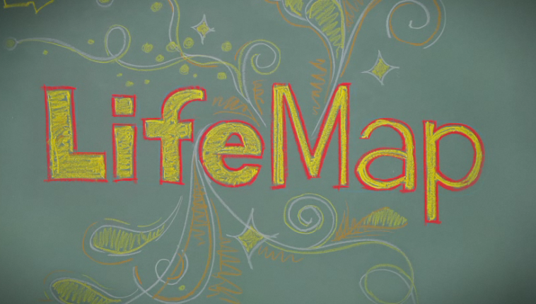
Kathleen Marquis, Academic Advisor
[overview]
[what it is and what we/ they do]
Notes:
I am a former Student Success Associate Professor and current Academic Advisor working closely with New Student Orientation and the RoadMap to Success Scholarship program. I will be discussing student self-assessment as it pertains to LifeMap. LifeMap is a term we use a lot of Valencia to describe a process of setting goals for life, career, and education. Goals act as a foundation for planning and provide direction. We encourage students to seek guidance from friends, family, faculty, and staff. We also provide LifeMap tools via their atlas accounts in order for self-driven research and development of individual goals.

Slide 24
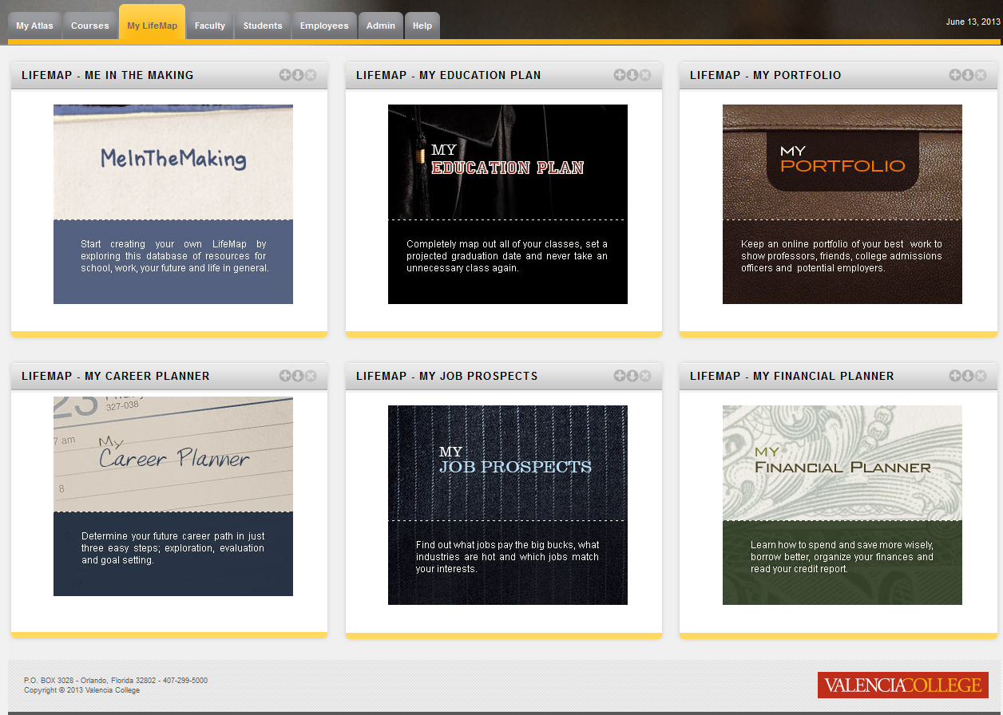
Notes:
LifeMap tools include “Me In the Making”, “My Education Plan”, “My Portfolio”, “My Career Planner”, “My Job Prospects”, and “My Financial Planner”. “Me In The Making” provides students with some examples of other student paths and how they navigated their goals; “My Education Plan” assists students in developing a plan to include all major specific requirements; “My Career Planner” offers personality assessments and strength finder tools to assist the student in determining a career goal. Each tool provides a unique approach to encourage student goals.

Slide 25

Notes:
LifeMap also speaks of courses designed for success, including specifically “SLS 1122: Student Success”. Students enrolled in the Student Success course are eligible to participate in the RoadMap to Success Scholarship program. The RoadMap program places emphasis on LifeMap and the utilization of LifeMap tools. The program also requires a set of developmental advising sessions. Students participating in the program will meet with an advisor throughout the term to review their plans and to receive feedback on their goals.

Slide 26
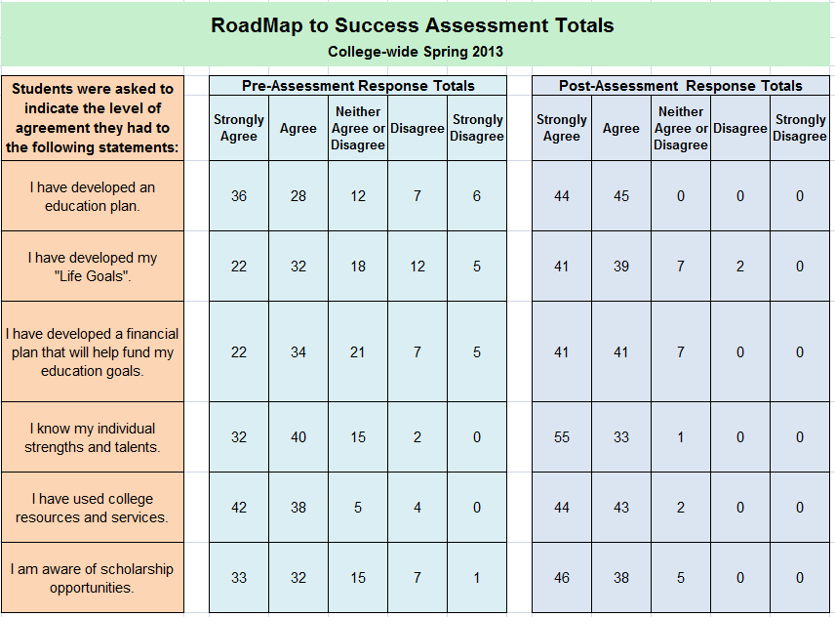
Notes:
In order to determine learning outcomes, the RoadMap to Success scholarship program participants are asked to self-assess their progress. The self-assessment is done through a survey instrument provided to the student both at the beginning and end of the program. Illustrated in the diagram are college-wide results of the pre and post assessments. Not all students participating in the program complete the scholarship requirements. These results are based off of program completers. The results show an increase in agreement with all statements. After using LifeMap tools and discussing their progress with an advisor throughout the RoadMap program, the students are reporting a stronger sense of their goals and a plan to achieve them.

Slide 27
Russell Takashima, Dean, Mathematics
Carnegie Statway™
A one year pathway that culminates in student completion of college-level statistics.
Curricula includes an intensive student engagement component within the classroom environment focused on increasing student motivation and tenacity.
The project includes hidden “starting strong” strategies to encourage “productive persistence”.

Slide 28
Productive Persistence
An evidenced-based package of practical student activities and faculty actions integrated throughout the instructional system to increase student motivation, tenacity and skills for success.
“Starting strong” is presented as a set of eight activities, grounded in on-going research helping instructors better understand and develop strategies for strengthening student skills related to self-assessment.

Slide 29
Roberta Carew, Mathematics
Project Name: Growth Mindset Intervention
Co-development
  Researcher + Practitioner
  Adapted to developmental math
  student constructs
  Article + letter to future student
Piloting
  Double-blind randomized trial
  Summer school Algebra 1 course
  Larger-scale trial:
  Santa Monica Community College

Slide 30
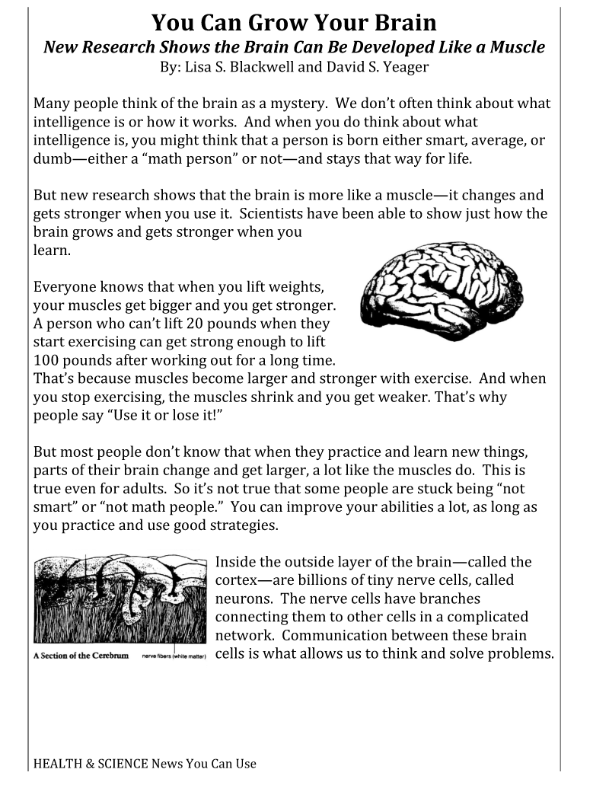
“Most people don’t know that when they practice and learn new things, parts of their brain change and get larger, a lot like the muscles do. This is true even for adults. So it’s not true that some people are stuck being “not smart” or “not math people.” You can improve your abilities a lot, as long as you practice and use good strategies.”

Slide 31
Course Dropout
Students Who Withdrew From Math
51% decrease
~40 minutes
$0
In collaboration with:
Greg Walton,
Dave Paunesku,
Carol Dweck,
Carissa Romero,
Roberta Carew,
& www.perts.net
N = 288, Z = 2.87, p = .004
Notes:
Basic Arithmetic, Pre-Algebra, Elementary Algebra, Intermediate Algebra, Plane Geometry

Slide 32
  Student Feedback:
  “As soon as I leave class, I go to the lab. When I leave the lab I go home and do more work. Even in the car, I am studying. Just doing work, doing work, doing work. All day long I am studying … and that was helping me fail my tests.
  After I read that article it clicked for me. I changed my study habits. Instead of just doing work throughout all my other activities, I started studying for shorter periods of time. And actually studying, not just working the same problems over again. I tried that for the test and I did so much better!”
  “I feel very confident … because i dedicate my time to learn the concepts thoroughly. I feel that if one person put in the work to really understand the concepts they can pass. I was never a "math person" but coming into [this course] has completely made a 360 degree turn [sic] about how i feel about math. It is great!”

Slide 33
Fostering Change
Beyond the Course Level
Incentives (faculty development?)
Models (department discussions?)
Build into Processes (program assessment?)
Discussion of What Works with Colleagues

Slide 34
Outcomes & Conversation
At the end of the session you will be able to:
    Articulate a reason for developing student self-assessment skills;
    Discuss several of the approaches and outcomes evident from the work of the panelists;
    Provide one example of a strategy for doing this connected to your of discipline / interest (student affairs…);
    Identify next steps or possible ways to use the strategies to advance discussions of teaching and learning upon return.

Slide 35
References
(when not included alongside the quotes in the slides…)
Bandura, A. (1986). Social foundations of thought and action. Englewood Cliffs, NJ: Prentice-Hall, Inc.
Nelson-Le Gall, S. & Resnick, L. (1998). Help seeking, achievement motivation, and the social practice of intelligence in school. In S. A. Karabenick (Ed.), Strategic help seeking (pp. 39-60). Mahwah, NJ: Erlbaum.
Schunk, D. H. (1996). Goal and self-evaluative influences during children’s cognitive skill learning. American Educational Research Journal, 33 (2), 359-382.
Stiggins, R., & Chappuis, J. (2005). Using student-involved classroom assessment to close achievement gaps. Theory Into Practice, 44(1), 1-18.

