Slide 1


How Business Intelligence Transformed the Culture at SPC
June 2013
State Assessment Meeting

Slide 2
Dan Gardner
Director of Institutional Research
Jesse Coraggio
Associate VP, Institutional Effectiveness, Research, and Grants
Institutional Research and Effectiveness
St. Petersburg College
P.O. Box 13489,
St. Petersburg, FL 33733
(727) 712-5237
FAX (727) 341-5411
Presenters

Slide 3
SPC - established in 1927
9 Campuses in Pinellas County
First FCS college to offer baccalaureate degrees;
1,168 (2012-13)
2012-13 FTE: 21,546
2012-13 Graduates: 6,149
Fall 2012 credit enrollment: 33,232 (unduplicated)
SPC Quick Facts

Slide 4
Using Business Intelligence to Improve Student Success
http://www.spcollege.edu/central/AE/Presentations.htm
Background

Slide 5
This presentation will describe:
Where we were…
Where we are now…
Where we are going…
SPC Pulse BI Demonstration
Today’s Goals

Slide 6

Two-to-three weeks to complete a data request
Discussions became stale
Arguments over the data definitions
New questions once data is received take another two-to-three weeks to get answered
Where we were…

Slide 7
SPC needed:
  timely, relevant, and valid information at the college, campus, and program levels,
  linked across multiple data systems,
  in an easy-to-interpret format to improve student success.
Why was Pulse a priority at SPC?

Slide 8
Step 1: Acknowledge that data in its purest sense is not very useful.
Step 2: Design a tool that defines, aggregates, and organizes the data into useful and relevant information for the stakeholders.
Step 3: Provide end-user training to assist them in correctly interpreting and using information properly.
Step 4: Consistently remind all end-users that data and information can be powerful, but it is only the beginning of the conversation.
Changing the Culture…
Notes:
Talk about Dec 2010 meeting—idea to just turn on the system
Data reports should be the beginning of the conversation about improvement, not the end.
Data reports should be used to support and drive change and improvement at the institution.
Talk about getting stakeholder input
Spring 2011, worked with Provosts and Deans to establish a list of data needs
Dec 2011, Provosts and Deans reports released
Jan 2012, Conversion of BOT Beginning of term “who’s here” presentation to using the BI tool
Talk about training plan and slow roll-out of users
Only through the proper use of this information can SPC gain (and retain) knowledge that can be used to improve institutional outcomes.

Slide 9
Culture of Inquiry
We encourage a data-driven environment that allows for open, honest dialogue about who we are, what we do, and how we continue to improve student success.
Transparency
We embrace openness in communication by providing access to college processes and procedures, expenditures, institutional effectiveness, and student success rates.
http://www.spcollege.edu/mission/
Changing the Culture…

Slide 10

Allows quick access to information required to make decisions.
Provides standardized information with the ability to look at data measures through multiple views.
Enables users to ‘drill-down’ to student-level detail and ‘roll-up’ to program, campus , and college-level perspectives.
Where we are now…

Slide 11
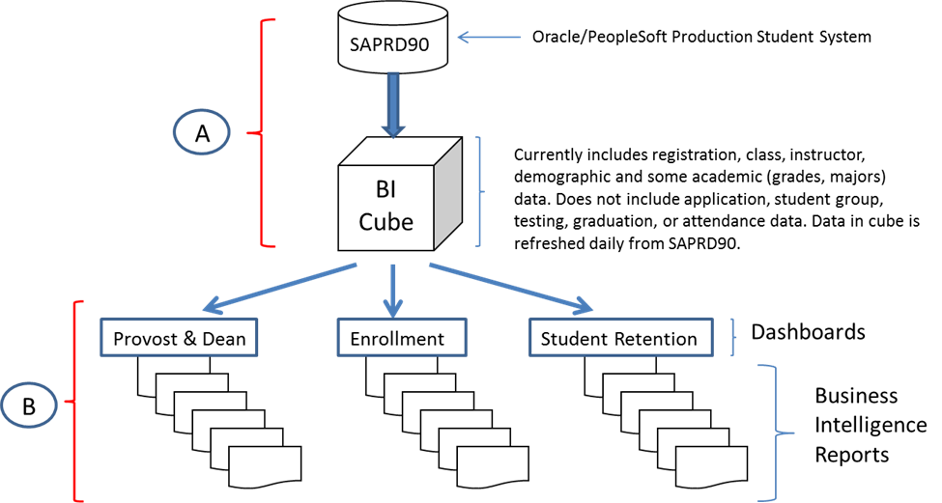
BI Student Cube Structure

Slide 12
Development Areas
Enrollment Data
Campus and Program Success
Budget and Expenditures
Retention
College Experience
Fall 2011
Sprig 2011
Spring 2013
Summer 2013
Spring 2014
Progression of Pulse

Slide 13
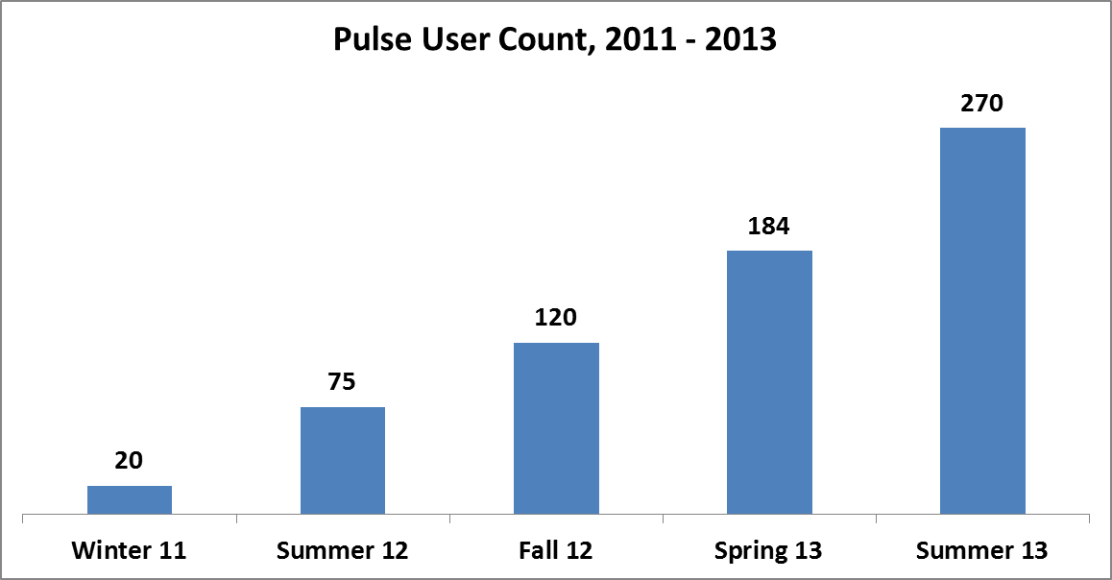
Active users, n = 270+
Type of users: Executive Team, Provosts, Deans, Program Directors, Functional Administrators, Advisors
Users

Slide 14
Level 1
Enrollment and Characteristics
Level 2
Student Success measures
Update
Specialized Strategic solutions
Training

Slide 15
The most important element of the SPC Pulse philosophy has been end-user empowerment.
Teaching them how to fish…

Slide 16
Managing accelerated expectations
Documenting while building
Limited programming resources
Tailoring specialized solutions
Building competence among executive and academic leaders
Ensuring security/privacy
Challenges

Slide 17
A college-wide solution (FERPA)
Validation of cohort tracking (Predictive Analytics)
Detailed Financial Aid information
Human Resources information
Facilities and inventory information
Further developed finance data
Where we want to go…

Slide 18
Questions?

