Slide 1
Mapping
Program Learning Outcomes to Curriculum
Presentation to State Assessment Meeting
June 21, 2013
Andrew Ray
Program Chair – BCT, CSET & DDT

Slide 2

Why does this matter?
Institutional Effectiveness is part of Valencia’s Faculty Compensation Plan
Assessment Plans approved Oct. 2011
Learning artifacts evaluated during Assessment Day May 2012
Assessment methods revised and reevaluated during Assessment Day May 2013

Slide 3
How are your Program Learning Outcomes?
We got through it…
Developed college-wide Gen. Ed. outcomes
Each program identified specific outcomes
Mapping of outcomes over curriculum

Slide 4
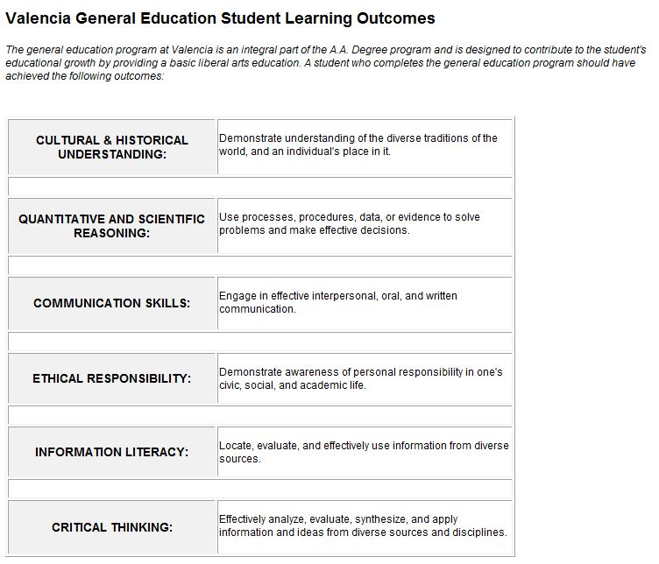

Slide 5
Program Learning Outcome Assessment
A.S. Degree – Building Construction Technology
Division of Architecture, Engineering, and Technology
Targeted Program Learning Outcome: Existing: Work in a team environment to analyze building types, develop a list of Programmatic requirements, sketch a schematic solution, and use this Information to develop drawings and models sufficient to present a competent architectural solution. Proposed revision: In a work group, develop a solution to meet architectural programmatic requirements | Targeted Course(s), Co-Curricular Program or Student Activity associated with the with the Academic Program: TAR2033C
 | Targeted Outcome(s) within the Course(s), Co-Curricular Program or Student Activity indentified above: Prepare design development drawings and scale model(s) as part of a Final Design Project
Performance Indicators for the Program Learning Outcome(s) selected: Successful completion of Final Project in capstone course | Performance Indicators for Outcome(s) within the Course(s), Co-Curricular Program or Student Activity selected: Assessment by course-specific rubric
Assessment Method (What assessment method - written assignment, speech, test, etc. - will you use to assess student ability related to the program / course outcomes selected): Rubric for Assessing Final Design Projects
Description of the Proposed Common Assessment Method (Common assessments should be designed to ensure a balance between (1) the need for a consistency within the program in order to ensure comparable student artifacts and (2) the need for reasonable flexibility in order to protect faculty freedom to design the delivery of course content): Rubric – only one course is offered, and only on West Campus; the same two instructors (Segura & Ray) have taught this capstone course over the last 4 years
Proposed Assessment Instrument (In some cases the assessment method may not need an associated assessment instrument – e.g., multiple choice tests): Rubric for grading Final Design Projects

Slide 7
Mapping Process
List all PLO’s
List all courses
Determine which PLO’s are addressed in each course
  Where content is introduced, reinforced, assessed
  Alternative: add Featured content

Slide 8
Program Learning Outcomes
A.S. Degree – Building Construction Technology
Division of Architecture, Engineering, and Technology
LEGEND: ∆ = Objective introduced □ = Part of course content ■ = Featured course content ▲ = Primary assessment; mastery of objective Learning Outcomes Upon graduation a student will be able to: | General Education Courses | ETD1031 Intro to Const/ Drafting | MTB2321 Technical Math | ETC1251 or ARC2461 Engineering Materials | ETD1100C Engin. Drawing | ETD1320 Intro to CADD | Electives | ETD1340 Advanced CADD | TAR1120C Architectural Drawing | BCN2405 Statics and Strengths | SUR1101C Basic Surveying & Measurement | BCN1721 Const. Planning and Control | BCN2563 Bldg. Service Systems | BCT1705 Contracts, Codes & Specifications | BCT2770 Bldg. Const. Estimating | TAR2033C Architectural Design
1. Demonstrate effective written, oral and visual/graphic communication skills. | ∆ | ■ | □ | ■ | ■ | ■ | □ | ■ | ■ | □ | ■ | □ | ■ | ■ | □ | ▲
2. Solve mathematical problems and equations utilizing algebraic and trigonometric functions. | ∆ | □ | ▲ |  | □ |  |  |  |  | ■ | ■ | □ | □ |  | □ | □
3. Demonstrate basic drafting proficiency, including the ability to use industry-standard computer software to generate 2D and 3D drawings. |  |  |  |  | ∆ | ■ | □ | ■ | ■ | □ | □ | □ | □ | □ | □ | ▲
4. Demonstrate fundamental knowledge of the systems and processes used to construct the built environment, including an understanding of industry terminology. |  | ∆ | □ | ▲ | □ | □ | □ | □ | ■ | □ | ■ | ■ | ■ | ■ | ■ | ■
5. Demonstrate basic competency in the use of surveying data collectors, calculating angles, and field book procedures, and describe their importance in construction reconnaissance. |  |  | ∆ |  | □ |  |  | □ | □ |  | ▲
6. Estimate the costs for labor, materials, and equipment for a construction project using industry-standard software and procedures. |  |  | ∆ |  |  |  | □ |  | □ |  |  | ■ |  |  | ▲ | ■
7. Develop a schedule of activities for a construction project, determine the critical path, and identify methods of compressing the completion time. |  |  | ∆ |  |  |  | □ |  | □ |  |  | ▲ |  |  | ■ | ■
8. In a work group, develop a solution to meet architectural programmatic requirements |  |  |  | ∆ | ■ | □ |  | □ | ■ |  | □ | ■ | ■ | ■ | ■ | ▲
Courses

Slide 9


“Hands-on” Activity!
Pick ONE Program Learning Outcome and map it across the courses in your curriculum
ALTERNATE:
Pick ONE Gen Ed PLO and map it across the general education curriculum

Slide 10
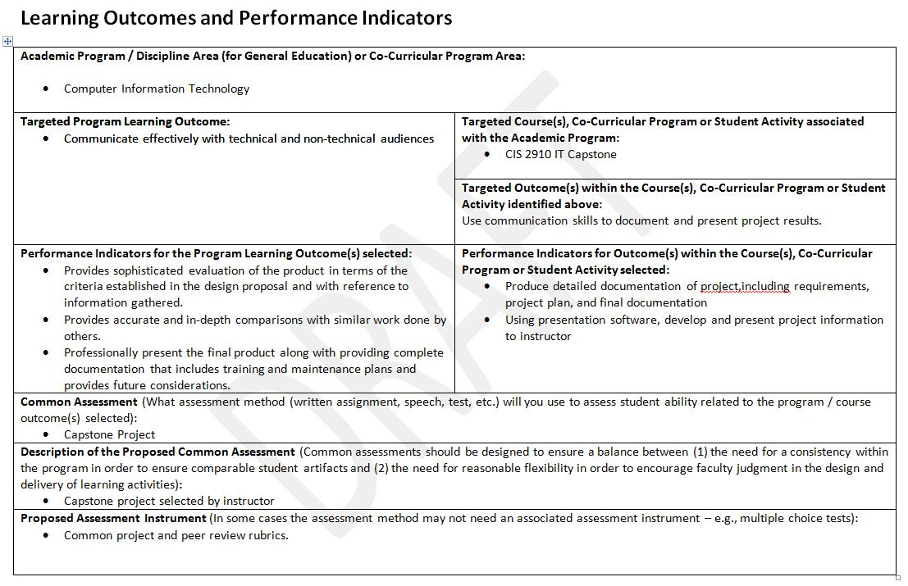

Slide 11
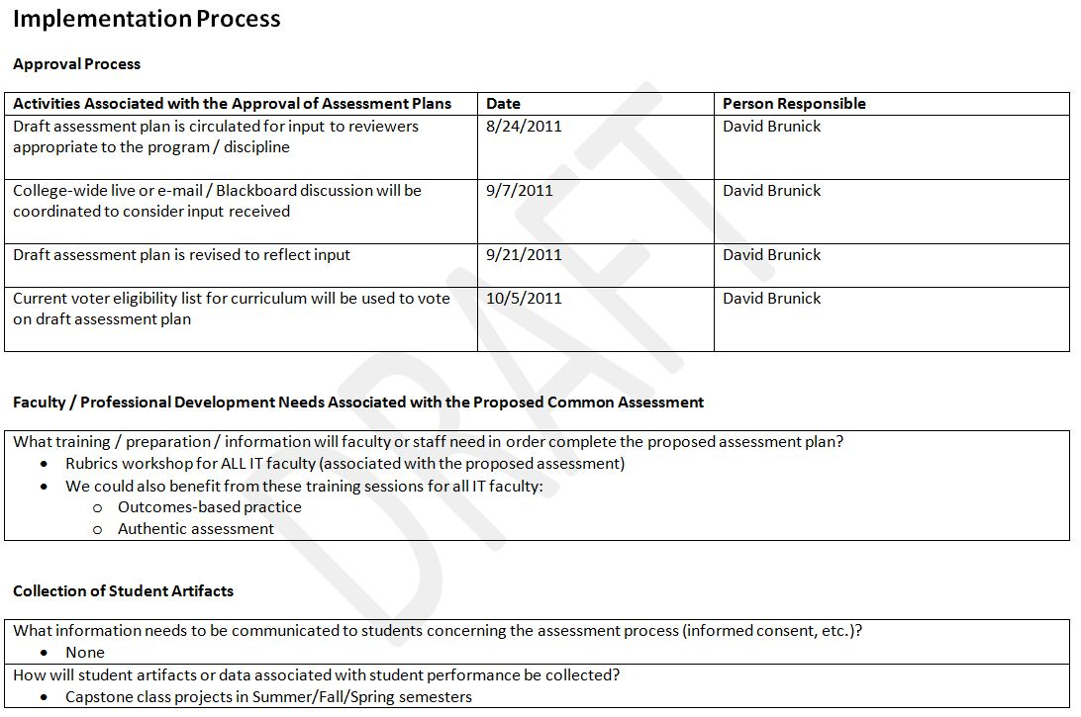

Slide 12
What is a good Rubric?
Clear, concise, specific description of student performance levels; preferably ONE page
Must address stated Learning Outcomes
Apply your favorite acronym
  KISS (Keep It Simple Stupid)
  SPAM (Simple, Practical, Achievable, Measureable)

Slide 13
Rubric for Evaluating Final Design Project – TAR 2033C Architectural Design (BCT)
Program Learning Outcomes Addressed and Project Criteria | Levels of Achievement
 | Beginning 1 | Developing 2 | Competent 3 | Accomplished 4
Existing Building Analysis Visit and document several buildings of a specific type/occupancy | Analysis & documentation incomplete; demonstrates minimal understanding of building type | Examined few buildings; analysis conclusions vague; design issues missing key points and not distinctly applied | Examined several buildings; conducted building analysis; discovered most design issues; applied knowledge gained from study | Examined many buildings; analysis thorough & complete; clearly articulates design issues; substantial and relevant application of knowledge gained
Client Building Requirements Program with list of space requirements and functional relationships | Incomplete solution, lacking in quality, fails to meet project requirements | Program lacking depth; Missing minor components and fails to adequately describe spaces and relationships | Developed program meeting stated objectives; space requirements and functional relationships are adequately addressed | Developed complete program exceeding minimum objectives; clearly articulates space requirements and functional relationships
Schematic Design: Quality of solution & application of architectural design principles. | Incomplete or missing required elements; solution lacks originality; ignores basic design principles | Solution shows evolving understanding of design principles, but does not achieve effective solution | Fulfills all program parameters; competent design | Exceeds program parameters; creative solution demonstrates unique design approach and understanding of design principles
Presentation: Demonstrate effective written, oral and graphic communication skills. | Unconvincing argument, not supported by fact, exhibits poor communication skills; graphics incomplete/poorly executed | Argument only somewhat effective/supported; less than professional communication standards; graphics detract from argument | Good argument, mostly supported , adequately communicated; graphics are competent | Convincing argument, properly supported , using professional communication standards; graphics enhance description of design solution
Industry Knowledge: Demonstrate fundamental knowledge of the systems and processes used to construct the built environment, and use correct terminology | Inarticulate and lacking in understanding of key building components; incorrect use of terminology | Shows some understanding of construction, but hesitant and unable to answer all questions | Clear and concise; well-defined; able to answer all questions | Project description conveys deep understanding of building process using appropriate vocabulary; articulate
Quality of Drawings/Models: Demonstrate basic drafting proficiency, including the ability to use industry-standard computer software to generate 2D and 3D drawings | Drawings incomplete or missing required views; model lacks detail sufficient to describe project | Drawings and model contain minor errors and lack precision in one or more areas | Drawings and model are accurate and adequately convey the design intent | Drawings are skillfully done and use proper lineweights to show detailed solution; model is precise and well-crafted
Teamwork Contribution to group effort: “In a work group, develop a solution to meet architectural programmatic requirements.” | Failed to attend scheduled group meetings; uncooperative; participation level much lower than group members | Attended most meetings and contributed in some ways, but effort below expected performance | Organized and met expected contribution level | Contributed greatly to the success and unity of the team; demonstrated leadership in true collaborative effort

Slide 14

QUESTIONS?

Slide 15
F I N

