Slide 1
State Assessment Meeting of Florida State Colleges
Assessing to Learn, Learning to Assess:
A gathering of professionals in academic and student affairs including faculty, staff, and administrators.
“Improvement—if it is to happen—will occur where faculty and staff have the most leverage to change how they approach teaching and learning.” -Ewell, Paulson, and Kinzie, 2011
June 20 & 21, 2013
Laura Blasi, Ph.D.,
Director, Institutional Assessment
lblasi@valenciacollege.edu

Slide 2
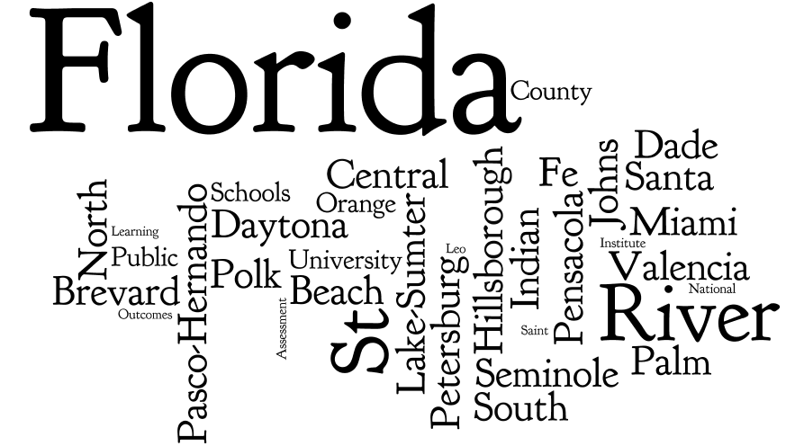
18

Slide 3
81
Academic Affairs
Academic Affairs & Planning
Academic Affairs and Workforce Programs
Academic Assessment
Academic Effectiveness and Assessment
Academic Support Center
Academic Technology
Adult High School
Advising
Advising and New Student Orientation
Allied Health
Architecture and Engineering Technology
Arts and Sciences
Assessment and Accreditation
Assessment Services
Business Administration
Business and Computer Technology
Business/IT/Social Sciences
Career Development Program
Career & Technical Education
Careers and Technology
Center for Teaching, Learning and Assessment
Chemistry
College of Business
College of Education
College of Public Safety
College of Workforce & Continuing Education
College Training and Development
College Writing Center
Communications
Computer Science
Corporate and Community Development
Corporate Training
Cosmetology
Criminal Justice
Engineering, Design and Construction
English
English for Academic Purposes
Faculty and Instructional Development
x

Slide 4
Participant Backgrounds
Library Services
Management
Mathematics
Modern Languages
Nursing
Office for Students with Disabilities
Orthotics and Prosthetics
Paralegal Studies or Legal Assisting
Performing and Visual Arts
Photography
Physical and Biological Sciences
Physical Sciences
Planning and Assessment
Public Safety Administration
Reading
Research and Institutional Effectiveness
Retention and Assessment
School of Humanities and Communication
Science
Social Sciences
Speech
Teacher Education
Technical and Adult Education
Visual and Performing Arts
Foreign Language
Health Careers
Health Careers & Human Services
Healthcare Administration
History, Language, and Social Sciences
Humanities
Humanities and Foreign Language
Industrial Education
Institutional Advancement
Institutional Effectiveness
Institutional Effectiveness and Research
Institutional Effectiveness, Research , Grants
Institutional Research
Instructional Support
Learning Assistance
Learning Resources
Learning Support
x

Slide 5
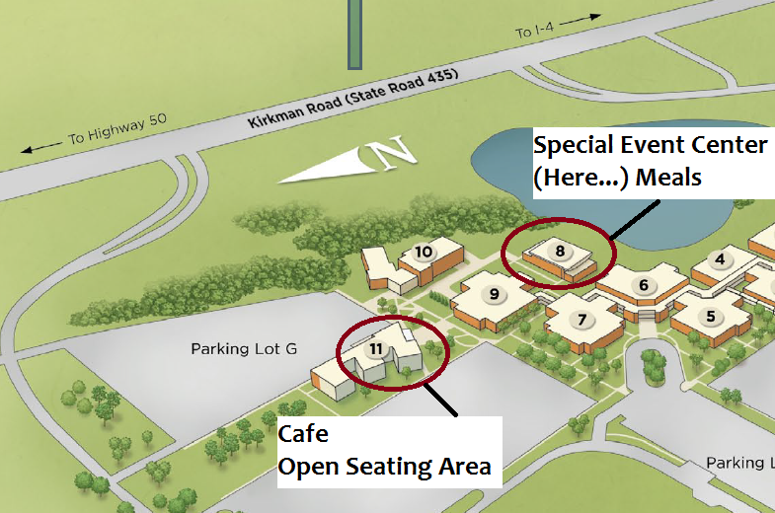

Slide 6
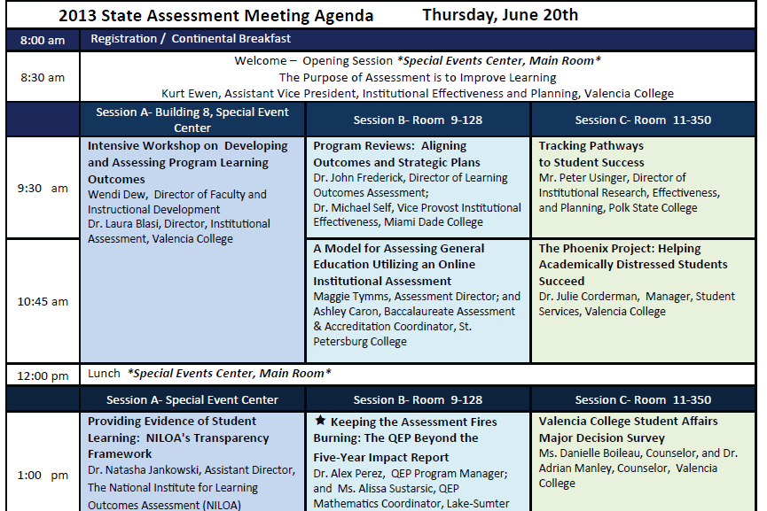
★ Indicates a “hands on” data session
“Work in Progress” sessions on Day Two
Survey link for feedback sent after
Materials posted online after the meeting

Slide 7
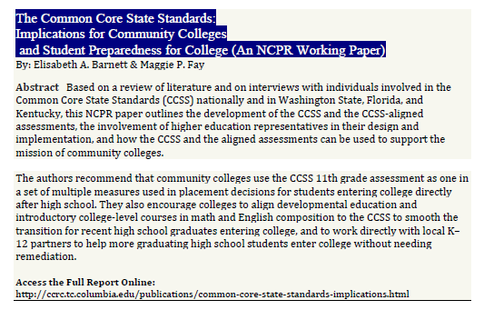
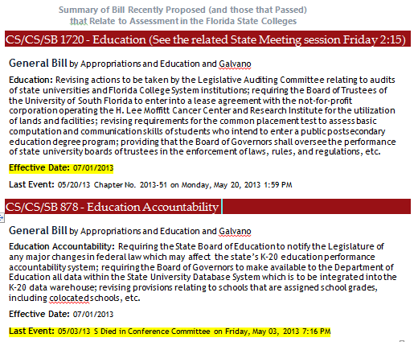
National Institute for Learning
Outcomes Assessment (NILOA) –
Dr. Natasha Jankowski Featured Speaker
2:15 Developmental Education session (MOOCs)
Appreciation for the work of presenters
Your own presentation proposals for next year
Opening session…

