Slide 1

Division Action Plans in Student Affairs
Putting Student Learning First

Slide 2

Agenda
Student Affairs Assessment Plan; Measurement of Students’ Experience and Learning
Departmental Unit Plans
  Annual Staff Objectives
  Data Collection
  Review, Report and Revise

Slide 3
Assessment; A “new definition”
The gathering of information about results, the comparison of those results with the results of the past, and the open discussion of the meaning of those results, the ways they have been gathered and their implications.
The Dance of Change; the Challenges to Sustaining Momentum in Learning Organizations, Peter Senge
Notes:
The learning organization
According to Peter Senge (1990: 3) learning organizations are:
…organizations where people continually expand their capacity to create the results they truly desire, where new and expansive patterns of thinking are nurtured, where collective aspiration is set free, and where people are continually learning to see the whole together.

Slide 4

Student Affairs Assessment Plan
Due to the breadth and depth of the work of “student affairs”, it is useful to consider assessment/evaluation from three different perspectives. Each type of assessment needs a timeline and a cycle that is reasonable to balance the work and its continual improvement.
Measures of effectiveness and efficiency
Measures of students’ experiences
Learning Assessments (Students and staff)
http://valenciacollege.edu/studentaffairs/assessmentPlan.cfm
Notes:
Examples of measures of effectiveness, students’ experience and learning assessment
While it is more clean to measure whether or not a student can solve a quadratic equation, measuring the effectiveness of a Financial Literacy program may be more “messy”.

Slide 5

Student Affairs
Assessment Cycle
Departmental Unit Plan; Departmental Goals
Based on Shared Vision; College Strategic Plan; Data
Assess, Review, Report, and Plan Again
Individual Staff Developmental Plans and Objectives
Student Affairs Division Plans
Notes:
Cascading: annual student affairs retreat to discuss overall division plans for the next year which flows from the collegewide plans.

Slide 6
Assessment Cycle
Our Guiding Principles
The Big Ideas:
http://valenciacollege.edu/ournextbigidea/qep.cfm
Strategic Plans
http://valenciacollege.edu/academic-affairs/institutional-effectiveness-planning/strategic-plan/documents/StrategicPlanBrochure.pdf

Slide 7
Our Department:
Planning and Working Together
Collaborative planning and work session:
What were we trying to do?
How will we know that it’s complete?
From the data, where do we still see work to do?
Begin again….
Notes:
Explain the 2012 retreat’s focus on developing the assessment tool, Student Survey. SMART goals and alignment of measurement with the objective.
2013 retreat analyzed data from student survey, gateway courses, and OSD retention and graduation data

Slide 8
It all depends on how you look at it!
  Build the assessment to get the information you want, not necessarily the answers you want.

Slide 9

2011-2012 Survey
Students’ self report regarding how they found our office. 72 students indicated that they found the OSD through “other” means.
Student Survey
Notes:
We I planned to develop the website because I thought that was the most utilized portal to our services. However…. We found faculty were our biggest advocates.

Slide 10
Decisions made by data
A common response (26%) was that students learned about OSD from a professor, often identified by name or discipline.
Based on these data we set a new goal for the following year… to reach out and strengthen our communication to faculty.

Slide 11
2012-2013 Departmental Plan
Based on the data from the 2011-12 Student Survey we established the goal for the next year’s plan
  In order to increase student’s access to our services we set a goal to strengthen communication with faculty
  Faculty Resource Guidelines/ Bookmark
  Submit Articles to the Faculty Newsletter
  Have greater presence in Open House/Faculty Welcome Back opportunities

Slide 12
Notes:
Cascading objectives- staff assistant used this 2.1. to create her own PDP goal of develop a bookmark to hand to faculty regarding the online faculty resource guide. The Director and other staff built their PDP objectives from Unit Goals.

Slide 13
Notes:
What was learned from the assessment results? What changes will you make in your initiative for the year to come?

Slide 14
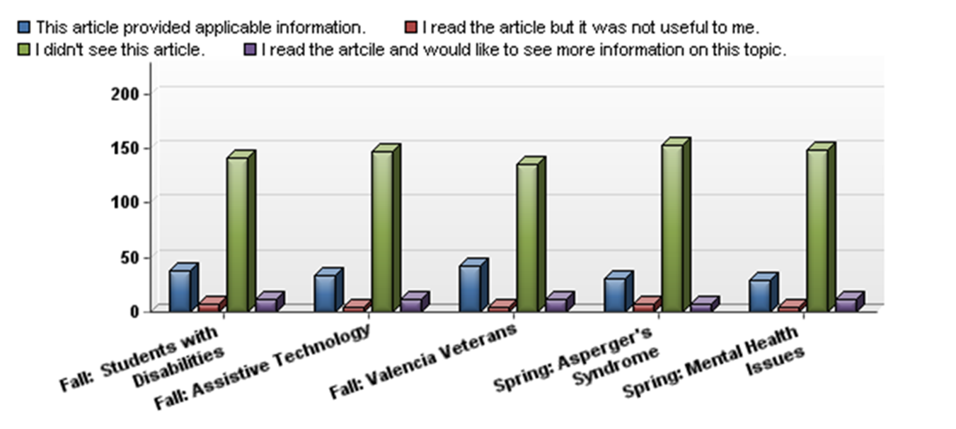
2012-2013 Faculty Survey
Notes:
Minimal effectiveness from our efforts. So refocus the efforts.

Slide 15
  Review, Report, and Revise
Data drives decisions
And revisions
Notes:
From here we back up and make decisions based on those data we collected.

Slide 16
 | Plan
1. Goal-principal purpose of plan (include how this relates to serving students or increasing student success or supporting LifeMap) | Building upon feedback from staff and faculty survey, the OSD strives to increase retention and graduation of students registered with the OSD through enhanced advising and targeted communication strategies.
2. Objectives-what will be accomplished and measured | 1. OSD will develop an intentional plan for advising based on LifeMap and Proactive advising models; this will include a curriculum for the initial advising session and a communication plan for case management follow-up. 2. OSD will research, develop, and/or implement more integrated software to improve access for students and to enhance the advising experience. 3. OSD will increase communication with faculty and staff regarding safety issues, classroom accommodations, and OSD resources. Write at least 3 articles for the Security offices college wide. Continue a project to include faculty in the accommodation of interpreted tests. Pilot a program to increase communication of the need for accommodations (NTI) for selected students.
3. Measures and Findings – How specifically measures will be conducted. How will we know the objective has been achieved? | To establish a baseline, I have requested data from the IR regarding retention and graduation rates for students also registered with the Office for Students with Disabilities. While the success and impact of the objectives above may take more than one year to measure, we will continue to track the data. Our proactive advising model will be evaluated via a student services pre and post assessment regarding student’s satisfaction with the advising available in the OSD. OSD will research the in-house Valencia Visits as well as other software advising systems that might be available to us to determine a most effective tool for the advising/OSD process. Once implemented, the OSD will elicit feedback from the OSD advisors regarding the effectiveness and usefulness of the new system. OSD increased communication will be measured by faculty and staff feedback. The faculty survey will be resent to a select group of faculty and staff who have been our targeted audience. These selected respondents will be representatives from each of the projects: Security, Faculty with students who are Deaf, and students who request to have their faculty notified via email. This objective will be achieved when respondents indicate that the improved communication helped them to serve students more effectively.
4. Action Plan – what is the implementation plan? | 1. a. The coordinators have been tasked with developing a curriculum for intake and registration based on the developmental Life Map advising philosophy. This curriculum will be a tool used by the advisor during the intake process. b. OSD will develop a communication plan to assist students through crucial points in the semester. Relative email templates will also be developed and sent to students according to the communication plan. 2. OSD staff will research various software options to determine what the most effective tool is for the OSD advising process. The research and selection process will be complete by the end of the planning year and necessary funds and/or purchase will be made the following year in consultation with the Office for Information Technology. 3.a. OSD staff will provide three informational articles to the offices of Security regarding students with disabilities. b. The Assistant Director will implement the faculty communication piece regarding interpreted testing. She will also gather feedback from students and faculty regarding the implemented process. c. OSD staff will pilot a program to increase communication of the need for accommodations (NTI) for selected students by emailing faculty for selected voluntary students.

Slide 18
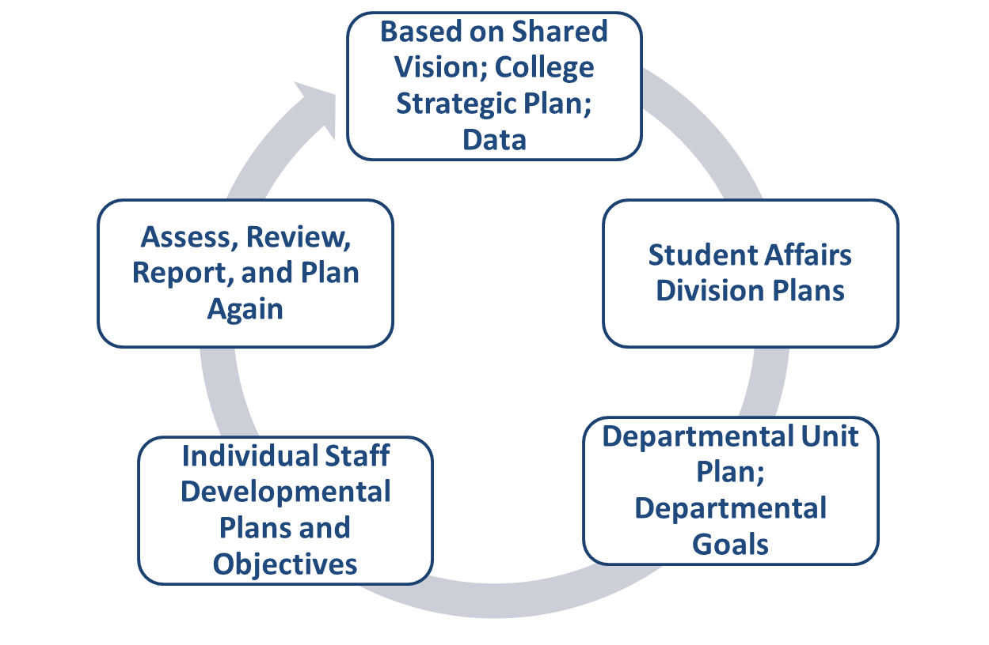
Summary

Slide 19
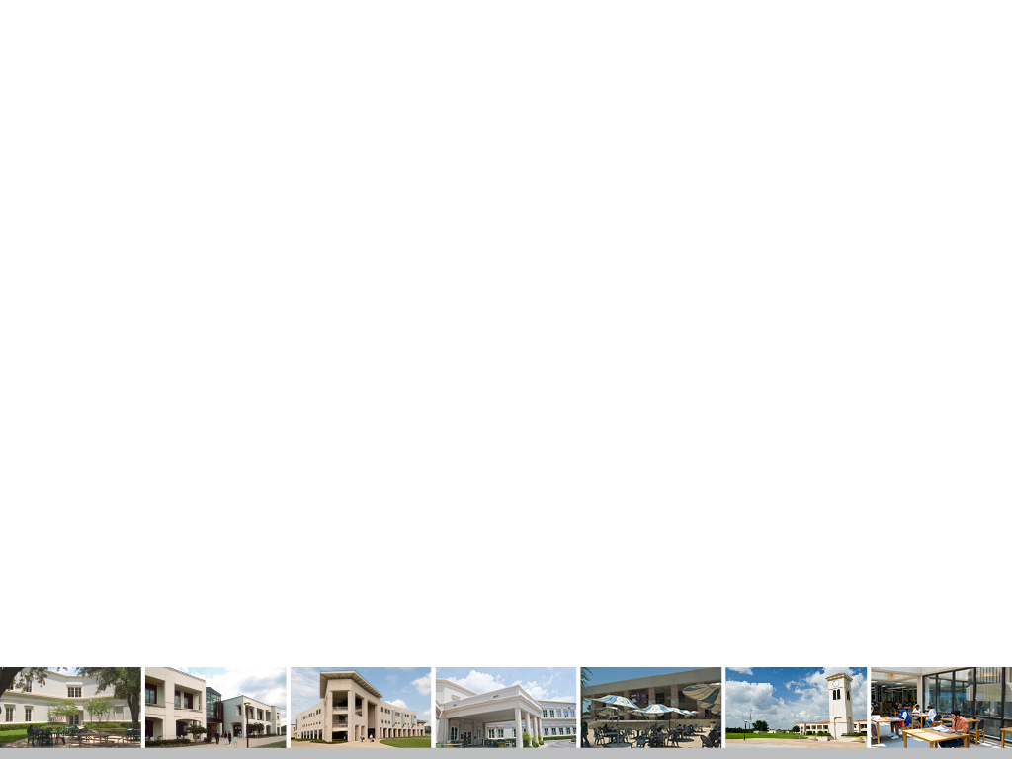
Questions and Thanks!

