Slide 1

Supporting Quality of Student Learning Online: Using Quality Matters to Strengthen Online Teaching and Learning
Erin O’Brien, Faculty Fellow, Faculty and Instructional Development & English Professor
Charles Fox, Assistant Director of Faculty and Instructional Development
Valencia College - Orlando, Florida

Slide 2

Introductory Questions
Does your institution use Quality Matters or another quality assurance rubric/measure?
What systems are in place to support your online and hybrid faculty?

Slide 3

Faculty Development, Digital Professor Certification, and Quality Matters
In this presentation we will be moving from general to specific. We will start with an overview of Faculty Development at Valencia, examine our Digital Professor Certification Program and demonstrate that Quality Matters is a thread that runs through all of the Digital Professor curriculum.

Slide 4


Faculty Development at Valencia is Competency Based

Slide 5
Planning and coordination with campuses, divisions & faculty groups
Faculty Development
Comprehensive, Coordinated Curriculum for All Faculty
Teaching in the Learning College Course
Scenarios
Associate Faculty Program
Online, evening workshops
On-boarding
New Faculty Orientation
Essential Competency Workshops
Portfolio Development/Tenure Support (TT only; cohort based)
Adjunct Faculty Development
Teaching/
Learning Academy
Essential Competencies of a Valencia Educator
(Adjunct, FT, TT, Tenured)
Destination
Learning Partners
Enhanced practice, professional renewal, and student learning
Need and/or interest
Program Learning Outcomes Assessment
LinC
Service Learning
Support for Curriculum Development
Online Teaching and Learning Programs
Introduction to Online Teaching & Learning
Quality Matters/Exemplar Online Course Program
Digital Professor Certification
Boot Camp for Online Instruction
Discipline- Specific Topics
Methods
Model-the-model
Project-based
Discussion
Collaboration among peers
Guided readings
Scenarios
Individual consultation
Modes
Online
Hybrid
Face-to-face
Support for College and Campus Initiatives

Slide 6
Important Facts about Faculty Development Curriculum
All of our courses are facilitated by Valencia experts
Courses are project-based so faculty end up with artifacts they can use in courses before program completion
Courses are designed to promote collaboration and discussion among colleagues
Courses model-the-model
Courses are developed through a collaborative process

Slide 7

Questions about Competencies and Faculty Development at Valencia?

Slide 8
Digital Professor Certification
Designed to culminate in the certification of faculty as "Digital Professors."
Designation indicates completion of 20 hours of professional development.
Mix of pedagogy and technology in online/hybrid teaching and learning.
Courses are
  aligned with the Essential Competencies of a Valencia Educator.
  developed according to the course learning outcomes.

Slide 9
Required Pedagogy Courses
The Digital Professor Certificate consists of
six required pedagogy courses (16 PD hours)
one optional pedagogy course (at least 2 PD hours)
one optional technology course (at least 2 PD hours)
For more information, go to our Digital Professor Certificate website
http://valenciacollege.edu/faculty/development/programs/online/DigitalProfessorCertification.cfm

Slide 10

Program Completion
After successful completion of all requirements, faculty are automatically awarded certification.
Digital Professors are recognized on Valencia’s website.
http://valenciacollege.edu/faculty/development/programs/online/DigitalProfessors.cfm

Slide 11

Questions about the Curriculum of the Digital Professor Certification Program?

Slide 12
Program Assessment
Participation in the Digital Professor Certificate Program …
improved my teaching skills in online and/or hybrid courses.
improved my teaching skills in face-to-face courses.
helped me to better understand the student experience in an online environment.
97.5%
87.5%
90%

Slide 13
Program Assessment
The facilitators modeled best practices in online teaching.
Observing the facilitators and their techniques helped to improve my teaching practice.
Interaction with colleagues in the program helped to improve my teaching practice.
100%
95%
95%

Slide 14
Participant Feedback
“The experience gained through the Digital Professor Program has been invaluable when teaching my first online course particularly since I had no online teaching experience prior to my involvement in the Program.
During the Program I have learned how to make an online course accessible to all students, to vary instructional and assessment techniques and to build an effective online course by using the Quality Matters rubric.”

Slide 15
Participant Feedback
“Many of the courses in the program included construction of real assignment/assessments that could be used in the courses I teach.”
“I learned so much from the facilitators…how they set up their classes, materials they used, and the participants in the courses were also helpful. I have found that I’m more sensitive to those who are climbing the learning curve.”

Slide 16
Participant Feedback
“I have applied what I learned in all aspects of my teaching. In my face-to-face courses I now use the learning management system to engage students outside of class and utilize a similar organizational structure to the class as modeled in the Professional Development classes. Of course I completely redesigned my online class and now engage students using different media (videos, flash games, discussion, etc…). The Quality Matters Rubric provides a great framework for a course!!!”

Slide 17

Quality Matters
A national benchmark for online course design
The Quality Matters Rubric is a set of 8 general standards and 41 specific standards used to evaluate the design of online and blended courses.
The Rubric is complete with annotations that explain the application of the standards and the relationship among them.
The rubric is based on best practices research and is recognized by many as the “gold-standard” in hybrid and online learning course design.

Slide 18
QM Rubric
https://www.qualitymatters.org/rubric

Slide 19
Course Outcomes For Quality Matters Peer Reviewer Training Course
Describe the underlying principles of the Quality Matters project
Use the QM Rubric and score it
Apply the Peer Course Review rubric
Decide if you wish to participate as a QM peer reviewer

Slide 20
Underlying Principles of QM
  QM is a faculty-driven, peer review process that is
  Collaborative
  Collegial
  Continuous
  Centered
    in academic foundation
    around student learning
Notes:
About The Content:
The underlying principles of QM are a primary reason for this wide-spread adoption. Quality Matters provides a faculty-driven, peer review process that is…
Collaborative: QM was designed by and for faculty to share expertise and experience relative to the design of a course.
Collegial: The course review process is a collegial discussion between faculty peers committed to
Continuous quality improvement. It is not an evaluation.
Centered in national standards of best practice, the research literature and instructional design principles designed to promote student learning.

Slide 21
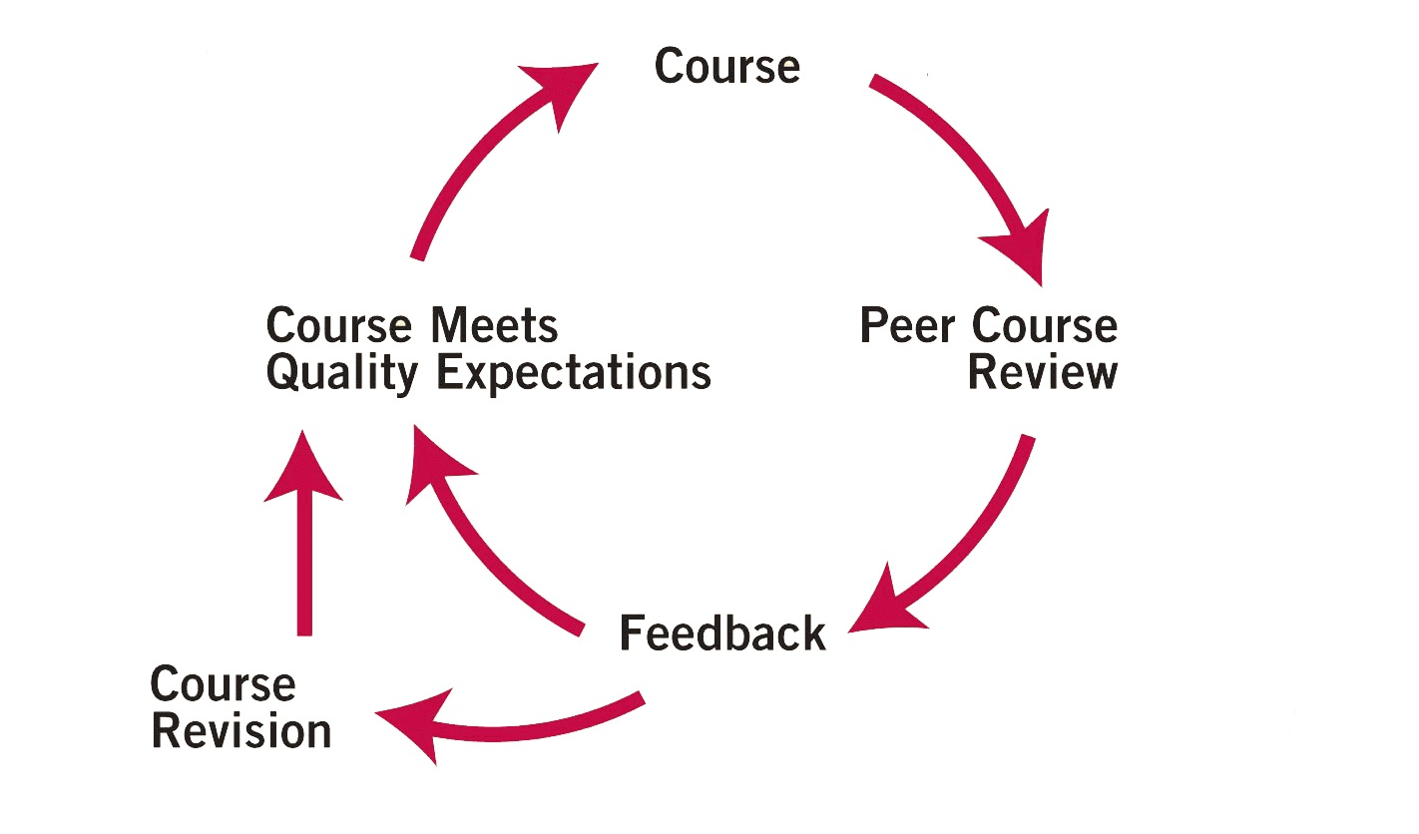
Peer Course Review Process
Notes:
About The Content:
QM Circle Process: This visual highlights the QM review process (point out that it is also on the cover of the QM Workbook).
Key points: QM is designed for continuous improvement; the goal is that ALL courses will eventually meet QM expectations.
How To Present It:
Ask participants to look at the diagram and make inferences about it. Typically, they will respond with “it’s a circular process;” “it’s continuous:” etc).
Begin with the COURSE and then continue through PEER COURSE REVIEW, FEEDBACK, COURSE REVISION and MEETS QUALITY EXPECTATIONS. Speak briefly about how each item contributes to the process. Participants will learn more about each item throughout the workshop, so your objective at this point in the presentation is to focus on:
QM is about continuous improvement.
All courses will eventually meet expectations.
QM is both a rubric and a process.
NOTE: The information below is for background only; you will go into greater depth about this slide later in the workshop.
This diagram illustrates the focus on continuous improvement and summarizes the Quality Matters course review process:
COURSE: Beginning at the top of the cycle, institutions decide to examine an online or hybrid course as part of a peer review. The institution may submit its course to QM for a formal review or, if the institution is a QM subscriber, it may conduct the formal course review in-house (both a formal QM review and a formal in-house process lead to QM recognition). The institution may also decide to use the rubric informally and do a review using its own process (this informal process does not lead to QM recognition).
PEER COURSE REVIEW: The course is then reviewed by a team of three peer reviewers using the QM Rubric. The QM rubric is based in national standards of best practice, the research literature, and instructional design principles. Peer reviewers must have online teaching experience and complete the Peer Reviewer Training to be eligible to serve on a formal QM review. The peer review team consists of at least one member from an institution other than the course’s home institution. The team also consists of one member from a discipline that matches that of the course. This combination of reviewers ensures a diverse set of perspectives.
FEEDBACK: Following the course review, the review team’s feedback is provided to the faculty member or team that developed the course. The feedback consists of two components:
Scoring - indicates which QM standards were and were not met by the course.
Feedback - a rich set of comments from the reviewers indicating the strengths of the course, areas for improvement and specific recommendations and suggestions for improving the course.
COURSE REVISION: Upon initial review, the course may or may not have met Quality Expectations. In either case, the QM review provides support for course revisions and improvement. If a course did not initially meet Quality Expectations, the team chair will re-review the course after revisions.
MEETS QUALITY EXPECTATIONS: QM expects that all courses will work toward and achieve quality expectations. The QM review process is not meant to be a test in which a course passes or fails. The overall goal is to provide a system for the improvement of course quality, rather than the simple assignment of a grade or quality level to the initial course.

Slide 22
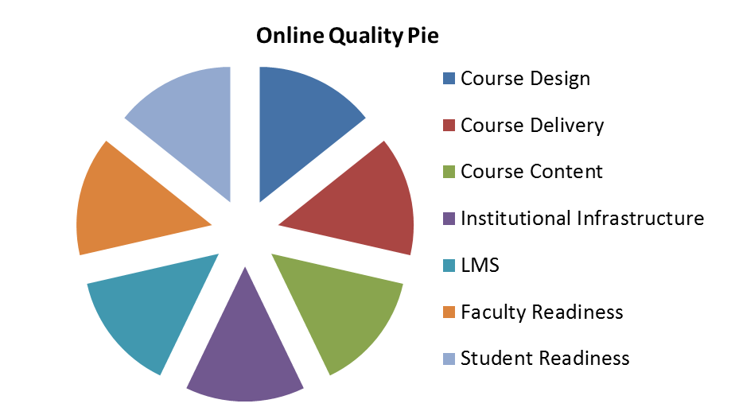
Factors Affecting Course Quality
QM Reviews Course Design ONLY
Notes:
About the Content: There are many factors that affect the quality of an online course. Among these factors are:
the course design (the forethought and planning that goes into an online course,)
the course delivery (the way the course is taught, also known as faculty performance),
the course content,
the learning management system and its functionality; technical support,
the institutional infrastructure (help desk, online library access, online tutoring access, etc.),
a faculty member’s training and readiness for online teaching,
and the students’ role with respect to engagement and readiness for an online course.
QM reviews just one aspect of online course quality – Course Design.
NOTE: you don’t have to read this list. You should emphasize design and delivery, of course, but you might also highlight the LMS (particularly if there have been recent issues with it that disrupted classes; or the institutional infrastructure (the availability of online student services or a 24/7 help desk); or student readiness (particularly if it’s a rural population with limited Internet access at home).

Slide 23
Design vs. Delivery
The faculty member is integral to both design and delivery.
QM is about DESIGN - not delivery or faculty performance
Course Design …
is the forethought and planning that a faculty member puts into the course.
Course Delivery …
is the actual teaching of the course, the implementation of the design.
Notes:
About The Content: This slide reinforces the concept that QM is about Design, not Delivery. QM recognizes that this is a fine line, but course design is the primary emphasis during a review.
Design is usually about what the faculty member plans and prepares for BEFORE the students arrive in the course; delivery is what happens after the students login and begin to engage with the content, the instructor and other students.

Slide 24
About The QM Rubric 2011-2013
Eight General Standards:
Course Overview and Introduction
Learning Objectives (Competencies)
Assessment and Measurement
Resources and Materials
Learner Engagement
Course Technology
Learner Support
Accessibility
Key components must align.
Alignment: Critical course elements work together to ensure that students achieve the desired learning outcomes.
Notes:
**** Handout: Participants must have a QM Rubric Workbook to use during the training.****
About The Content: There are 8 main sections of the rubric (these are the 8 General Review Standards and are noted in red letters in the QM Workbook). The rubric consists of 41 Specific Review Standards which are distributed over these 8 general categories.
Take the time to point out the organization of the QM Workbook and how the rubric is organized:
Eight General Review Standards
Forty-one Specific Review Standards
In Table Format: 1st column is Specific Review Standards; 2nd column is point value; the 3rd and 4th columns provide space to make a Yes or NO decision; and the last column is the annotation.
Talk about QM’s intention to be “holistic” and that a QM review is intended to ensure that all parts of the course work together. You can use the metaphor of a cake recipe.
Baking a cake is fairly simple if you follow the recipe and correctly measure and add the right ingredients (and the result is also fairly simple and straightforward: if you do it correctly, you end up with a cake).
Reviewing an online course is much more complex: not only must you include all the “ingredients” but they must all work together to support the learning objectives. For example, you could have strong, measurable learning objectives but if they don’t align with the assessments, you still don’t have a quality online course.
Note: Your discussion of alignment should be brief and introductory; you will spend more time explaining “Alignment” in another section of the presentation.

Slide 25
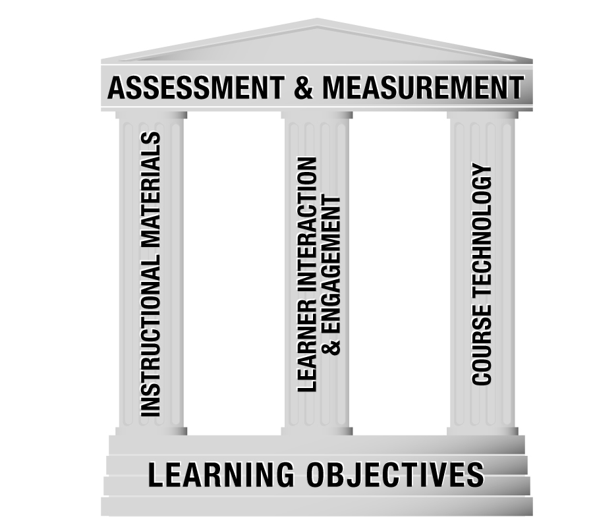
Key Sections that Must Align
Notes:
About The Content: The QM Rubric takes a holistic view of the course and that's why it's so important that the learning objectives ALIGN with the assessments, resources and materials, student interaction, and technology standards.
Alignment refers to the direct link between the learning objectives (Standard 2) and the assessments and measurements (Standard 3), resources and materials (Standard 4), learner engagement (Standard 5), and course technology (Standard 6). Under the principle of alignment, these later four aspects of the course are driven by and support the learning objectives.
As you begin to apply the QM Rubric, pay special attention to the six specific review standards (2.1, 2.2, 3.1, 4.1, 5.1 and 6.1) in the rubric that include alignment matters (and the red word “Alignment” included in each standard box). The diagram on this slide illustrates the dynamic relationship that supports alignment between these standards.

Slide 26
QM II: Self-Review at Valencia
A team of faculty is in the process of developing “QM II.” This course models an exemplar course and provides faculty an opportunity to learn and use tools that make it possible to meet QM standards.
Participants develop a Start Here and one other learning module of choice to meet QM Standards at the end of the 10-week course.
This course will provide faculty with an opportunity to self and peer review, revise and align course content using the QM Rubric Standards.
Notes:
Facilitator: Take a minute to log in and show the participants how to access this tool and how it works.

Slide 27

Online Classroom Observation Form

Slide 28
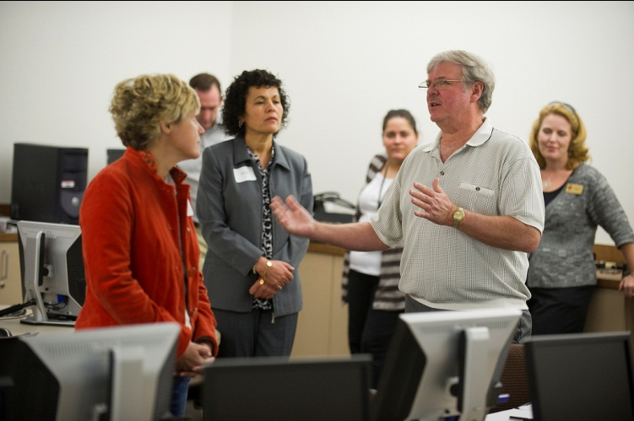
Questions about Digital Professor and Quality Matters?

Slide 29
Thanks for Coming!
Charles Fox
cfox17@valenciacollege.edu
Erin O’Brien
eobien@valenciacollege.edu

