Slide 1
The Phoenix Project
Using Data to Develop a Comprehensive Academic Probation Program at a Large College

Slide 2
Session Objectives
Identify stakeholders at your institution for this work
Understand why data is key to the development of this process
Identify your population and the challenges this entails
Identify learning centered strategies to reach this population of students

Slide 3
Introduction
Dr. Julie Corderman, Manager of Student Services at the Winter Park Campus of Valencia College
Oversee front line staff for Student Services at our campus-includes Answer Center, Career Center and Atlas lab
Adjunct Instructor in Psychology
Developing a comprehensive Probation and Suspension program at Valencia

Slide 4
How We Got Started
Our campus Dean tasked the Career Center with working with Probation and Suspension students
The idea behind this appointment was following the O’Banion Model of assisting students with focusing on long term goals and goal setting
    Life Goals
    Career Goals
    Educational Goals (Major)
    Course Selection
    Schedule
On-going conversations with my advisors about the probation student population
Created an ad hoc system for my advisors to use as a method of keeping each other in the loop with regards to student we were seeing

Slide 5
First Steps
Began to collect and tally Probation Passes
  (We had passes collected from a three year period)
Began discussions with OIT on creating a data report (18 months)
Sent a team of Student Services staff members to Destinations program during Summer to begin discussion of interventions (3 months)
Sent team members to NACADA conference
Developed a work team of key stakeholders

Slide 6
Stakeholders
Who are the stakeholders at your school?
Who might be invested in this work?
Who do you need at the table for discussion?
Who are the best advisors for the job?
Think broadly and forward

Slide 7
Stakeholders at Valencia
Project Facilitator
Academic Deans (2)
Faculty (2)
Deans of Students (2)
Counselors (2)
Conduct Coordinators (2)
Career Advisors (2)
Financial Aid Liaison (1)
Black Board Liaison (1)
OIT Liaison (1)

Slide 8
Why Data is Key
Helps you to separate fact from fiction
Enables you to have important information when speaking to various stakeholder groups at the college
Enables you to begin to formulate a plan
Enables you to determine if your plan is working
Enables you to tweak portions of your program as supported by the data

Slide 9
Examples of How Data Directed Us
Redesigning our probation pass
Identifying our population and developing interventions based on numbers
Flex courses - should students on P2 be able to take them?

Slide 10
The Probation Pass
Advisors began to see more and more students rolling onto academic probation as Banner helped us to “clean up” reports
Many of the probation students we were seeing were not able to articulate reasons for being on probation
Many of the probation students did not have clear educational goals; supporting O’Banion’s Model
Many of these students had unrealistic expectations about how many classes they could successfully navigate in a term
Many of the students were not taking responsibility for changing their academic behavior

Slide 11
Probation Pass Data: Q. Why are you on Probation?
 | Blank | Poor time management | Personal or Family problems | Lack of focus or motivation | Working too much/work schedule | Accident or sickness | Failing grades/low GPA | Misunderstood the question
1 | 0 | 14 | 23 | 29 | 24 | 10 | 99 | 17
2 | 0 | 9 | 14 | 21 | 14 | 0 | 93 | 18
3 | 2 | 2 | 13 | 28 | 7 | 4 | 36 | 6
4 | 3 | 36 | 45 | 66 | 19 | 12 | 159 | 102
5 | 19 | 4 | 36 | 70 | 8 | 31 | 27 | 63
6 | 5 | 52 | 35 | 108 | 36 | 7 | 119 | 98
7 | 2 | 24 | 18 | 48 | 29 | 3 | 138 | 10
8 | 1 | 6 | 5 | 12 | 1 | 0 | 47 | 3
9 | 0 | 7 | 9 | 20 | 20 | 1 | 80 | 4
10 | 2 | 16 | 19 | 60 | 15 | 2 | 28 | 66
Total | 34 | 170 | 217 | 462 | 173 | 70 | 826 | 387
Percentage | 2% | 9% | 12% | 26% | 10% | 4% | 46% | 21%

Slide 12
Probation pass data: Q. What will it take to get off Probation?
 | Blank | Pass my classes/try harder | Manage time more wisely | Use Valencia ressources (skill shops, labs etc) | Retaking failed classes to raise GPA | Quit job/reduce working hours | Seek help from teachers and advisors | Misunderstood the question
1 | 9 | 91 | 29 | 1 | 46 | 19 | 2 | 2
2 | 45 | 55 | 22 | 5 | 10 | 9 | 5 | 15
3 | 2 | 67 | 7 | 2 | 4 | 9 | 2 | 4
4 | 29 | 182 | 61 | 33 | 15 | 30 | 28 | 27
5 | 6 | 4 | 23 | 8 | 11 | 1 | 0 | 27
6 | 42 | 198 | 85 | 23 | 37 | 49 | 18 | 15
7 | 25 | 109 | 52 | 11 | 32 | 24 | 11 | 5
8 | 4 | 27 | 2 | 1 | 41 | 2 | 0 | 0
9 | 8 | 42 | 30 | 10 | 20 | 40 | 8 | 5
10 | 8 | 129 | 39 | 12 | 6 | 23 | 10 | 6
Total | 178 | 904 | 350 | 106 | 222 | 206 | 84 | 106
 | 10% | 50% | 19% | 6% | 12% | 11% | 5% | 6%

Slide 13
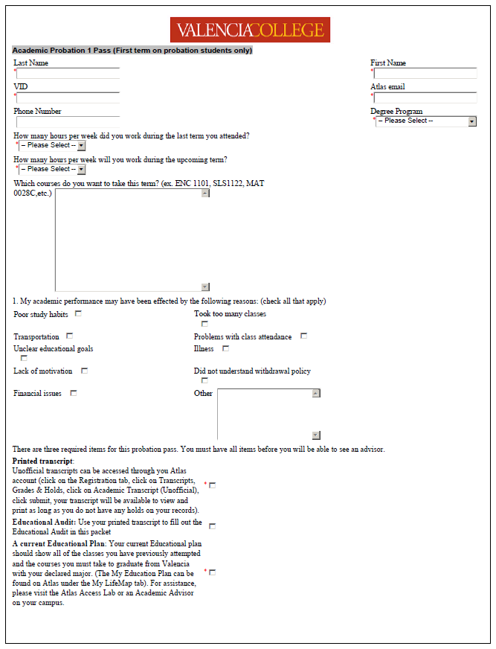

Slide 14
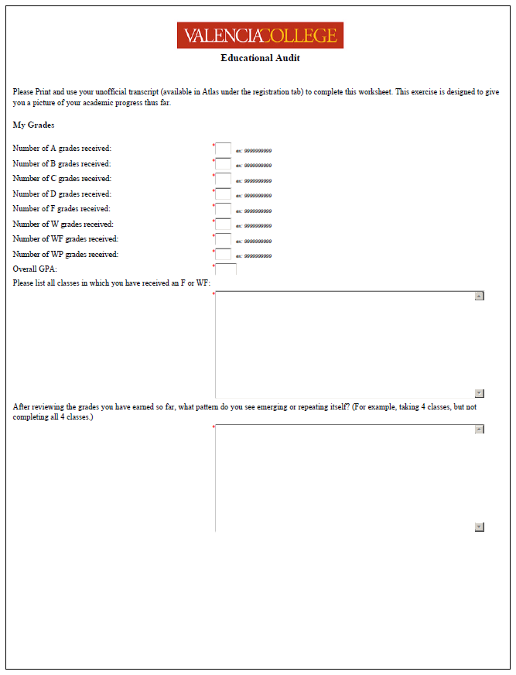

Slide 15
Building the Database
(2 years in the making)
We had to determine how to gather the population information from our data warehouse
We had to define our population (different parameters AW, P1, P2, SU)
We had to determine what types of data were important to mine:
        Term GPA
        CUM GPA
        Major
        HS
        Zip Code
        Sex
        Ethnicity
        Cleared vs. registered
We had to determine when to run the report during a term cycle
We had to determine which fields to mine the data from to get correct data

Slide 16
Defining Our Population: Our First Look at the Data
Our first usable report was run at the end of Summer term 2011
We just ran our 5th report at the beginning of December 2012
Each term we run a college wide report plus a report on our pilot group vs. a control group
In addition, each term we begin to experiment with digging deeper into the data to answer theories about our work such as:
“Do flex term courses have an impact on student outcomes?”
“What impact is withdrawing having on this population?”

Slide 17
Population by Status

Slide 18
Grouped by Goal

Slide 19
Allied Health Pending Students

Slide 20
Our Initial Thoughts
Large numbers –how are we going to manage?
How can we manage the flow of these students so they can be evenly distributed (by Campus? By Advisor?)
With the varying numbers in each group, do we want to have different levels of intervention for each group?
Does there need to be a different strategy with our Allied Pre-Clinical students?
What about including our Academic Warning students?

Slide 21
Blackboard Course: A Solution for the Masses
Schools that we studied were dealing with much smaller numbers
Began seeing some schools with online tutorials and forms for students
We already had a form called the “Probation Pass” for students online
We initially created a Blackboard course as a way to “corral” students college wide
The course enables us to direct flow where we can manage it
Allows students to check in via e-mail
Contributes to ongoing dialogue during the term
Allows same advisor to follow a student throughout their time on Probation
Allows us to gather data on effectiveness of assignments

Slide 22
Building the Course
We went through many attempts at this (still a work in progress)
Created a set of online assignments that students are given each term they are on probation
Manually load names each term AFTER previous term grades have rolled
Advisor is the “Instructor” of the course and determines what assignment to give a student based on questionnaire information
Advisors can send reminders to their students as well as personal e-mails encouraging students during the term
Assignments are built to be self-gradeable
Student must receive 80% or more on every assignment to be cleared for future courses
Credit restrictions apply to probation and suspension students

Slide 23
Blackboard 101: P2 Population
All students go through the “Orientation assignment” their first term on Probation
This assignment includes:
            Catalog definitions of Probation and Suspension
            Probation process and student responsibility
            Probation Contract
            Questionnaire - reasons for being on Probation (student selects from options)
            Quiz regarding understanding of the process
In subsequent terms, students are given assignments to complete BEFORE registration for the next term
These assignments are based on the results of the students’ questionnaire

Slide 24
Academic Probation Questionnaire
My academic performance may have been affected by the following reasons:
Poor time management
Transportation
Problems with class attendance
Juggling work and school
Childcare issues
Course difficulty
Lack of Communication with instructors
No chosen major
Family/relationship concerns
Illness
Financial issues
Early morning classes or late classes
Lack of motivation
Emotional/psychological issues
College adjustment/transition problems
Too much socializing
Did not meet with Academic Advisor
Did not use tutoring services or labs
Study problems
Other
Solutions (check all that may apply)
I commit to the following actions this semester:
Academic/Study Skills
Work related/ Financial
Complete __ _ study hours per week
Make college a priority
Keep a time management log that outlines class
Maintain regular class attendance
Manage work, personal, and study time
Consult regularly with instructors about progress
Seek tutoring from Valencia’s Support Labs
Attend workshop(s)
Consult with Advisor regarding academic progress
Complete required probation assignments by deadline(s)
Other
Use tutoring services and labs
Communicate/visit with instructors
Change study environment
Form a study group
Attend Academic Workshops
Learn about goal setting
Be aware of academic calendar
Get career counseling
Get a different job
Quit job/remain unemployed
Reduce working hours
See Financial Aid Counselor
Time Management
Family/Personal
Set goals
Say “No”
Make a “To Do” list
Reward yourself
Turn off cell phone
Other
Discuss goals with family members
Delegate duties
Make appointment with Counseling/Consultation
Develop routines
Get medical help
Say “No”

Slide 25
Blackboard Assignments
Orientation (In Development)
Time Management Math Support
Learning Styles Writing Support
Procrastination
Study Habits
GPA Calculator
Communicating with your Instructors
Defining Your Career Path
Financial Planning
Academic Resources
Educational Planning
Reading and Writing Skills
Test Anxiety
Loneliness/Depression
Is Online for Me?

Slide 26
Pilot Project
Has run for 4 terms
Served between 50-150 students per term
60/40 Success Rate
Team consists of 4 full-time advisors & 7 part-time advisors (only 1 FT advisor is one of my direct reports. The others are “volunteering”)

Slide 29
Trends
Students who do not respond to e-mails during the term tend to do worse
Students who are engaged with their advisor tend to improve
Students are coming in earlier during the registration process
Financial Aid has become more aligned with this process due to changes in Satisfactory Academic Progress terms
Students who take ownership of their performance and take steps to make changes have the best improvement
Many students are not willing to make changes
The population’s overall GPA is slowly rising
              Many of the low performers have stopped coming to school
              Many have lost Financial Aid and are no longer able to attend school
              We are intervening earlier

Slide 32
P2s and Flex Start Grades

Slide 33
Future Work
Moving all forms that students use to Dynamic Forms
Rolling out a website for students in Academic Distress
Creating a timeline for scaling the program college wide
Separate strategies for P1, P2, and SU statuses
                P1=Hold and Advisor meeting; course load may be limited
                P2=Hold and Blackboard course; course load will be limited
                SU=Sit out a term and while sitting out, student needs to complete workshop and remediation plan before readmit
Implement a strategy for Academic Warning students
Faculty to examine Early Alert programs

Slide 34
Contact Information
Dr. Julie Corderman, Manager Student Services, Winter Park Campus
407-582-6868, jcorderman@valenciacollege.edu

