Slide 1
School of Allied Health
Information Session
Please sign-in here:
https://tinyurl.com/AlliedHealth-Info-SignIn
Using Zoom:
Recommend using a laptop, tablet, or mobile app for the best experience.

Slide 2
Allied Health Videos
Inside Look at CVT
https://www.youtube.com/watch?v=lNCxh_vt_kA
Dental Hygiene: 360 Interactive Lab Tour
https://www.youtube.com/watch?v=17S8qJi1FWk
Dental Hygiene: A Day in the Life of a Valencia Student
http://www.kaltura.com/tiny/wlo2y
Respiratory: A Day in the Life of a Valencia Student
http://www.kaltura.com/tiny/xdvlc
Radiography: 360 Interactive Lab Tour
https://www.youtube.com/watch?v=6ZBBt6qeNhc

Slide 3
Welcome to the
School of Allied Health
Information Session
Overview of Allied Health Programs

Slide 4
Overview
This is not a program orientation
Today’s topics are accurate to date
All admission requirements MUST be met prior to applying
Individual responsibility to check Program Guides regularly for changes and updates
  Allied Health Program Updates
Notes:
Degree-Seeking students must attend New Student Orientation (or EMT Program Orientation if an EMT student) this Info Session is neither.
Info sessions are updated with new program statistics after each round of applications; also updated yearly for catalog changes and/or Program Guide updates
Students are to be vigilant and active in their process with applying to ensure they are up-to-date with accurate information during the academic year which they intend to apply to make sure all current requirements are met.

Slide 5
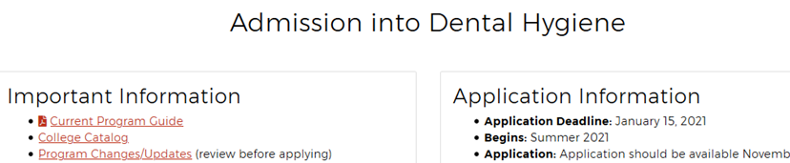
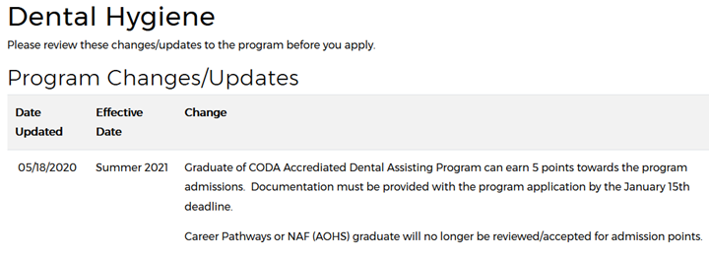

Slide 6
Introductory Information

Slide 7
Are you a Valencia College student?
Follow the steps to enrollment: https://net1.valenciacollege.edu/future-students/admissions
The Virtual Answer Center is your first stop in seeking answers to many of your questions with enrollment steps, admissions, and financial aid.
Online application:
Valenciacollege.edu,
  Click “Future Students”
  Email Enroll@valenciacollege.edu for general inquiries
*Transient Students – FloridaShines is NOT an admission application to be a Valencia College student; you must apply online and pay $35
International Students - visit International Student Services Office
  Eligible for all AS Allied Health programs & TC EMT
Veterans – connect with the Office of Veteran Affairs
  Discuss tuition benefits and credit earned from the military
Notes:
Answer Center serves new and current students; at the Downtown Campus, “First Stop” is the Answer Center equivalent.
Students seeking Allied Health programs must first apply to be active Valencia students in order to apply and be considered for limited-access programs
Transient status students are a common issue – students who apply through FL Shines are given Atlas access and VIDs, but are not active degree-seeking students, and must apply for admission to Valencia (or if a prior active degree-seeking/certificate-seeking/personal interest student, can submit a Change of Major to personal interest/other) in order to apply for Allied Health program of interest.

Slide 8
Helpful Links for New Students
Virtual Answer Center: Get answers to questions regarding financial aid, Florida residency, and admissions.
  https://valenciacollege.edu/students/answer-center/
Submit your statement of Florida Residency: https://valenciacollege.edu/admissions/admissions-records/florida-residency.php
Need to take PERT?
  https://valenciacollege.edu/students/assessments/pert.php
Fill out FAFSA:
  https://studentaid.gov/h/apply-for-aid/fafsa
College Calendar (important dates and deadlines)
  https://valenciacollege.edu/academics/calendar/
Veteran student services:
  veterans@valenciacollege.edu

Slide 9
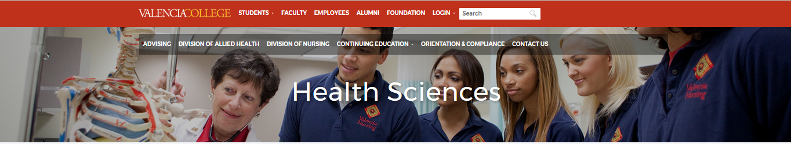
Health Sciences Website
www.valenciacollege.edu/health
Overview of Important program information
Program Guides
Allied Health Program Updates
Application Information
Notes:
When advising students, using the Health Sciences web pages serve as a useful tool in describing individual program requirements

Slide 10
Degrees Offered at Valencia
Associate in Arts (A.A.): General two-year degree designed for students who plan to transfer to a University.
Associate in Science (A.S.): Designed for students who want to enter the work force immediately and may also want to transfer to a university or bachelor program.
  Technical Certificate (T.C.): Typically paired with an A.S. degree, or is often done separately
Bachelor of Science (B.S.): Prepares the student to enter an advanced position within a specialized career field. Students must complete an associate degree before transferring into the baccalaureate program at Valencia.
  Advanced Technical Certificate (A.T.C.): Typically paired with a B.S. degree, or is often done separately
Notes:
Catalog page for reference: https://catalog.valenciacollege.edu/degrees/

Slide 11
Degrees and Certificates Offered at
Valencia College

Slide 12


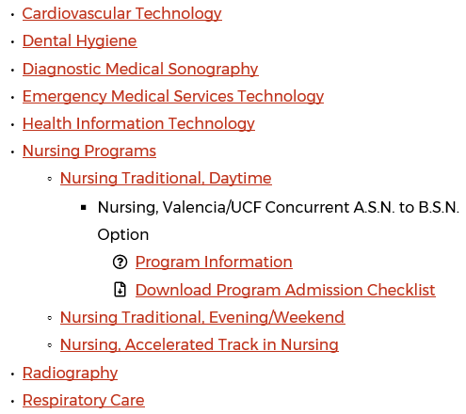
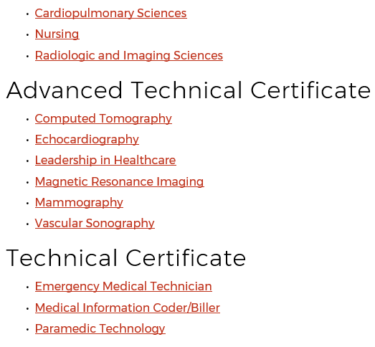
Notes:
https://valenciacollege.edu/academics/departments/health-sciences/
Veterinary Tech not included in this presentation as this program is not offered exclusively with Valencia College: https://catalog.valenciacollege.edu/degrees/associateinscience/alliedhealth/veterinarytechnology/

Slide 13
NEW Open Access Allied Health programs
Associate in Science
  Health Navigator
Technical Certificate
  Health Care Specialist

Slide 14
Open Access vs. Limited Access
Allied Health A.S. degrees are limited access:
  Admission to Valencia does not guarantee acceptance to a limited-access degree program. Limited-access programs have specific admission requirements.
Some T.C. programs are open access:
  EMT – open access (no application)
  Medical Info Coder/Biller – open access (no application)
  Paramedic Technology – limited access (application required)
Students who complete the required course work in a Technical Certificate will automatically receive the certificate, meaning you do not apply for graduation, like a degree requires
See which programs are eligible for financial aid:
http://catalog.valenciacollege.edu/financialaid/generaleligibility/
Notes:
Catalog reference for Limited-Access: https://catalog.valenciacollege.edu/degrees/associateinscience/limitedaccessprograms/

Slide 15
T.C. Medical Information Coder/Biller &
A.S. Health Information Technology (HIT)
TC Coder/Biller is open-access, while HIT is limited-access.
Because many of these courses are required for both the Technical Certificate Medical Coder/Biller and A.S. Health Information Tech., these courses are only offered in specific semesters for each program, and not every program course can be offered every single semester as they follow a specific sequence.
See the Updates page for the Program Sequence

Slide 16
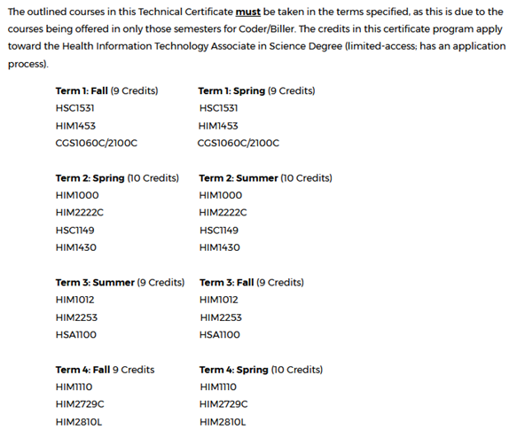
Notes:
Students who enroll for either the Fall-to-Fall sequence or Spring-to-Spring sequence, and successfully complete all courses, will complete the TC program in 4 terms.

Slide 17
Program Descriptions & Career Exploration

Slide 18
Cardiovascular Technology
Invasive (in the body/below the skin) CVT program designed for students to learn to perform, at the direction of a qualified physician, technical procedures for identifying and treating abnormalities of the heart
Perform procedures like catheterization (tubing inserted through blood vessels) in order to assess blood flow for diagnosis and treatment of cardiovascular injury and disease.
A.S. Cardiovascular Technology B.S. Cardiopulmonary Sciences
Notes:
Cardiac catheterization, a long narrow tube called a catheter is inserted into an artery or vein in your groin, neck, or arm
Electrophysiology studies test the electrical activity of your heart to find where an arrhythmia (abnormal heartbeat) is coming from. These results can help you and your doctor decide whether you need medicine, a pacemaker, an implantable cardioverter defibrillator (ICD), cardiac ablation or surgery
The program is accredited by the Joint Review Committee on Education in Cardiovascular Technology (JRC-CVT; http://jrccvt.org/) and by the Commission on Accreditation of Allied Health Education Programs (CAAHEP) Graduates are eligible to take the national Registered Invasive Cardiovascular Specialist exam administered by Cardiovascular Credentialing International

Slide 19
Dental Hygiene
Prepares students to become licensed as a primary oral health care professional and educate patients on ways to improve and maintain good oral health in a fully-functional Dental Hygiene Clinic on the West Campus
As a Dental Hygienist, you’ll examine patients for signs of oral disease and providing preventative dental care, cleanings, and X-rays. Program students provide preventive dental hygiene services to the student population as well as to the general public.
Notes:
Currently one of Valencia’s most competitive programs!
Dental Clinic information coming to Health Sciences landing page soon – cleaning/preventative services available to students and public
Dental Clinic information: https://catalog.valenciacollege.edu/studentservices/healthservice/
This program is accredited by the Commission on Dental Accreditation and has been granted the accreditation status of “approval without reporting requirements.” The Commission is a specialized accrediting body recognized by the U.S. Department of Education.
Graduates are eligible to take the National Dental Hygiene Board Exam and Florida or regional examinations for licensure as registered dental hygienists

Slide 20
Diagnostic Medical Sonography
This program teaches students about playing a role in the treatment and care of patients by producing images of organs using high frequency sound waves via ultrasound.
A Sonographer provides the images of the soft tissue organs of a patient—like the liver, gallbladder, kidneys. Sonographers may also get to share in an experience most people remember for a lifetime—providing expectant mothers with their first glimpse of an unborn child.
A.S. DMS B.S. Radiologic and Imaging Sciences
Notes:
Notoriously Valencia’s most competitive program; in the running with Dental Hygiene for most-sought out program in Allied Health
The program is accredited by the Commission on Accreditation of Allied Health Education Programs (CAAHEP)
Graduates are eligible to take the national certifying examinations administered by the American Registry of Diagnostic Medical Sonographers.

Slide 21
Emergency Medical Services
EMTs and Paramedics assess injuries, administer emergency care and transport injured or ill people to medical facilities.
The EMS programs teach theory and clinical applications, and provides hands-on experiences that prepare students for National Registry certification as Emergency Medical Technicians and Paramedics.
T.C. EMT T.C. Paramedic A.S. EMS
Notes:
The program will prepare the student for national registry as an emergency medical technician after completion of EMT program, and a Paramedic after completion of the Paramedic program.
Step 1: EMT (offered every term – dev. Ed only prerequisite; Medical Terminology recommended beforehand)
Step 2: Paramedic (Application every June for Fall – West Campus, and September for Spring – Osceola Campus)
Step 3: A.S. EMS Technology General Education courses can be completed prior to admission to Paramedic as AA General, or after EMT and Paramedic
A Florida-approved accredited program through Commission on Accreditation of Allied Health Education Programs (CAAHEP)

Slide 22
Medical Information Coder/Biller
This certificate prepares students for entry-level employment responsible for assigning correct diagnostic and procedural codes to medical documentation from patients’ records using International Classification of Diseases (ICD Coding) to ensure appropriate insurance reimbursement.
The Medical Information Coder/Biller program can either be taken as a separate certificate or lead into applying for the A.S. in Health Information Technology
T.C. Medical Info Coder/Biller A.S. Health Information Technology
Notes:
Course descriptions: https://catalog.valenciacollege.edu/coursedescriptions/coursesoffered/him/
https://catalog.valenciacollege.edu/degrees/associateinscience/alliedhealth/healthinformationtechnology/
Most work as medical coders, sometimes called coding specialists; completion of TC students eligible for Certified Coding Associate (CCA – in program guide)

Slide 23

Health Information Technology
The HIT program prepares students to become Health Information Technicians with potential for advancement to management positions (which may require advanced education and/or experience)
Employment sectors for health information technology professionals are hospitals, clinics, insurance companies, nursing homes, doctors’ offices, and rehabilitation centers
https://my.ahima.org/careermap
Earn the T.C. Medical Info Coder/Biller within the degree
Notes:
https://catalog.valenciacollege.edu/degrees/associateinscience/alliedhealth/healthinformationtechnology/
https://my.ahima.org/careermap
B.S. HIM at UCF: http://catalog.ucf.edu/preview_program.php?catoid=3&poid=690
Advanced positions with Health Information: https://ccie.ucf.edu/wp-content/uploads/sites/12/2018/09/him-hsa.pdf
Graduates are eligible to take the Registered Health Information Technician certification exam administered by the American Health Information Management Association.

Slide 24
Health Care Specialist
This certificate prepares students for entry-level employment as assistants in health care services settings while exploring pathways to a nursing, allied health, or transfer-focused associate's degree.
This program is for individuals who are currently employed in the health field or seeking employment in entry-level positions in doctor's offices, hospitals, pharmacies, clinicals, and community health organizations.

Slide 25
Health Navigator
Health Navigators assist those who need help navigating their health care or simply accessing community resources. From health insurance to hospitalization and from wellness to rehabilitation.
Health Navigators may also facilitate access to care and follow-up for sick and complicated patients with cancer, HIV, and a range of other complex health problems. In addition, Health Navigators can assist with identifying and enrolling patients in various health insurance plans including ACA Exchanges, Medicaid, Medicare, and disability services.

Slide 26
Radiography
The Radiography program teaches students to become highly skilled professionals in the safe and effective use of radiation to treat patients by operating X-ray imaging equipment and perform diagnostic imaging examinations that help doctors accurately diagnose and treat their patients for injury and disease.
Radiographers are employed primarily in hospitals but are also available in radiological/imaging centers, urgent care clinics, private physicians’ offices, and public health service facilities.
A.S. Radiography B.S. Radiologic and Imaging Sciences
Notes:
The program is accredited by the Joint Review Committee on Education in Radiology Technology. Graduates are eligible to take the national certifying examination administered by the American Registry of Radiologic Technologists. (ARRT)
Because Dental Hygiene uses radiographic imaging, students interested in Dental may also find Radiography to be a secondary option for a career
Students also interested in Radiography may consider CVT as a career path due to the use of radiographic imaging primarily for heart-related ailment diagnosis

Slide 27
Respiratory Care
Respiratory Therapists are an integral member of any medical team and serve as life-support specialists that work to restore the heart and lung system to normal function
Assist physicians in treating patients who experience heart or breathing disorders among various patients, ranging from premature infants with underdeveloped lungs to patients with chronic asthma or chronic lung disease such as COPD/emphysema.
A.S. Respiratory Care B.S. Cardiopulmonary Sciences
Notes:
This program is accredited by the Commission on Accreditation for Respiratory Care.
Graduates are eligible to obtain the national credential(s) through the National Board for Respiratory Care. Once the A.S. degree in Respiratory Care is complete, students can continue on and get the Bachelor’s degree from Valencia in Cardiopulmonary Sciences

Slide 28
Career Exploration
Exposure to bodily fluids, peer-to-peer exams, direct patient care, life and death professions
  All Allied Health professions listed prior (except HIT in most settings)
Students accepted into these programs will be expected to adhere to Centers for Disease Control (CDC) guidelines
  Know your program before you apply!
Each of the discussed programs are high in-demand with students earning employment soon after graduation
Highly recommend research for the purpose of knowing what you’re getting into before acceptance
What is your why?
Notes:
Several health sciences programs have clinical experiences that may expose the student to blood borne pathogens via contact with bodily fluids such as blood and saliva. *you have to touch people!*
Students accepted into these programs will be expected to adhere to Centers for Disease Control guidelines regarding the use of Universal Precautions which includes the use of personal protective equipment such as masks, gloves, and eyewear. *25 lbs weighted vest in Rad*

Slide 29
Career Center
If you are undecided about which career to choose or need more information about specific career outlooks, contact the Career Center:
  http://valenciacollege.edu/careercenter
Services available for students:
  discover career options best suited to them
  decide on a major related to career choice
  review resumes, cover letters, and more!
Campus locations:
West SSB 206 Osceola 2-125
East 5-230 Winter Park 1-214
Notes:
SLS & HSC1004 students – take your assignments seriously for research/career interviews/reflection papers, etc.

Slide 30
What is ‘Pending’?

Slide 31
Pending Allied Health Students =
Active Valencia students who are pending program acceptance
A student’s primary or secondary major is declared as a “Pending Allied Health” when applying. If the student is accepted into their program of choice their major will reflect that specific program.
Limited Access: The student must apply and be accepted into the program in order to register for courses specific to that program. Admission to Valencia does not guarantee acceptance to a specific program.
(Limited number of students accepted)
Open Access: Students are able to start the program without a separate program application process other than applying to be a Valencia student.
Notes:
Limited access status occurs when student demand exceeds available resources such as faculty, instructional facilities, equipment, etc. Admission to Valencia does not guarantee acceptance to a limited-access degree program. Limited-access programs have specific admission requirements.

Slide 32
Financial Aid
Estimated total cost (posted on Health Sciences website) https://catalog.valenciacollege.edu/financialinformationfees/estimatedexpenses/
May not be full-time each term in program
Primary major - AA (prerequisites)
Secondary major - “pending” status for Limited Access Health Program AS until accepted
If Unmet Need, visit Answer Center about work study, Foundation scholarships, or other resources
Foundation Scholarships: https://www.valencia.org/
Scholarship Bulletin Board:
https://valenciacollege.edu/finaid/scholarship-bulletin-board.php
Notes:
Foundation Scholarships: https://www.valencia.org/
Scholarship Bulletin Board: https://valenciacollege.edu/finaid/scholarship-bulletin-board.php

Slide 33
Technical Certificate EMT and Financial Aid
After enrolling into EMS1119, 1119L, and 1431L – check your Atlas email for an email from ‘Ask Atlas’
  Follow the link given for required orientation and compliance information as soon as possible
  May also receive communication from HealthScienceApplications@valenciacollege.edu
To receive financial aid for the EMT courses, you may need to:
  Declare the AA degree as your primary major
  Declare the EMT Technical Certificate as your secondary major
  Have at least 12 elective credits remaining in the AA Degree

Slide 34
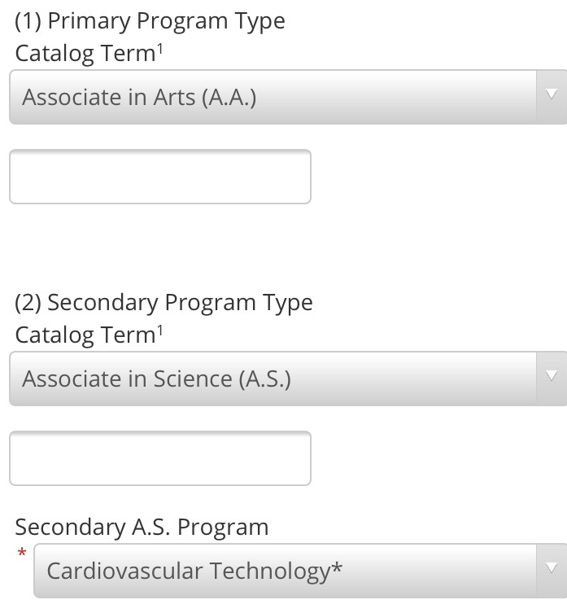
Change of Program/Major Form
*This is a limited access, selective admissions program that may require an additional application. Contact the specific department for more information. An Associate in Arts in General Studies will be added to your student record if you have not been previously awarded an A.A. degree or higher. This will allow you to take prerequisite courses for the limited access program.
Important Note: Students may earn only one A.A. degree. If you have already completed an A.A. or Bachelor’s degree at Valencia College or at another institution, you may not seek another A.A. degree at Valencia College.
Notes:
Note that students are given description of limited-access while completing Change of Program/Major form

Slide 35
Overview of Program Facts & Requirements

Slide 36
​ Programs​ | ​ Admission Deadlines​ | ​ Location​ | ​ Admitted Students ​ | ​ Minimum GPA​ | ​ Minimum TEAS​
Cardiovascular​ Technology​ | May 31*​ | West Campus​ | 16​ | 2.5​ | 58.7​
Dental Hygiene​ | Jan. 31​* | West Campus​ | 25​ | 2.5​ | 58.7​
Diagnostic Medical Sonography​ | May 31​* | West Campus​ | 12​ | 2.5​ | 58.7​
EMT (TC)​ | Open-access​ | West & Osceola Campus​ | Varies (130)​ | None​ | None​
EMS (AS) & Paramedic (TC)​ | May 31* & Sept. 30​* | West (Fall) & Osceola (Spring)​ | West 50 OSC 30​ | 2.0​ | None​
Health Info Tech​ | May 31* | Online​ | 25​ | 2.0 | None​
Medical Info Coder/Biller (TC)​ | Open-access​ | Online​ | Varies​ | None​ | None​
Radiography​ ​ | Jan. 31* | West Campus​ | 25​ | 2.5​ | 58.7​
Respiratory Care​ ​ | Sept. 30*​ | West Campus​ | 30​ | 2.0​ | None​
Notes:
*Deadlines are subject to change*

Slide 37
Program Format
ACADEMICALLY DEMANDING
  Change of grading scale
    A 93-100
    B 85-92
    C 76-84
      (Anything less than 76 is not considered passing)
  Schedules are set for each term
    Students do not have several options of course days/times like prerequisite general education courses (with the exception of Paramedic as ‘shift-friendly’)
  Time management, support system, & financial planning
  Transportation to clinical sites*
    Students responsible for travel to clinical locations which can be in Orange, Osceola or Seminole counties and assigned at random
    Job placement after program completion between 90-100%
Notes:
Students do not get a choice of clinical site based on where they live; random assignment (except Paramedic) as spots for students completing clinical rounds are limited

Slide 38
Cardiovascular Technology Program Sample Schedule
Example:
First semester, Fall, first year:
CVT 1000C 4.0 credits - Thursday 9am-4pm=6 hrs. + 3hrs study
CVT 1270 3.0 credits- Wednesday 800am-1130am=3 hrs. +3hrs study
Approximately 15 hrs. of committed time per week
Fall semester, second year:
CVT2620C 4.0 credits - Monday-9am-4pm= 6hrs+ 3hrs study
CVT2842L 4.0 credits -Tuesday-9am-4pm=6hrs+3hrs study
CVT2420C 4.0 credits -Wednsday-9am-4pm-6hrs+3hrs study
Hospital rotation-630am-430pm=10 hrs.
Hospital rotation-630am-430pm=10 hrs.
Approximately 47 hrs. a week
Notes:
Similar across Sonography, Radiography, Dental Hygiene – the first semester of the first year is always on the lighter side to give introduction; Respiratory also has a first term of introduction, however, the program is shorter and therefore needs a time commitment sooner during the program.
Do not be fooled by the lower number of credit hours or approximate time – this can vary on students’ outside obligations and still requires a balance and time management
Paramedic is a full-time 12-14 credit hour commitment each of the 3 terms – no buffer for introductory info
HIT/Coder-Biller can range from 9-12 credit hours in a given semester, and because all online aside from Gen. Eds, this can be a learning curve for some students!

Slide 39
Program Statistics

Slide 40
Programs | Average Points | Average GPA | Average TEAS | Number of Applications | Application Year
Cardiovascular Technology | 72 (with interview) | 3.3 | 70 | 36 | 2023
Dental Hygiene | 65 | 3.6 | 75 | 156 | 2023
Diagnostic Medical Sonography | 57 | 3.5 | 73.6 | 57 | 2023
TC Paramedic (West Campus) | 23 | 3.2 | N/A | 47 | 2023
TC Paramedic (Osceola Campus) | 22 | 3.0 | N/A | 11 applicants 6 agency sponsored | 2022
Health Info Tech | 45 | 3.2 | N/A | All students accepted | 2023
Radiography | 59 | 3.4 | 78 | 88 | 2023
Respiratory Care | 49 | 3.1 | N/A | 63 | 2022

Slide 41
Allied Health Program
Admissions Requirements

Slide 42
A.S. Degrees Typical Admission Requirements
Review the current specific Program Guide
Meet with your assigned advisor
Satisfy entry testing requirements and complete mandated courses in reading, English and math
Complete all prerequisite courses, plus additional courses to be competitive
All official High School or GED and College Transcripts must be on file
Have the minimum overall GPA to apply
*ATI - Test of Essential Academic Skills (TEAS)
  Minimum score 58.7%
  *Not all programs have this requirement
Pay $15 Health Sciences application fee
Apply by program application deadline
Notes:
EMT and Bachelor-level programs do not use an admission point system – students who meet admission requirements are conditionally accepted
Read the Guide of your program of interest in its entirety and confirm you are meeting all enrollment, course completion, and performance standard requirements before applying!

Slide 43
Health Sciences Orientation and Compliance
Please email the Compliance office now if you have any possible legal obstacles that may prevent you from participating in a limited access health program. HScompliance@valenciacollege.edu
After acceptance to a Health Sciences program and prior to starting the program, students are required to complete clinical compliance requirements. Students are asked NOT to begin the steps listed below until after acceptance to a program in order to have up-to-date information submitted through the Valencia-approved vendor (discussed at program orientation!):
Participate in mandatory program orientation
Complete background check, drug testing, and Fingerprinting through Valencia-approved vendor
Complete specified CPR/BLS American Heart Association course
Complete health physical exam
Obtain required immunizations
    Also required for program purchase - Uniforms, books, lab kit, polo shirts, name pins (possibly spend around $400 or more)
International students
In addition to all the requirements for compliance (after acceptance) a second background check from your home country is required. There is an additional cost associated with this. If you have a concern about how this may impact your program acceptance, please reach out to the compliance team – hscompliance@valenciacollege.edu

Slide 44
Diagnostic Medical Sonography
Orientation and Compliance
Complete compliance requirements as soon as you accept your seat in the program
Shadowing requirement: Two 8-hour shadowing experiences - to be completed prior to program orientation; scheduled during one-on-one with faculty
These steps are to be completed ONLY if accepted to the program
  Currently this is the only program with this requirement
Notes:
Accept seat to program
Schedule one-on-one meeting with faculty to schedule shadowing
Complete compliance before shadowing
Attend orientation

Slide 45
Academic Requirements

Slide 46
Course Placement
PERT/SAT/ACT/AP/IB Placement into coursework varies from student to student – please see advising for questions on course placement and registration.
All scores must be requested to be sent to Valencia College if courses and/or exams that were not completed here
  Ex. AP/CLEP request from CollegeBoard
  TEAS from ATI TEAS
Notes:
Discussed at New Student Orientation

Slide 47
Prerequisite Courses
Check if program prerequisite courses also have prerequisites.
Can take prerequisite courses on any campus and on multiple campuses at the same time
Can take prerequisite courses in multiple formats (online, classroom, mixed mode, etc.)
Can be a part-time or full-time student while preparing for a Health Sciences program

Slide 48
General Program Prerequisites

Slide 49
General Prerequisites
Please check your Program Guide
BSC 2093C Anatomy and Physiology I
BSC 2094C Anatomy and Physiology II
MCB 2010C Microbiology
PSY 2012 General Psychology
ENC 1101 Freshman Composition I
CORE Humanities (meets Valencia General Education requirement)
POS 2041- U.S. Government or AMH 2020- U.S. History 1877 to Present
MAC 1105 College Algebra / Core Math or STA 2023- Statistical Methods
CGS 1060 Introduction to Computers
PHY 1007C Physics with Medical Applications
EMS 1010 Essentials of Human Structure & Function
HSC 1531 Medical Terminology
You can receive additional admission points by taking either HSC1004 (Professions of Caring) or SLS1122 (New Student Experience). As a pending Health Sciences Student, HSC1004 will satisfy the SLS1122 requirement for the AA degree; your advisor will process the substitution.
Notes:
Overall requirements for programs – all are not required for every program

Slide 50
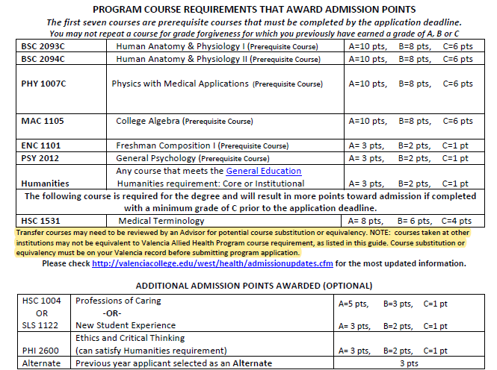
SAMPLE: Point System for Competitive Selection
Notes:
https://valenciacollege.edu/academics/programs/health-sciences/documents/diagnostic-medical-sonography-program-guide.pdf

Slide 51
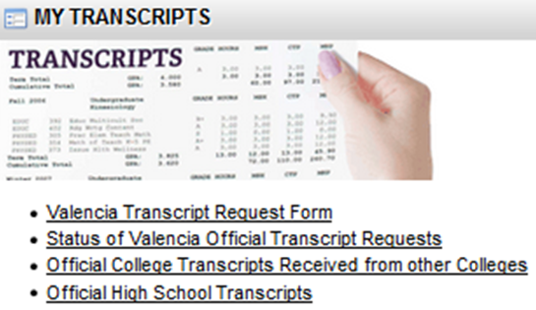
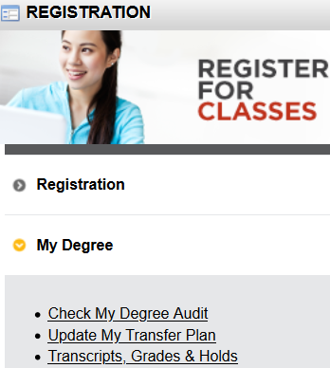
Transferred Courses
1) All official transcripts, including prior colleges and HIGH SCHOOL, as well as any official AP/IB/CLEP scores, should be submitted to Valencia well in advance of a health science program application deadline, as transcripts can take up to 20 business days to be processed and evaluated.
NOTE: Your application will be ineligible if you are missing transcripts.

Slide 52
Transferred Courses (continued)
In order for transfer courses to be considered for admission requirements, transfer courses may need to be evaluated with advising before applying.
Check your unofficial academic transcript in Atlas (Courses tab, Registration, Transcripts) to view your transferred coursework. If your transfer courses do not equal Valencia’s required health science courses, they will appear as XFER on your file.
Meet with an Allied Health Program Advisor to determine your best possible course of action such as:
  Request a Non-Equivalent Course review (NEC), or request a substitution (Substitutions and NEC reviews are not recommended for XFER courses with ‘C’ grades.)
  or register for the required course at Valencia.
A general Academic Advisor can also help you determine if the courses you have taken outside of Valencia are acceptable for your desired program.
Early preparation is important!

Slide 53
Grade Forgiveness
Per the Valencia college catalog, State Regulation 6A-14.0301, grade forgiveness cannot be applied to grades of “C” or higher
Valencia will not use the higher grade of a repeated course if the grade of “C” or higher was earned on the first attempt
Notes:
https://www.flrules.org/gateway/ruleno.asp?id=6A-14.0301 Link to state regulations (training and referral purposes)

Slide 54
Are You Ready For Biology?

Slide 55
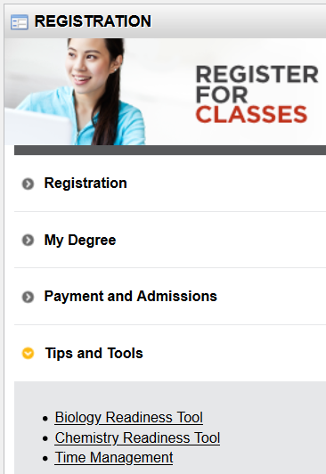
Biology Readiness Tool
If you register for BSC1010C, you will receive an email to take the Biology Readiness Tool (BRT). This tool will help you determine if you are ready to take BSC1010C or if you should take CHM1025C first.
Determining if you are ready to take BSC1010C will save you time and money!
Notes:
Students are looking to get around a 70% readiness for BSC1010C based on the results of this module

Slide 56
BSC1010C General Biology 1
Prerequisite Recommendations
While not required, the Science department recommends
If you do not have a strong science background:
BSC1005C and CHM1025C (can be taken separately) before taking BSC1010C and HSC1531 simultaneously
OR
CHM1025C before taking
  BSC1010C AND HSC1531 simultaneously
OR
CHM1025C before taking BSC1010C
*Note: taking these courses may impact your financial aid. See an Advisor for more details.
Notes:
*completing Dev math is required before reg to BSC1010C – recommended to have more math completed prior to enrolling (MAT1033C and/or MAC1105)
A fundamental chemistry knowledge is crucial for BSC1010C success, taking BSC1010C & HSC1531 together in the same term helps students do better in both classes, building a stronger science foundation. Taking HSC1531 before BSC2093C promotes success in BSC2093C
*Science Departmental Approval - a minimum grade of B in Honors Biology and Honors Chemistry; or AP Biology and AP Chemistry
Strong indication for future science courses

Slide 57
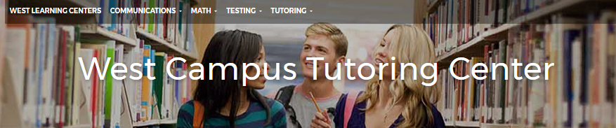
https://valenciacollege.edu/students/learning-support/west/tutoring/subject.php
Online tutoring: https://libguides.valenciacollege.edu/distancetutoring
Subjects Available for Tutoring:
Biology
Anatomy and Physiology
Physics
Mathematics
  From Developmental to Differential Equations
Communication
  EAP, English, and Speech
PERT and TEAS exam preparation

Slide 58
ATI TEAS (Test of Essential Academic Skills)
The TEAS is required to apply to these Allied Health Programs:
CVT, Dental Hygiene, Radiography, Sonography: Minimum Composite score 58.7% required
Retake limit of 3 times per 12-month period; must wait 30 days between test administrations; recommend first attempt be 3 months prior to application deadline
ATI TEAS scores are valid for 2 years - ATI only; version V not accepted
TEAS taken outside of Valencia requires official score from ATI Testing must be sent to Valencia (ATI charges a transfer fee).
ATI Score Matching Request Form
  This request is only to match up your score report from ATI to your Valencia account. ATI Score Matching Request Form
Notes:
More expensive for non-students*
Valencia Student- $65 per test; Non-Valencia Student- $85 per test; Test fees are non-refundable.

Slide 59
ATI-TEAS
Students must make an appointment to take the TEAS exam (Assessment Center).
ALL sections of the TEAS must be taken in one sitting - TEAS covers English, Reading, Math and Science
The ATI TEAS is a computerized test with a time limit of 209 minutes. Maximum of THREE attempts in 12 months; this includes tests taken at other institutions. Number of attempts is calculated from your first attempt. Students must wait 30 days between attempts. The cost for Valencia Students is $65, and non-Valencia students is $85. ATI TEAS scores are valid for 2 years.
ATI TEAS Resources:
All Campus Libraries
Assessment Services – Taking the TEAS
ATI TEAS Review Sessions - *Must be a current student to access*
TEAS | Reading | Mathematics | Science | English & Language Usage
Number of Questions | 53 | 36 | 53 | 28
Time Limit (Minutes) | 64 min | 54 min | 63 min | 28 min
Specific Content Covered | Key Ideas & Details Craft & Structure Integration of knowledge & ideas | Numbers & Algebra Measurement & Data | Human Anatomy & Physiology Life & Physical Sciences Scientific Reasoning | Conventions of standard English Knowledge of Language Vocabulary acquisition

Slide 60
Before you Apply to Any Valencia Allied Health Program
All admission requirements must be satisfied BEFORE submitting an application
The grades for each prerequisite course must be posted to your Valencia Atlas account BEFORE submitting your application to a Valencia health program.
All transcripts - High School and College - must be posted to your Valencia Atlas account BEFORE submitting your application.
  Applications submitted that have not met all criteria are considered ineligible
  Examples:
  TEAS taken outside of Valencia (score not posted in Atlas) – students must request scores from ATI, then complete the ATI Score Matching Request Form before applying!
  Minimum GPA not met
  Grades not posted
  Transcripts not received and evaluated

Slide 61
Check Atlas to see if you have an assigned Advisor:
Academic Profile (Courses Tab)
Education Plan (LifeMap)
*Highly recommend to meet with an Allied Health Program Advisor early on for semester planning well before an application deadline*

Slide 62
On behalf of the School of Allied Health –
Thank you!
Questions? Ask us!

