Slide 1
Ucf-VC campus bookstore
Dual enrollment student ordering guide

Slide 2

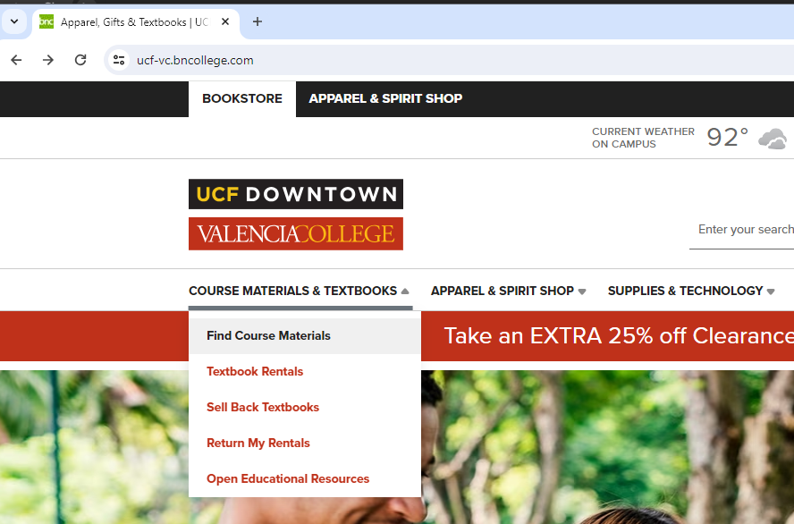
Step 1
STEP 1: VISIT OUR WEBSITE
UCF-VC.BNCOLLEGE.COM AND CLICK
COURSE MATERIALS & TEXTBOOKS,
AND THEN CLICK FIND COURSE

Slide 3
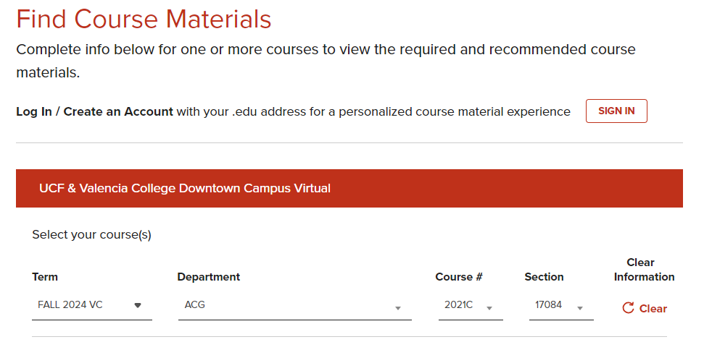
STEP 2
ENTER COURSE INFORMATION FOR INDIVIDUAL STUDENTS FOR THE CURRENT TERM.
NOTE: FOR BILLING PURPOSES EACH STUDENT MUST HAVE A SEPARATE ORDER. NO BULK ORDERS.

Slide 4
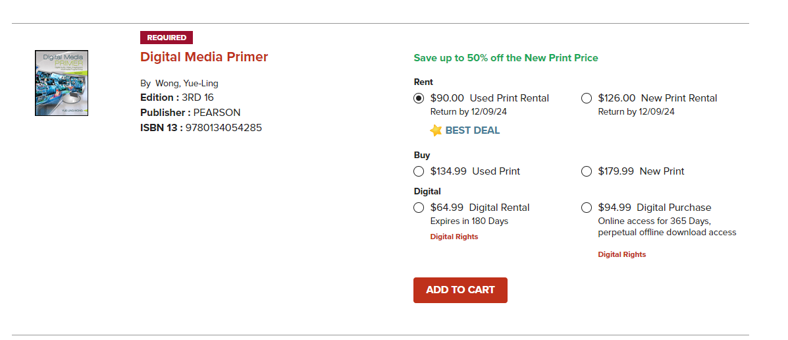
STEP 3
All course materials will generate
Select the preferred format of new, used, or digital
Do not select rent
ADD ALL REQUIRED ITEMS TO CART TO CONTINUE
NOTE: WE WILL FULFILL WHATEVER CONDITION IS ACTUALLY IN STOCK (EXAMPLE, IF YOU ORDER NEW AND WE ONLY HAVE USED, WE WILL FULFILL USED AND CHARGE THE REDUCED PRICE).

Slide 5
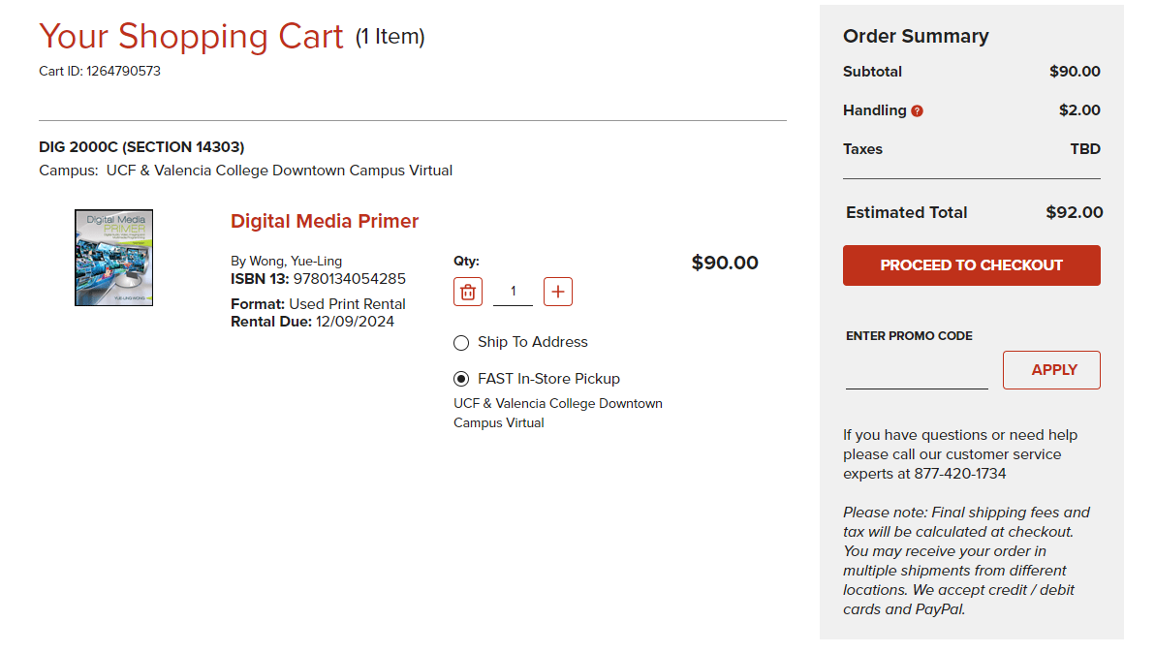
Step 4
Checkout
Note: IF YOU ARE A DE COUNSELOR ORDERING FOR MULTIPLE STUDENTS, SELECT "CONTINUE AS GUEST" AS THE STUDENT'S NAME MUST MATCH THE NAME AND EMAIL ON THE ORDER.

Slide 6
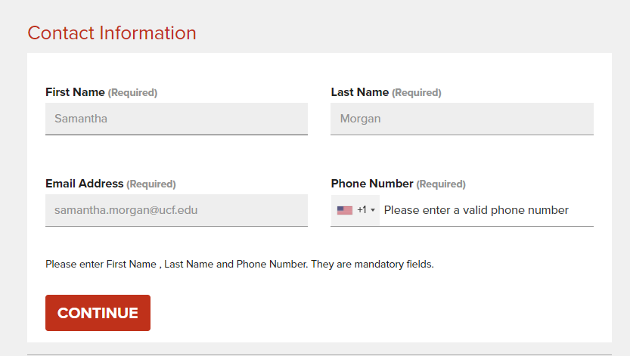
STEP 5
ENTER STUDENTS FIRST AND LAST NAME AS ONE IN THE "FIRST NAME" FIELD
ENTER HIGH SCHOOL NAME IN THE "LAST NAME" FIELD
First & Last
Name of School
THIS WILL GREATLY IMPROVE BILLING SPEED AND ACCURACY, AS WELL AS REDUCE ORDERS BEING CANCELLED

Slide 7
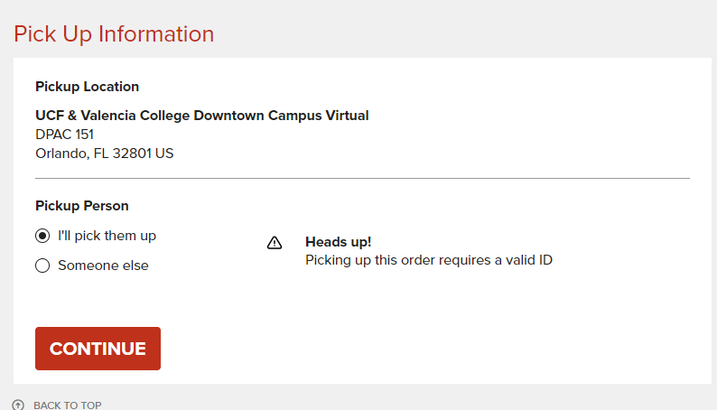
Step 6
Please select in-store pick up:
  UCF-Valencia Campus
DPAC 151
SHIPPING is not FREE we recommend all de students select in-store pick up.
NOTE: FREE UPS GROUND WILL ARRIVE IN 1-2 BUSINESS DAYS
ANYWHERE IN FLORIDA, do not SELECT 2ND DAY OR NEXT DAY AIR

Slide 8
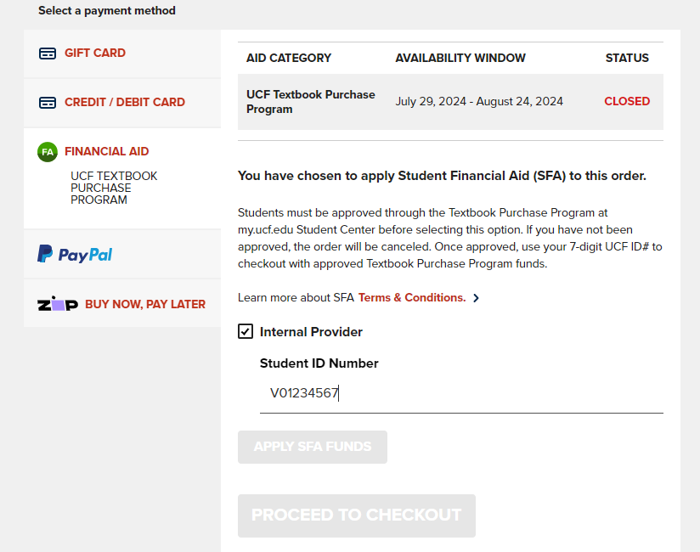
Step 7
PAYMENT SCREEN - CLICK FINANCIAL AID, THEN CHECK THE INTERNAL PROVIDER BOX
NOW ENTER THE STUDENTS NAME, AND VALENCIA ID V########
YOU NO LONGER NEED TO ADD DE

Slide 9
STEP 8
COMPLETE YOUR ORDER
YOU WILL RECEIVE AN ORDER CONFIRMATION EMAIL AND THEN A SEPARATE EMAIL WHEN THE ORDER IS READY FOR PICK UP.

Slide 10
CONTACT US
Please email textbooksonline@ucf.edu or call 407-823-3166 with any questions during the ordering process we are here and happy to help.

