Slide 1

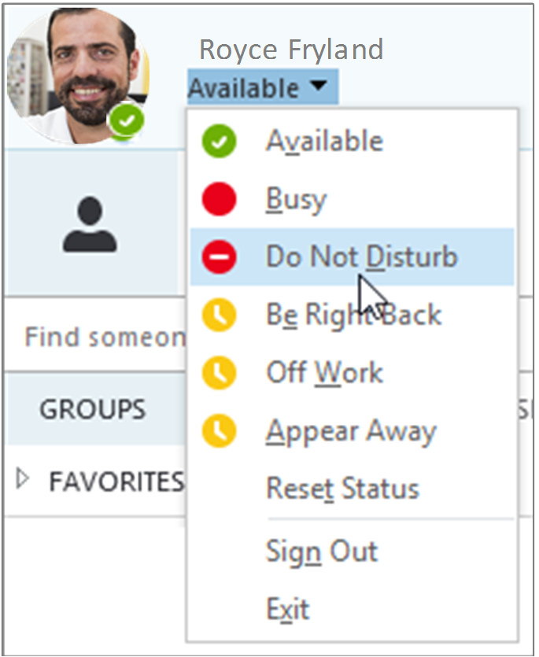
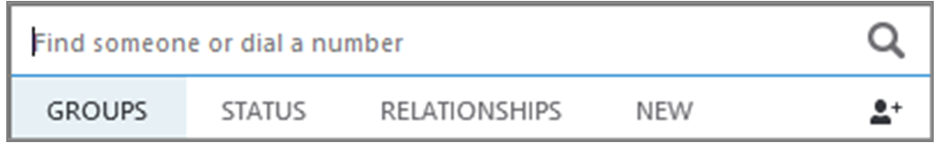
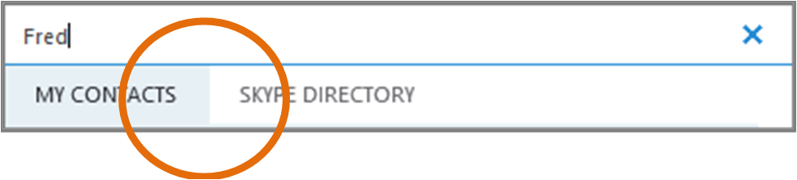
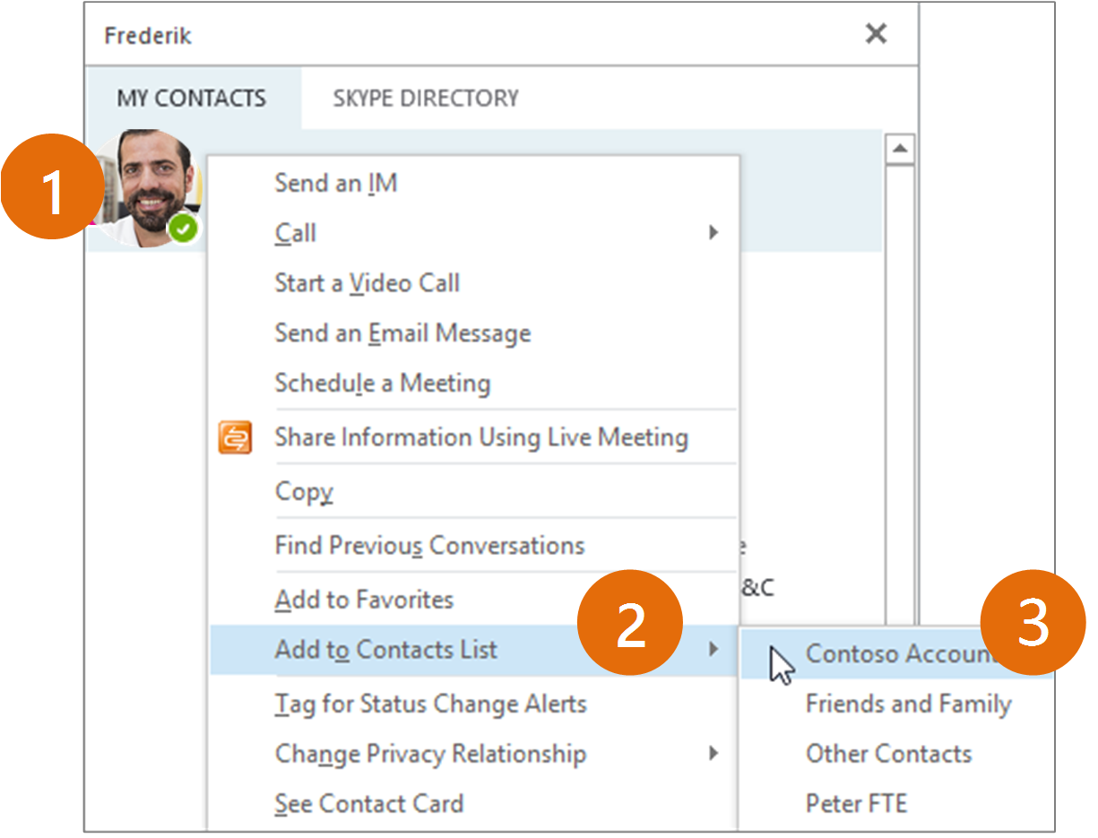
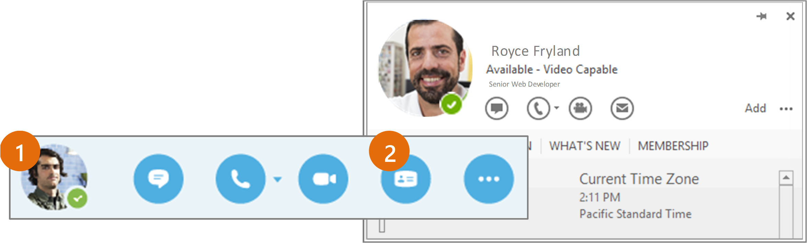
Contacts, presence, and IM Quick Start Guide, pages 4 and 1
Want to shut your virtual office door?
Presence is automatically set based on your Outlook calendar but you can change it temporarily if you want to. Presence status is a quick way for other people see whether or not you’re free to chat. Here are the presence settings you can change:
Quick Start Guide
Contacts, presence, and IM
Find someone
Connect with people in your organization, or with friends who have a Skype account.
Type a name in the Search box. As soon as you do, the tabs below the Search field change from this: to this:
If your presence is: | It means you are:
Available * | Online and available
Be Right Back ** | Away from your computer briefly
Away *, ** | Logged on, but have been away from computer for a period of time.
Off Work ** | Not working or not available
Busy *, ** | Hard at work and shouldn’t be interrupted
In a call * | In a Skype for Business call (two-party call)
In a meeting * | In a meeting (using Skype for Business or Outlook)
In a conference call * | In a Skype for Business conference call (Skype meeting with audio)
Do Not Disturb ** | Do not want to be disturbed. You will see IMs, but only if you’re both in the same Workgroup.
Presenting * | Giving a presentation
Out of the office | Set to OOF in your Outlook calendar
Offline * | Not signed in
Unknown | Presence can’t be detected
If the person is in your organization, stay on the MY CONTACTS tab. If not, click on the SKYPE DIRECTORY tab. It will narrow your search if you know their full name or Skype user name.
Add a contact
Once you find a person, add them to
your Contacts list for quick access.
Right-click the name in the search
results.
Click Add to Contact List.
Pick a group to add your new
contact to.
* Set automatically for you based on your keyboard activity or Outlook calendar.
** You can set your presence to this anytime you want.
View a contact card
Tap a contact picture.
Tap the Contact Card button to open Contact Card.
Which Skype should I use?
Skype for Business is for connecting with a co-worker or business associate.
Skype is for connecting with your grandma, or chatting with friends while gaming.
© 2015 Microsoft Corporation. All rights reserved.

Slide 2
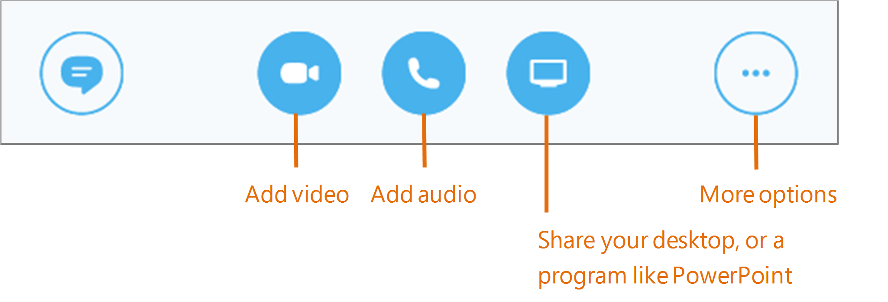
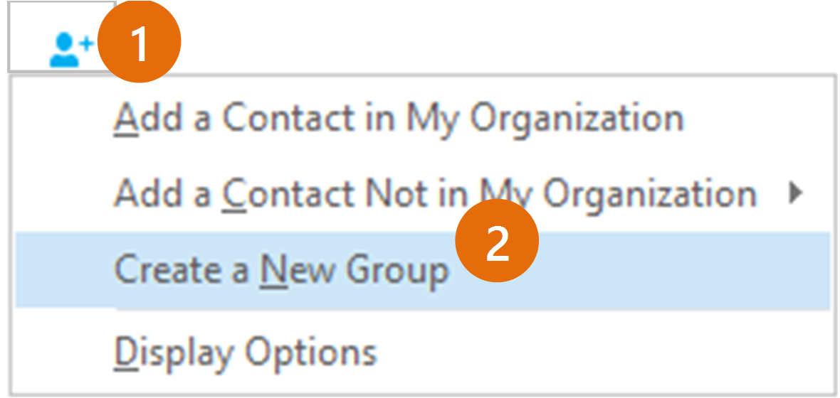
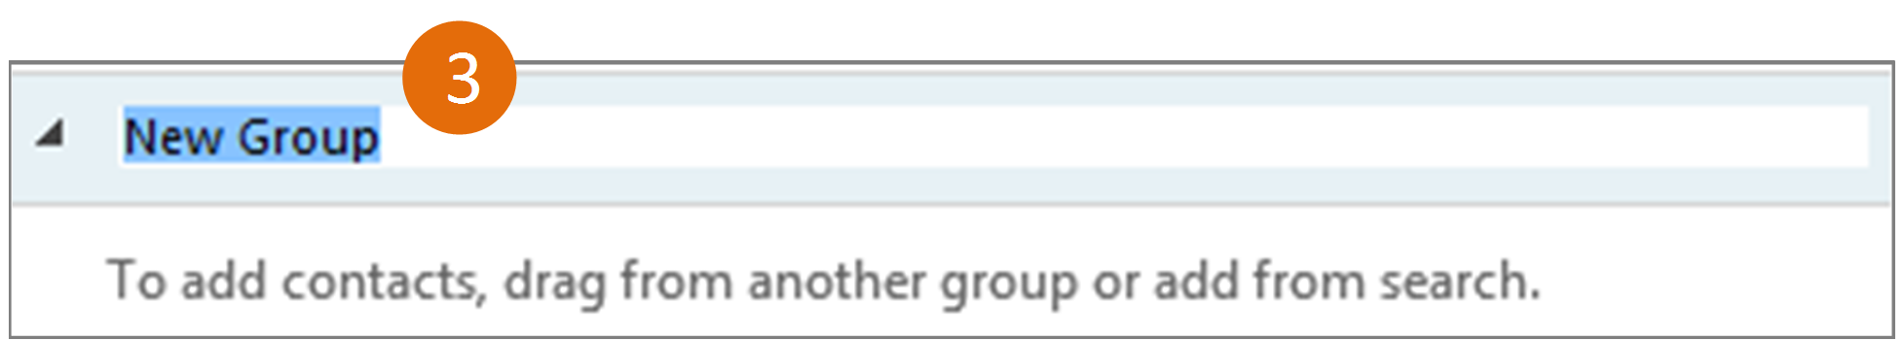
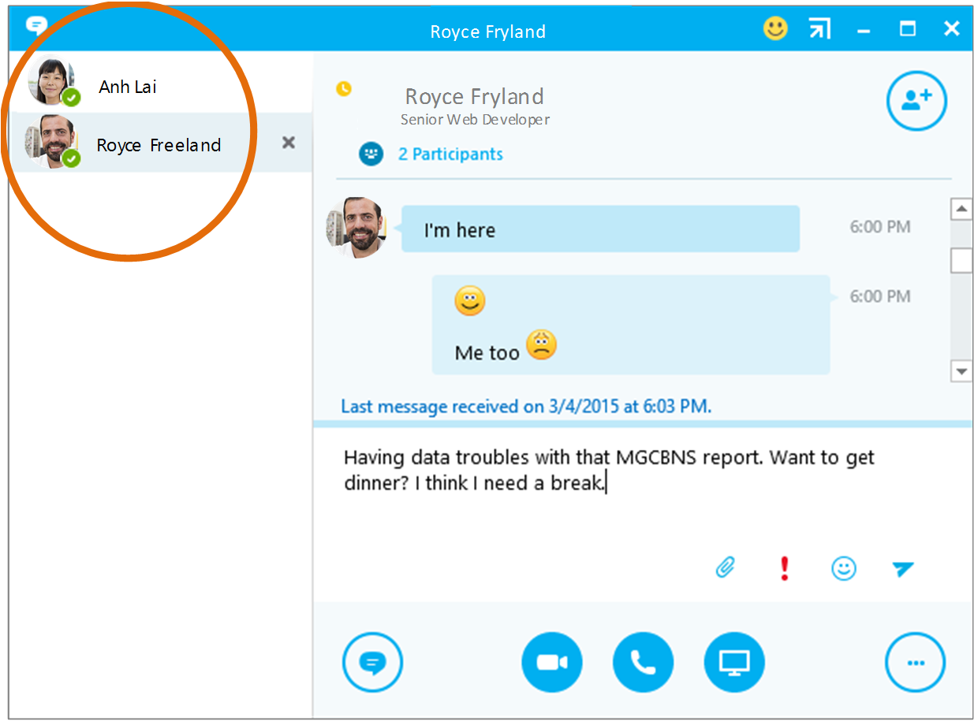

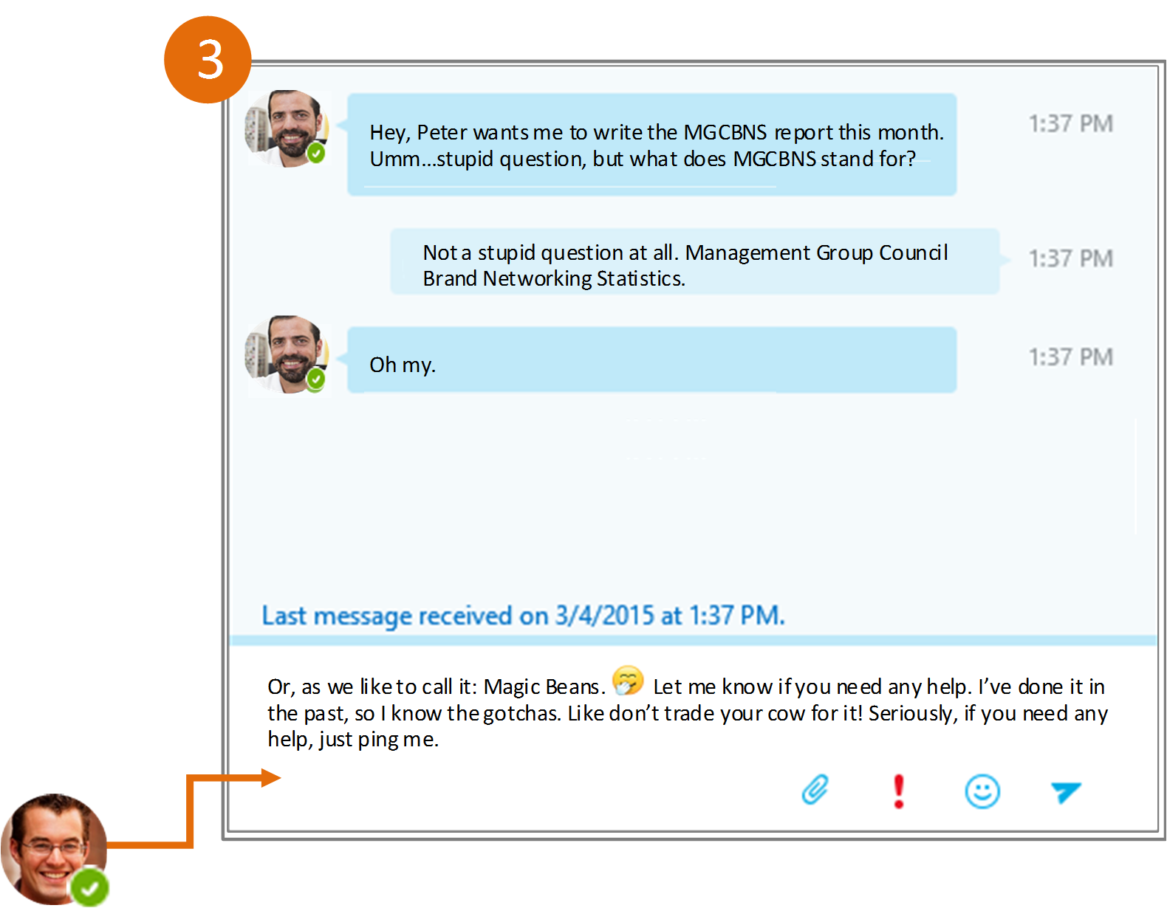
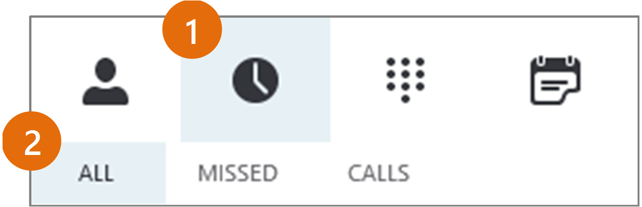
Contacts, Presence, and IM Quick Start Guide, pages 2 and 3
Create a group
Set up a group for each team you work with so you quickly see who’s available, or communicate with the entire team at once.
Click the Add a Contact button.
Select Create a New Group.
Begin typing your new group name.
Add audio, video and share files in an IM conversation
Switch between conversations
If you have several conversations
or meetings going on at the
same time, Skype for Business
displays them all in one place, so
you can toggle between them.
Click a tab on the left to view an
IM conversation.
Send an instant message
Use instant messaging (IM) to touch base with your contacts right away.
In your Contacts list, point to
the contact you want to IM. If
you want to IM with more
than one contact, hold down
the Ctrl key and click each
contact name.
Click the IM button.
Type your message and
press the Enter key on
your keyboard.
Find a previous IM conversation
If you use Outlook and Exchange, Skype for Business automatically saves your IM conversation history. To view or continue a previous IM conversation or see an IM request you missed:
Need to add someone to
the IM?
Click the Conversations tab.
Click the All or Missed tab. If you don’t see the conversation you’re looking for, click View More in Outlook at the bottom of the list.
Double-click the conversation that you want to open.
From the main Skype for Business window, drag a contact pic onto the IM window.

