Slide 1
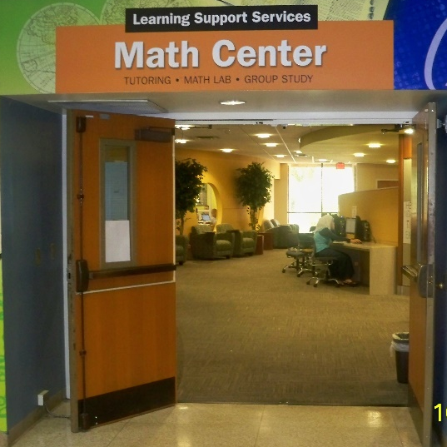
Math Lab Orientation
MAT 1033C
VALENCIACOLLEGE, WEST CAMPUS

Slide 2
Math Center Includes:
Math Open Lab: A computer lab where Developmental Math students work
on lab activities in the presence of Lab Instructors to
reinforce concepts learned in their Math class.
Math Connections: A learning community where Developmental Math
students interact with their peers and Math Instructors.
Hands-On Math: Assists students in understanding mathematical concepts
using manipulatives such as board games and every-day
objects.
Tutoring Center: Tutors are available for walk-in assistance, no appointment
necessary.

Slide 3
DESIGNED FOR YOU!
Operation Hours:
Monday to Thursday: 8 am – 8 pm
Friday: 8 am – 7 pm
Saturday: 10 am – 3 pm
The Math Lab includes:
Professional Lab Instructors
100 computers
Student Resources Table {stapler, hole puncher, print card machine}
2 Print Stations {print card required, $0.10/page}

Slide 4
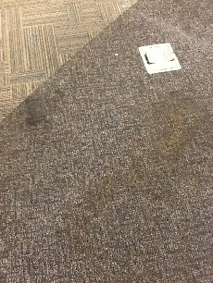
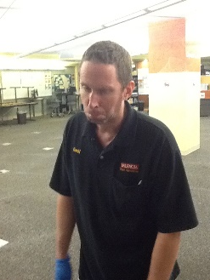
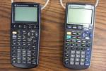
Lab Policies
Food or drinks NOT permitted
CHECK OUT MATERIALS:
at the Information Desk with VID card
Cell phone use NOT permitted
Calculators for MAT1033C only
CHILDREN NOT PERMITTED (Safety reasons)
Bring headphones: to view concept videos

Slide 5
Lab Procedures
Raise the Green flag only when:
A Password needs to be entered
A Lab Instructor’s signature is needed
For any other assistance raise the Red flag.

Slide 6
Lab Grade
Attendance is tracked through Student Time Tracker on all computers in the West Campus Math Lab only.
You must clock in and out properly to get credit for attendance.
Make sure to clock out from the clocked in computer on every visit.
Lab work is 10% to 20% of class grade*
(*check with your professor for their individual grading scheme)
¾ of the lab grade is based on assignments
¼ of the lab grade is based on weekly attendance
Attendance

Slide 7
Lab Time
Students must complete their lab time during their
assigned lab class schedule.
Open Lab Times are limited: Check Open Lab times
FALL 2013 - OPEN LAB TIMES
DAY | TIME | OPEN SEATS*
 |  | *Subject to first come first serve basis
Monday | 8 am - 9 am | 100
Monday | 9 am - 11 am | 0
Monday | 11 am - 11:30 am | 100
Monday | 11:30 am - 12:30 pm | 25
Monday | 12:30 pm - 1 pm | 100
Monday | 1 pm - 2 pm | 25
Monday | 2 pm - 2:30 pm | 100
Monday | 2:30 pm - 3:30 pm | 0
Monday | 3:30 pm - 4 pm | 75
Monday | 4 pm - 4:30 pm | 25
Monday | 4:30 pm - 5 pm | 0
Monday | 5 pm - 6 pm | 75
Monday | 6 pm - 7 pm | 25
Monday | 7 pm - 8 pm | 0
Notes:
REMINDERS…..

Slide 8
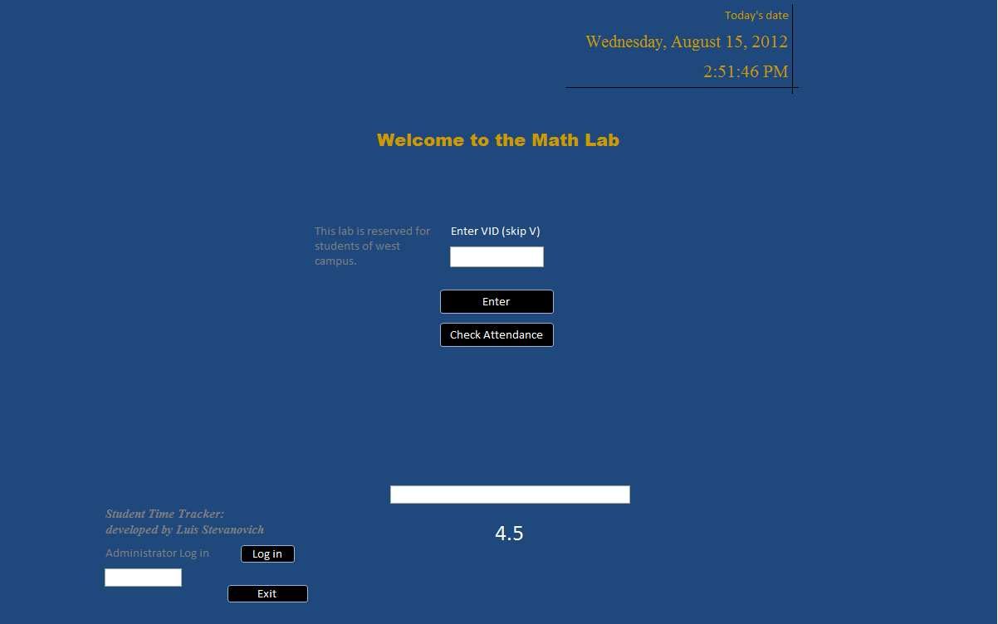
Student Time Tracker (To CLOCK IN)
1. Type in your VID without the V
2. Click Enter
Notes:
REMINDERS…..

Slide 9
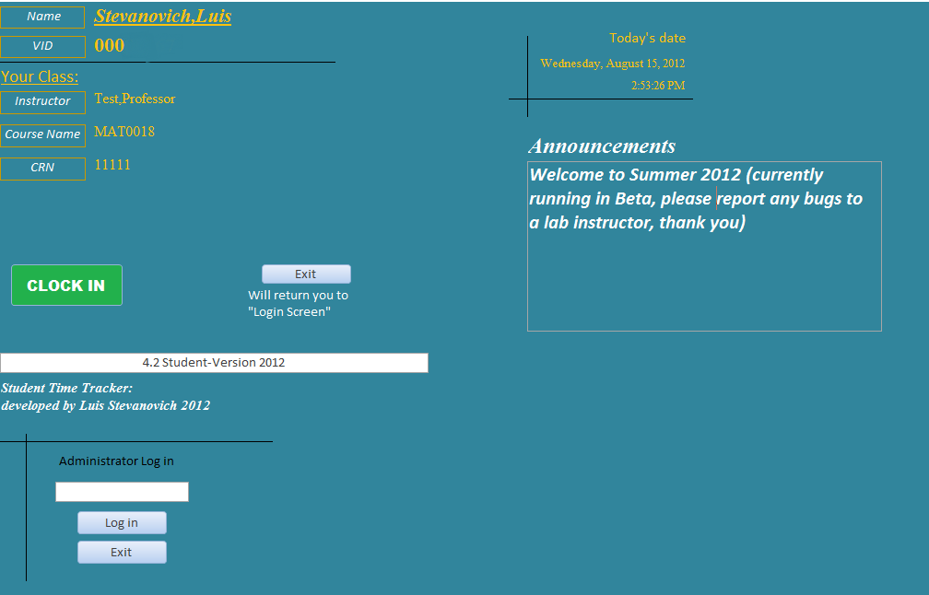
Student Time Tracker (To CLOCK IN)
3. Click CLOCK IN
Notes:
REMINDERS…..

Slide 10
Student Time Tracker (After Clock In)
Drag the Clock Out box out of your way
3. Click CLOCK IN
Notes:
REMINDERS…..

Slide 11
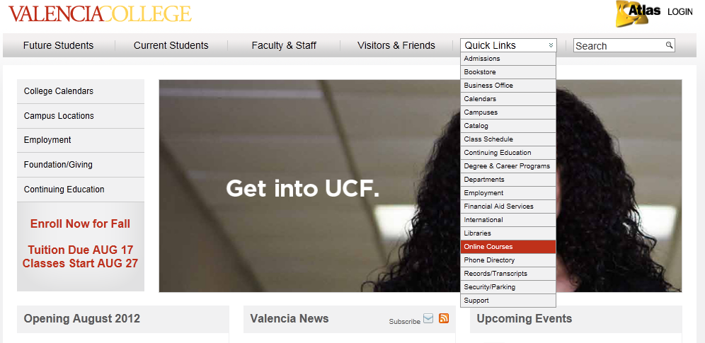
Blackboard Access
Go to the Valencia website
Go to Quick Links & drop down to Online Courses. Click Online Courses.

Slide 12
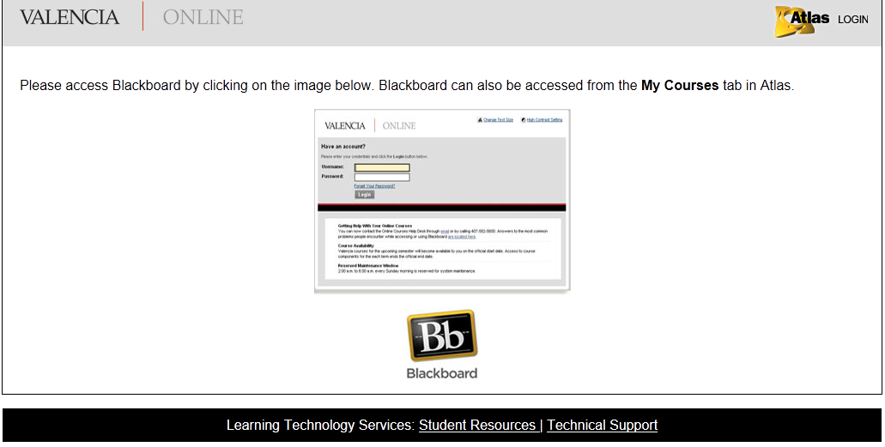
Blackboard Access
Click on Blackboard.

Slide 13
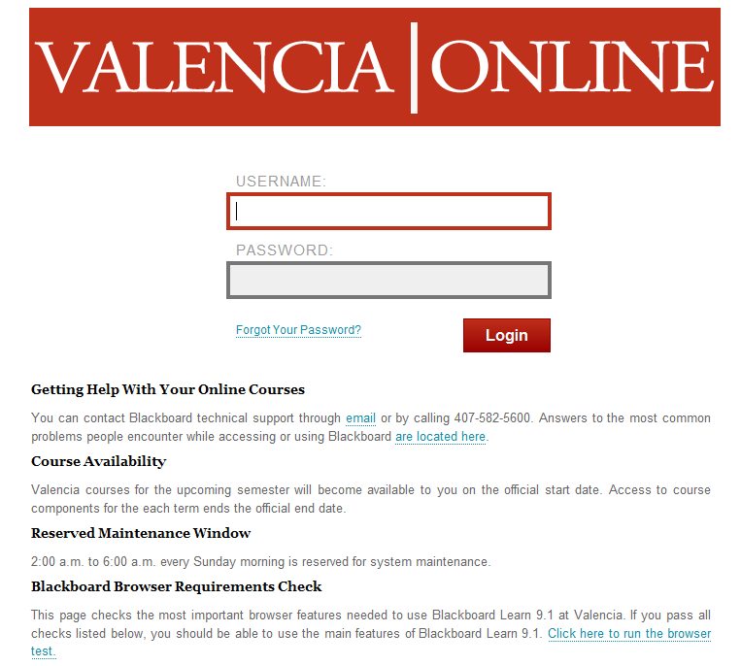
Blackboard Access
Enter your
Atlas User name &
Atlas Password.

Slide 14
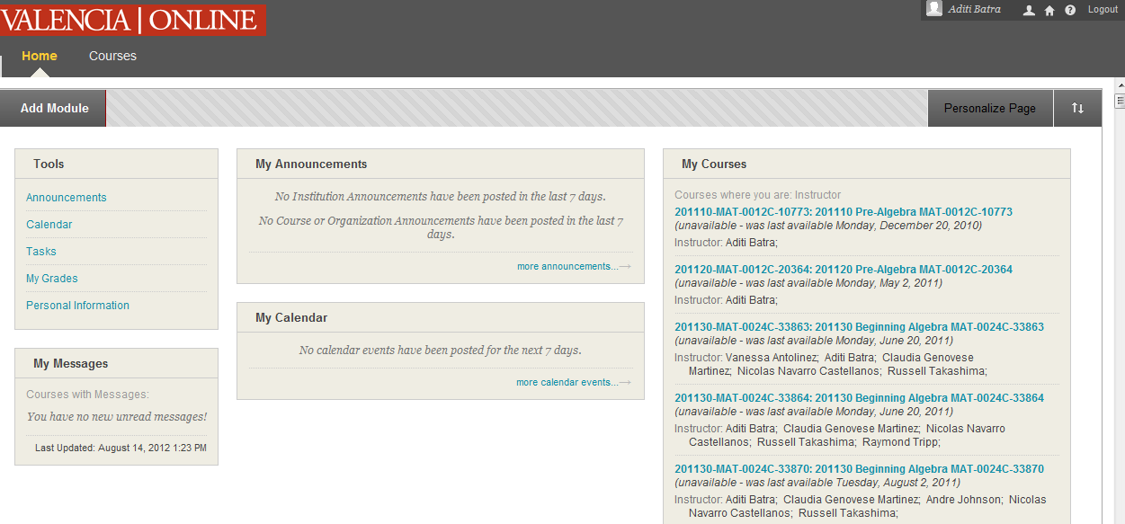
Blackboard
Always check your name when you Log in
Click on your Math course

Slide 15
Blackboard
Videos on how to access Blackboard, MyMathLab and MLP
Copy Course ID to register for MyMathLab
Access the Math Open Lab website.

Slide 16
Blackboard
Click on Math Workshops to access Hands on Math Workshops
The Math Lab is on Facebook. Click on Facebook icon and join the group!

Slide 17
Blackboard
Click on SYLLABUS, and print the document!

Slide 18
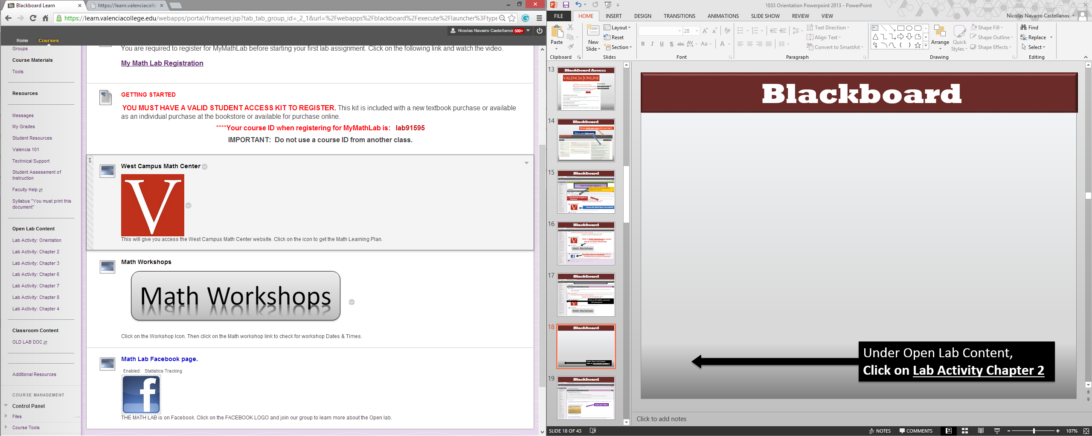
Blackboard
Under Open Lab Content,
Click on Lab Activity Chapter 2

Slide 19
Blackboard
Icebreaker Video

Slide 20
Blackboard
Concept Videos
Complete Lab Project: You must have completed the Chapter Worksheet before Lab Self-Quiz

Slide 21
Completing a lab assignment
Fill entire Math Learning Plan (MLP) as you complete
each step.
Complete one MLP per chapter assignment.
Follow all instructions in Blackboard from this MLP
to complete the Lab Activity.
View optional icebreaker video.
View concept videos from the chapter.
In the box, explain what you learned from viewing the
videos.
Print Lab Project Worksheets.
Present the completed worksheets to a Lab Instructor.
The Lab Instructor will sign & date the completed Lab
Project.
Complete Project Self-Check Quiz in MyMathLab.
Get signed off by a Lab Instructor.
If score is less than 100% on Self-Check Quiz, explain
what you need to work on in the box.
Complete the Lab Assessment. Score at least 70%
& get signed off by a Lab Instructor.
Step 1
Step 2
The remaining steps must be completed in the Open Lab.
Step 3

Slide 22
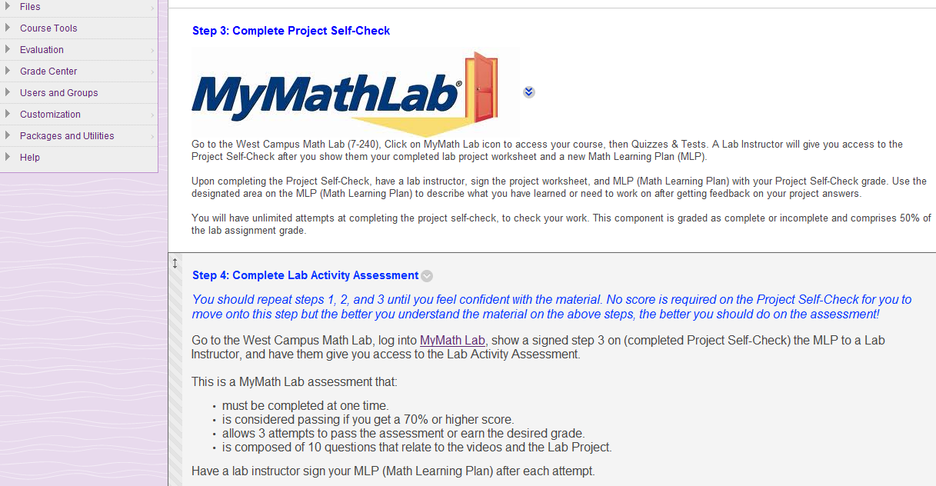
Blackboard
Click on MyMathLab to
register for MyMathLab

Slide 23
MyMathLab Registration
Click on Student to register!

Slide 24
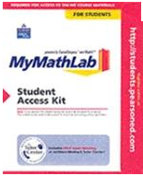
MyMathLab Registration
Use the following to register for MyMathLab :
Course ID (on the home page of your Math course on Blackboard)
Any valid email address
A valid Access Code
(If repeating the same course from prior two
semesters, please show your unofficial transcript
from Atlas to a Lab Instructor when prompted
for a code in MyMathLab.)
A prepaid access code comes in this MyMathLab
Student Access Kit

Slide 25
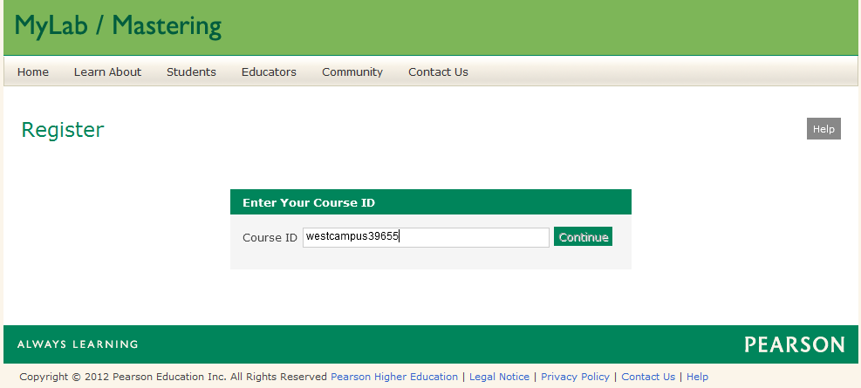
MyMathLab Registration
Paste the Course ID from Blackboard
Click Continue

Slide 26
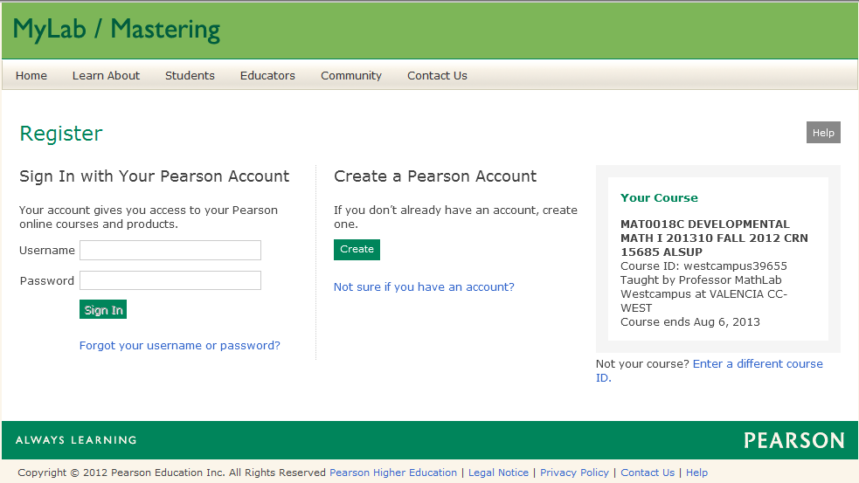
MyMathLab Registration
Check your course details
Click Create to
create a new
account
If already registered
with Pearson, type in
your Username &
Password

Slide 27
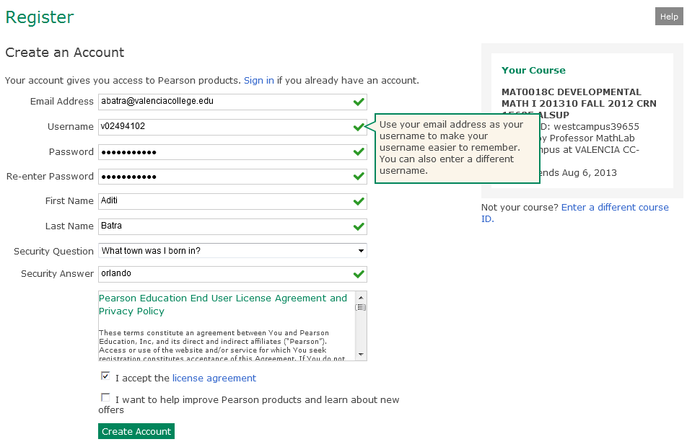
MyMathLab Registration
Atlas username@mail.valenciacollege.edu
Fill in all your information to create an account
Click Create Account

Slide 28
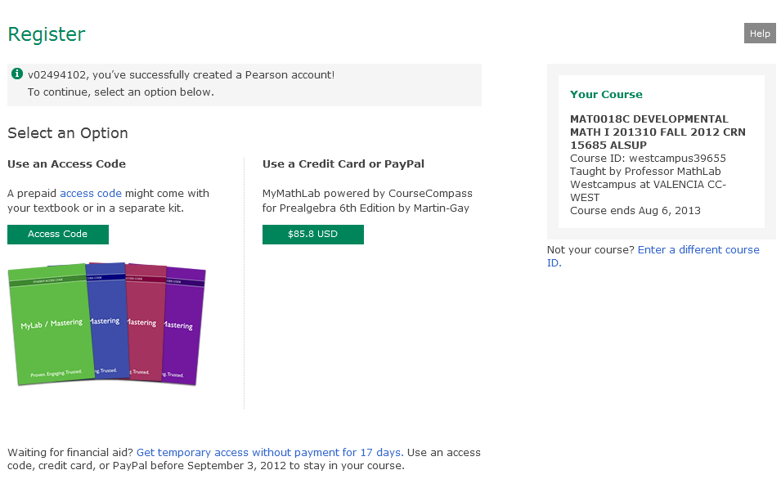
MyMathLab Registration
Select an Option for the Access Code

Slide 29
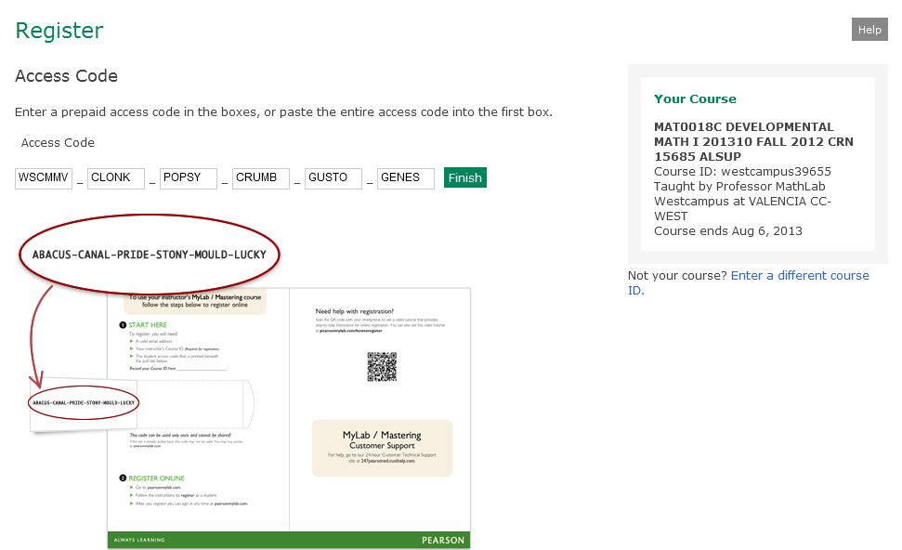
MyMathLab Registration
Enter the Access Code
Click Finish

Slide 30
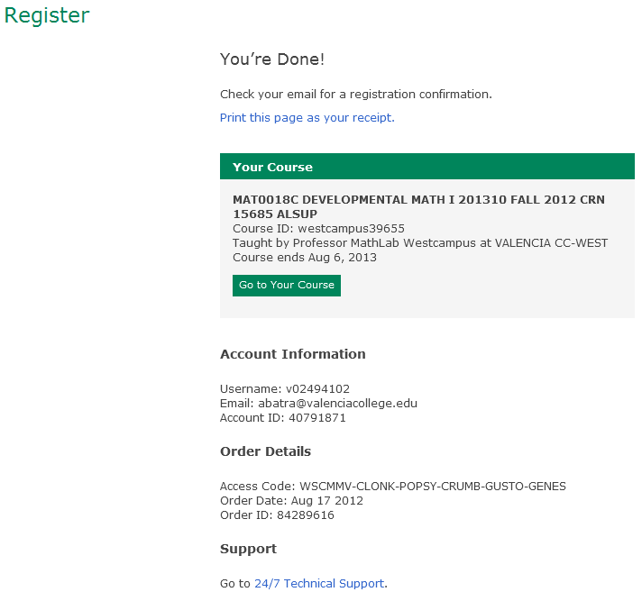
MyMathLab Registration
When finished with registration, Online Product Registration Confirmation email is sent to your email address. Save that email for future reference.
Click
Go to your Course

Slide 31
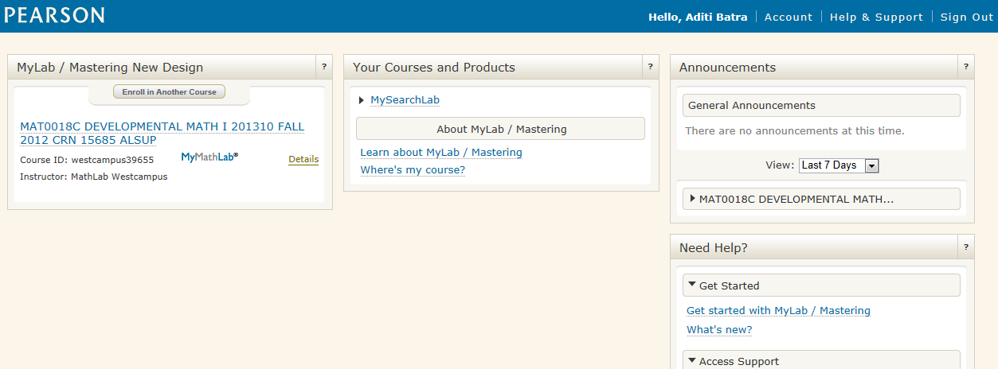
MyMathLab
Always check your name when you log in MyMathLab
Click on your Math course

Slide 32
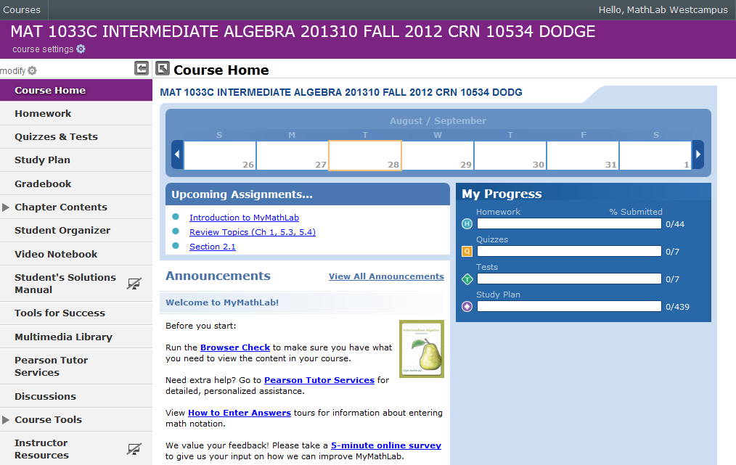
MyMathLab
Access Self-Check Quiz & Lab Assessment

Slide 33
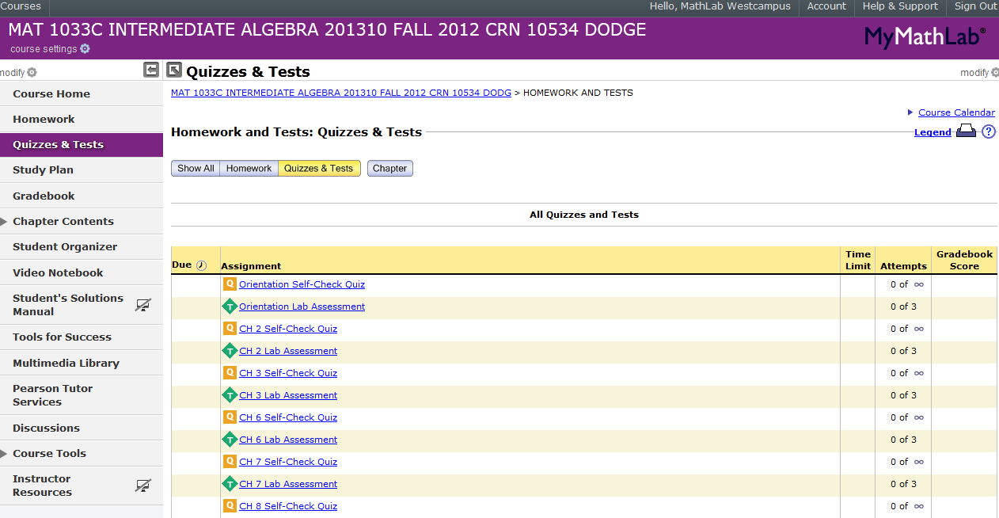
MyMathLab
Access Self-Check Quiz & Lab Assessment
Access Grade book to review Self-Check Quiz & Lab Assessment
Access Multimedia Library to view textbook online

Slide 34
MyMathLab
Due Dates (If unknown, check with your professor)

Slide 35
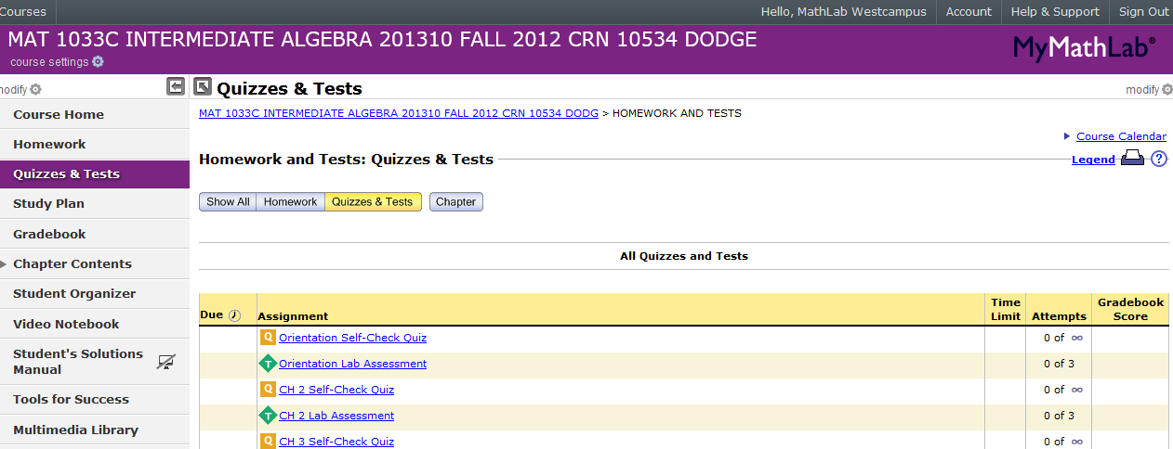
MyMathLab
Log Out
from
MyMathLab
when
finished

Slide 36
Lab Assignments
Concept Videos & Lab Syllabus contains
(Project Worksheets and MLP)
are found in Blackboard.
Self-Check Quizzes & Lab Assessments
are done in MyMathLab at the Valencia
West Campus Math Open Lab only.
Notes, textbook or any other assistance is
not allowed on Lab Assessments.

Slide 37
Lab Policies
Raise the Green flag only when:
A Password needs to be entered
A Lab Instructor’s signature is needed
For any other assistance raise the Red flag.

Slide 38
Blackboard
Log Out from Blackboard when finished

Slide 39
Student Time Tracker (To Clock Out)
3. Click CLOCK IN
Click Clock Out
Notes:
REMINDERS…..

Slide 40
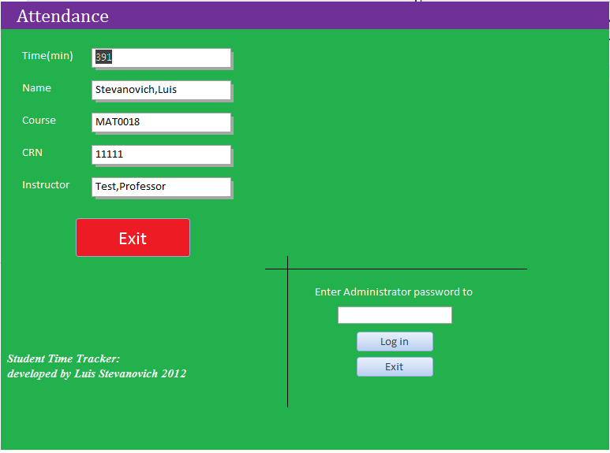
Student Time Tracker (After Clock Out)
Total minutes spent in the week
from Monday to Saturday
3. Click CLOCK IN
Click
Exit
Notes:
REMINDERS…..

Slide 41
Math Lab Quiz
1. What do students need to bring to work on lab assignments? MLP, VID, Writing Utensil, Paper/Notebook etc. 2. What are the different clock in, log-in and sign-in that you do when you come to the Math Lab? Clock In Student Time Tracker, Log In Blackboard, Log In MyMath Lab 3. How do you know what assignments are due? Due Dates column in MyMath Lab OR check with your professor 4. Which is more important: attendance or assignments? Assignments 5. What do you do to get assistance in the Math Lab? Sit down at a computer and raise the red flag
6. When do you raise the Green flag? When a password or Lab Instructor signature is required

Slide 42
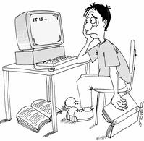
WHEN LIFE GETS TOUGH,
TALK TO SOMEBODY
Talk to your Professor
Talk to a Lab Instructor
Talk to a Counselor in SSB-110
Don’t Give Up

