Slide 1

LEARNING SUPPORT SERVICES
MAT 1033C
MATH OPEN LAB ORIENTATION
VALENCIACOLLEGE, WEST CAMPUS

Slide 2
Math Center Includes:
Math Open Lab: A computer lab where Developmental Math students work
on lab activities in the presence of Lab Instructors to
reinforce concepts learned in their Math class.
Math Connections: A learning community where Developmental Math
students interact with their peers and Math Instructors.
Hands-On Math: Assists students in understanding mathematical concepts
using manipulatives such as board games and every-day
objects.
Tutoring Center: Tutors are available for walk-in assistance, no appointment
necessary.

Slide 3

DESIGNED FOR YOU!
Fall Operation Hours:
Monday to Thursday: 8 am – 8 pm
Friday: 8 am – 7 pm
Saturday: 10 am – 3 pm
The Math Open Lab includes:
  Professional Lab Instructors
  100 computers
  Student Resources Table {stapler, hole puncher, print card machine}
  2 Print Stations {print card required, $0.10/page}

Slide 4

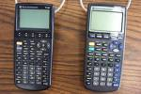



Lab Policies
CHECK OUT MATERIALS:
at the Information Desk with VID card
Food or drinks NOT permitted
Calculators for MAT1033C only
Cell phone use NOT permitted
Bring headphones: to view concept videos
Raise the red flag at a computer for assistance
by a lab instructor
CHILDREN NOT PERMITTED (Safety reasons)

Slide 5
Lab Grade
    Attendance is tracked through Student Time Tracker on all computers in the West Campus Math Lab only.
    You must clock in and out properly to get credit for attendance.
    Make sure to clock out from the clocked in computer on every visit.
  Lab work is 10% to 20% of class grade*
  (*check with your professor for their individual grading scheme)
        ¾ of the lab grade is based on assignments
        ¼ of the lab grade is based on weekly attendance
Attendance

Slide 6

Lab Time
Weekly Attendance is Required for All Students
  Week begins on Monday & ends on Saturday {no rollover minutes}
    Full Term = At least 50 minutes per week (cumulative)
    Flex Term = At least 75 minutes per week (cumulative)
Notes:
REMINDERS…..

Slide 7
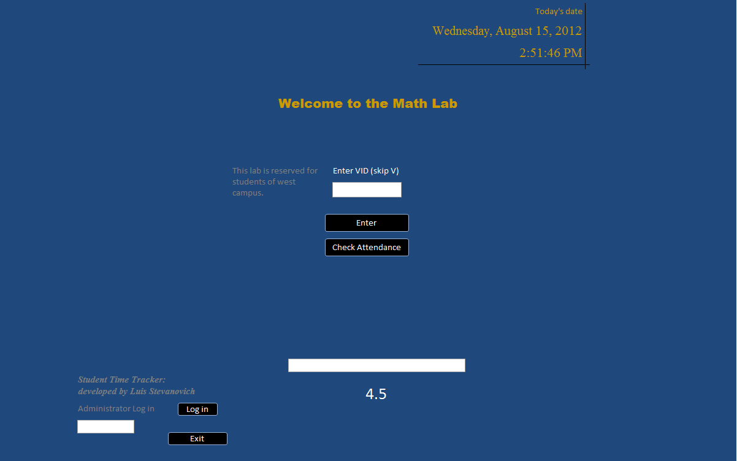
Student Time Tracker
(To CLOCK IN)
1. Type in your VID without the V
2. Click Enter
Notes:
REMINDERS…..

Slide 8
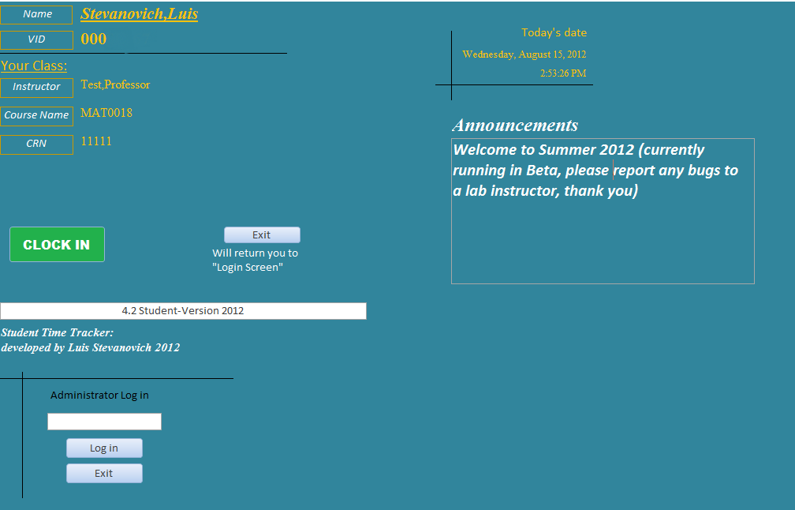
Student Time Tracker
(To CLOCK IN)
3. Click CLOCK IN
Notes:
REMINDERS…..

Slide 9
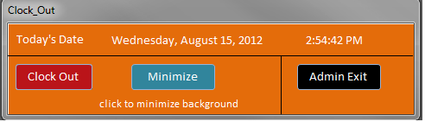
Student Time Tracker (After Clock In)
Drag the Clock_Out box out of your way
3. Click CLOCK IN
Notes:
REMINDERS…..

Slide 10
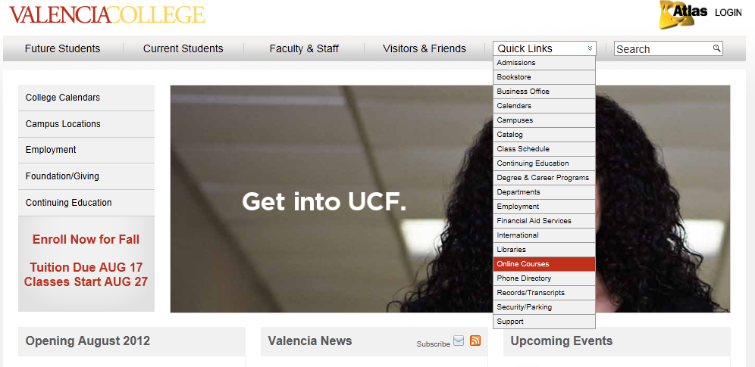
Blackboard Access
Go to the Valencia website
Go to Quick Links & drop down to Online Courses. Click Online Courses.

Slide 11
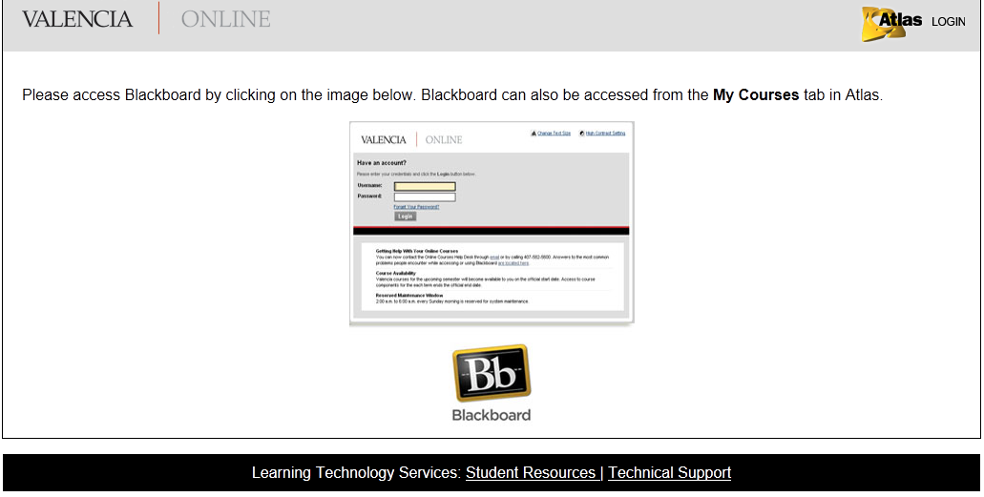
Blackboard Access
Click on Blackboard.

Slide 12
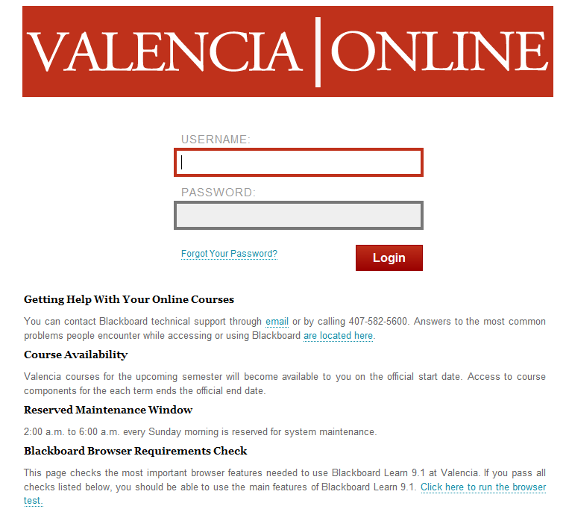
Blackboard Access
Enter your
Atlas User name &
Atlas Password.

Slide 13
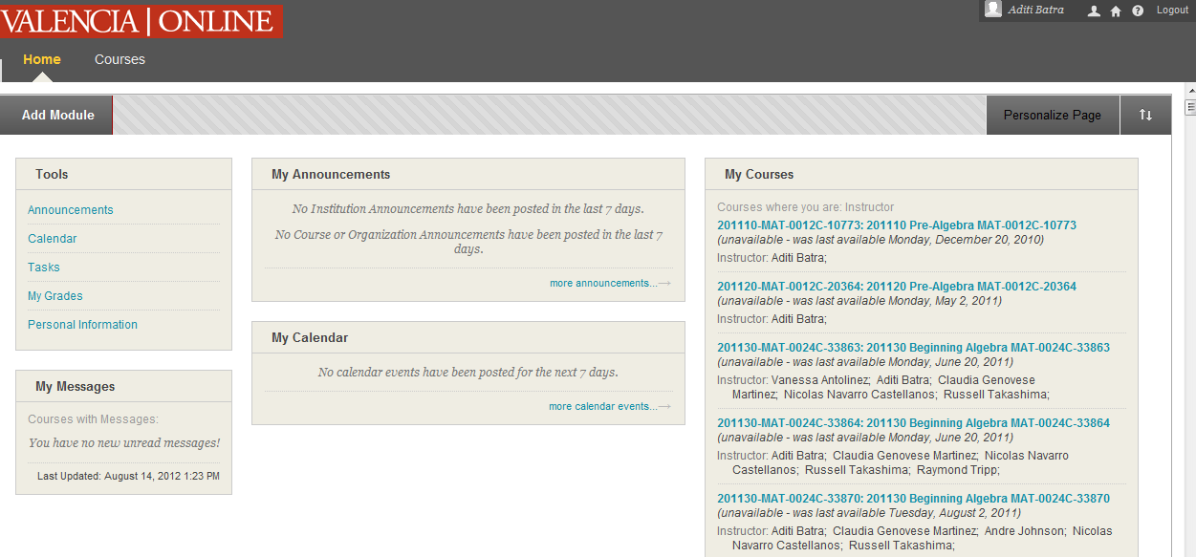
Blackboard
Always check your name when you Log in
Click on your Math course

Slide 14
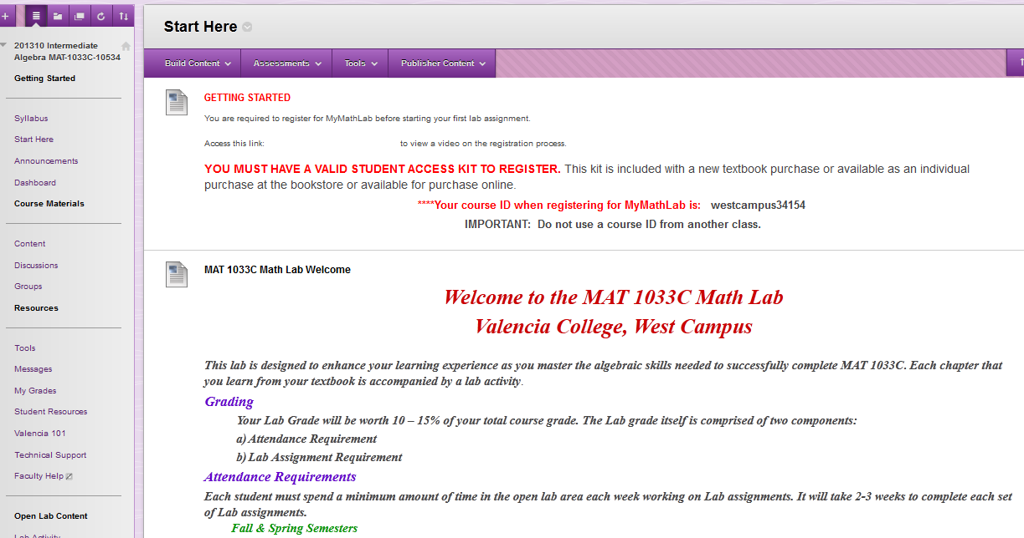
Blackboard
Course ID required to register for MyMathLab

Slide 15
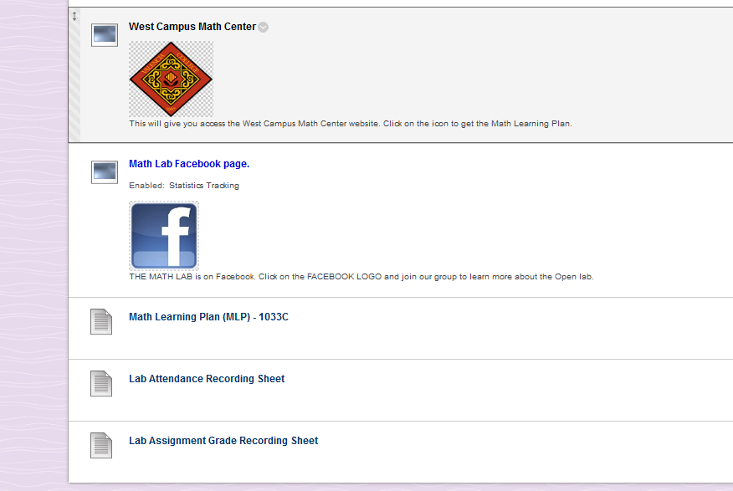
Blackboard
Print one Math Learning Plan (MLP)
sheet for each chapter.
Required or Optional (Check with your professor)

Slide 16
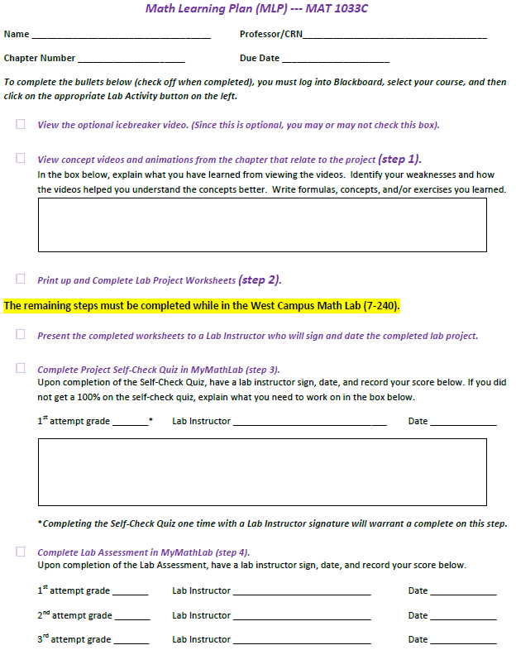
Completing a lab assignment
Fill entire Math Learning Plan (MLP) as you complete
each step.
Complete one MLP per chapter assignment.
Follow all instructions in Blackboard from this MLP
to complete the Lab Activity.
View optional icebreaker video.
View concept videos from the chapter.
In the box, explain what you learned from viewing the
videos.
Print and Complete Lab Project Worksheets.
Present the completed worksheets to a Lab Instructor.
The Lab Instructor will sign & date the completed Lab
Project.
Complete Project Self-Check Quiz in MyMathLab.
Get signed off by a Lab Instructor.
If score is less than 100% on Self-Check Quiz, explain
what you need to work on in the box.
Complete the Lab Assessment. Score at least 70%
& get signed off by a Lab Instructor.
Step 1
Step 2
The remaining steps must be completed in the Open Lab.
Step 3

Slide 17
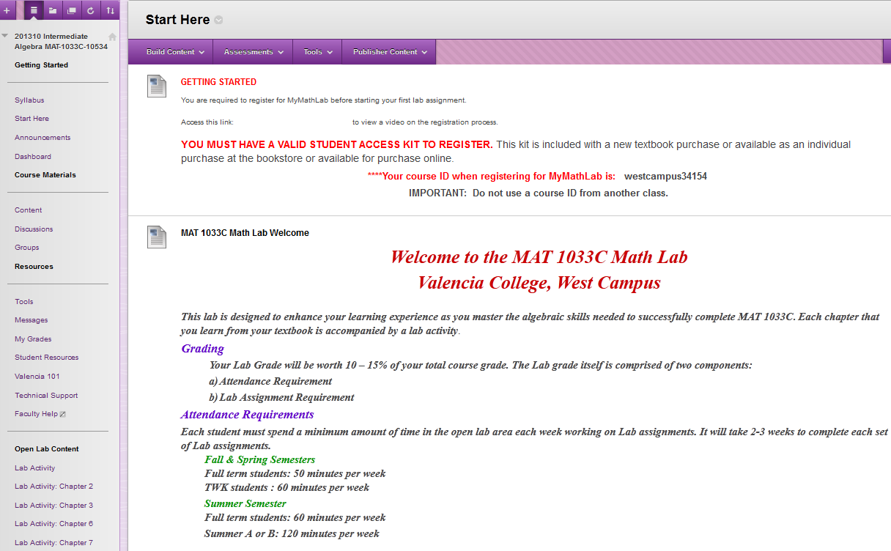
Blackboard
Under Open Lab Content,
Click on Lab Activity

Slide 18
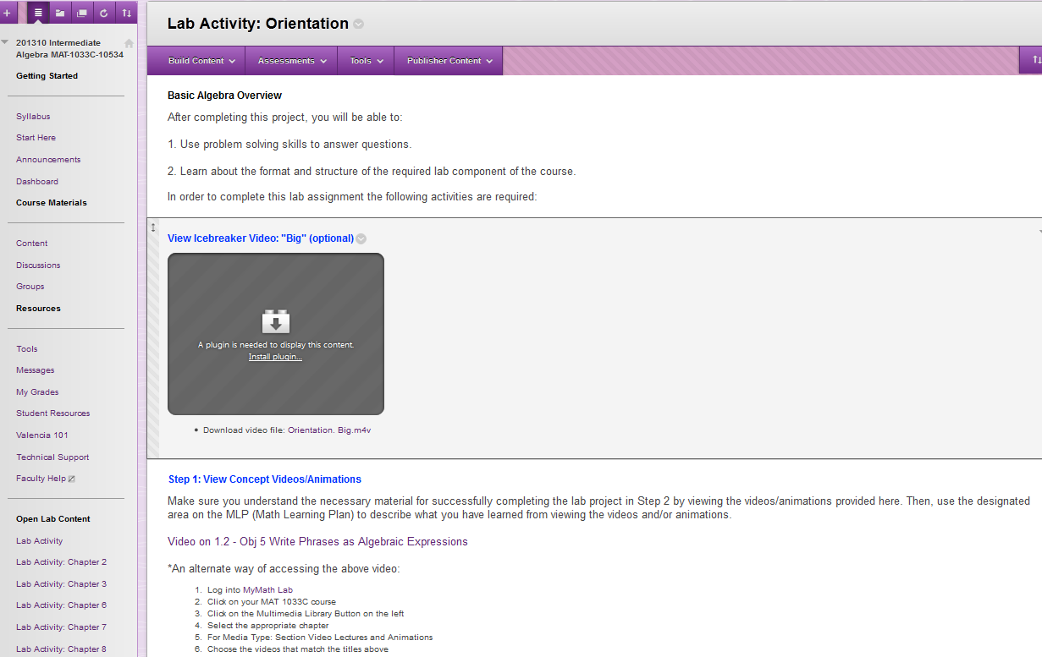
Blackboard
Icebreaker Video (optional)
Concept Video

Slide 19
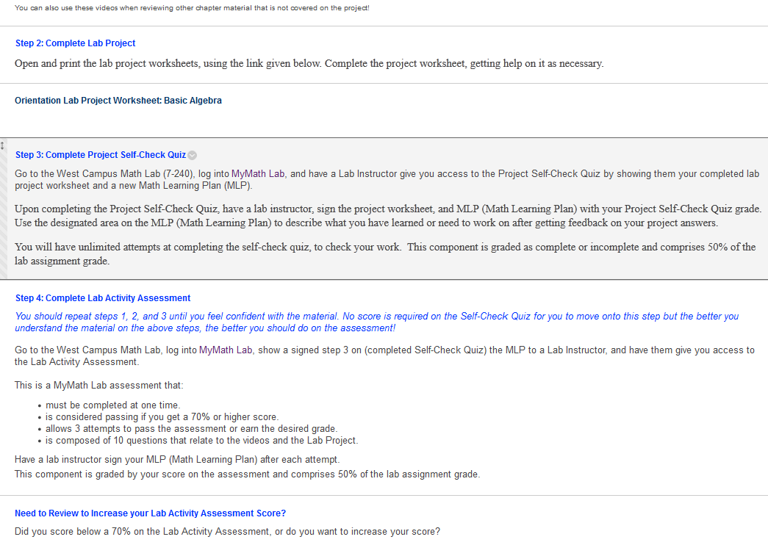
Blackboard
Lab Project Worksheet
Click MyMath Lab to
register for MyMathLab

Slide 20
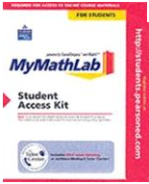
MyMathLab Registration
Use the following to register for MyMathLab :
Course ID (on the home page of your Math course on Blackboard)
A valid email address (Atlas email preferred)
A valid Access Code
(If repeating the same MAT 1033C course from Summer 2012,
please show your unofficial transcript from Atlas to a Lab
Instructor to get registered in MyMathLab when prompted for a code.)
A prepaid access code comes in this MyMathLab
Student Access Kit

Slide 21
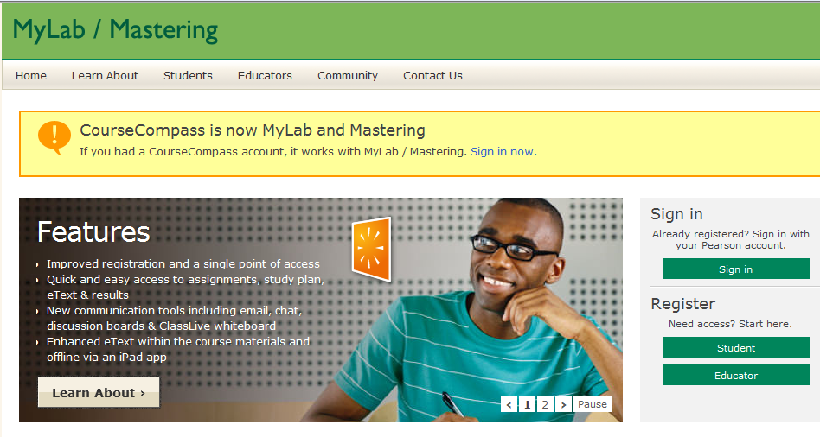
MyMathLab Registration
Click on Student to register with Pearson

Slide 22
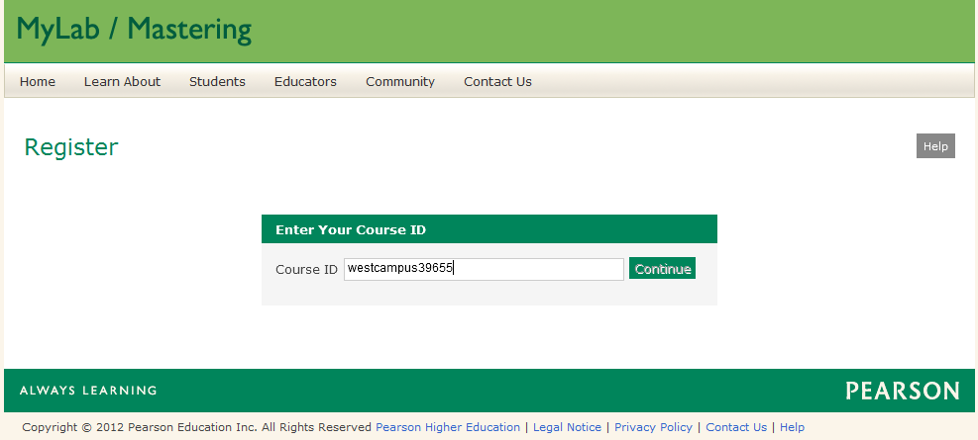

MyMathLab Registration
Type the Course ID from Blackboard
Click Continue

Slide 23
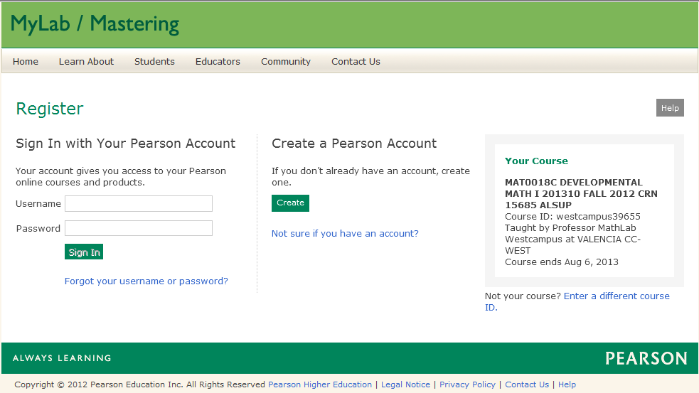
MyMathLab Registration
Check your course details
Click Create to
create a new
account
If already registered
with Pearson, type in
your Username &
Password

Slide 24
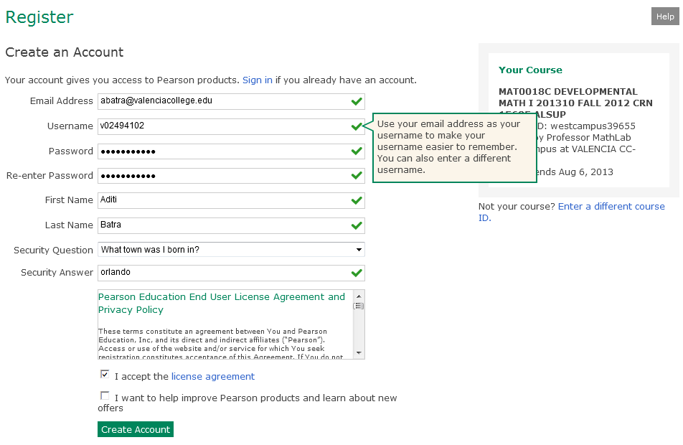
MyMathLab Registration
Fill in all your information to create an account
Click Create Account

Slide 25
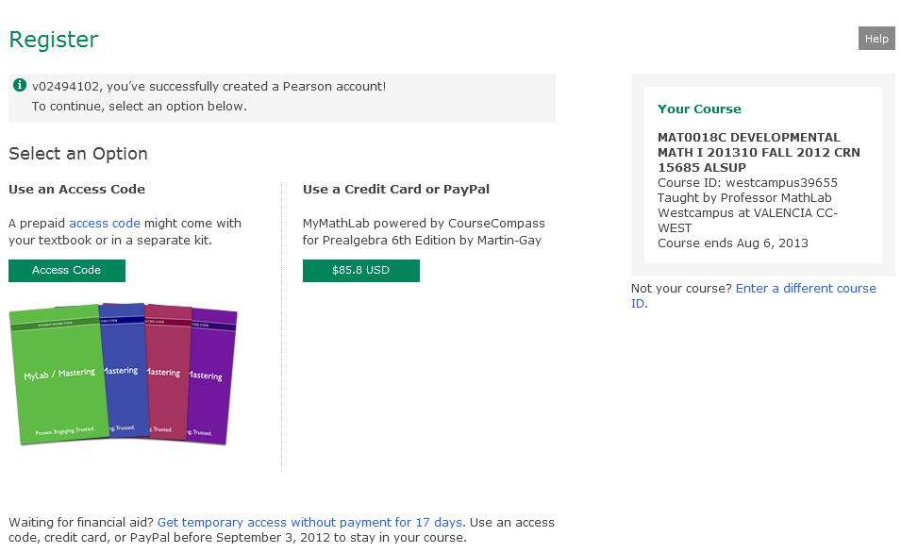
MyMathLab Registration
Select an Option for the Access Code

Slide 26
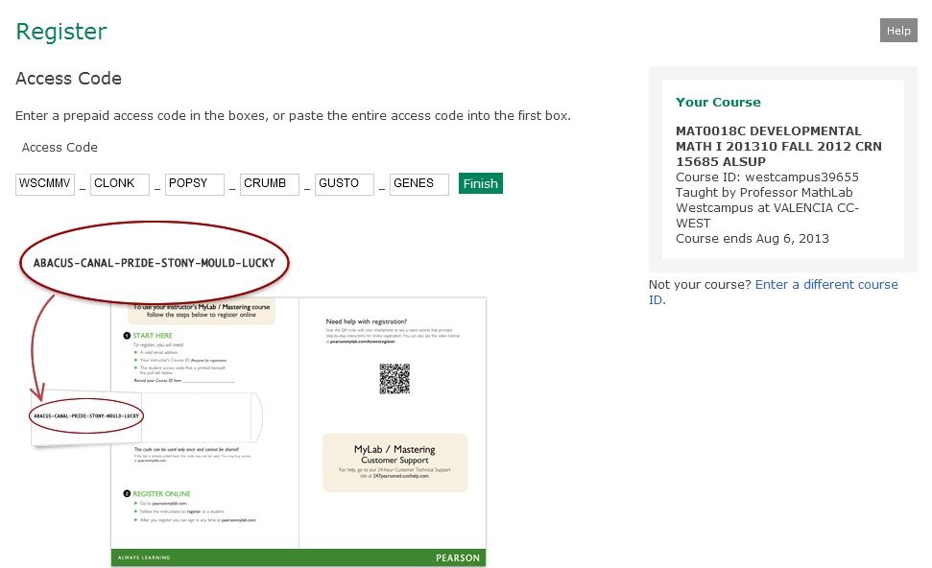
MyMathLab Registration
Enter the Access Code
Click Finish

Slide 27
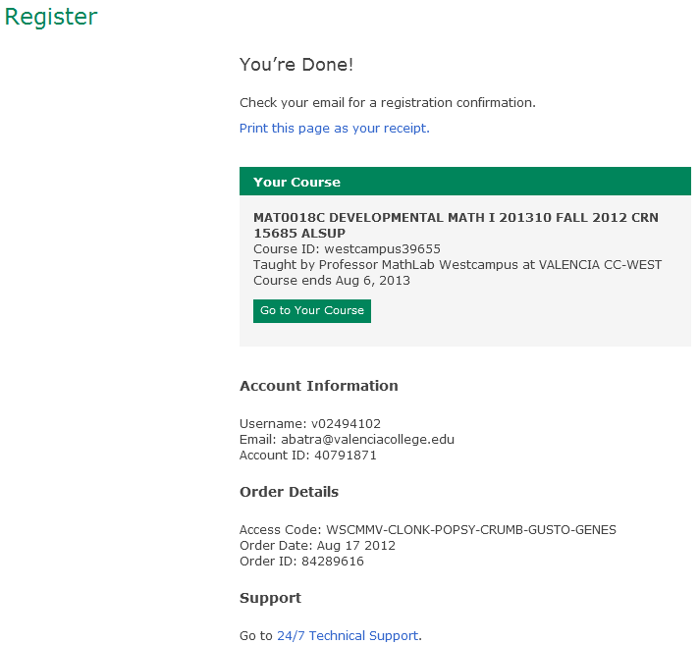
MyMathLab Registration
When finished with registration, Online Product Registration Confirmation email is sent to your email address. Save that email for future reference.
Click
Go to your Course

Slide 28
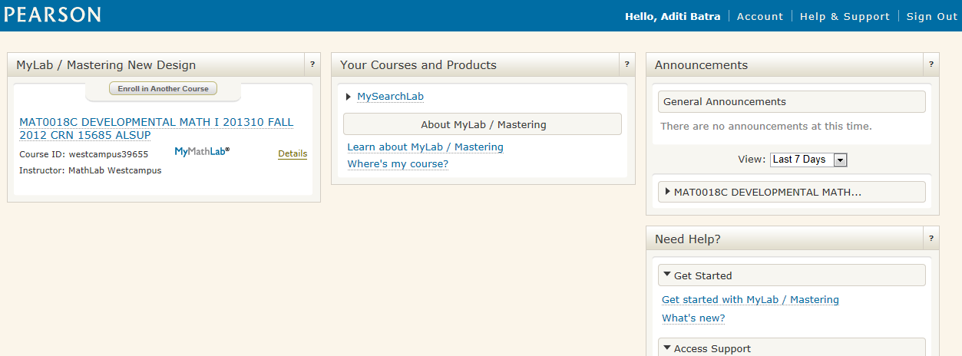
MyMathLab
Always check your name when you log in MyMathLab
Click on your Math course

Slide 29
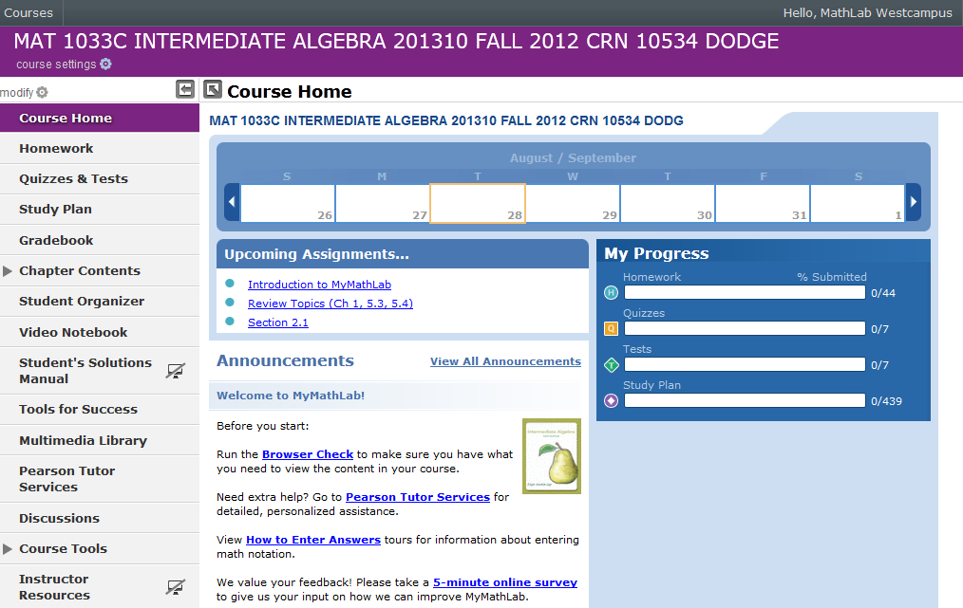
MyMathLab

Slide 30
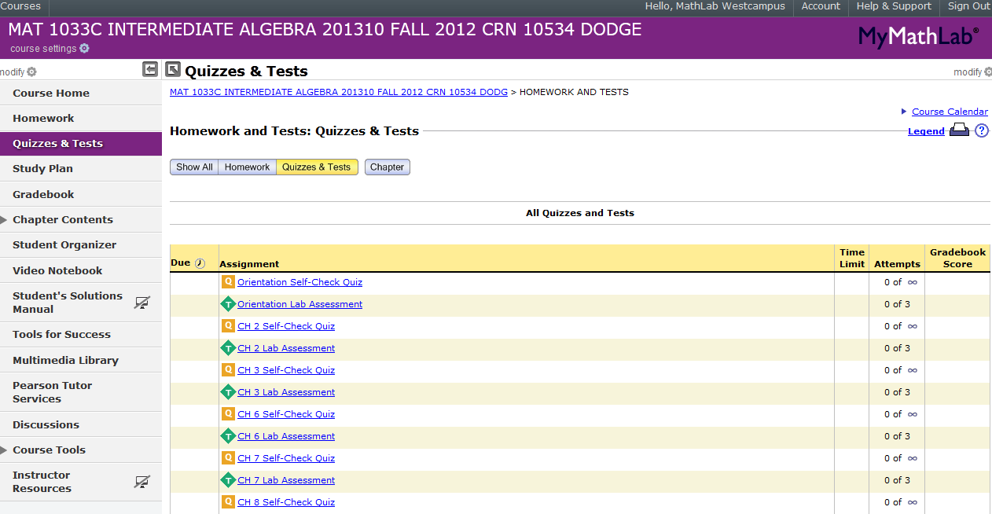
MyMathLab
Access Self-Check Quiz & Lab Assessment
Access Gradebook to review Self-Check Quiz & Lab Assessment
Access Multimedia Library to view textbook online

Slide 31
MyMathLab
Due Dates (If unknown, check with your professor)

Slide 32

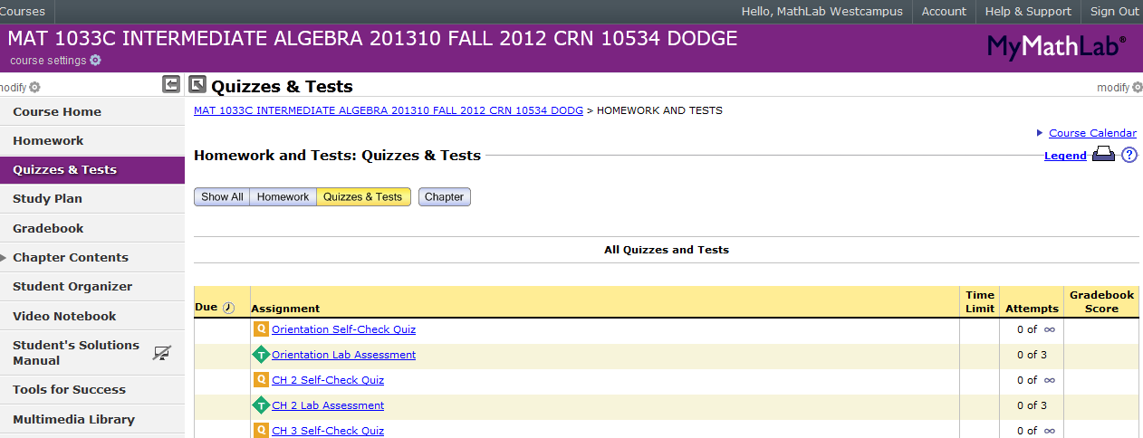
MyMathLab
Log Out
from
MyMathLab
when
finished

Slide 33
Lab Assignments
Concept Videos & Lab Project Worksheets
are found in Blackboard.
Self-Check Quizzes & Lab Assessments
are done in MyMathLab at the Valencia
West Campus Math Open Lab only.
No assistance is allowed on Lab Assessments
i.e. do not use notes & textbook on them.

Slide 34
Blackboard
Log Out from Blackboard when finished

Slide 35
Student Time Tracker (To Clock Out)
3. Click CLOCK IN
Click Clock Out
Notes:
REMINDERS…..

Slide 36
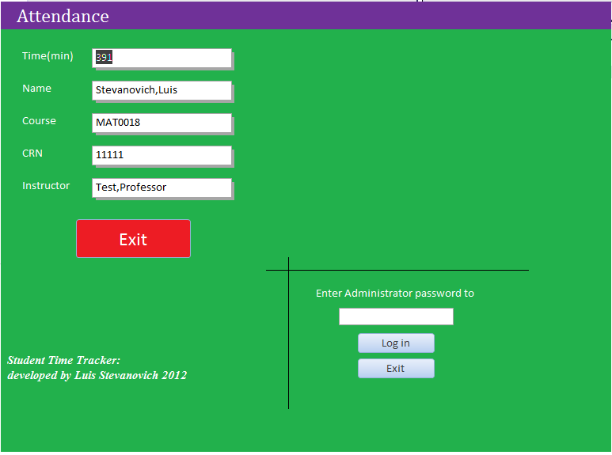
Student Time Tracker (After Clock Out)
Total minutes spent in the week
from Monday to Saturday
3. Click CLOCK IN
Click
Exit
Notes:
REMINDERS…..

Slide 37
Math Lab Quiz
1. What do students need to bring to work on lab assignments? VID, MLP, Writing Utensil, Paper/Notebook etc. 2. What are the different clock in, log-in and sign-in that you do when you come to the Math Lab? Clock In Student Time Tracker, Log In Blackboard, Log In MyMath Lab 3. How do you know what assignments are due? Due Dates column in MyMath Lab OR check with your professor 4. Which is more important: attendance or assignments? Assignments 5. What do you do to get assistance in the Math Lab? Sit down at a computer and raise the red flag

Slide 38
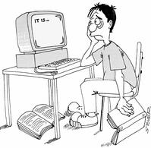
WHEN LIFE GETS TOUGH,
TALK TO SOMEBODY
Talk to your Professor
Talk to a Lab Instructor
Talk to a Counselor in SSB-110
Don’t Give Up

Slide 39



