Slide 1
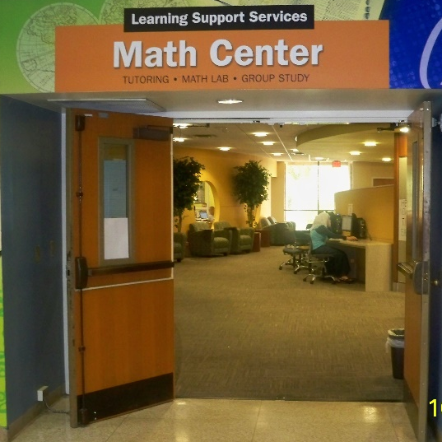
Math Lab Orientation
MAT0022C
VALENCIACOLLEGE,
WEST CAMPUS

Slide 2
Math Center Includes:
Math Open Lab: A computer lab where Developmental Math students work
on lab activities in the presence of Lab Instructors to
reinforce concepts learned in their Math class.
Math Connections: A learning community where Developmental Math
students interact with their peers and Math Instructors.
Hands-On Learning: Assists students in understanding mathematical concepts
using manipulatives such as board games and every-day
objects.
_______________________________________________________________________________
Tutoring Center: Tutors are available for tutoring many subjects. Check with the Information desk for complete information.

Slide 3
DESIGNED FOR YOU!
Operation Hours:
Monday to Thursday: 8 am – 8 pm
Friday: 8 am – 7 pm
Saturday: 10 am – 3 pm
The Math Lab includes:
Professional Lab Instructors
110 computers
Student Resources Table {stapler, hole puncher, print card machine}
2 Print Stations {print card required, $0.10/page}

Slide 4
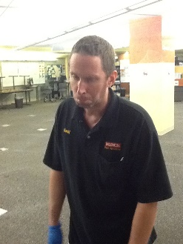
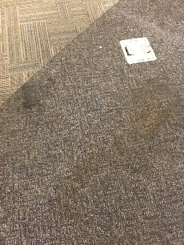
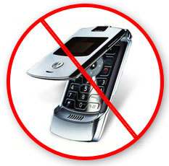
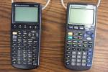
Lab Policies
Food or drinks NOT permitted
Cell phone use NOT permitted
Calculators for MAT1033C only
CHECK OUT MATERIALS:
At the Information Desk with VID card
Bring headphones: to view concept videos
CHILDREN NOT PERMITTED (Safety reasons)

Slide 5
Lab Procedures
Raise the Green flag only when:
A Password needs to be entered
A Lab Instructor’s signature is needed
For any other assistance raise the Red flag.

Slide 6
Lab Grade
Attendance is tracked through the Accutrack
program at the West Campus Math Center only
including the Math Open Lab, Math Connections and
Hands-On Learning.
Lab grade is 15% of class grade*
(*check with your professor for their individual grading scheme)
¾ (11.25%) of the lab grade is based on completing lab assignments
¼ (3.75%) of the lab grade is based on weekly attendance
Attendance

Slide 7
Accutrack
Weekly Attendance is required for all students.
Week begins on Monday and ends on Saturday {no rollover minutes}
Full Term = Minimum of 50 minutes per week
Ten Weeks/Flex Term = Minimum of 75 minutes per week
You must Sign In and Sign Out of the Accutrack program
to get credit towards the required Math Center attendance.
Notes:
REMINDERS…..

Slide 8
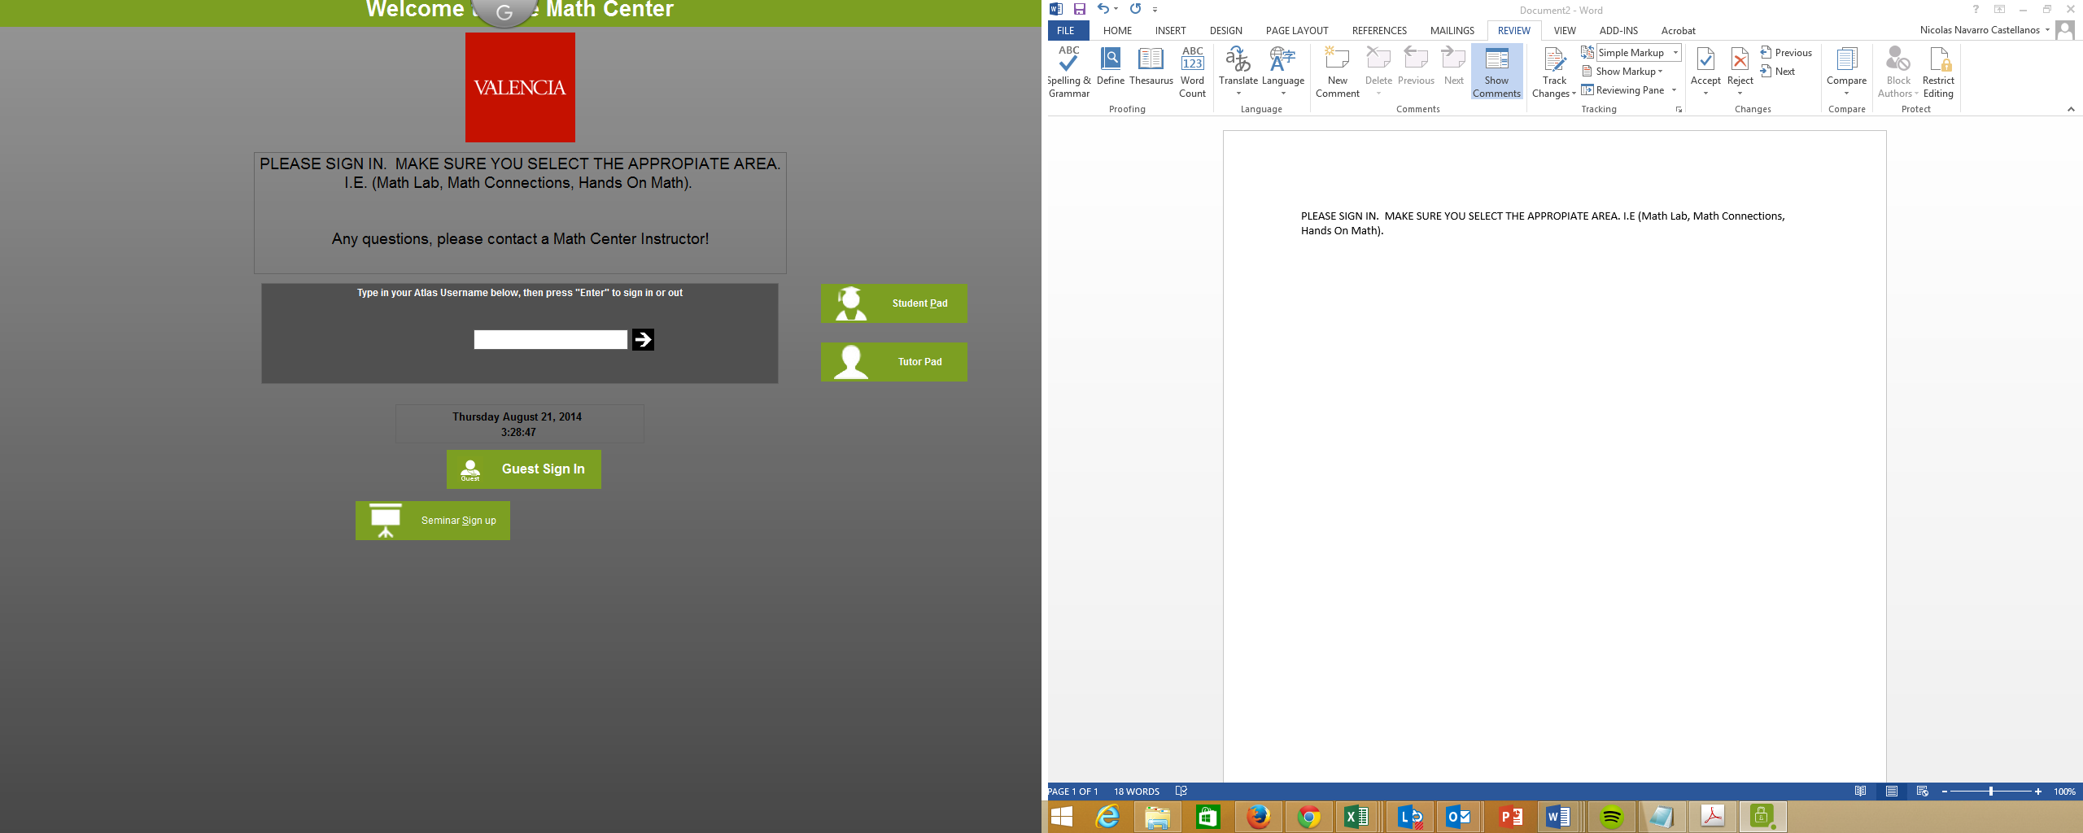
Accutrack
Type your Atlas Username
Notes:
REMINDERS…..

Slide 9
Accutrack
Select all four:
Category
Service Type
Service
Instructor
Notes:
REMINDERS…..

Slide 10
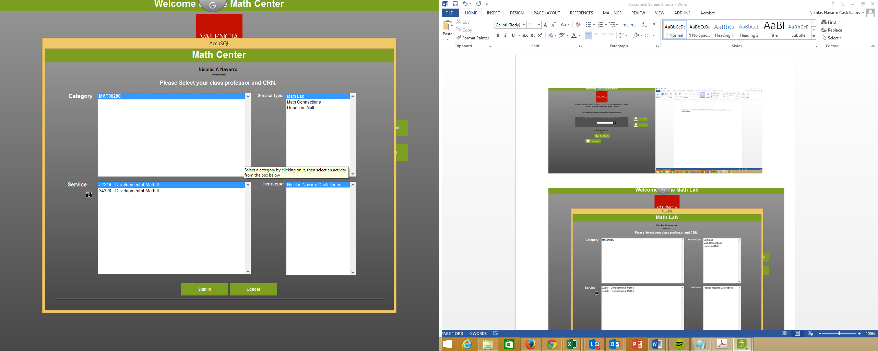
Accutrack
Click
Sign IN
Notes:
REMINDERS…..

Slide 11
Accutrack
You are now signed in Accutrack
Notes:
REMINDERS…..

Slide 12
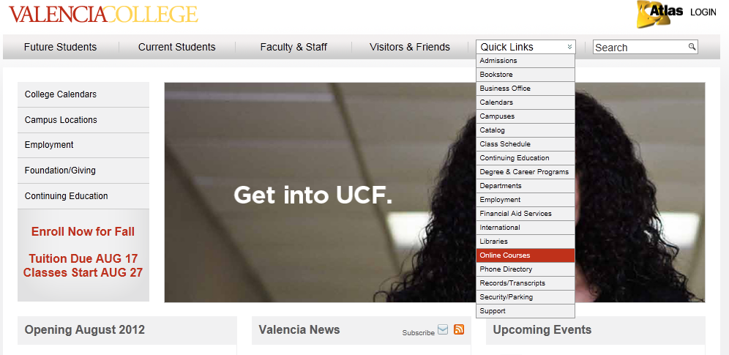
Go to the Valencia website
Go to Quick Links & drop down to Online Courses. Click Online Courses.

Slide 13
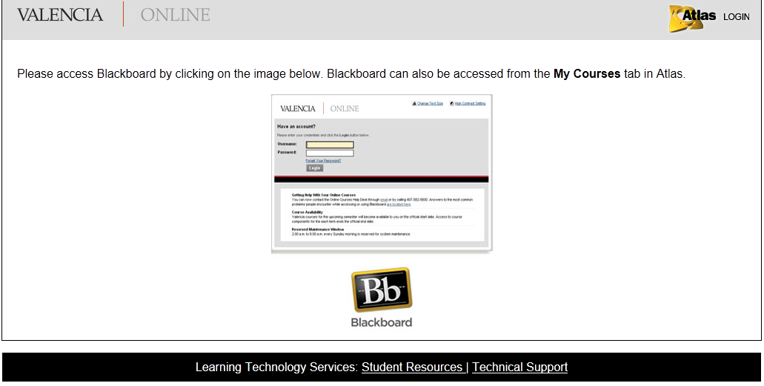
Blackboard Access
Click on Blackboard.

Slide 14
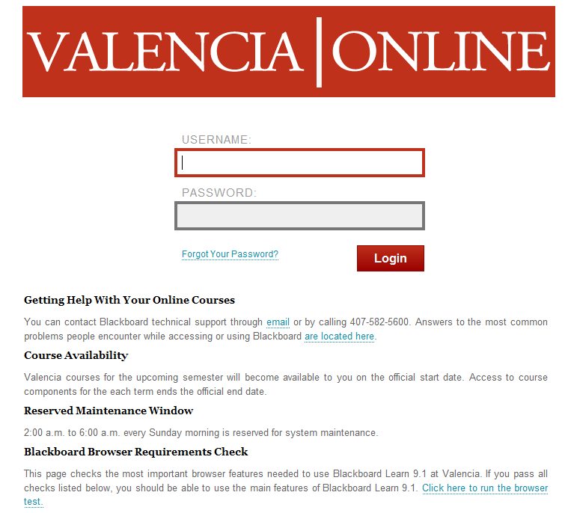
Blackboard Access
Enter your
Atlas Username &
Atlas Password

Slide 15
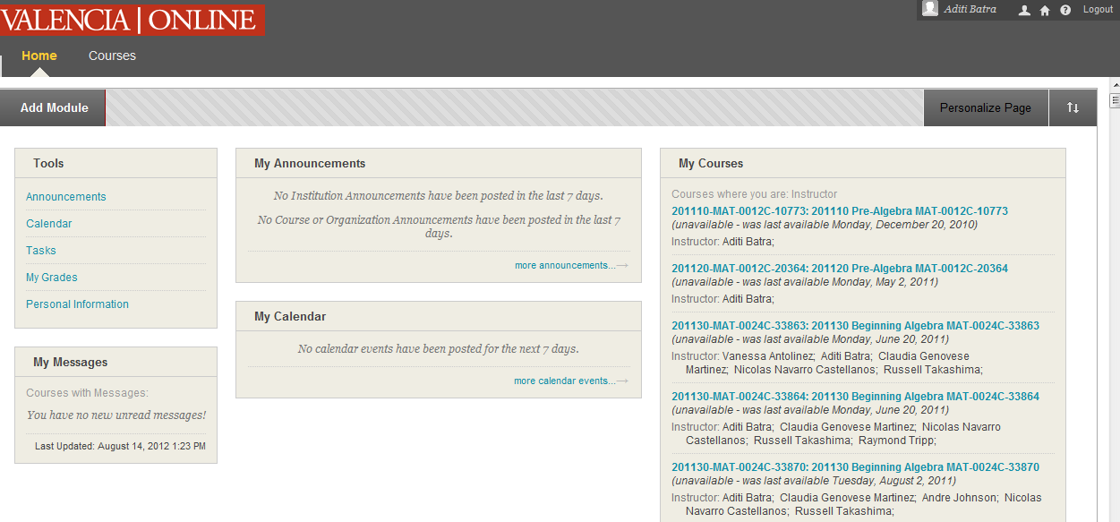
Blackboard
Always check your name when you Sign In
Click on your Math course

Slide 16
Blackboard
Copy Course ID
to register for
MyMathLab
Click MyMathLab icon to
register for MyMathLab

Slide 17
MyMathLab Registration
Click on Student to register!

Slide 18
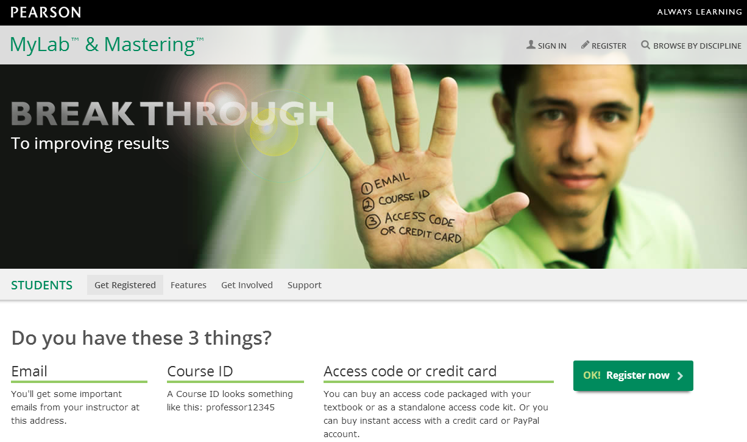
MyMathLab Registration
Click on OK Register now to register!

Slide 19
MyMathLab Registration
Use the following to register for MyMathLab :
Course ID (located in your Math course on Blackboard)
A valid email address
A valid Access Code (A prepaid access code
comes in this MyMathLab Student Access Kit)
(If repeating the same course from prior semester,
Summer 2014 only, please show your unofficial
transcript from Atlas to a Lab Instructor to get a
code for MyMathLab.)

Slide 20
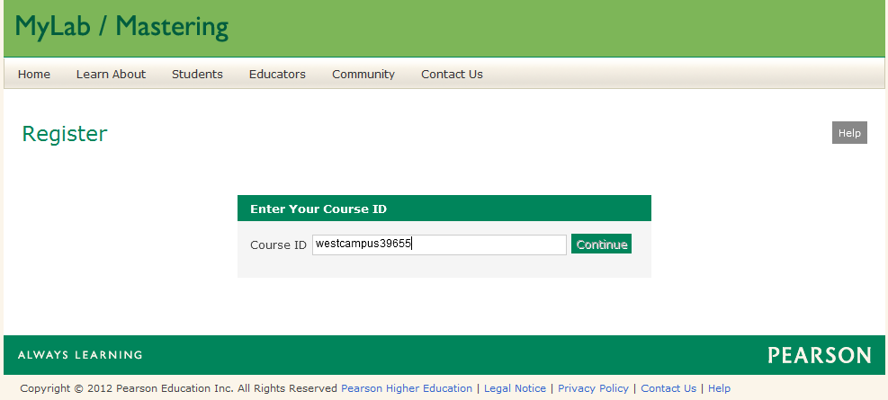
MyMathLab Registration
Paste the Course ID from Blackboard
Click Continue

Slide 21
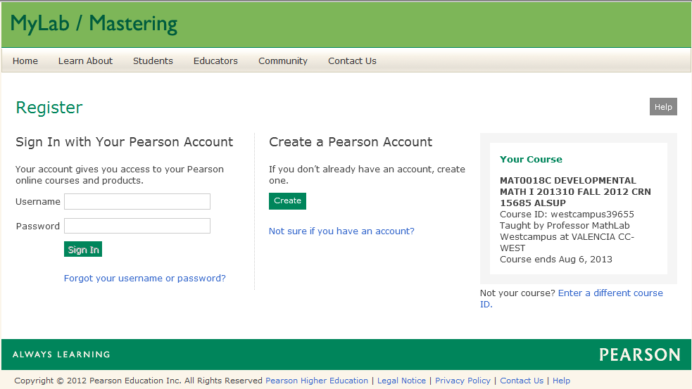
MyMathLab Registration
Check your course details
Click Create to
create a new
account
If already registered
with Pearson, type in
your Username &
Password

Slide 22
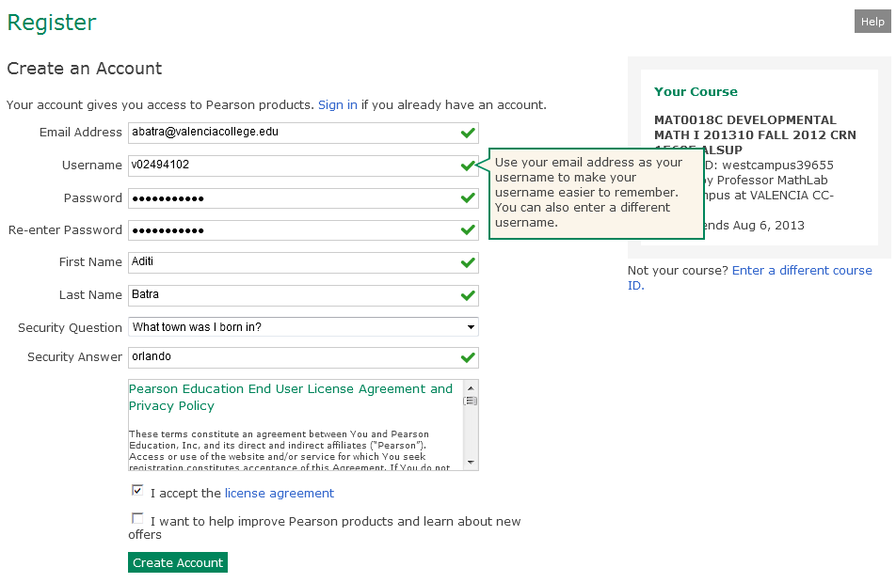
MyMathLab Registration
AtlasUsername@mail.valenciacollege.edu
Fill in all your information to create an account
Click Create Account

Slide 23
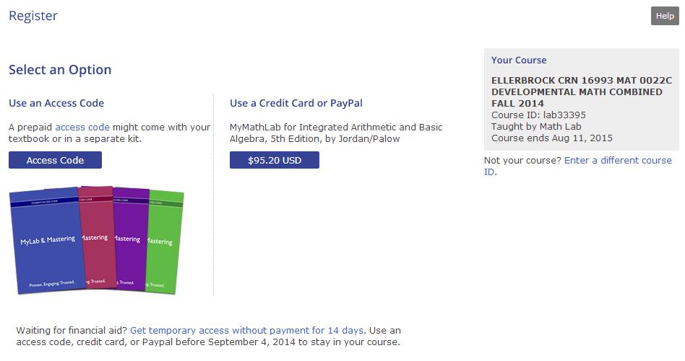
MyMathLab Registration
Select an Option for the Access Code

Slide 24
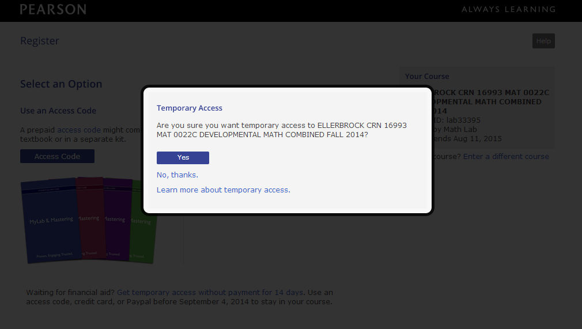
MyMathLab Registration
Click Yes

Slide 25
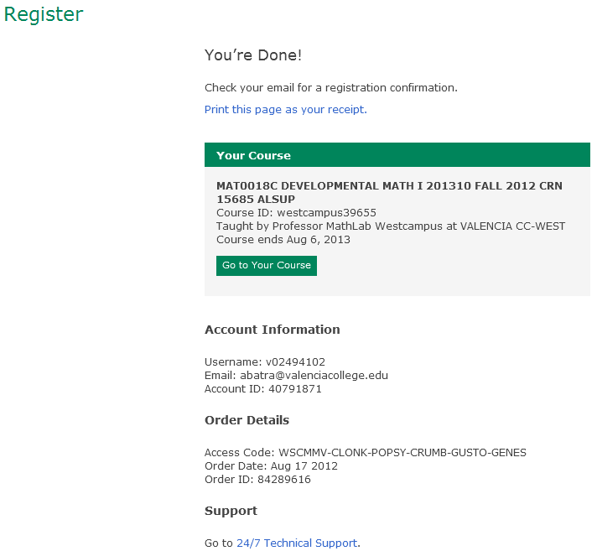
MyMathLab Registration
When finished with registration, Online Product Registration Confirmation email is sent to your email address. Save that email for future reference.
Click
Go to your Course

Slide 26
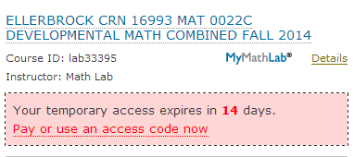
MyMathLab
Always check your name
Click on your Math course
Within 14 days of registration,
pay or use access code

Slide 27
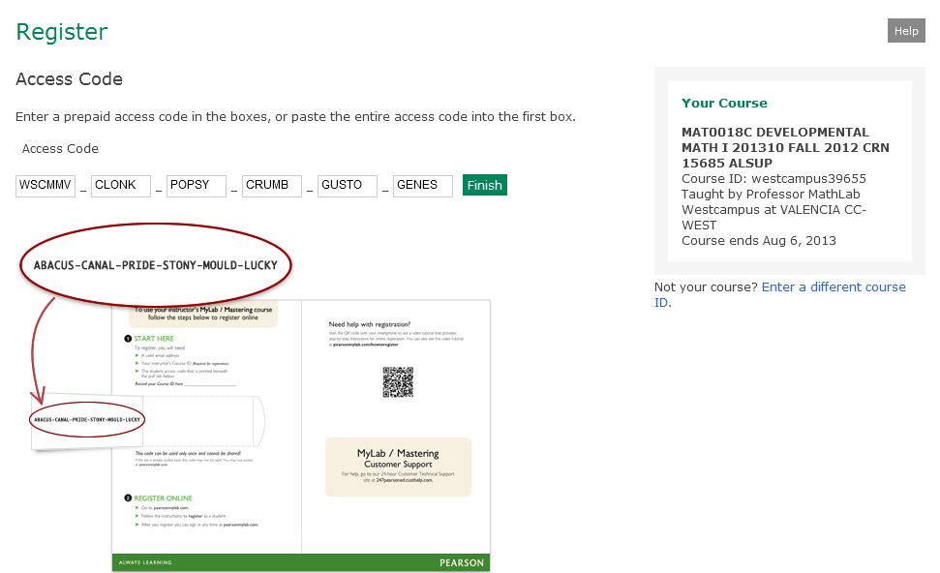
MyMathLab Continued Access
Enter the Access Code
Click Finish

Slide 28
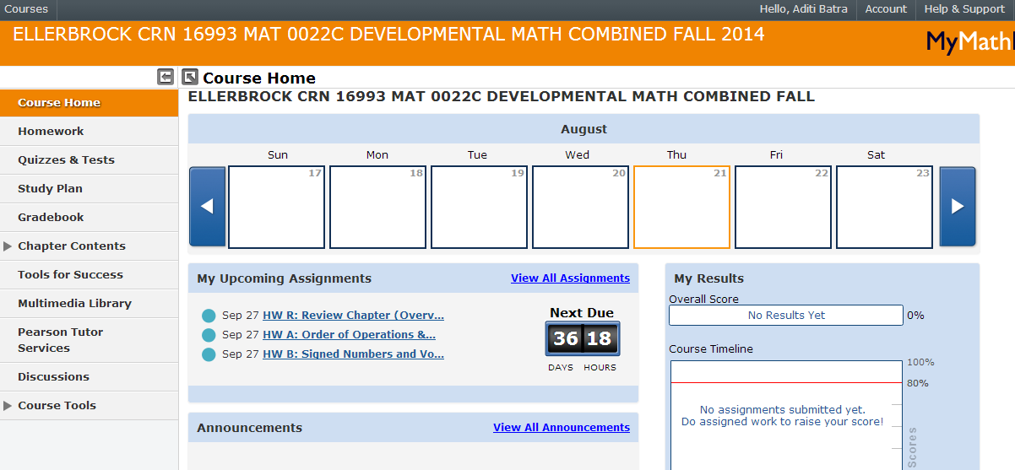
MyMathLab
Access Homework (Lab) Exercises for practice
Access Lab Quizzes
Access Study Plan
Access Gradebook to review Quizzes
Access Multimedia Library to view textbook,
video lectures, animations etc. online

Slide 29
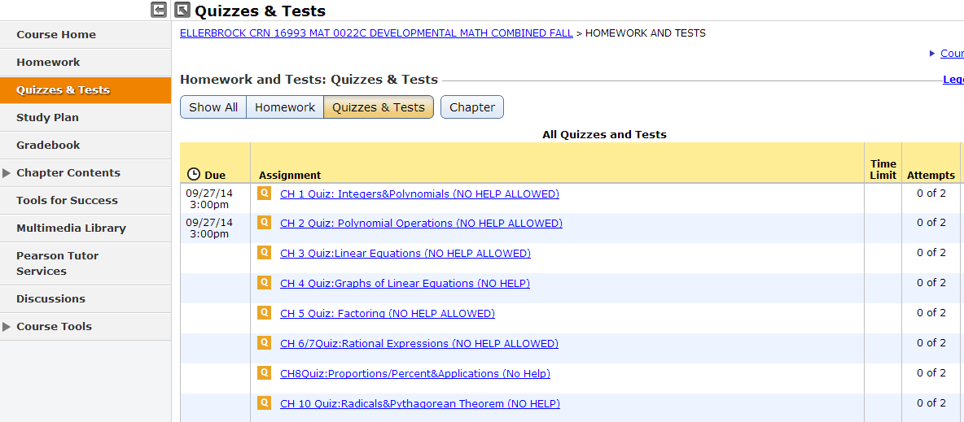
MyMathLab (Quizzes)
Due Dates ( If unknown, check with professor )

Slide 30
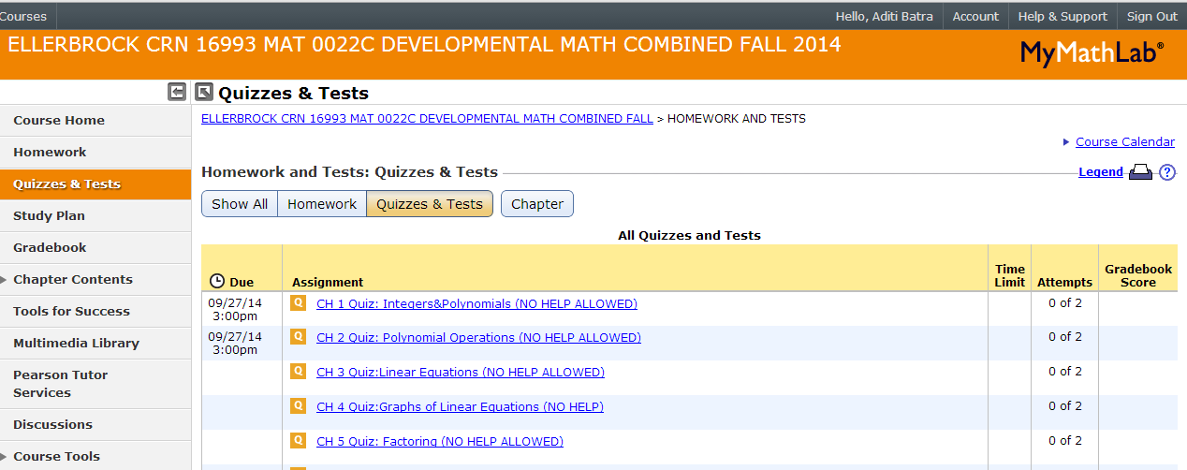
MyMathLab
ALWAYS
Sign Out
from
MyMathLab
when
finished

Slide 31
Blackboard
Click on Math Workshops for info
on Hands on Learning Workshops
Click on West Campus Math Center
to access Math Learning Plan
The Math Lab is on Facebook. Click on
Facebook icon and join the group!

Slide 32
Blackboard
Print an MLP for each Lab assignment

Slide 33
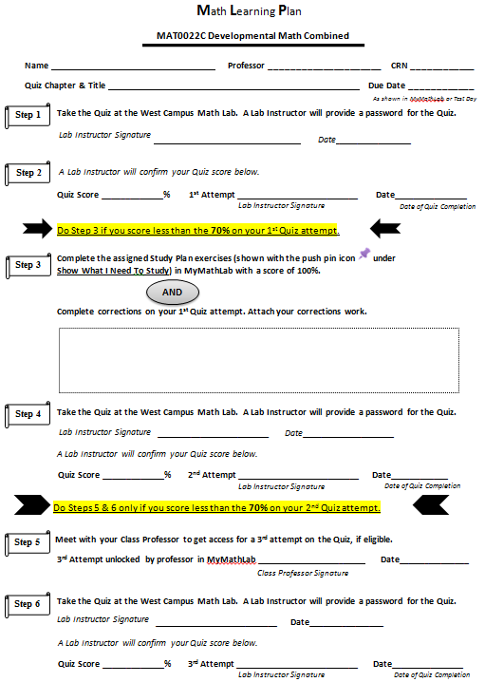
Completing a lab assignment
Fill entire Math Learning Plan (MLP)
as you complete each step. Fill one MLP
per lab assignment.
Take the Quiz at the West Campus Math Lab.
A Lab Instructor will provide a password for the Quiz.
A Lab Instructor will confirm your Quiz score. If you score 70%, you are done.
If score is less than 70% on the Quiz:
Complete the assigned Study Plan exercises in
MyMathLab with a score of 100 % AND complete
Corrections on your 1st Quiz attempt.
Take the Quiz at the West Campus Math Lab.
A Lab Instructor will provide a password for
the Quiz. A Lab Instructor will confirm your
Quiz score. If you score at least 70%, you are done.
If score is less than 70% on the Quiz:
Meet with your professor to get a 3rd attempt on the Quiz, if eligible.
If 3rd attempt is unlocked in MyMathLab by your
professor, take the Quiz at the West Campus Math Lab.
A Lab Instructor will provide a password for the Quiz.
A Lab Instructor will confirm your Quiz score.

Slide 34
Lab Procedures
Raise the Green flag only when:
A Password needs to be entered
A Lab Instructor’s signature is needed
For any other assistance raise the Red flag.

Slide 35
Lab Assignments
Lab Assignments are done in .
Quizzes are done at the Valencia
West Campus Math Open Lab only.
Absolutely no assistance is allowed on
Quizzes. That means notes, textbooks,
calculators or any other assistance is
not allowed on Quizzes.

Slide 36
Blackboard
Sign Out from Blackboard when finished

Slide 37
Accutrack Sign Out
Sign Out of Accutrack. You will see your time for this week and this semester.
Notes:
REMINDERS…..

Slide 38
Math Lab Quiz
What do students need to bring to work on lab assignments?
MLP, Writing Utensil, Paper/Notebook etc.
2. What are the different sign-in that you do when you come to the Math Lab?
Sign In Accutrack, Sign In Blackboard, Sign In MyMathLab
3. How do you know what assignments are due?
Due Dates column in MyMathLab OR check with your professor
4. Which is more important: attendance or assignments?
Assignments
5. What do you do to get assistance in the Math Open Lab?
Sit down at a computer and raise the red flag
6. How is lab attendance recorded?
Using the Accutrack program
7. When do you raise the Green Flag?
When a password or Lab Instructor signature is required

Slide 39
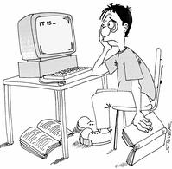
WHEN LIFE GETS TOUGH,
TALK TO SOMEBODY
Talk to your Professor
Talk to a Lab Instructor
Talk to a Counselor in SSB-110
Don’t Give Up

