Slide 1


LEARNING SUPPORT SERVICES
MAT0020C
MATH LAB ORIENTAION
WEST CAMPUS

Slide 2

DESIGNED FOR YOU!
The Math Center is your resource Monday to Sunday
  Professional Lab Instructors
  110 computers
  Student Resources Table {stapler, hole puncher}
  Red and Blue Print Stations {print card required, $0.10/page}
  Access friendly environment; hardware & software accommodations available. Please ASK………

Slide 3

YOUR $UCCESS IN MATHEMATICS
  Begins By:
    Following policies for a comfortable learning environment: {MATH CENTER POLICIES}
    Reading your Lab Syllabus , Class Syllabus, Class Notes and by being organized
    Using your Lab Manual to successfully complete assignments on or before due dates {CALENDARS}
    Asking a lab instructor/professor for assistance……

Slide 4

Assignments and Attendance
    Assignments are done in
    Pre-test/Mastery test are to be done in the Math Lab.
    NO help on Pre-test/Mastery test.
    Attendance is tracked through Accutrack at the
    West Campus Math Lab only.
  Lab work is 15% of class grade (check with your professor)
        ¾ of that grade is based on assignments
        ¼ of that grade is based on weekly attendance

Slide 5
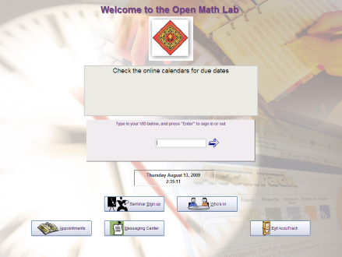

Logging in Accutrack
Weekly Attendance Required for All Students:
  First time Sign-in:
      Type your VID, Select your Instructor, CRN
      Click Continue
      Click Yes
  Next Sign-in:
      Type your VID (Instructor, CRN already selected)
      Click Continue
  Week begins on Monday and ends on Sunday {no rollover}
    Full Term = Minimum of 50 minutes per week

Slide 6

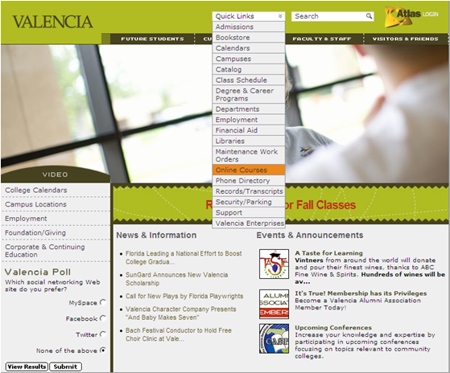
www.valenciacc.edu
1. Go to the
Valencia website
2. Go to
Quick Links
drop down menu
to Online Courses

Slide 7
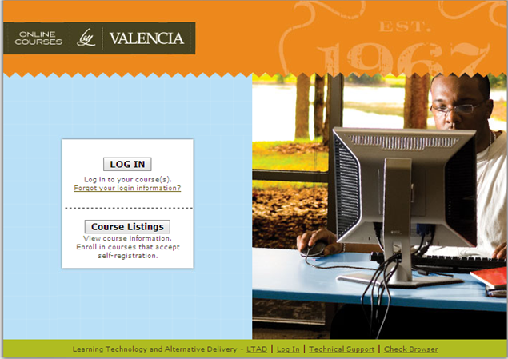
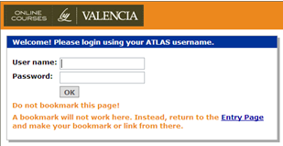
3. Click Log IN
4. Enter your Atlas User name and Atlas Password.

Slide 8

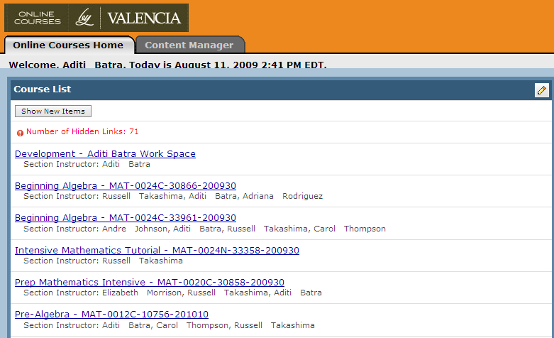
5. Select your current MAT0020C course

Slide 9
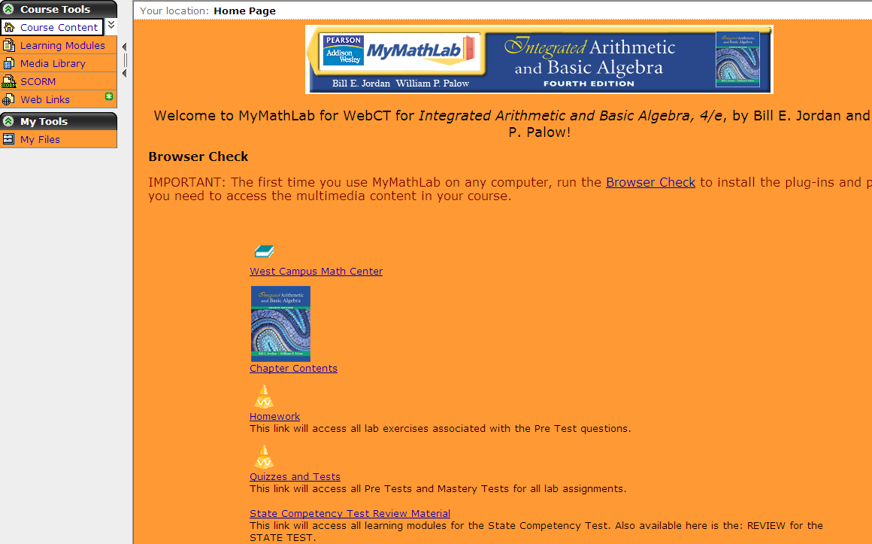
Home Page

Slide 10
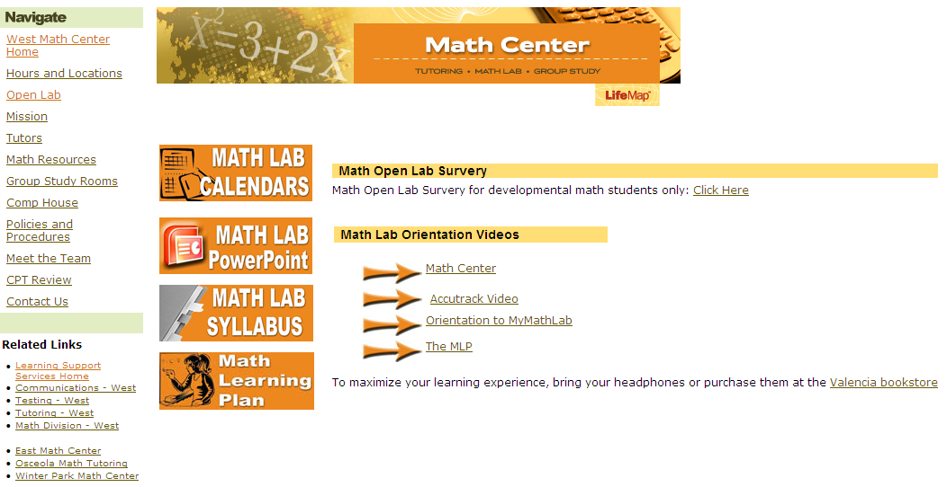
West Campus Math Center's Homepage

Slide 11
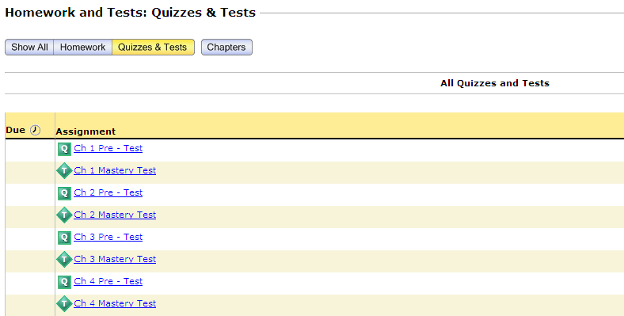
Take a Test/Quiz

Slide 12
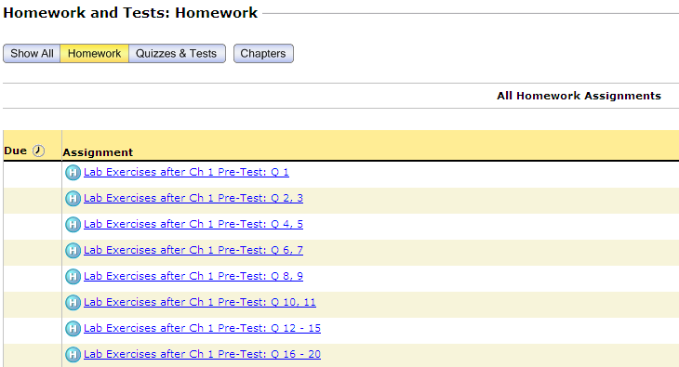
Do Homework

Slide 13
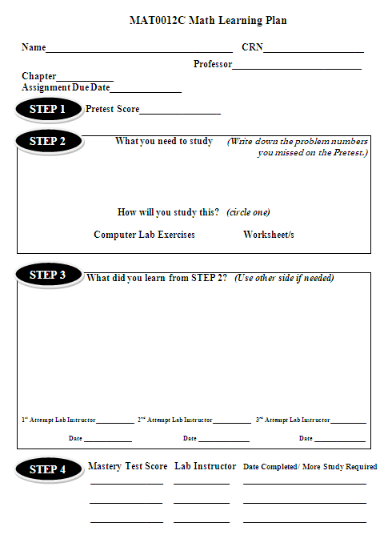
Completing a lab assignment
Fill entire Math Learning Plan (MLP) in
your Lab Manual as you complete each step.
(One MLP per assignment)
STEP 1 Take Pre-test in the lab
STEP 2 Do computer lab exercises/worksheet
on missed questions on pre-test and
score 100%
STEP 3 Write down what you learned and
get signed off by a Lab Instructor
STEP 4 Take Mastery test in the lab and
get signed off by a Lab Instructor
Score at least 80% on Mastery tests

Slide 14

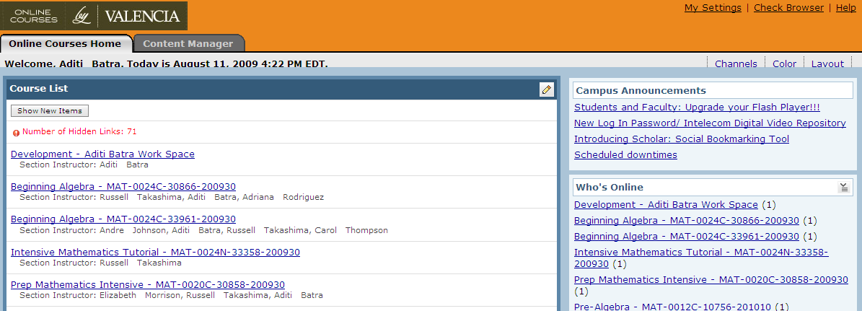

Always Log out when finished
Always check your name when you Log in

Slide 15
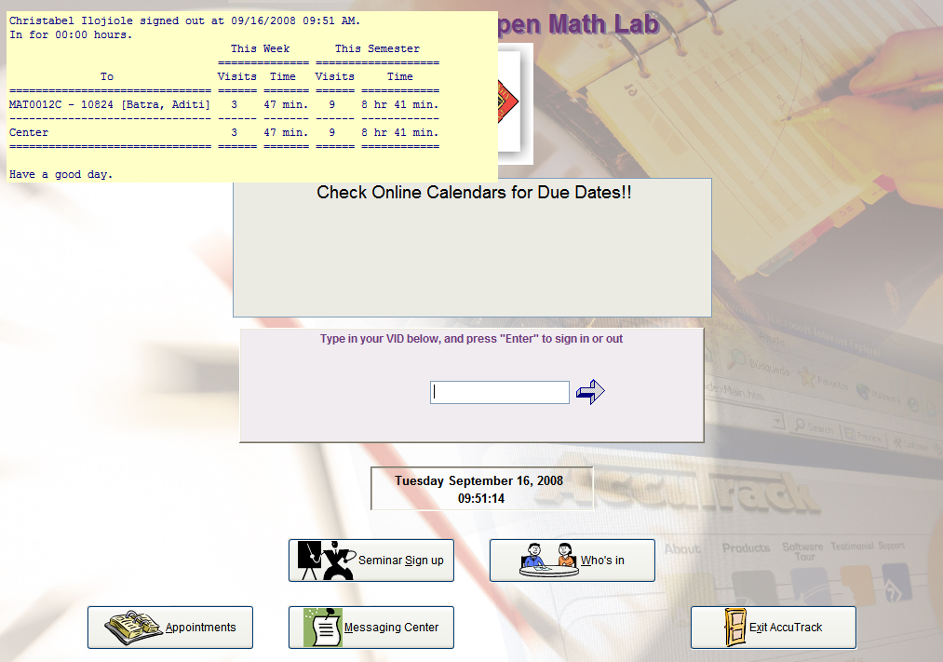

Lab Attendance Credit each Week
  Time spent during each
  visit adds up within the week.
  Sign-out table displays:
  The number of visits made
  in the semester.
  Time spent for current week
  and semester in the lab.
  Full Term= at least 50 min/week

Slide 16
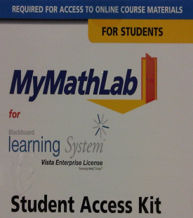
IMPORTANT INFO.
You need a Blue MyMathLab Student Access Kit
Enter the access code within the first fifteen days of the term.
OR
Unofficial Transcript - Turn in your unofficial transcript if
you took the course in the last two semesters. (print from Atlas)
___________________________________________________________________________________
MAT0020 – Register for the Competency Test in the lab & practice for it on

Slide 17




BECOME A SUCCESSFUL STUDENT
  *Read Math Lab Syllabus
  *Bring your Class Notes and
  Lab Manual and keep them
  organized
  *Check Lab Calendar frequently
  *Ask your MAC (Math Academic Coaches)
  *See other LSS RESOURCES

Slide 18

WHEN LIFE GETS TOUGH,
TALK TO SOMEBODY
Talk to your Professor
Talk to a Lab Instructor
Talk to a Counselor in SSB-110
Don’t Give Up

Slide 19



“STRESSED” is “DESSERTS” spelled backwards

Slide 20



