Slide 1
Welcome Back
Fall 2013
Math Department-West campus
8/21/2013

Slide 2
Agenda:
Introductions
Dean Russell Takashima: Legislation on Developmental Education
Prof. Boris Nguyen: SL program
Prof. Amy Comerford: Valencia Conference
Scheduled labs (MAT 0018C, MAT 0022C, MAT 0028C and MAT 1033C)
Final Exams (MAT 0018C, MAT 0022C, MAT 0028C)
Spring 2013 Passing rates
Opportunities for Professional Development within the math department starting Spring 2014.
Manipulative Activities for MAT 0018C, MAT 0022C, MAT 0028C and MAT 1033C

Slide 3
Scheduled labs
Scheduled labs: 50 minutes per week
Math Lab has been divided into four sections (28 computers each)
  Section 1: Red
  Section 2: Blue
  Section 3: Purple
  Section 4: Green
  Training Room: Gray. To be used as lab for some classes.
Labs will be held at four different sections and at the training room
The lab chronograms will follow the course timeline.
Open Times: Lab will have open times available for a limited period Monday through Saturday. (Friday open lab from 2pm to 7 pm and Saturday from 10 am to 2 pm)

Slide 4
FALL 2013 - OPEN LAB TIMES DAY TIME OPEN SEATS*
*Subject to first come first serve basis
Monday –as an example-
8 am - 9 am: 100 seats
9 am - 10 am: 25 seats
10 am - 11 am: 50 seats
11 am - 11:30 am : 100 seats
11:30 am - 12:30 pm: 25 seats
12:30 pm - 1 pm: 100 seats
1 pm - 2 pm: 25 seats
2 pm - 2:30 pm: 100 seats
2:30 pm - 3:30 pm: 0 seats
3:30 pm - 4 pm: 75 seats
4 pm - 5 pm: 50 seats
5 pm - 5:30 pm: 100 seats
5:30 pm - 6 pm: 75 seats
6 pm - 7 pm: 50 seats
7 pm - 8 pm: 0 seats

Slide 5
          Math Lab Orientations
          Math Lab Orientations
          First week of classes during scheduled time.
          Orientations have been changed to reflect the changes.
          Please inform your students that they will need their Valencia ID number, Atlas user name, Atlas Password and the code from unopened MyMathLab Student Access Kit during lab orientation.
          Students will be instructed on how to register themselves in MyMathlab during orientation.

Slide 6
Lab Assignments
MAT 0018C, 0022C, 0028C: Homework has been reduced to fit the new lab times.
Procedures for these classes will remain the same. All Students must print the Math Learning Plan (MLP). No exceptions.
MAT 1033C: Lab activities have been reduced to fit the schedule labs (Lab Worksheets, Lab Self-Quiz and Lab Assignments)
  Lab Worksheets: Located within the Lab syllabus. This is the first item students must print.
  Lab Self-Quiz and Assignment: Located on MyMathLab (password protected)

Slide 7
MAT 0018C, MAT 0022C and MAT 0028C
8 quizzes in MAT 0022c and 0028c
7 quizzes in MAT 0018c
Students are allowed 2 attempts per quiz.
The third attempt on a Quiz is up to the instructor. The Instructor is in charge of adding a third attempt for a student in MML.
If student passes each lab quiz with 70% or better, the Final Exam is not an exit exam
If student does not pass each lab quiz with 70% or better, the Final Exam is an exit exam. The passing grade for the exit exam is 70% or better.

Slide 8
Final Exams (MAT 0018C, MAT 0022C, MAT 0028C)
MAT 0018C Final Exam in MML, 40 questions.
MAT 0022C Final Exam in MML, 40 questions
MAT 0028 Final Exam in MML, 40 questions.
No re-takes

Slide 9
Blackboard & Mymathlab:
Navigate Blackboard and MyMathLab
Place due dates in MyMathLab.
Place specific instructions for quizzes, such as: calculator allowed on a quiz title.
If applicable, open third attempt for MAT 0018/ 0022/ 0028 students on quizzes and sign their MLP sheet.

Slide 10
MAT 0028C Final Exam
Information for students;
  The MAT 0028C Final exam will be given before the final exam week (except for the Flex start classes)
  Students need to register for the final exam in order to select time and day of the test.
  The exam location is pending.
  A Practice Final Exam will be in your MyMathLab course for students to practice the course concepts.
Information for instructors;
  The Final exam will be imported to your course one week prior to the exam being given (PLEASE DO NOT MODIFY THE EXAM)

Slide 11
West Campus Developmental Math Passing Rates
Spring 2013

Slide 12
Spring 2013: Passing rate MAT 0018C (Enrollment 814 students)

Slide 13
Spring 2013: Passing rate MAT 0022C (Enrollment: 87 students)

Slide 14
Spring 2013: Passing rate MAT 0028C (Enrollment: 1110 students)

Slide 15
Opportunities for Professional Development
Innovation Academy
Seven Essential Competencies of the Valencia Educator:
  Assessment
  Inclusion and Diversity,
  Learning Centered Teaching Strategies,
  Outcomes- Based Practice,
  Scholarship of Teaching and Learning,
  Professional Commitment
  LifeMap: Developmental Advising.
Organized around each competency.
Leadership opportunities

Slide 16
Examples of
Hands-On Activities
Courtney Watson

Slide 17
Manipulatives:
Models that incorporate mathematical concepts, appeal to the senses, and can be moved by students

Slide 18
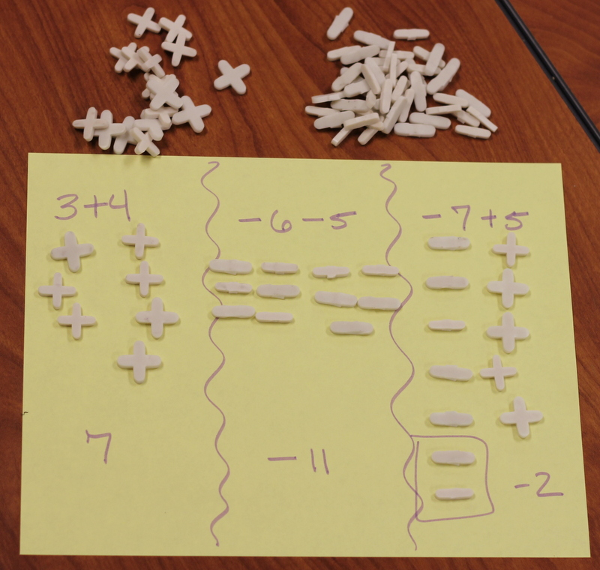
Adding and Subtracting Integers

Slide 19
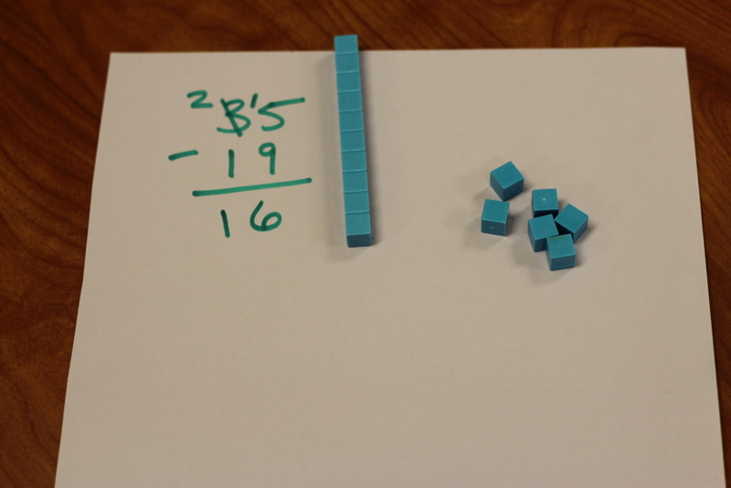
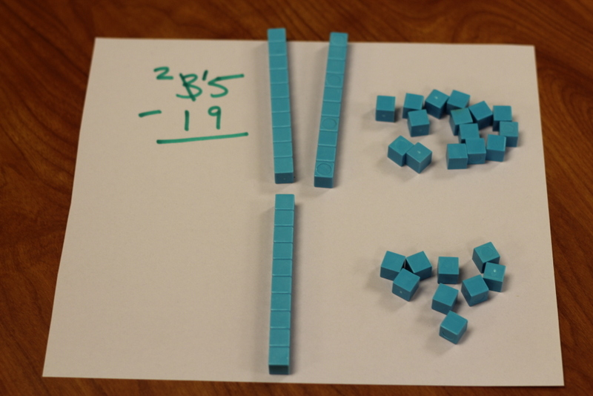
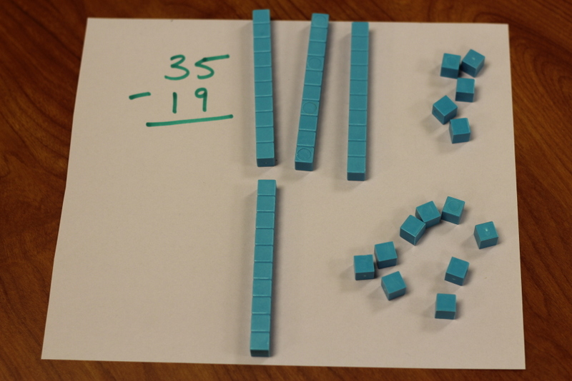
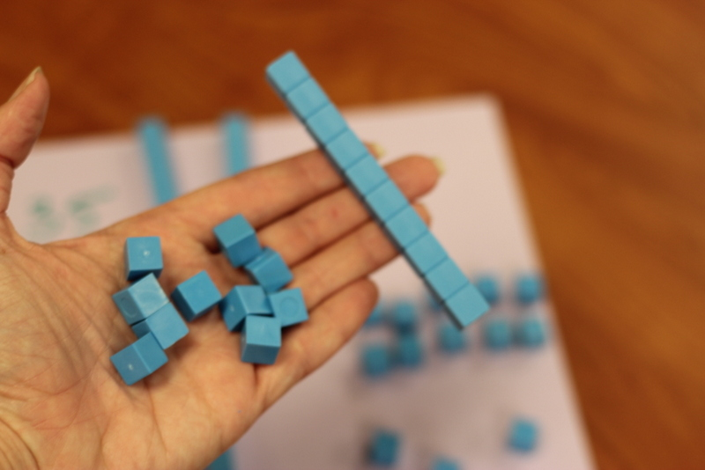
Base 10 Blocks
Subtracting with Regrouping

Slide 20
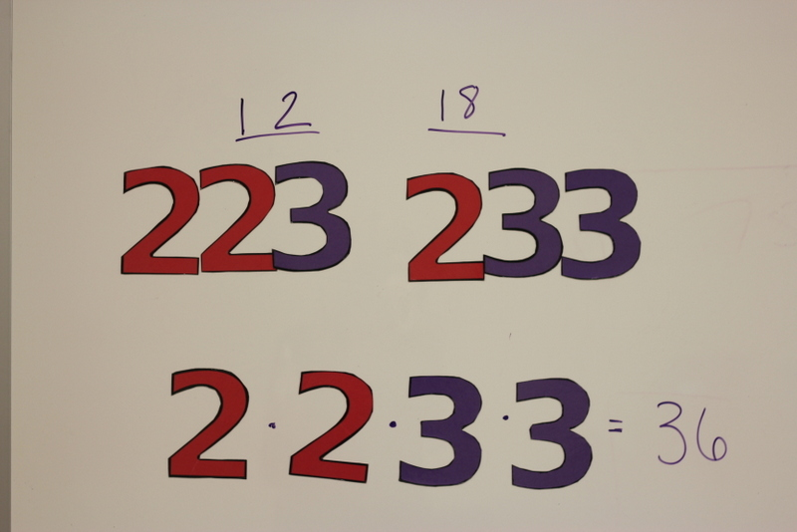
LCD

Slide 21
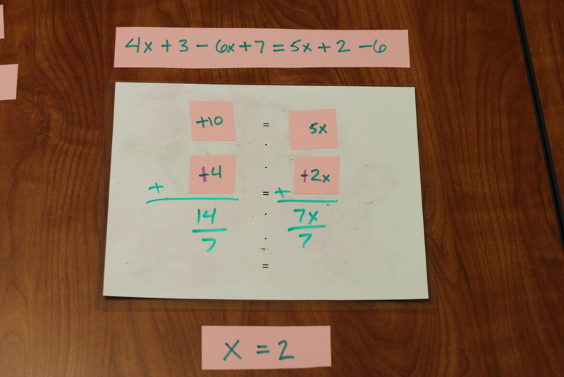
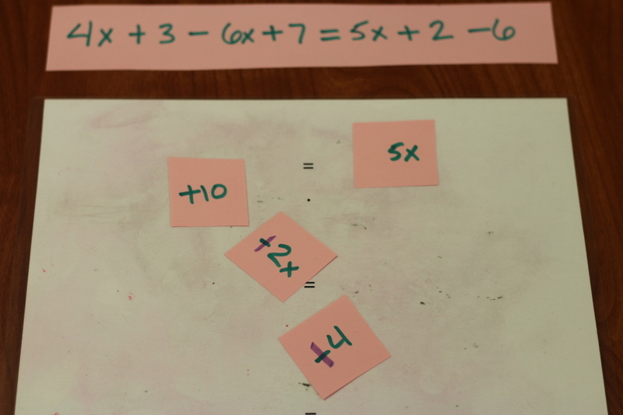
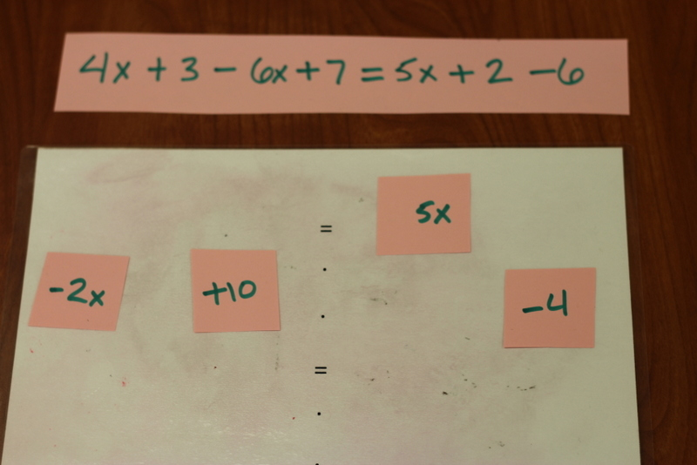
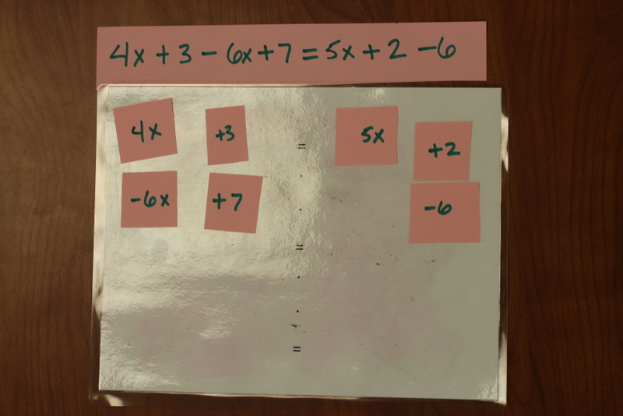
Solving with
Combining Like Terms

Slide 22
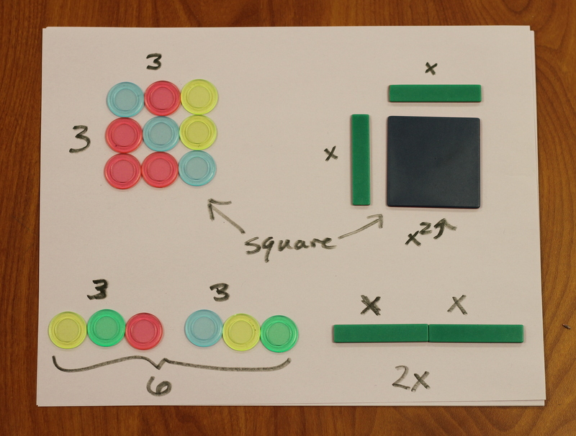
Polynomials

Slide 23
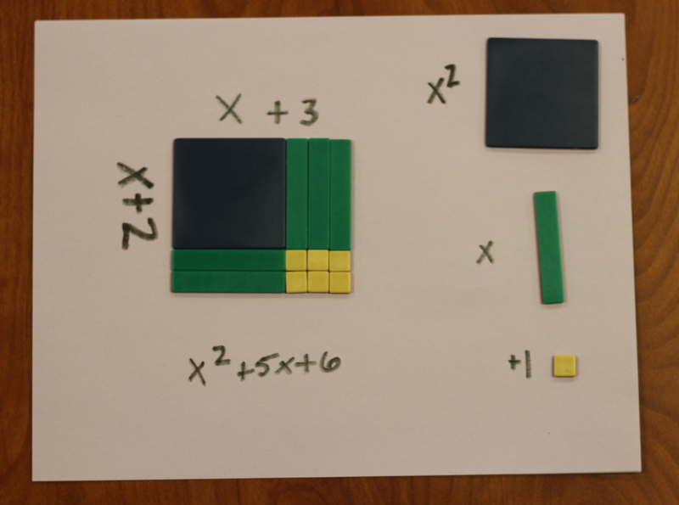
Factoring Trinomials

Slide 24
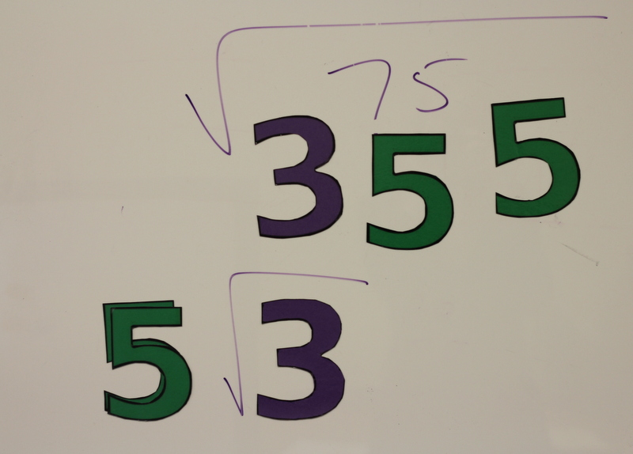
Simplifying Radicals

Slide 25
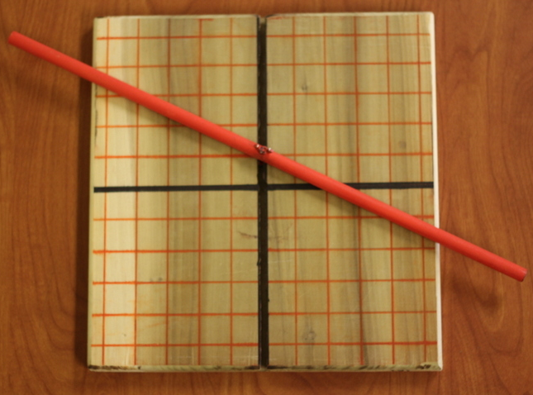
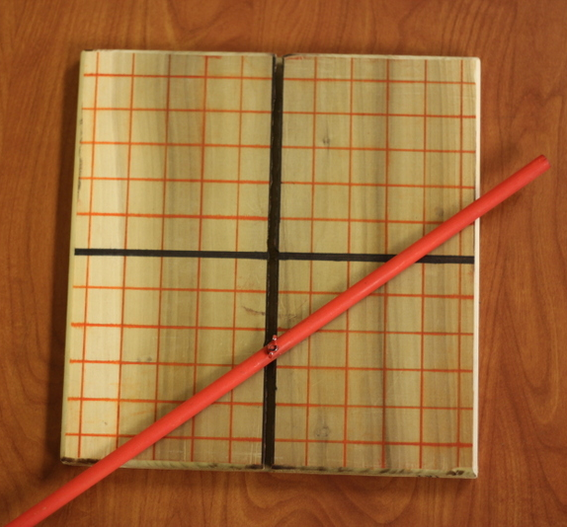
Graphing

Slide 26
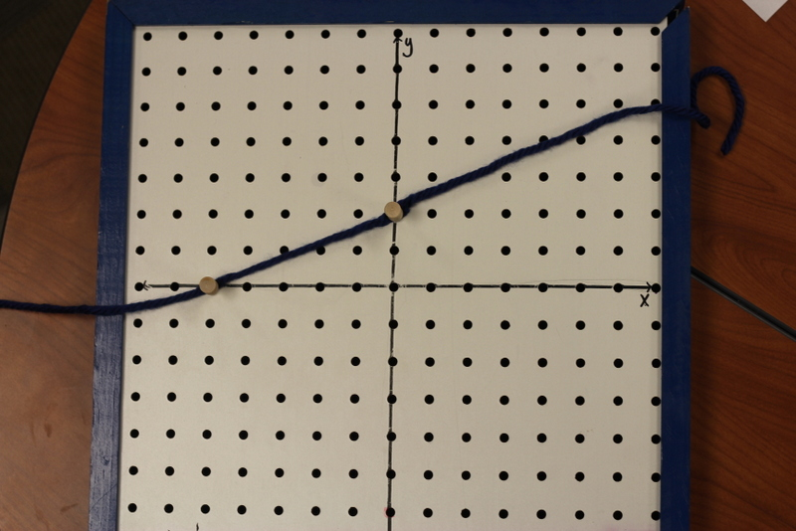
Graphing with intercepts

Slide 27
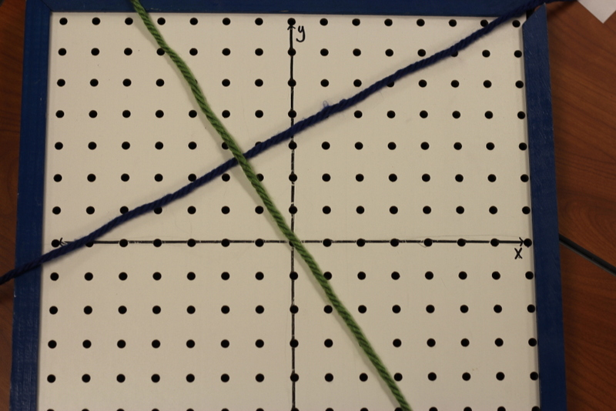
Perpendicular

Slide 28
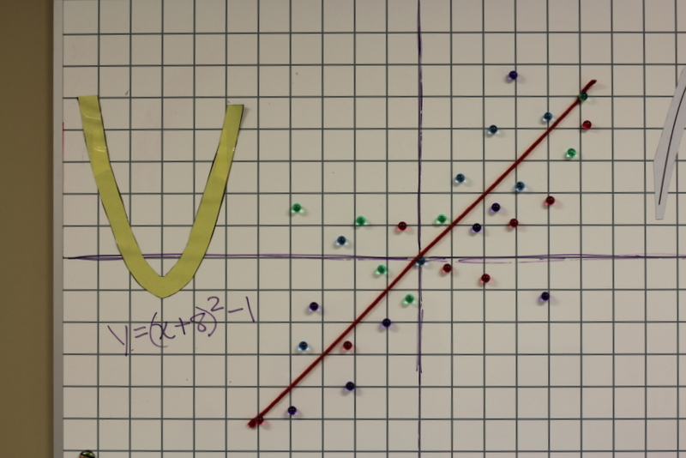
Translation/Scatter plot

Slide 29
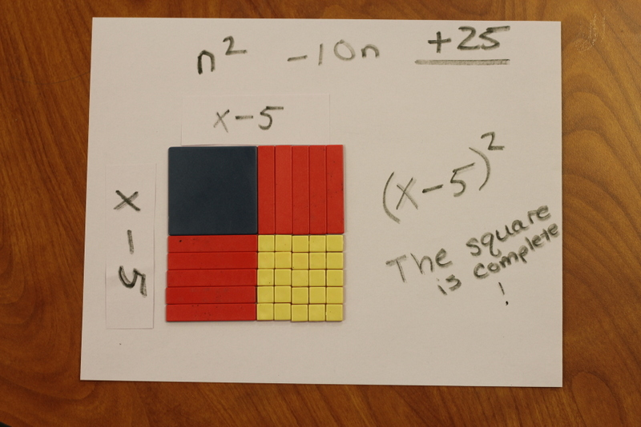
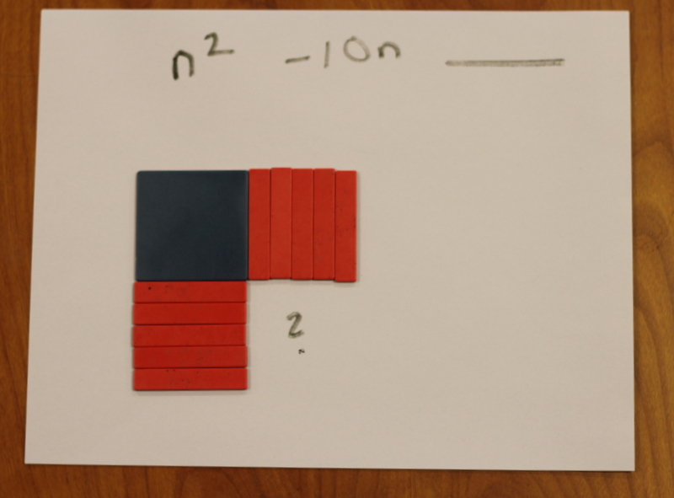
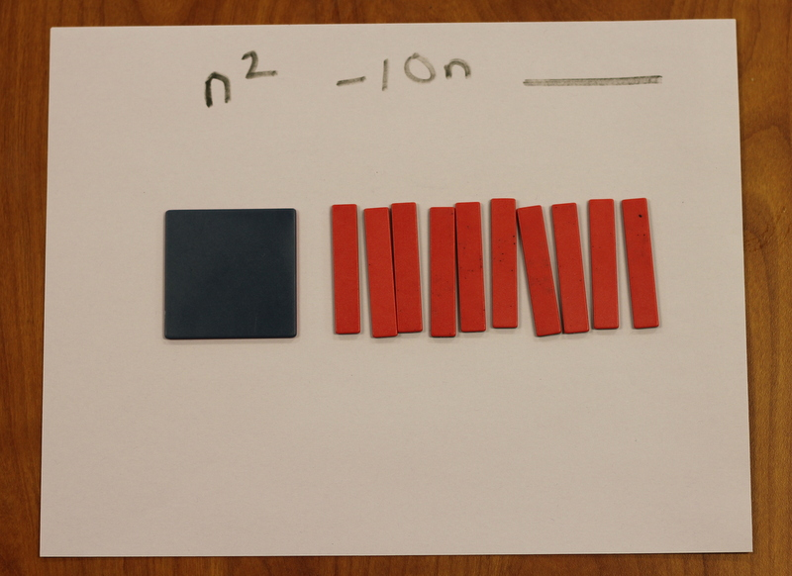
Completing the Square

