Slide 1
Narrative 101
Tell a Story That Everyone Wants to Hear!

Slide 2
What is Narration?
Narration is the mode that people use to tell stories.
You use narration whenever you relate a series of events or incidents.

Slide 3
Organization of a Narrative
Since narration is the mode that focuses on a series of events, how well you present the sequence will influence how your reader understands it.
Narratives are typically presented in chronological order—the presentation of events in the order in which they happened.
Sometimes writers use flashbacks—incidents purposely presented out of sequence—to give the reader important background information.
Make sure to use transition words or devices that allow the reader to easily flow through the sequence of events without getting lost.

Slide 4
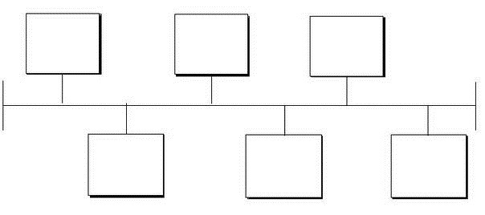
Organization Quick Tip
When pre-writing or planning for a narrative assignment, make a timeline of events.
This allows you to visualize the story from beginning to end. Establishing a beginning, middle, and end is the first step in creating focused paragraphs.

Slide 5


Topic Sentences
Writing a clear topic sentence helps the reader follow the sequence of events of the story.
They help the reader understand the point of view of the paragraph.
Typical topic sentences provide the topic along with the attitude about the topic.

Slide 6

Point of View
Point of view is the perspective from which you relate the events of the story.
Often, first-person point of view is used.
First-person point of view tells the story as if you participated in or experienced the event.
When using first-person point of view, words such as I and me are used.
Another point of view often used is third-person point of view—when you relate the events as an observer rather than a participant.
When using third-person point of view, words such as he, she, her, they, etc are used.

Slide 7

Stay Focused
Make sure you do not include too few specific details; this happens because you know the story so well that you often leave out information that the reader needs to understand the story.
Make sure you do not include too many specific details that are from another event indirectly related to the event your telling; this can confuse the reader.
To prevent these mistakes, focus the narration on your reader’s needs and your purpose in writing it.

Slide 8

Checklist
Does the introduction set the scene for the sequence of events to follow?
Is your chosen point of view used consistently?
Does the paper follow chronological order? If a flashback has been used, has the switch been made clear to the reader?
Is the paper unified, with all supporting details and examples related to the main idea?
Are there enough specific details and examples to guide the reader?

Slide 9

Dialogue
Dialogue is a great way to enhance your narrative writing.
It is a great way to incorporate action.
The reader is able to “experience” the story as it is being told.
Remember, great narratives “show” rather than “tell.”

Slide 10

Formatting Dialogue
When writing dialogue, begin a new paragraph for each new speaker.
Enclose actual spoken words in quotes.
A phrase or tag line identifies the speaker and appears in the same paragraph as the speaker’s words. Once the flow of the conversation is established and it’s easy to identify the speakers, tag lines can be eliminated.

Slide 11

Dialogue in Action
  Example:
  “Do you need a ride?” asked Patti, pulling up in her Jaguar beside her best friend.
  “Yes I am afraid so. My Porsche has broken down,” said Melissa.
  “Hop in. I’ll drive you.”
  “ Are you sure?”

Slide 12
Dialogue Format (cont.)
Tag lines are treated as interrupters. When they appear in the middle of quoted words, they are enclosed by two commas.
“If I don’t find a ride,” Melissa said, “I can’t go to the Brain Bowl competition.”
“Ok, I’ll drive. Don’t fret,” Patti assured her.

Slide 13


Punctuation and Dialogue
Periods and commas always go inside quotation marks.
Other punctuation marks—such as question marks and exclamation marks—go inside if they belong to the quotation and outside if they do not. (Note: only use one end punctuation mark)
He asked, “May I have this dance?”
What do you think of “No new taxes”?
Do you believe in an “eye for an eye”?

Slide 14
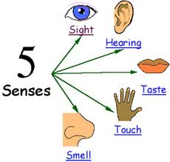
Bring the Narrative to Life
Details are very important—you want the reader to feel as if they are in the story you have created.
While writing, think about the five senses: sight, touch, taste, smell, sounds. Readers want to experience the story in every way.
Don’t be afraid to incorporate figurative language (simile, metaphor, hyperbole etc.)

