Slide 1
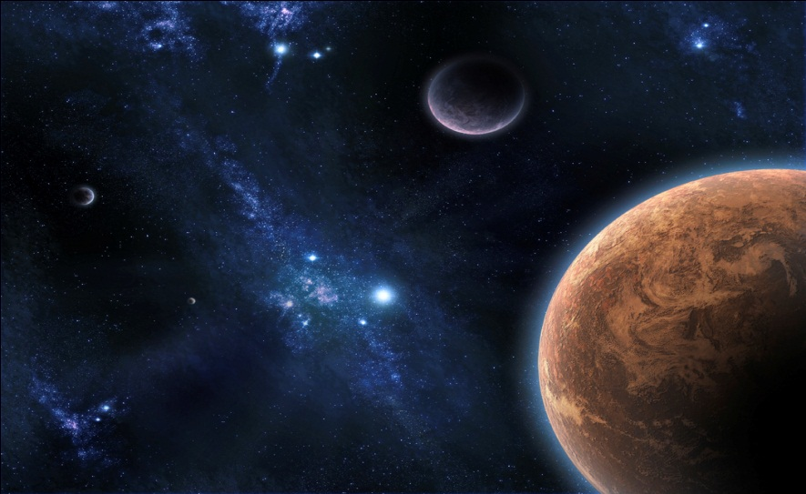
Incorporating Quotations I
This quick PowerPoint explains how you can properly incorporate/integrate your quotations in 5 different ways.

Slide 2
1. Quotations NEED TO be integrated smoothly
When you use a quote in your paper, it must be worked comfortably into your own sentence structure. How can we do this? Here are some examples!
Correct Example: After June’s humiliating Piano recital, Waverly adds insult to injury by declaring, “You aren’t a genius like me”(Tan 151).
Incorrect Example: After June’s humiliating piano recital, Waverly adds insult to injury. “You aren’t a genius like me” (Tan 151).
Explanation: Notice in the second example, the quote stands alone. Remember, a direct quotation can never stand alone because then it isn’t properly integrated. Instead, it is simply placed into the student’s writing without any introduction or reason. In the first example, which is the correct one, the quote is nicely integrated with an introductory phrase, and we know who is speaking because the writer used specific names and the signal word, “declare.” Also, because this is probably not the first time the writer is mentioning the author, the author isn’t introduced, so they have an parenthetical citation with the author’s last name and page number in MLA format to give the author credit.
Off to #2!

Slide 3
2. If a quotation must be altered to fit your tense, clarify, or add a term/NAME/letter, place brackets around the change
Example: Referring to one of his co-workers, Sammy observes that “[Stokesie] thinks he is going to be manager some sunny day” (Updike 290).
Explanation: We used quotation marks here because these are the exact words from Updike’s text. We placed brackets around the name because the original text uses, “he,” so in order to be more specific because his name isn’t mentioned at the beginning of the sentence, it’s best that we clarified who “he” is for the reader. Also, we added a parenthetical citation at the end with the author’s last name and page number in MLA format to give the author credit.
Let’s find out a third way to incorporate quotations into our writing!

Slide 4
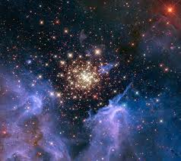
3. If you WISH TO OMIT UNNECESSARY INFORMATION FROM THE MIDDLE OF A QUOTE, USE ellipsis
The three dots, or ellipsis, are only necessary when you are omitting words in the middle of a quote. But be sure that what you omit information, it does not significantly alter the source’s meaning.
Example: “As Morgenstern put it, “Joe Glaser... Proved to be the right man at the right time” (128).
Example: During their phone conversation, Toby’s father tries to win Toby over by saying, “I’ve made some mistakes... We all have. But that’s behind us. Right, Tober?” (211).
Explanation: For the first example, the ellipsis used show that information was eliminated in the body of the quote. In the second example, the ellipsis contain four dots rather than the usual three. This shows not only was information eliminated from the original text, but also, that more than one sentence was omitted. Both examples have parenthetical citations in MLA Format to give the author credit. Let’ see #4!

Slide 5
4. Use single quotation marks to indicate a quote within a quote
When there is a quote within a quote, the quote you use gets double quotation marks and any quoted material within this quote receives single quotation marks.
Example: “The reporter told me, “When I interviewed the quarterback, he said ‘they simply played a better game.’”
Explanation: The words,“ They simply played a better game,” are already placed in quotation marks because it’s what the quarterback said when the reporter interviewed him, so it’s the player’s own words. Now, in this quote, the reporter is being interviewed saying, in his own words, what he did, so those words get placed in double-quotation marks, so the single quotation marks indicate the quote within a quote. Any information that you are quoting that already has quotation marks around it needs to be placed in single quotation marks. Let’s finish up with our last suggestion on how to integrate quotations!

Slide 6
5. If you are having trouble integrating a quote, the colon is your friend
A colon,:, is often used to introduce or integrate quotes. Keep the colon in mind if you cannot find an easy way to place the quote with your own words. The colon is often used to integrate a block quote as well.
Example: Though Wangero implies she understands the value of the quilts better than her mother, Mrs. Johnson knows much more about the quilts than Wangero does, including the way they were designed: “[o]ne was in the Lone Star pattern. The other was Walk Around the Mountain” (Walker 347).
Explanation: This example shows how to use a colon to integrate a short quote smoothly.

Slide 7
GOOD LUCK!
For more information and more examples on Incorporating Quotations, stop by the CSSC on the Winter Park Campus in Room 136. The information in this tip sheet can be credited to authors, Maimon, Peritz, and Yancey, of The Brief McGrawl-Hill Handbook and The Purdue Online Writing Lab at http://owl.english.purdue.edu/owl/.

