Slide 1
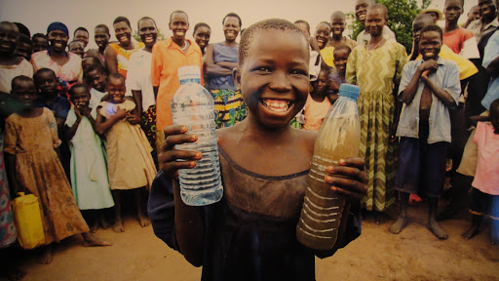

Slide 2
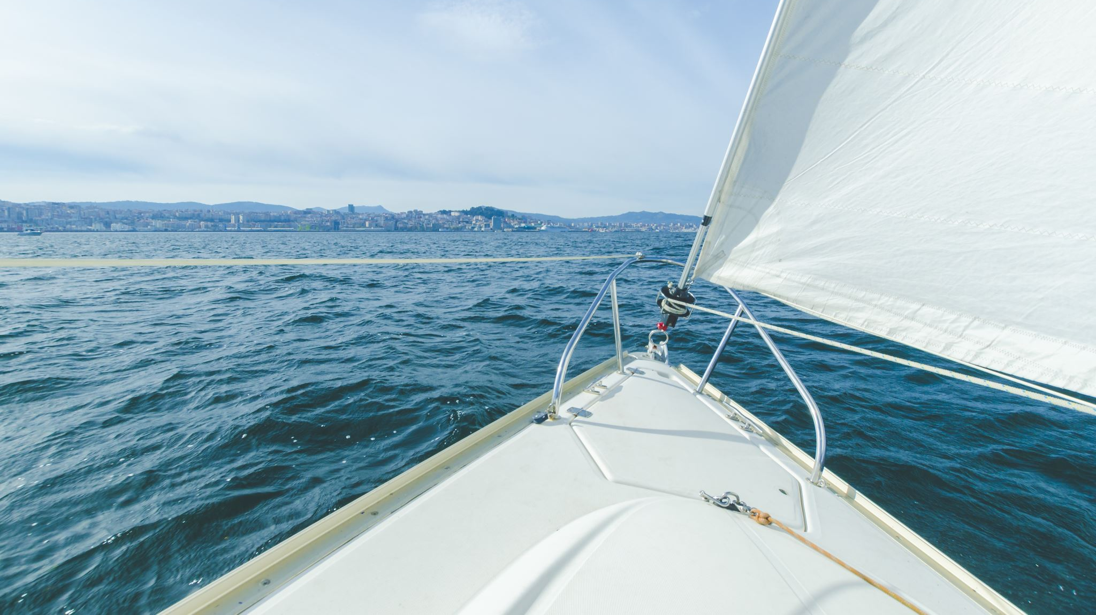
Water Scarcity
VGD Capstone Project
Staphana edouard

Slide 3
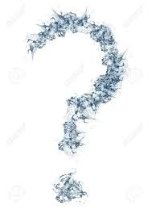
What is water scarcity

Slide 4

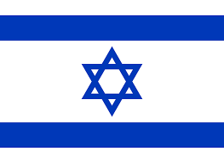


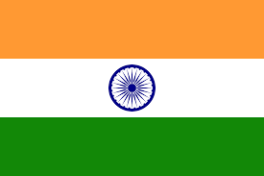

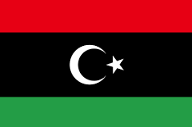
Water scarce countries

Slide 5
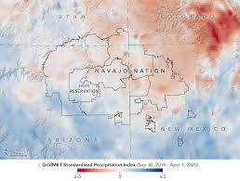
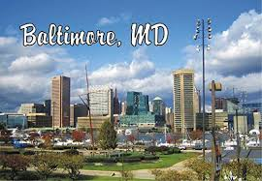
Navajo Nation and Baltimore Water Crisis
Navajo Nation (Indian reservation)
  more than one-third of the population lacks access to running water or indoor plumbing facilities.
  Residents rely on monthly water bottles deliveries
  Seek water in local wells or watering hole.
  Wait times for piped water supply is up to 15 years and cost $12, 000.
Baltimore, Maryland
  Water rates more than doubled (to repair water infrastructure)
  Residents were paying more than 3.6% of their income for water.
  From 2010 to 2018 water service costs increased by 127%

Slide 6
The causes of water scarcity
Climate change
Pollution
Population growth
“We’re currently facing a global water crisis. Our populations and economies are growing and demanding more water. But our supply is threatened by climate change, water waste and pollution.”
Betsy Otto

Slide 7
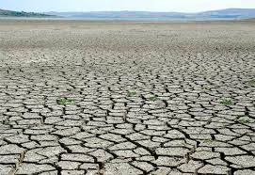
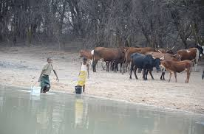
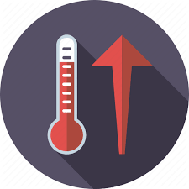
Climate Change

Slide 8
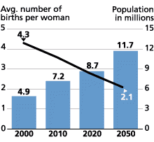
Population Growth

Slide 9
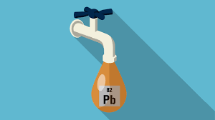
Water Pollution -> chemicals

Slide 10
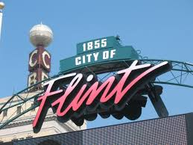
Lead infested water crisis

Slide 11
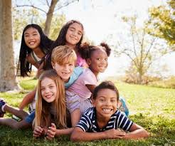
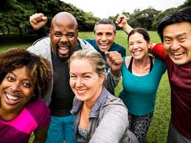
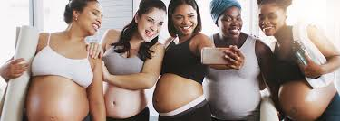
Consequences of drinking lead infested water

Slide 12
How lead affects the human health in general
Could cause:
  Kidney cancer
  Brain cancer (gliomas)
  Act synergistically with other carcinogens.

Slide 13
What can we do?
EASY STEPS YOU CAN TAKE:
  Reduce indoor water use
  Reduce outdoor water use (landscapes)
  Volunteer for the cause
Donate to charity
Raise awareness
Get involved locally, visit Captains for Clean Water for more information
  https://captainsforcleanwater.org/

