Slide 1
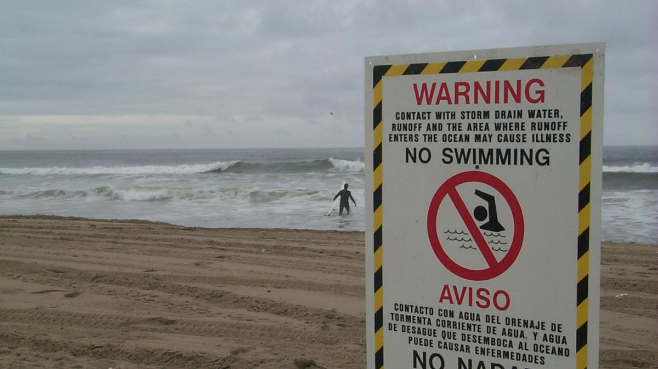
Less Ego, More Eco in Our System
A Global Perspective on Water Pollution
Paige Bero

Slide 2
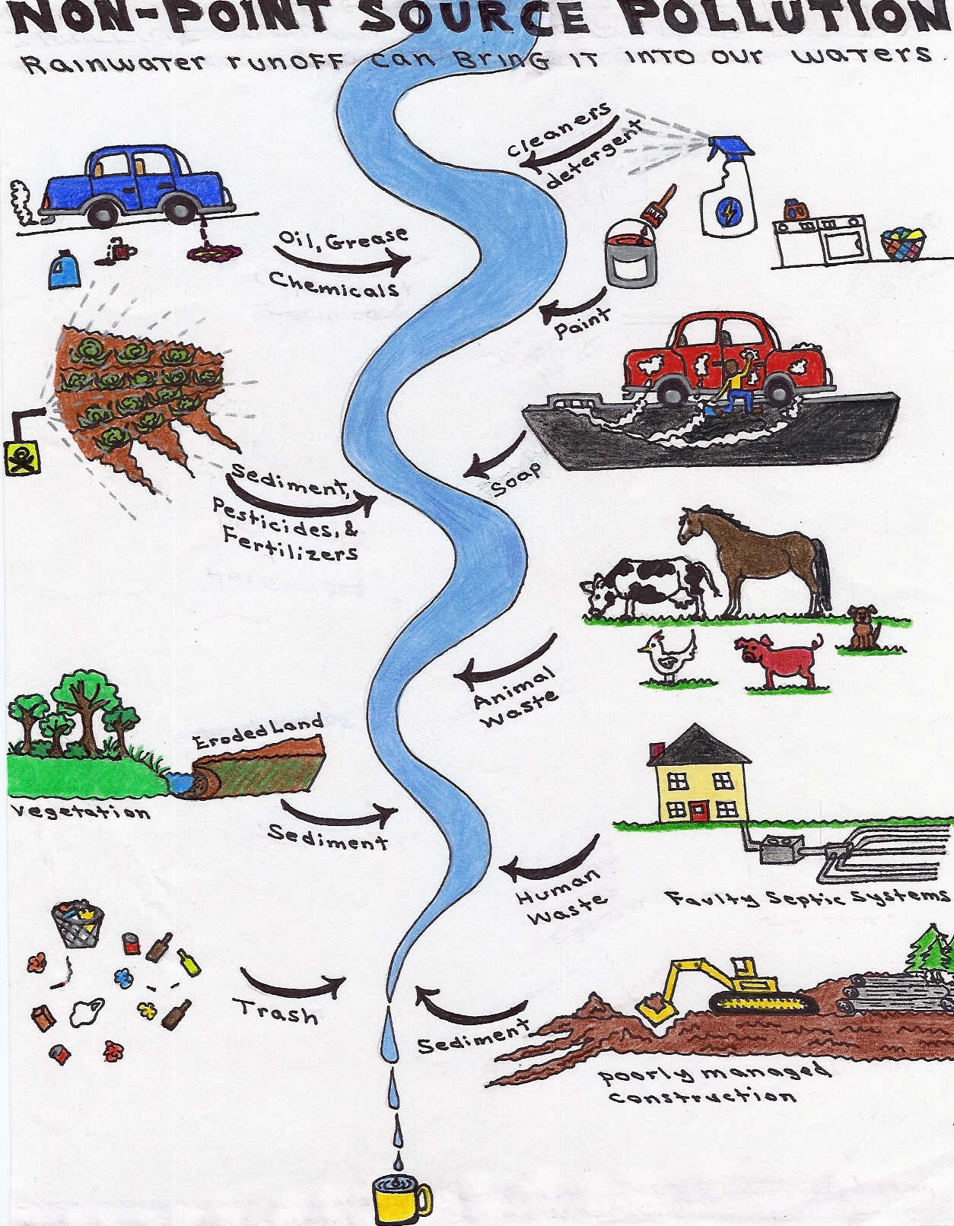
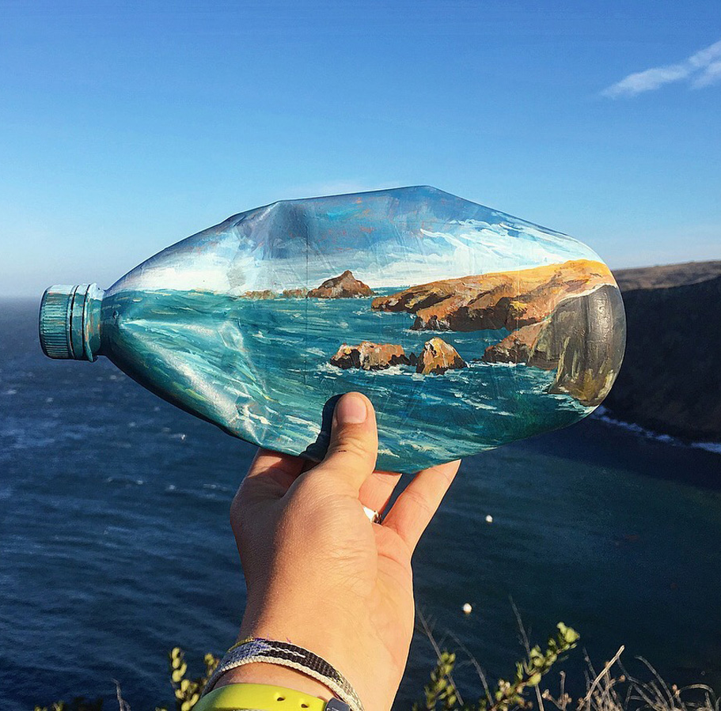
The Basics:
Water Pollution:
Release of substances into a body of water – Ocean, Lake, River
Accumulates faster than able to break down
Poses harm to environment
Anthropogenic Source - Caused by human
Chemicals
Trash
Nonpoint Source:
Most prevalent type and more complex to fix
Pollutants are INDIRECTYLY placed into water – 80% comes from land
Notes:
Nonpoint Source
Most prevalent type and more complex to fix
Pollutants are INDIRECTYLY placed into water – 80% comes from land
Water Pollution:
Release of substances into a body of water
Accumulates faster than able to break down
Poses harm to environment
Anthropogenic Source - Caused by humans

Slide 3
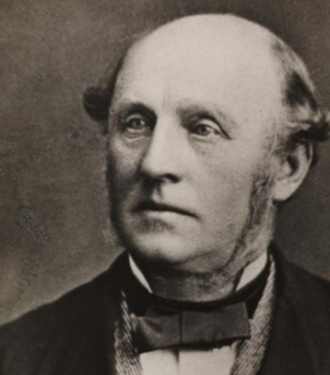
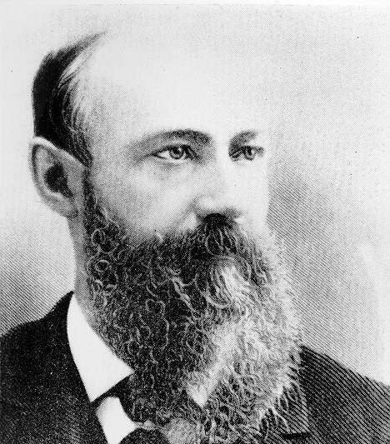
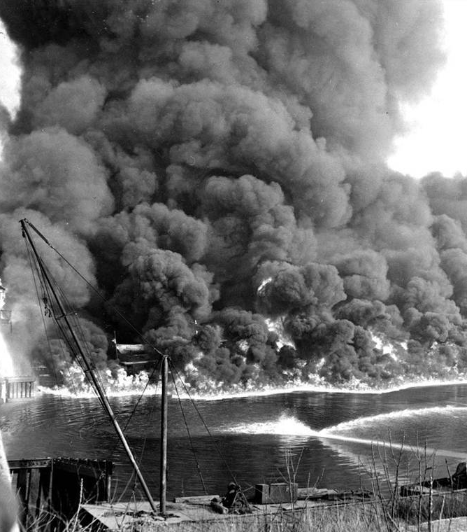
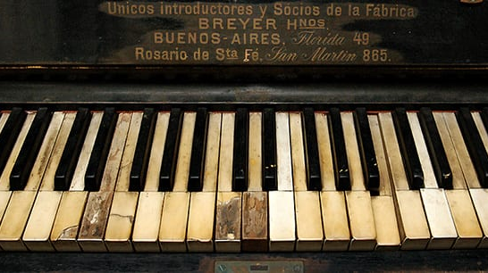
History of Plastics and Pollution
1856: Alexander Parkes creates 1st man-made plastic (Parkesine)
1863: John Westly Hyatt created cellulose nitrate from Parkes creation, alternative source to Ivory
Created to conserve natural wildlife
Industrialization and both World Wars saw increase in plastics and alternative polymers: shift from sanitation to pollution
Disasters created start of regulations
Clean Water Act – 1972
Research was initiated
Plastic Resin ID Code in 1988

Slide 4
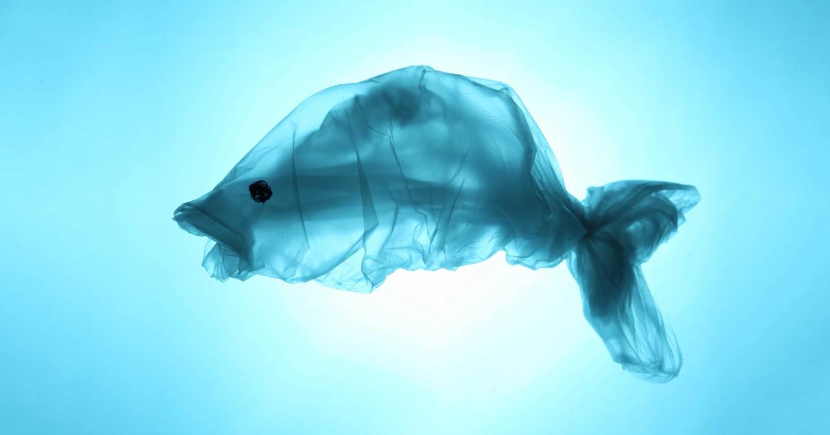
Marine Life: More Than a Pretty Face
Microplastics – Plastic doesn't Decompose!
Animals mistake it for food and ingest it
Microbead Free-Waters Act of 2015
Notes:
Area of water with little to no oxygen
Runoff water sparks algae bloom
Decomposition consumes oxygen
Hypoxia kills marine life or forces them to leave
Broken down plastic from suns UV light - photodegradation
Animals mistake it for food and ingest it
Microbead Free-Waters Act of 2015 -> Only with U.S and microbeads, NOT Microplastics

Slide 5
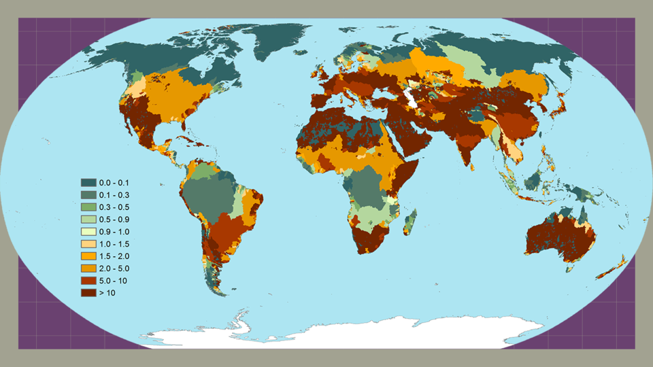

Slide 6
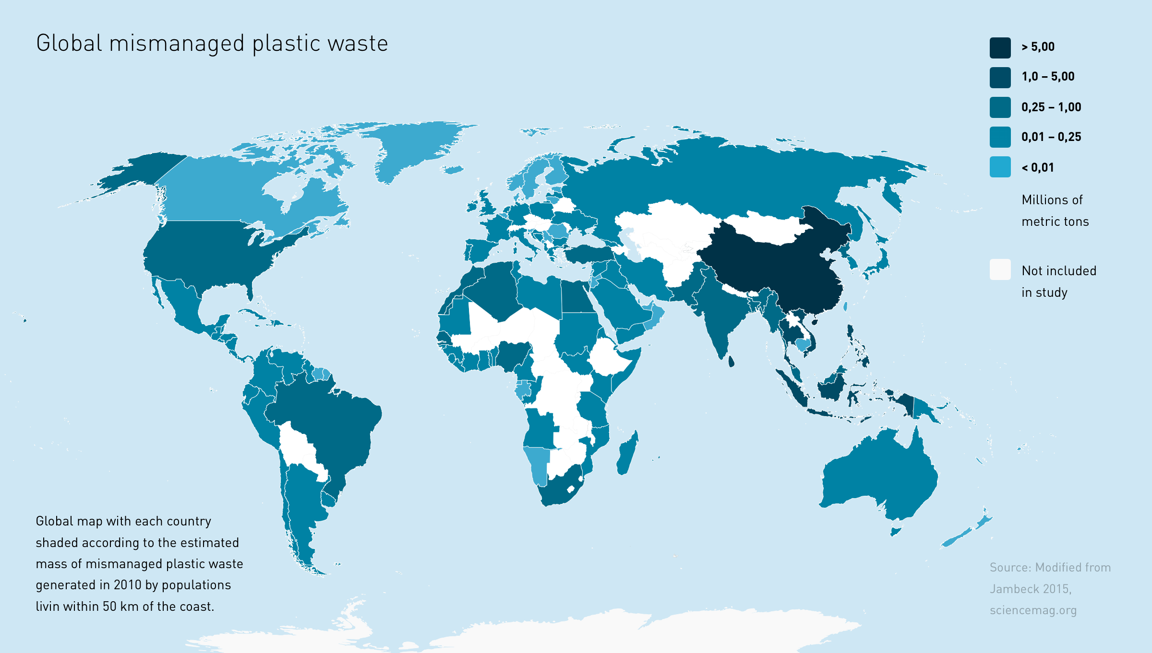

Slide 7
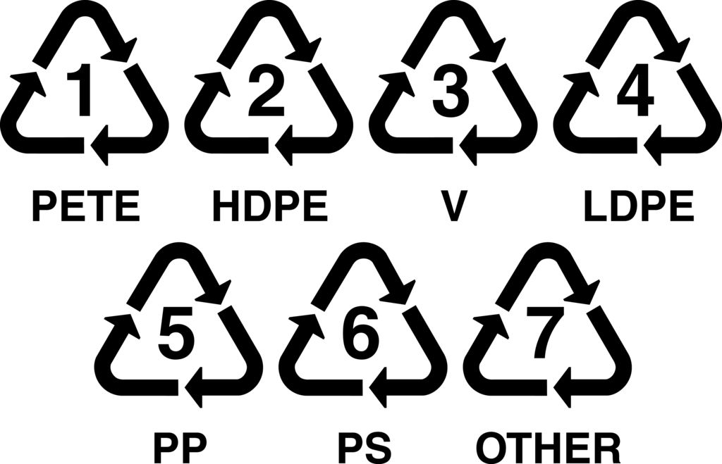
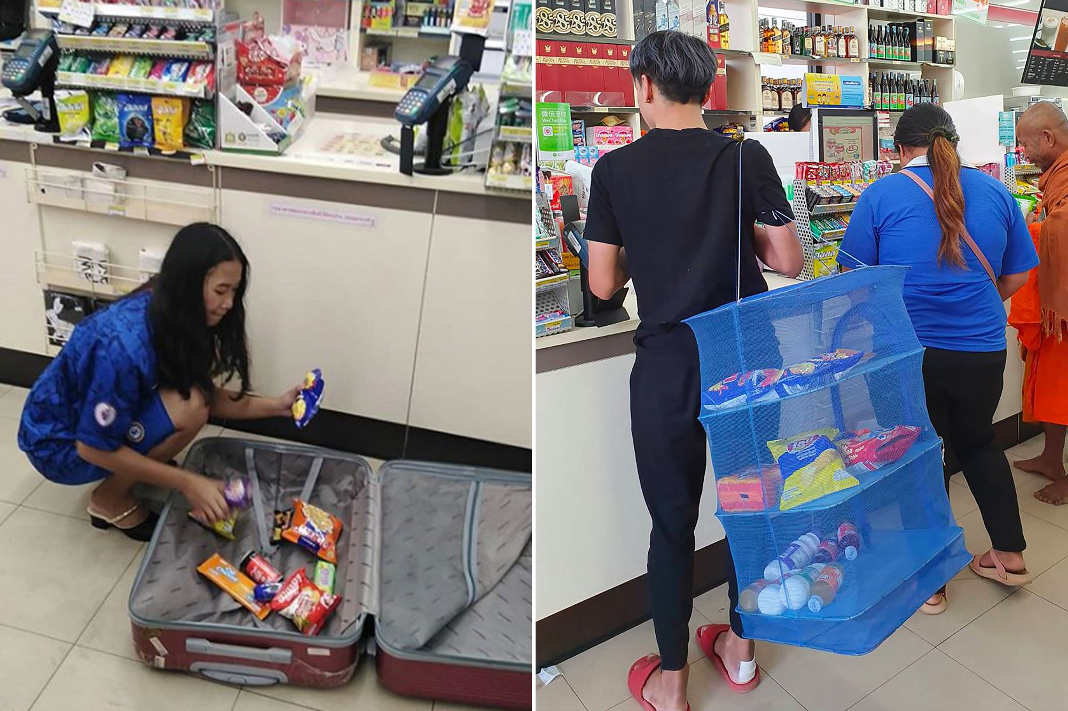
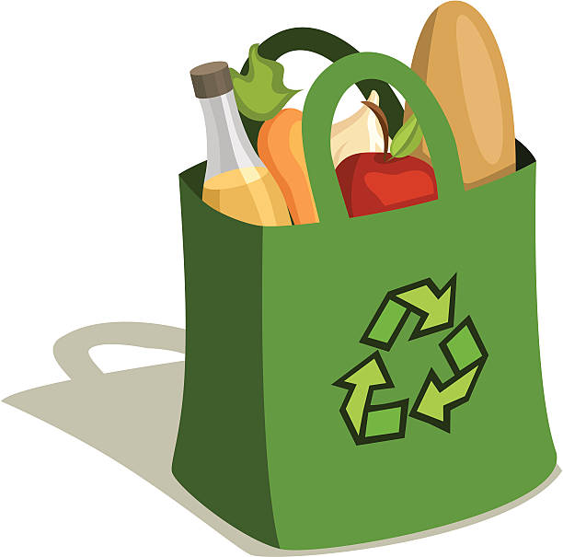
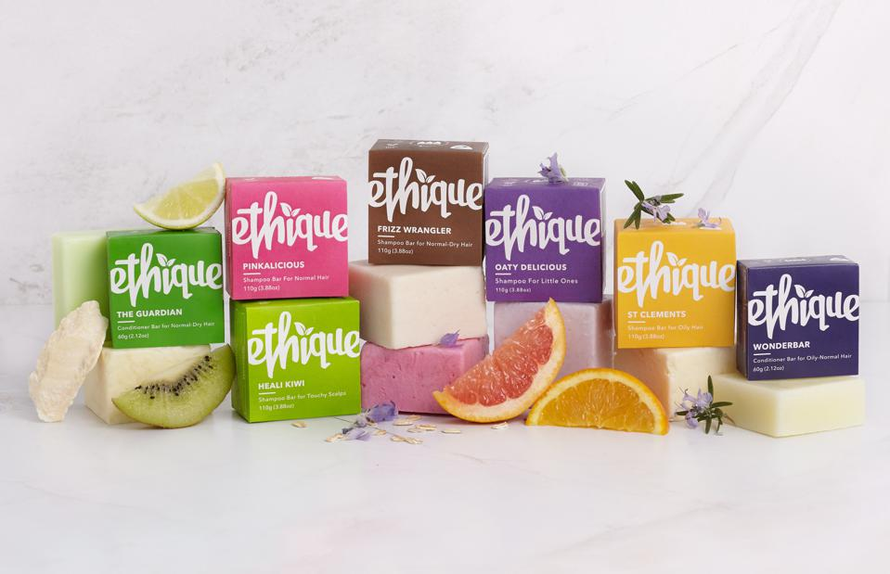
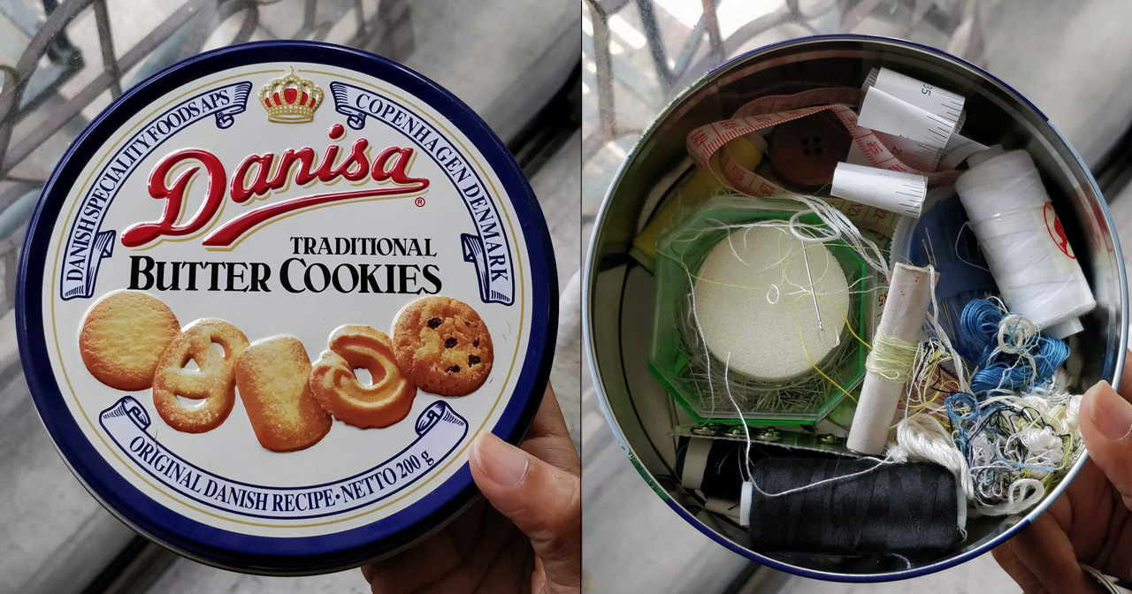
Reduce Waste Consumption
Reuse products when able
Recycle old waste into new product
Notes:
Ex.: Thailand ban on plastic bags
“Less is more” policy
Bulk can be better
Avoiding plastic that takes longer to degrade/unable to degrade
-------------
Reusable alternatives are more durable
Bags, bottles, straws, etc.
Single use items may serve use for other needs
Pet waste cleaning with bags, cleaning tools with toothbrushes, etc.
Clothes can be sold or donated
--------
Companies utilize this approach the most
Cost-effective

Slide 8
Trash Cleanups: Good for different reasons
Not ideal solution to preserve and protect marine life
Does not address new waste being created daily
Still an ideal tool for education, advocacy and charity

Slide 9
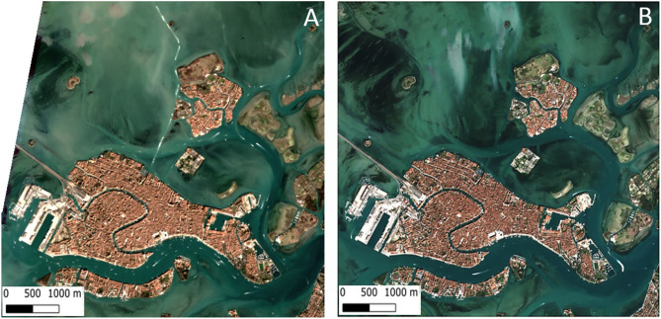
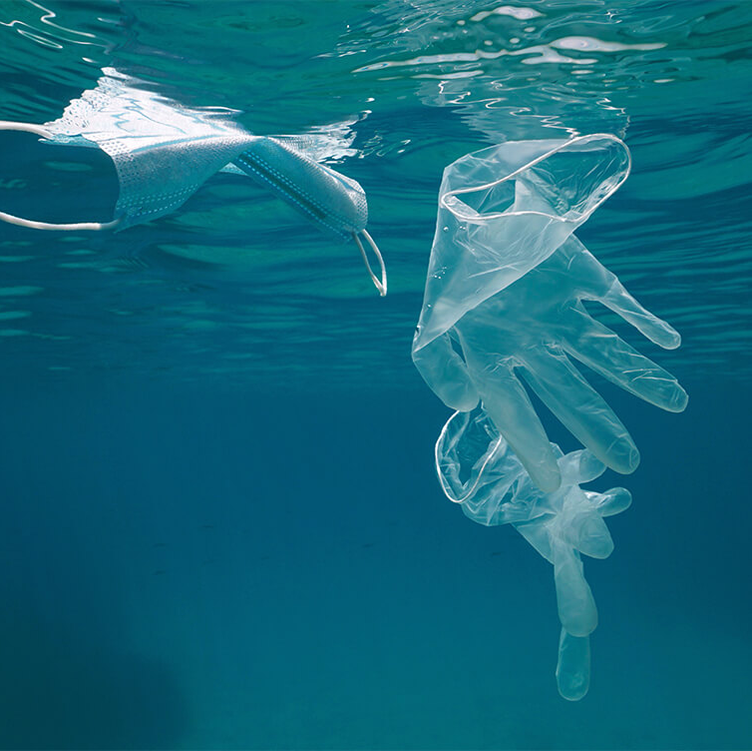
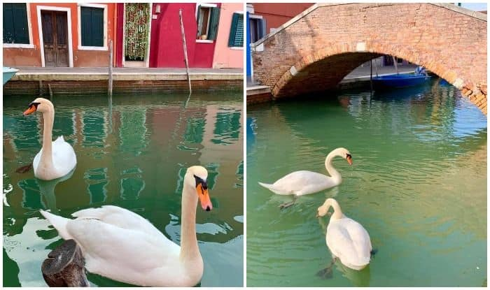
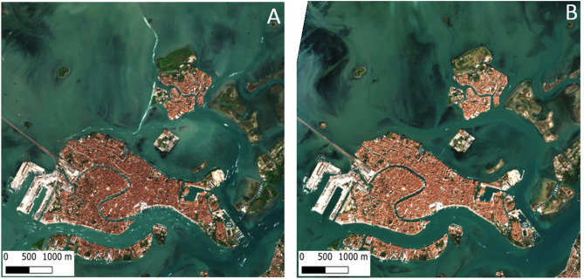
COVID-19 and Water Pollution: A Double-Edged Sword
In Quarantine
After Quarantine
Decreased water traffic has created less water pollution
Wildlife ventures out into previously polluted water
High increase of PPE (gloves and masks) found in water
Notes:
https://www.sciencedirect.com/science/article/pii/S0048969720331326#f0015
https://www.ncbi.nlm.nih.gov/pmc/articles/PMC7498239/
https://www.ncbi.nlm.nih.gov/pmc/articles/PMC2690367/

Slide 10
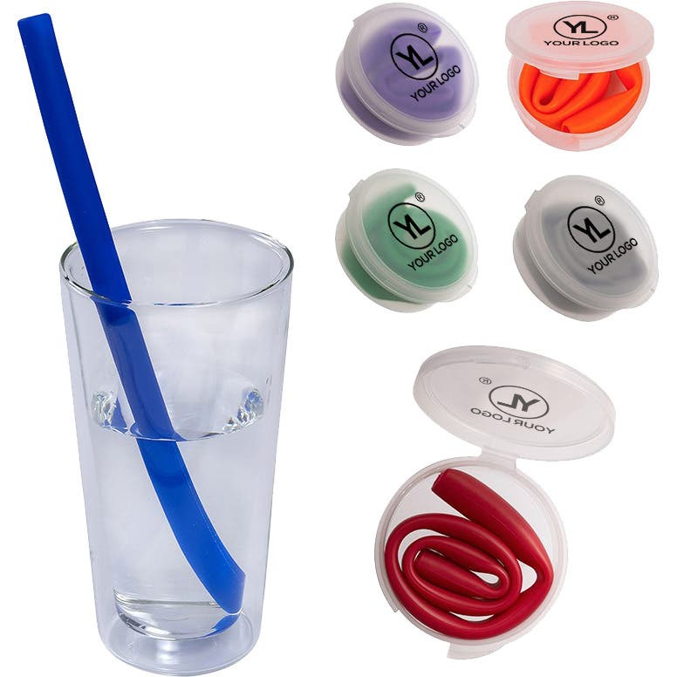
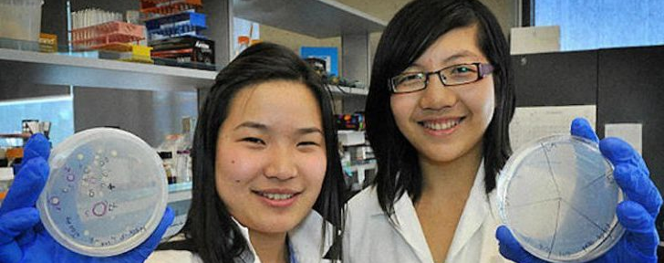
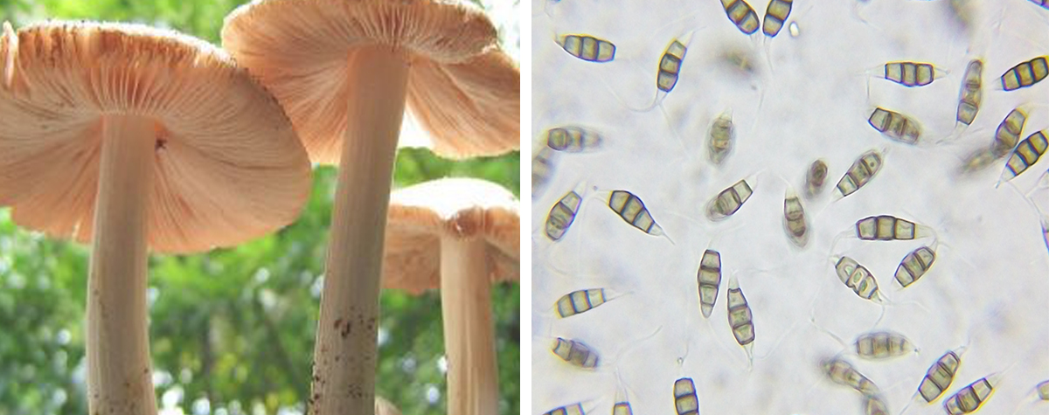
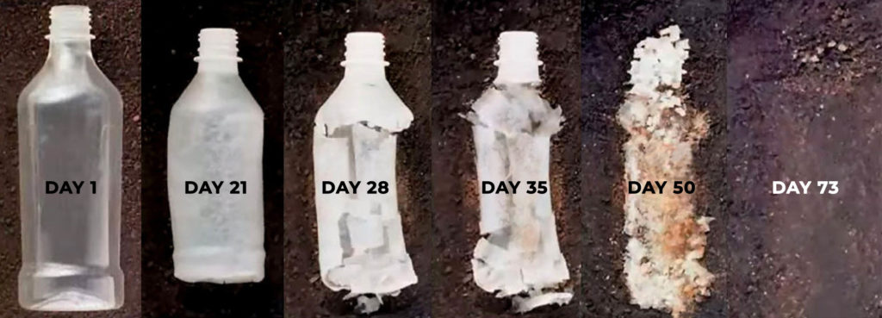
The Future of Waste Management
Alternate plastic composition
Hemp
Sustainable tools for living – zero/minimal waste
Straws
Organisms that consume plastic
Fungi
Worms
Bacteria
Founders of Novoloop
Notes:
https://www.e3s-conferences.org/articles/e3sconf/abs/2018/26/e3sconf_icacer2018_03002/e3sconf_icacer2018_03002.html

Slide 11
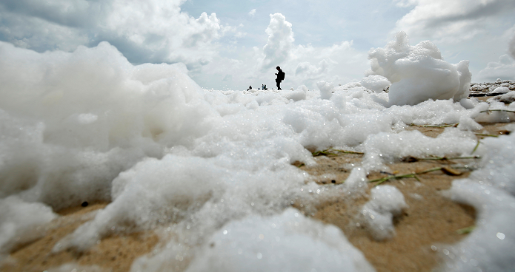
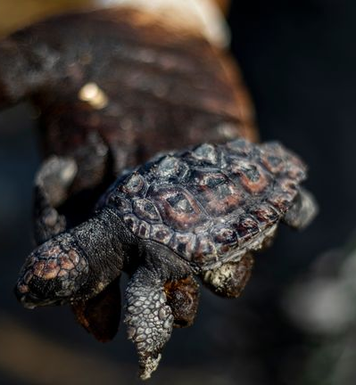
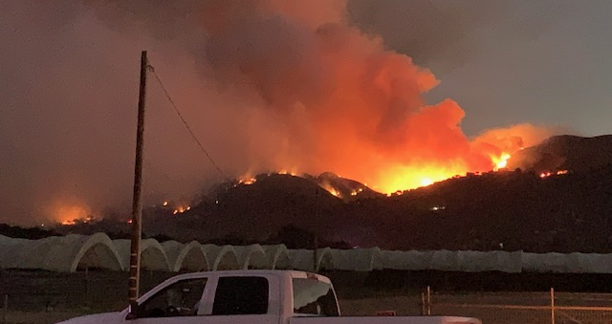
Urgent Call to Action
Notes:
https://www.unwater.org/water-pollution-increasing-global-concern/
http://www.fao.org/land-water/news-archive/news-detail/en/c/1032702/?utm_content=buffer1b51f&utm_medium=social&utm_source=twitter.com&utm_campaign=buffer

Slide 12
Bibliography
“Alexander Parkes.” Edited by Encyclopedia Britannica, Encyclopædia Britannica, Encyclopædia Britannica, Inc., www.britannica.com/biography/Alexander-Parkes.
“Basic Information about Nonpoint Source (NPS) Pollution.” EPA, Environmental Protection Agency, 7 Oct. 2020, www.epa.gov/nps/basic-information-about-nonpoint-source-nps-pollution.
Braga, Federica, et al. “COVID-19 Lockdown Measures Reveal Human Impact on Water Transparency in the Venice Lagoon.” Science of The Total Environment, Elsevier, 22 May 2020, www.sciencedirect.com/science/article/pii/S0048969720331326#f0015.
D'Aprile, Aurora. “Rethinking Plastic Use to Protect the Ocean and Tackle Climate Change.” Foresight, 26 May 2020, www.climateforesight.eu/oceans/rethinking-plastic-use-to-protect-the-ocean-and-tackle-climate-change/.
“History and Future of Plastics.” Science History Institute, 20 Nov. 2019, www.sciencehistory.org/the-history-and-future-of-plastics.
“John Wesley Hyatt.” Encyclopædia Britannica, Encyclopædia Britannica, Inc., www.britannica.com/biography/John-Wesley-Hyatt.
“Plastic Waste in the Ocean.” Future Ocean – Ozeanwissen, www.futureocean.org/ozeanwissen/topics/plastic_en.php.
Schrage, Scott. “Researchers ID, Map Phosphorus Pollution of Global Freshwater.” Nebraska Today | University of Nebraska–Lincoln, 1 Mar. 2018, news.unl.edu/newsrooms/today/article/researchers-id-map-phosphorus-pollution-of-global-freshwater/.
US Department of Commerce, National Oceanic and Atmospheric Administration. “What Is the Biggest Source of Pollution in the Ocean?” NOAA's National Ocean Service, 8 Oct. 2008, oceanservice.noaa.gov/facts/pollution.html.

