Slide 1
Fighting Global Issues from Home
VGD Capstone Project
Carla Reyes

Slide 2
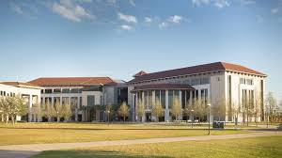
My Journey

Slide 3
Course Work
International Politics INR 2002
Intro to Humanities HUM 1020
Interpersonal Communications SPC 1017
CLEP Spanish I and II

Slide 4
Becoming a Global Citizen

Slide 5
Valencia College International Opportunities
Get Involved! Clubs and Organizations
Study Abroad Opportunities
International on campus Events

Slide 6
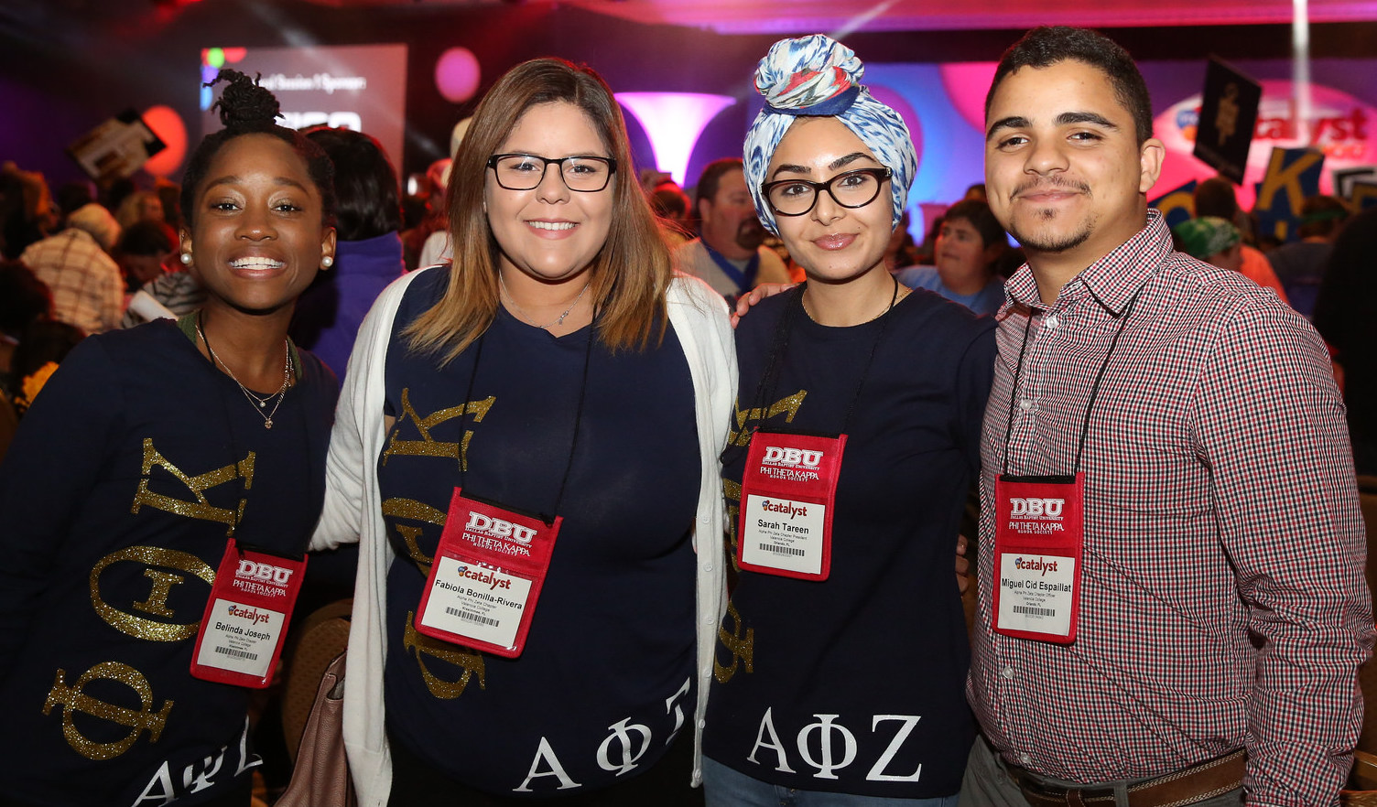
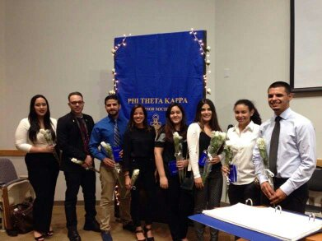
Phi Theta Kappa International Honors Society

Slide 7
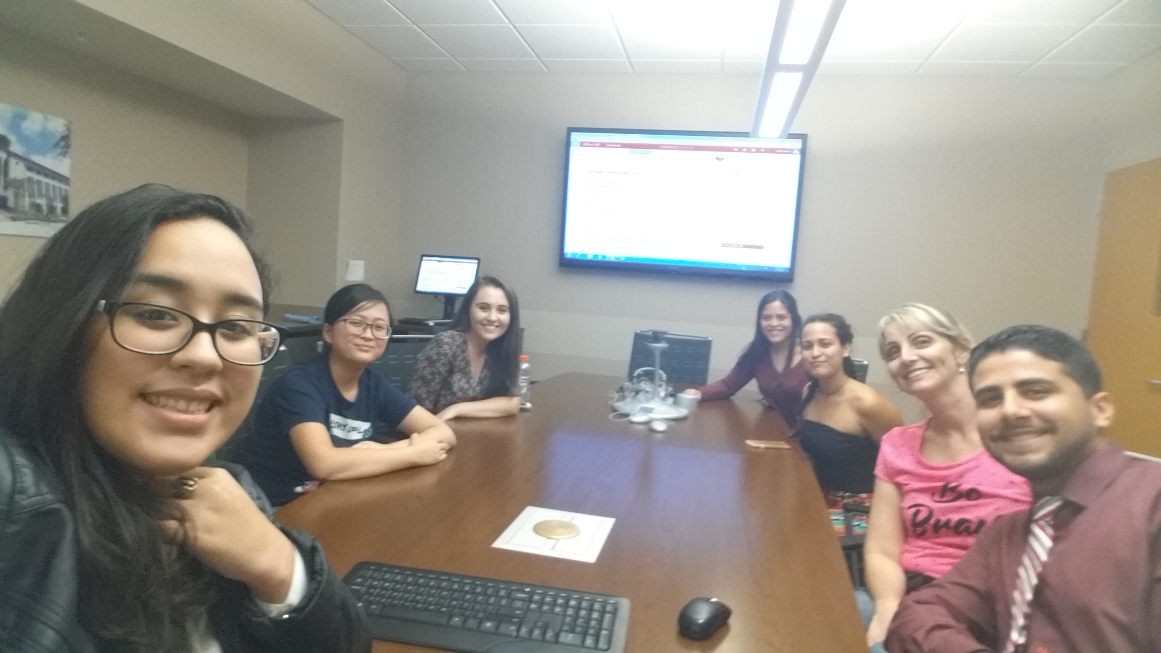
PTK College Project
Purpose: Create a better environment for international students on the Osceola campus.

Slide 8
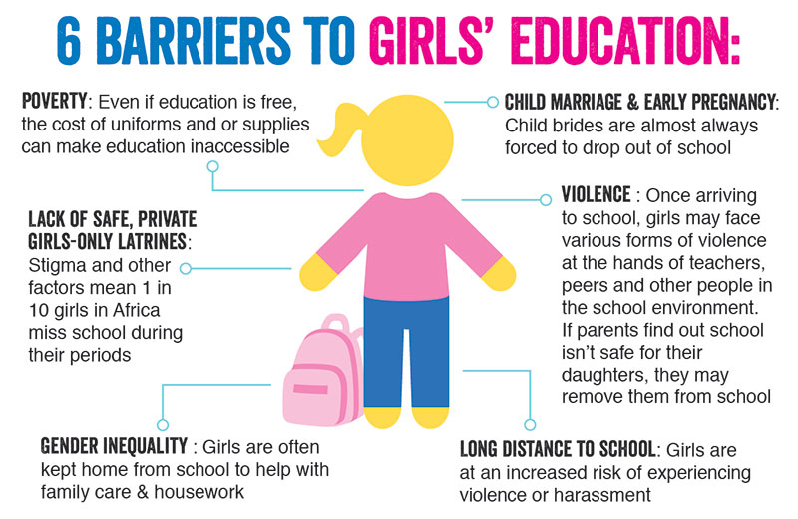
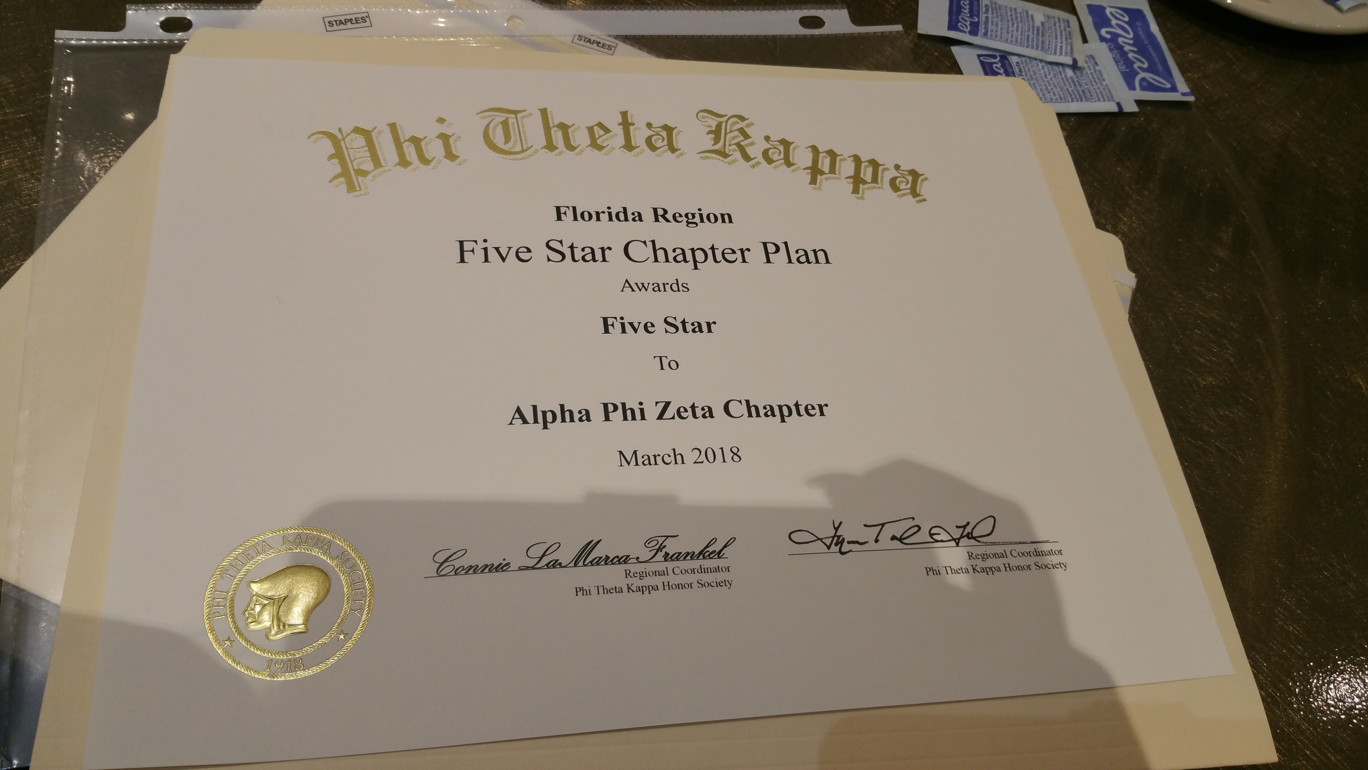
PTK Research Project
Purpose: To bring awareness to the international issue regarding inequality in education due to gender.

Slide 9
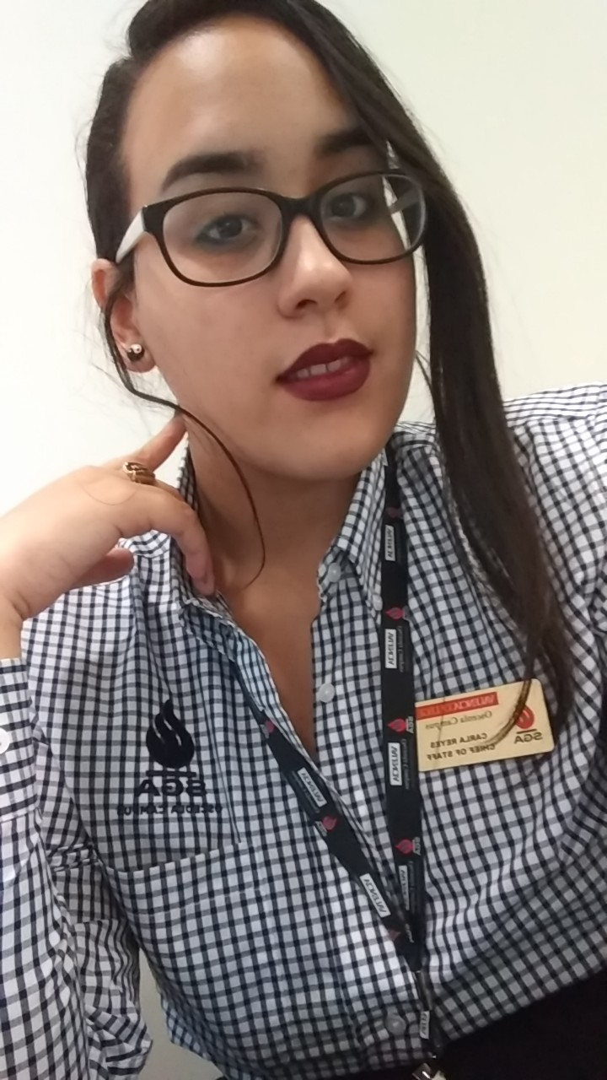
Student Government Association

Slide 10
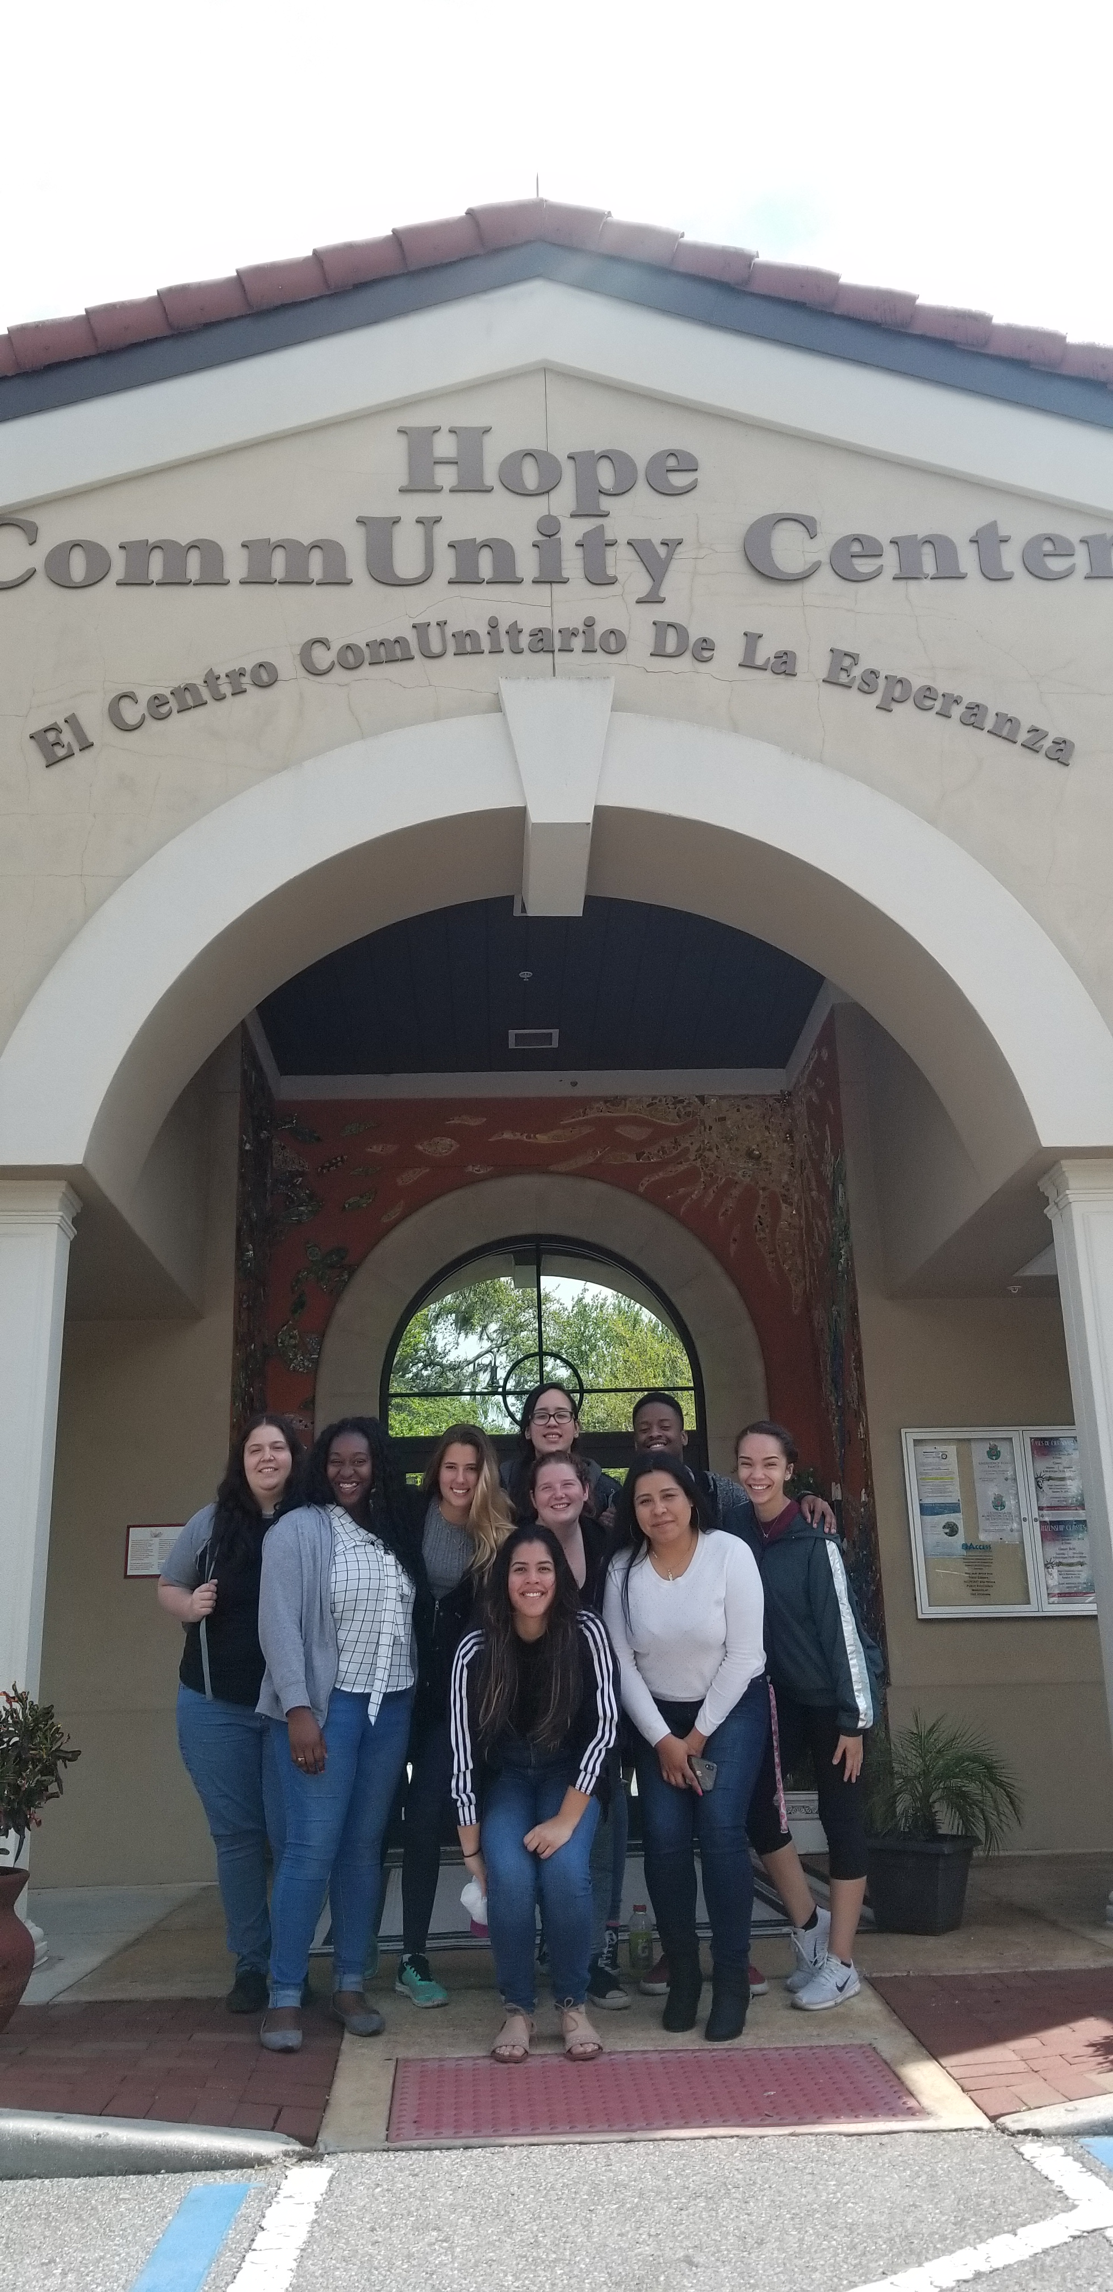
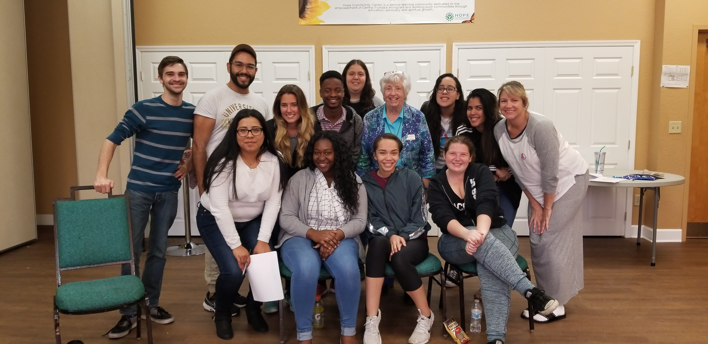
Apopka Service Learning Trip

Slide 11
D.A.C.A. and Dreamers

Slide 12
Next Step: Greece!
International Service Learning in Greece (SLS 2940)

Slide 13
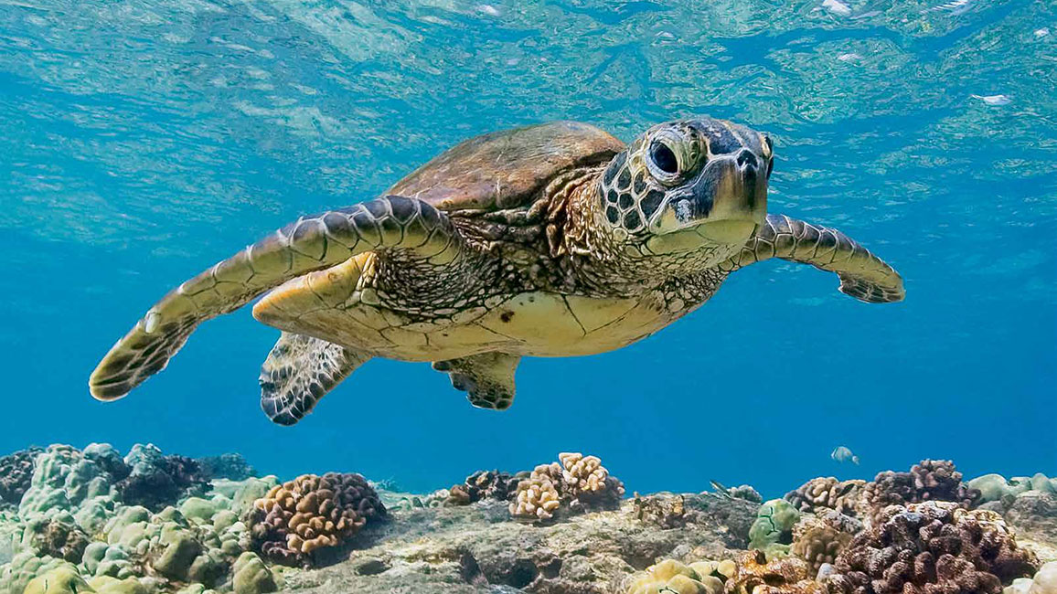
Global Solutions to Local Issues: Florida to Greece

Slide 14
Thank You for Listening! Any Questions?

Slide 15
Works Cited
“Gender.” Gender | Educate a Child, educateachild.org/explore/barriers-to-education/gender. Accessed April 08, 2019
“Gender Equality in Education.” UNESCO UIS, 15 Mar. 2019, uis.unesco.org/en/topic/gender-equality-education. Accessed April 08, 2019
“Gender Inequality in Education.” Gender Stats, 13 Mar. 2019, genderstats.org/2018/07/13/gender-inequality-in-education/. Accessed April 08, 2019
“Greece.” International Rescue Committee (IRC), www.rescue.org/country/greece. Accessed April 08, 2019
“Home.” Hope CommUnity Center, www.hcc-offm.org/. Accessed April 08, 2019
“Students.” Valencia College Study abroad, https://valenciacollege.edu/students/study-abroad/. Accessed April 08, 2019
“Scholarship.” Phi Theta Kappa, https://www.ptk.org/default.aspx. Accessed April 08, 2019
“What Is DACA and Who Are the DREAMers?” Anti-Defamation League, www.adl.org/education/resources/tools-and-strategies/table-talk/what-is-daca-and-who-are-the-dreamers. Accessed April 08, 2019

